Slide 1
Unit 14 – Lesson 2
What does
your father do?

Slide 2
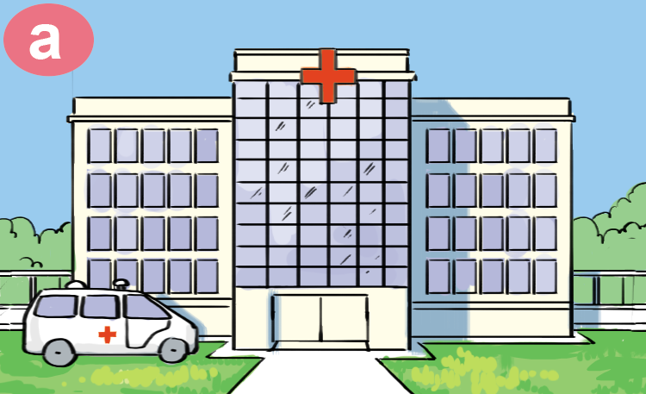
hospital
/ˈhɒspɪtl/

Slide 3
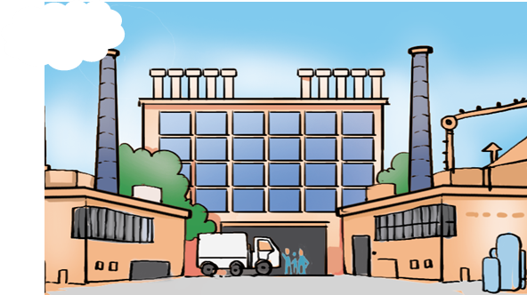
factory
/ˈfæktəri/

Slide 4
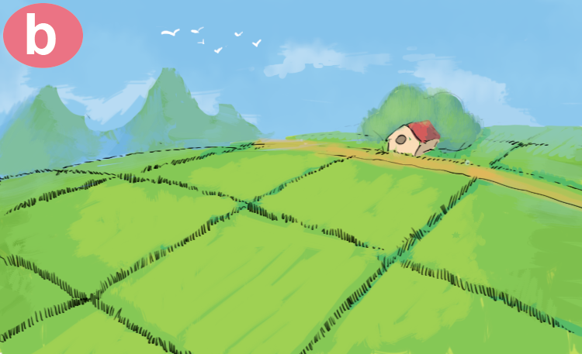
field
/fiːld/

Slide 5
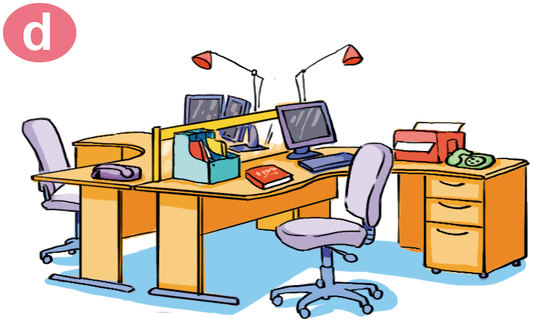
office
/ˈɒfɪs/

Slide 6

clerk
/klɜːrk/

Slide 7
Vocabulary
clerk
office
field
factory
hospital

Slide 8



GAME
Notes:
Ms Huyền Phạm - 0936.082.789 – YOUTUBE: MsPham. Facebook: Dạy và học cùng công nghệ.

Slide 9
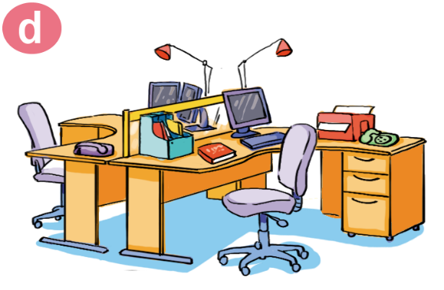

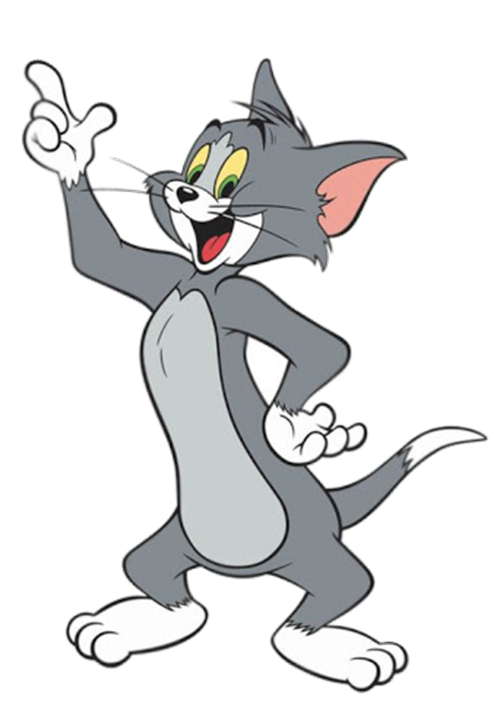
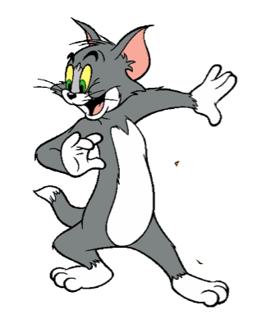



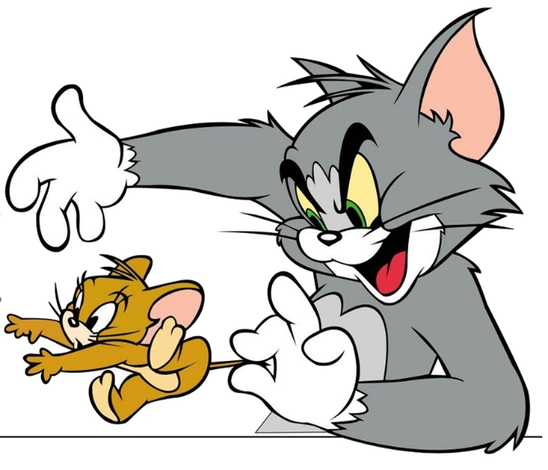
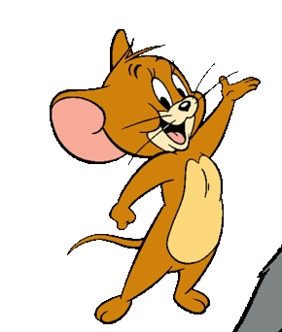

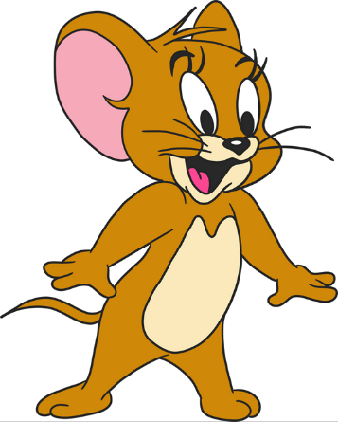

clerk
Notes:
Ms Huyền Phạm - 0936.082.789 – YOUTUBE: MsPham. Facebook: Dạy và học cùng công nghệ.

Slide 10
factory
Notes:
Ms Huyền Phạm - 0936.082.789 – YOUTUBE: MsPham. Facebook: Dạy và học cùng công nghệ.

Slide 11

field
Notes:
Ms Huyền Phạm - 0936.082.789 – YOUTUBE: MsPham. Facebook: Dạy và học cùng công nghệ.

Slide 12
office
Notes:
Ms Huyền Phạm - 0936.082.789 – YOUTUBE: MsPham. Facebook: Dạy và học cùng công nghệ.

Slide 13
hospital
Notes:
Ms Huyền Phạm - 0936.082.789 – YOUTUBE: MsPham. Facebook: Dạy và học cùng công nghệ.

Slide 14

THANK YOU!
Notes:
Ms Huyền Phạm - 0936.082.789 – YOUTUBE: MsPham. Facebook: Dạy và học cùng công nghệ.

Slide 15
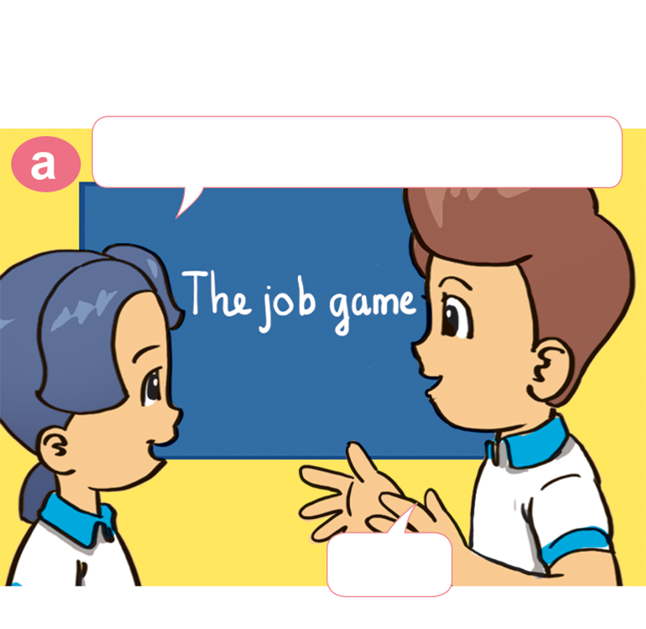
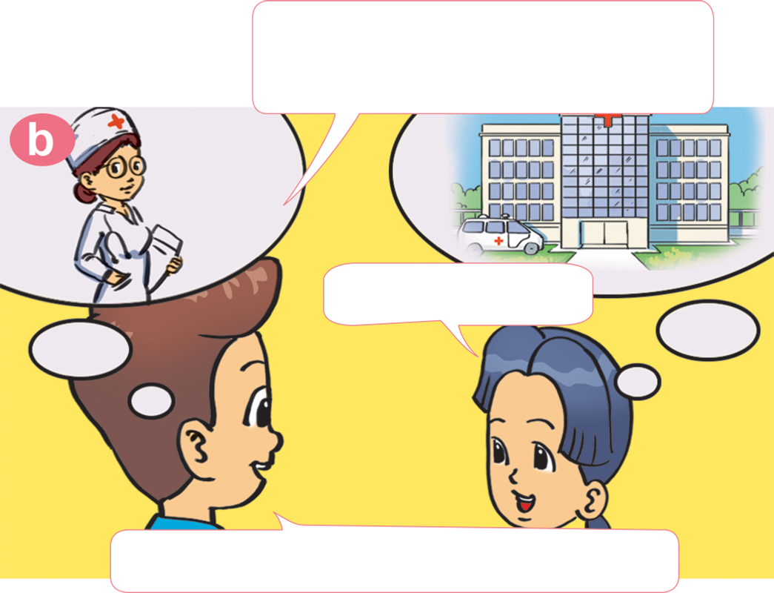
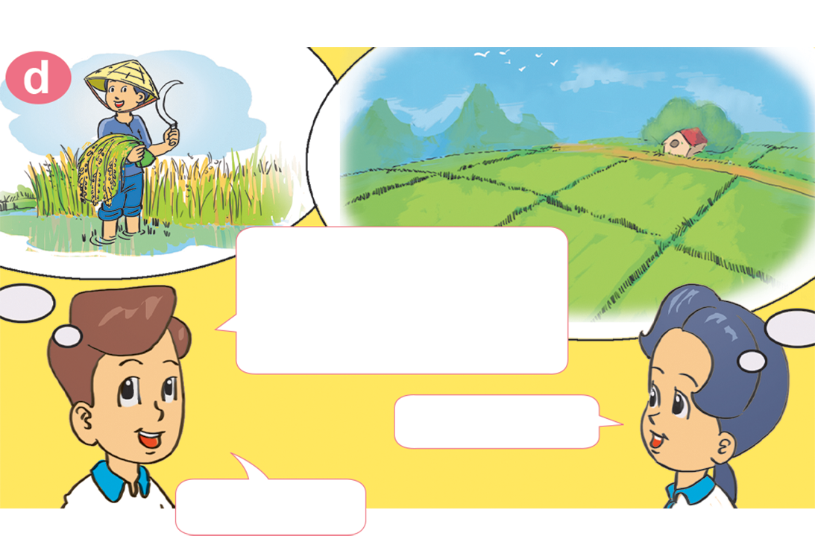
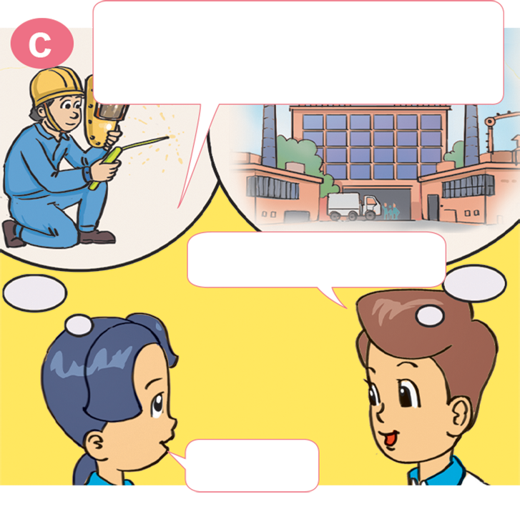
1. Look, listen and repeat
She's a doctor.
Where does she work?
Let's play a game of jobs.
ln a hospital.
OK
Well done! Now it's your turn.
He's a worker.
Where does he work?
She's a farmer.
Where does she
work?
ln a factory
ln a field.
Great.
Correct!

Slide 16
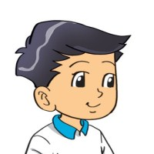
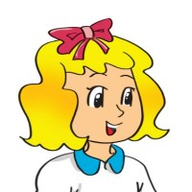
2. Point and say
a doctor
Where does ___________ work?
in a hospital
A doctor works ________________.

Slide 17

2. Point and say
a farmer
Where does ___________ work?
A doctor works ________________.
in a field

Slide 18
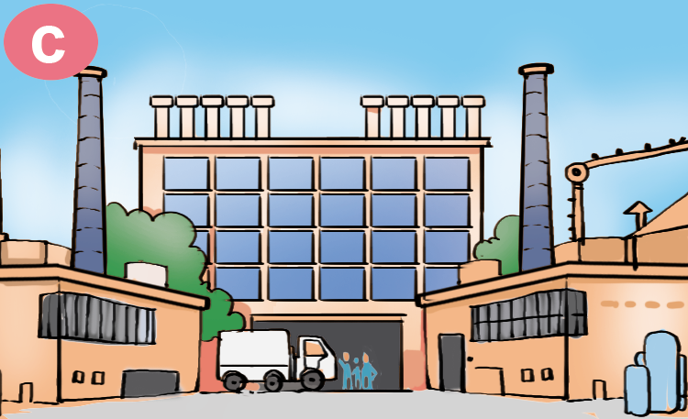
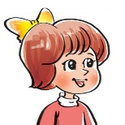
2. Point and say
a worker
What does your ___________ do?
A worker works ________________.
in a factory

Slide 19

2. Point and say
a clerk
Where does ___________ work?
A clerk works ________________.
in an office

Slide 20


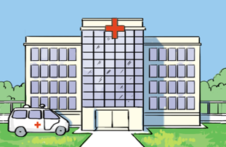
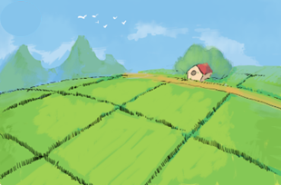
Where does a/an ______ work?
A/an _____ works _______.
school
office
hospital
factory
field

Slide 21
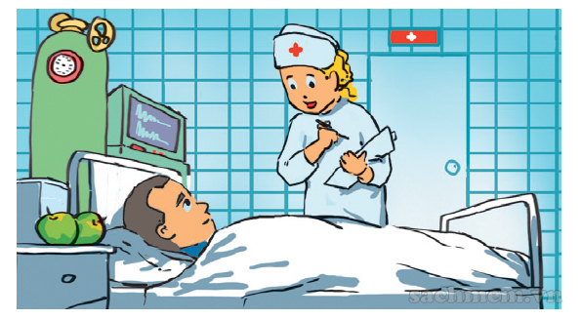
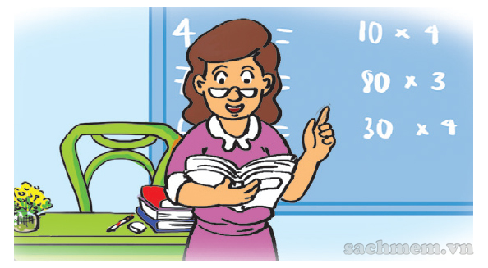
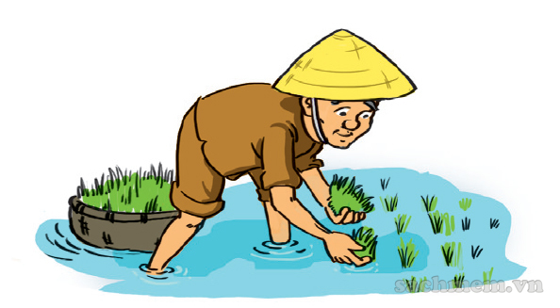
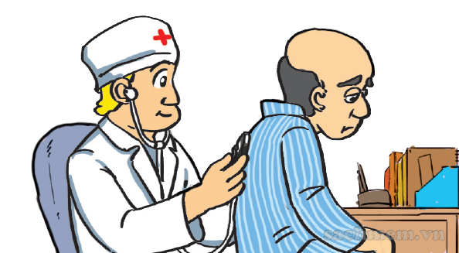
3. Listen and tick.
a
b
2
4
c
d
1
3

Slide 22
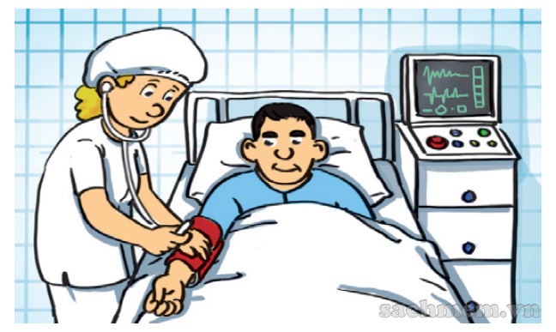
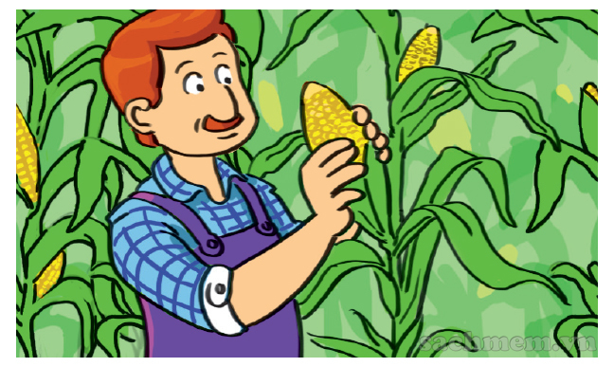
5. Look and write.
This is Ann's mother. She is ____________________. She works ________________.
This is Ann's father. He is ___________________. He works _________________.
a doctor
/ a nurse
a farmer
in a hospital
in a field

