Slide 1
Unit 12 – Lesson 1
What does
your father do?

Slide 2

teacher
/ˈtiːtʃər/

Slide 3

student
/ˈstuːdnt/

Slide 4

farmer
/ˈfɑːrmər/

Slide 5

worker
/ˈwɜːrkər/

Slide 6
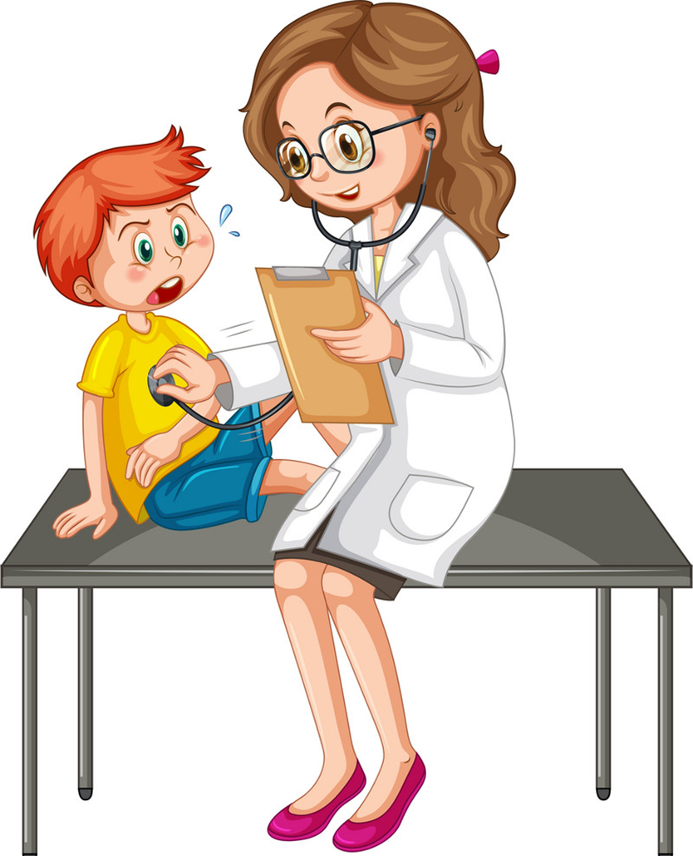
doctor
/ˈdɒktər/

Slide 7

nurse
/nɜːrs/

Slide 8

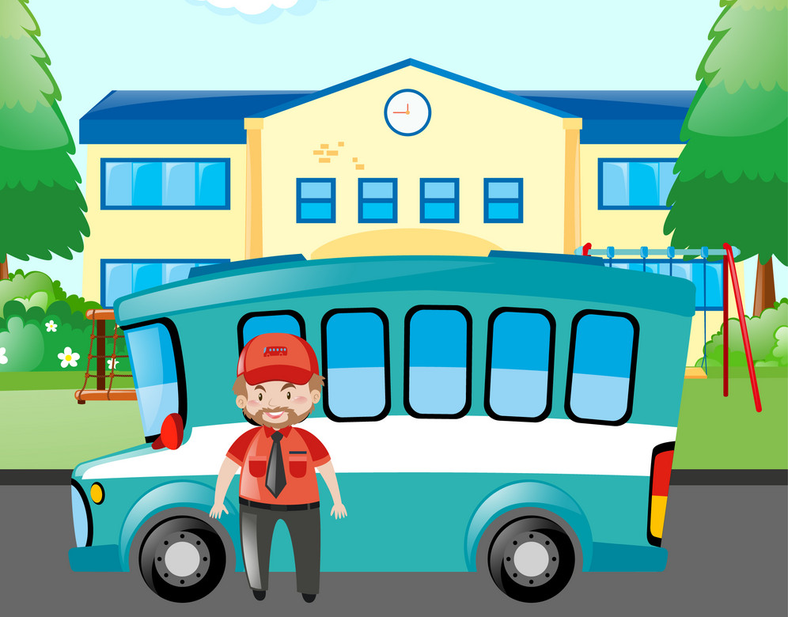
driver
/ˈdraɪvər/

Slide 9

job
dʒɒb/

Slide 10


factory
/ˈfæktəri/

Slide 11




Vocabulary
student
teacher
farmer
worker
factory
driver
doctor
nurse
job

Slide 12
Match
factory
teacher
farmer
student
doctor

Slide 13
Match
worker
nurse
driver
job

Slide 14


Look, read and fill
student
farmer
They are _________s.
This boy is a __________.
worker
teacher
The _________ is young.
My mother is a ___________.
factory
doctor
Tha’t s a ___________.
She’s is a ___________.
driver
nurse
The _________ is kind.
This is a beautiful _______.

Slide 15
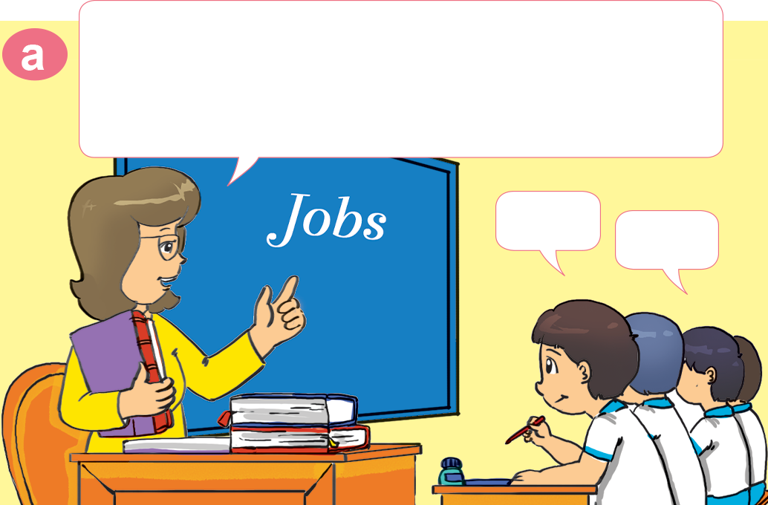
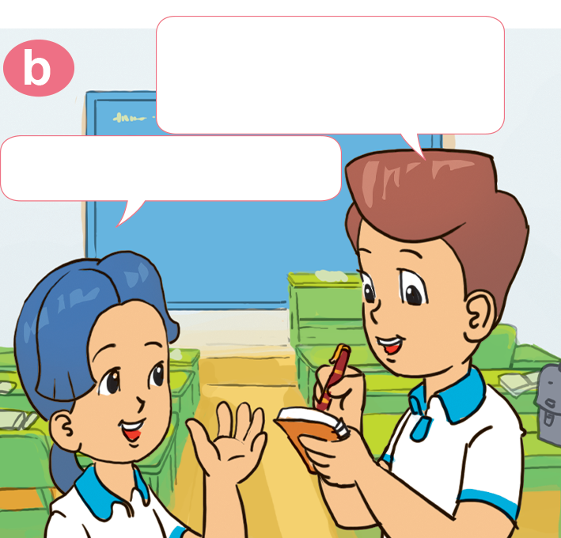
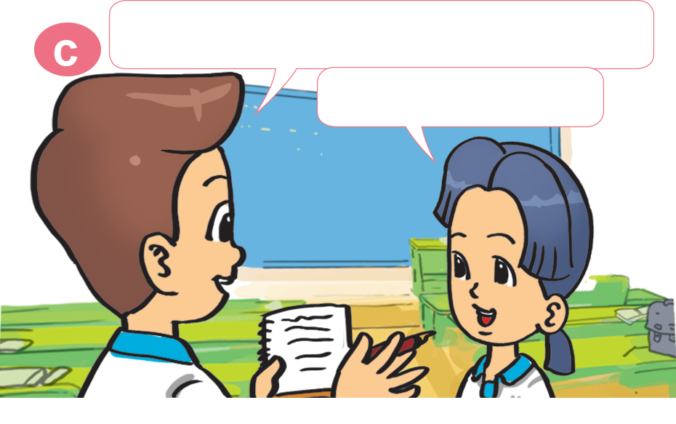
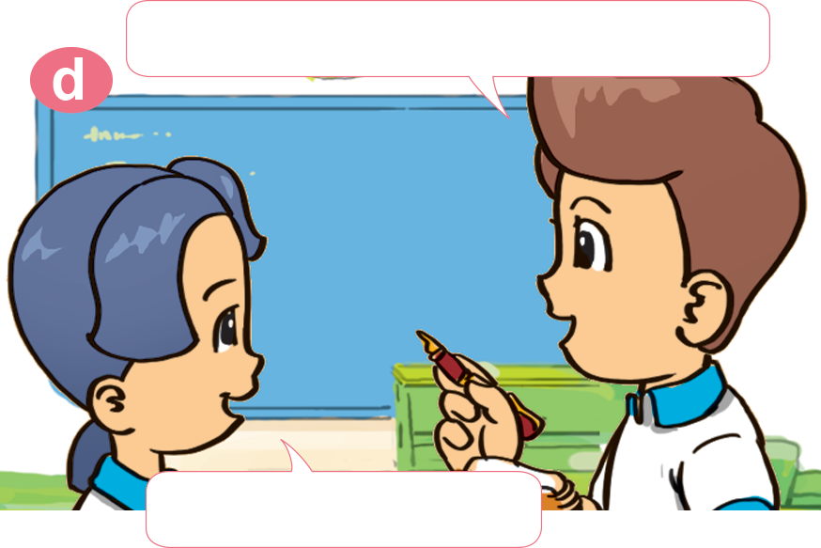
1. Look, listen and repeat
Class, get into pairs, please!
lnterview your partner about the
jobs of his or her family members.
What does your father do, Mai?
He's a teacher.
Yes.
Ok.
And what about your mother?
What does your sister do?
She's a nurse.
She's a student.

Slide 16
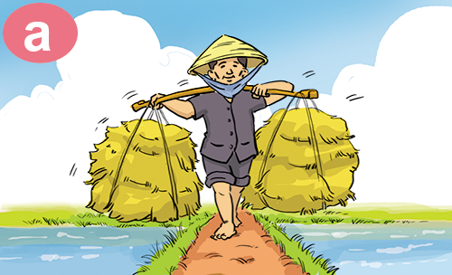
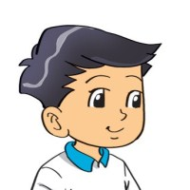

2. Point and say
What does your ___________ do?
father
He's ___________________.
a farmer

Slide 17
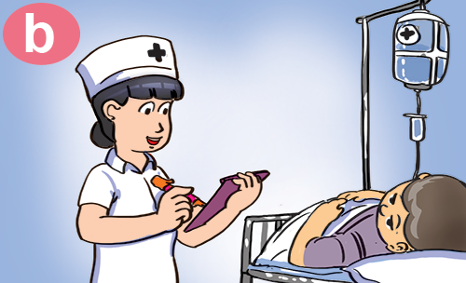

2. Point and say
What does your ___________ do?
mother
She's ___________________.
a nurse

Slide 18
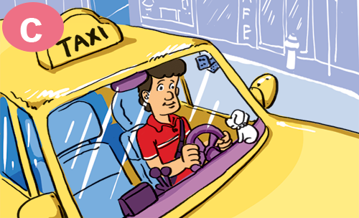
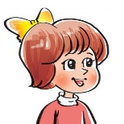
2. Point and say
What does your ___________ do?
uncle
He's ___________________.
driver

Slide 19
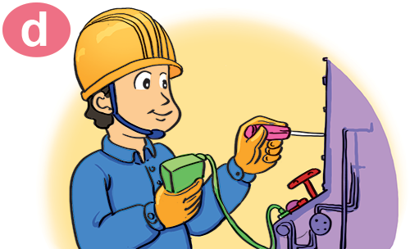

2. Point and say
What does your ___________ do?
brother
He's ___________________.
a factory worker

Slide 20


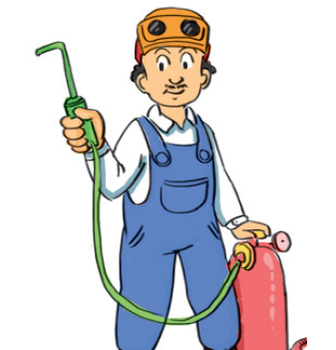
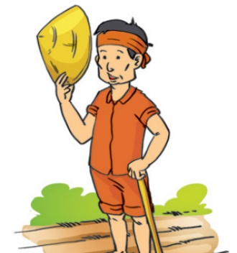
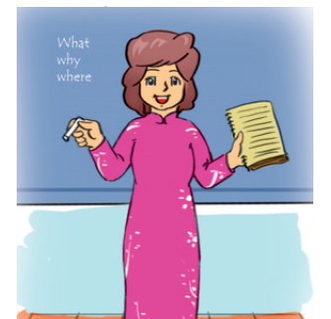
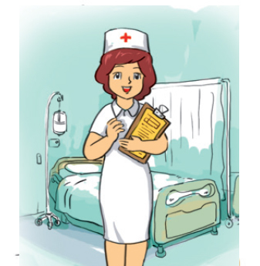
3. Listen and tick.
1. Father
2. Mother
3. Brother
4. Sister
✓
✓
✓

Slide 21
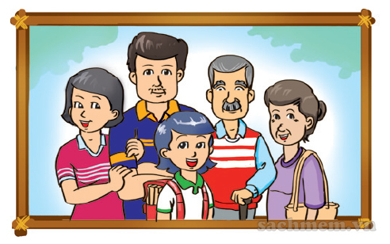
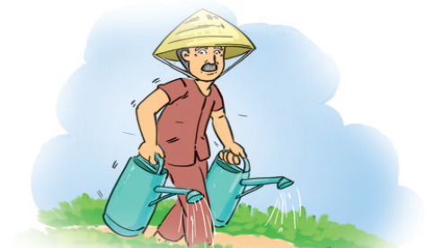
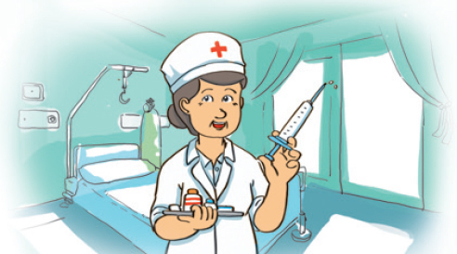
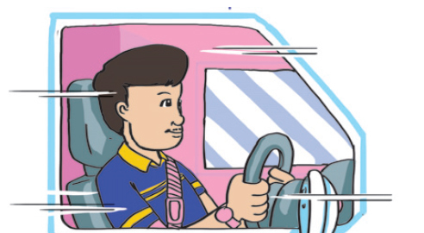
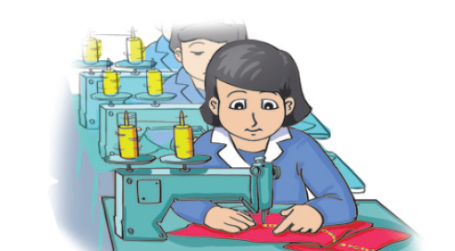
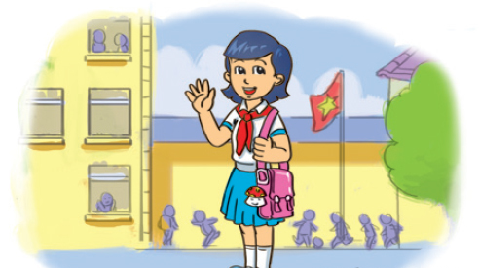
4. Look and write.
This is a photo
of my __________.
My grandpa is a ______________.
My grandma
________________.
family
farmer
is a nurse
My father
________________.
My mother
__________________.
a student
I am ____________.
is a driver
is a factory worker

Slide 22
What does your ___________ do?
He/she is a/an _________.
driver
teacher
farmer
student
worker
doctor
nurse

