Slide 1
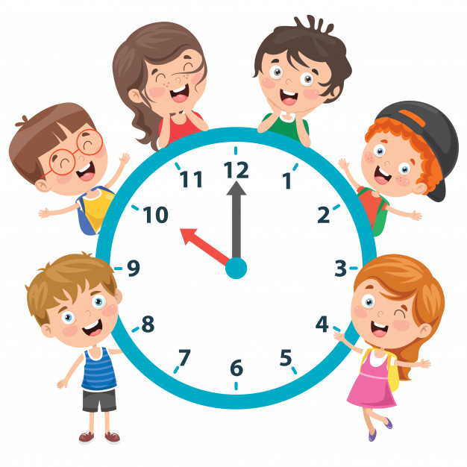
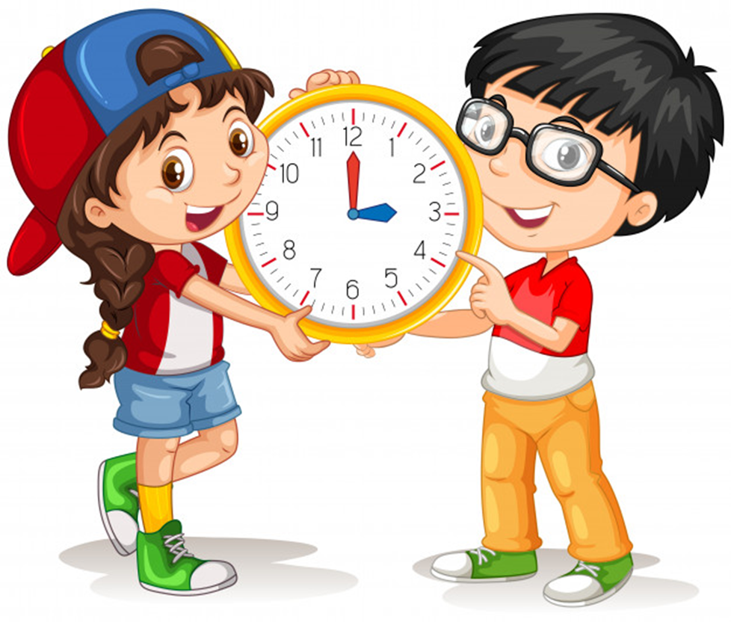
Unit 11
What time is it?
Lesson 1

Slide 2
NUMBER

Slide 3
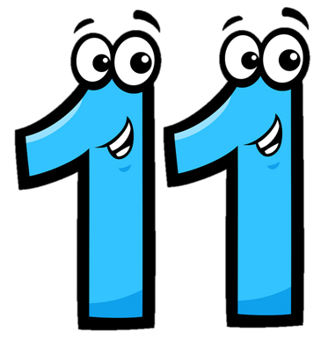
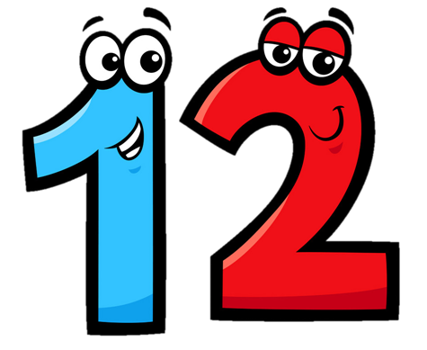
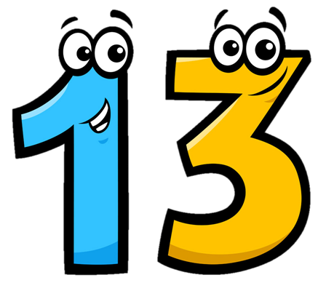
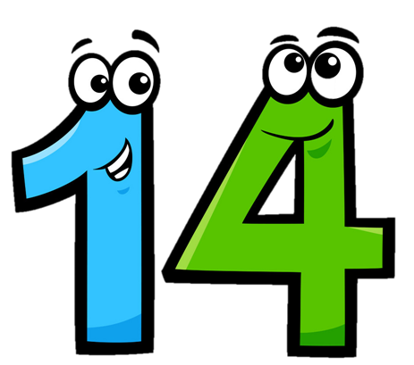
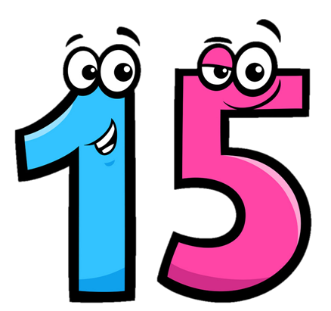
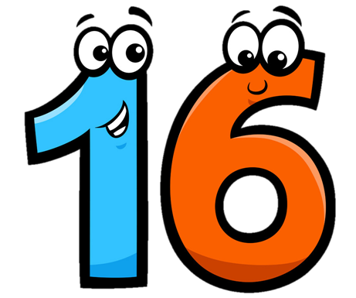
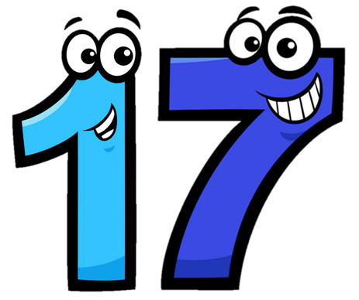
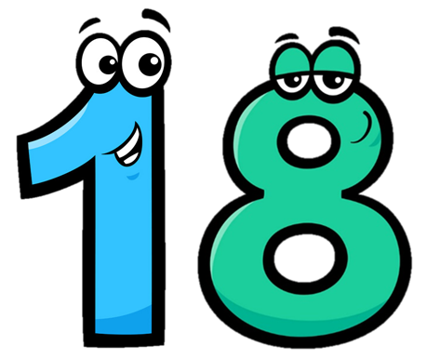
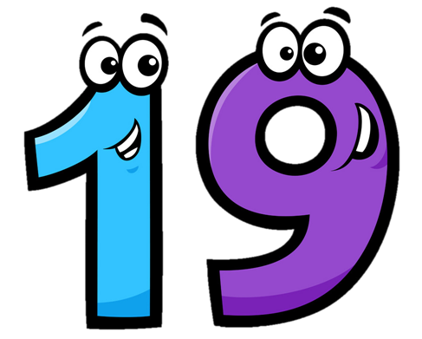
Eleven
/ɪˈlevn/
Twelve
/twelv/
Thirteen
/ˌθɜːˈtiːn/
Fourteen
/ˌfɔːˈtiːn/
Fifteen
/ˌfɪfˈtiːn/
Sixteen
/ˌsɪksˈtiːn/
Seventeen
/ˌsevnˈtiːn/
Eighteen
/ˌeɪˈtiːn/
Nineteen
/ˌnaɪnˈtiːn/

Slide 4


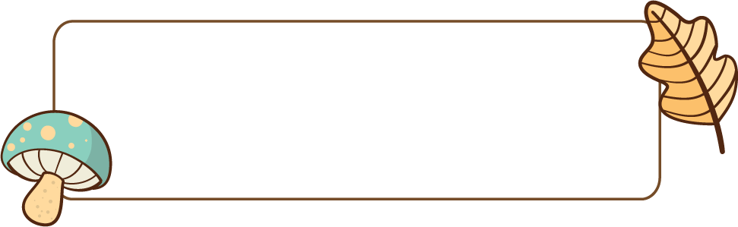
Choose the correct number
a
b
c
Twelve

Slide 5
Choose the correct number
a
b
c
Eleven

Slide 6
Choose the correct number
a
b
c
Fifteen

Slide 7
Choose the correct number
a
b
c
fourteen

Slide 8
Choose the correct number
a
b
c
Thirteen

Slide 9
Choose the correct number
a
b
c
Seventeen

Slide 10
Choose the correct number
a
b
c
Nineteen

Slide 11
Choose the correct number
a
b
c
Eighteen

Slide 12
Choose the correct number
a
b
c
Sixteen

Slide 13
Look read and circle
Fifteen
Sixteen
Seventeen
Eleven
Thirteen
Twelve
Eighteen
Nineteen
Sixteen

Slide 14
Look read and circle
Fifteen
Thirteen
Eighteen
Eleven
Sixteen
Twelve
Fourteen
Fifteen
Sixteen

Slide 15
Look read and circle
Eleven
Nineteen
Eighteen
Twelve
Eleven
Thirteen
Fifteen
Fourteen
Twelve

Slide 16
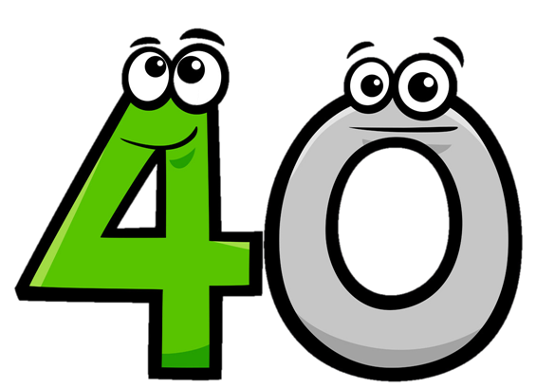
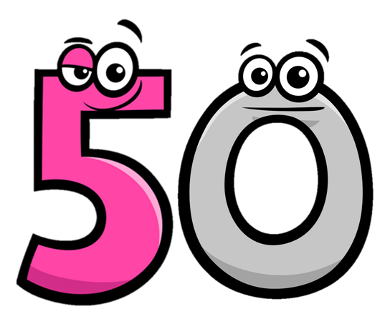
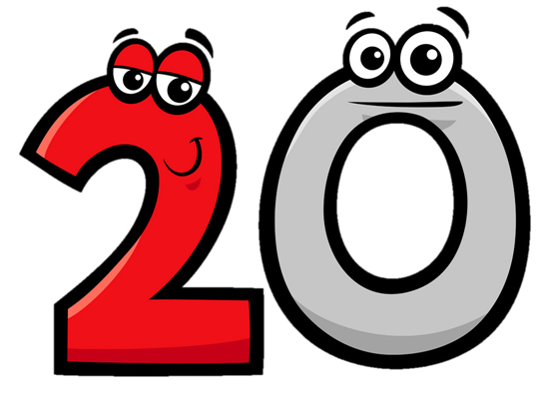
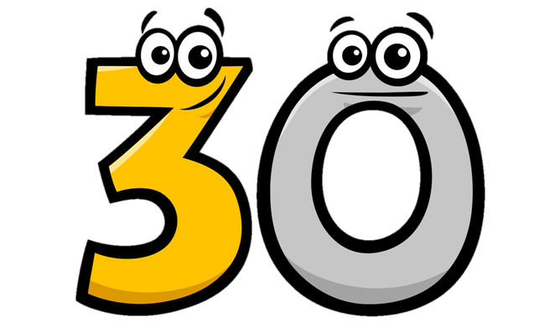
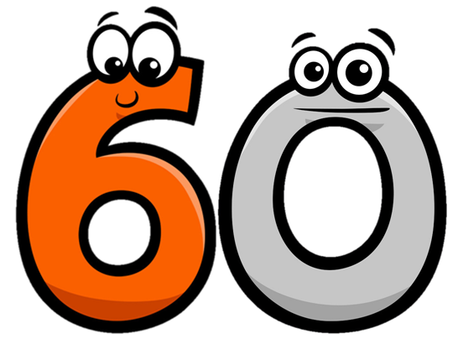

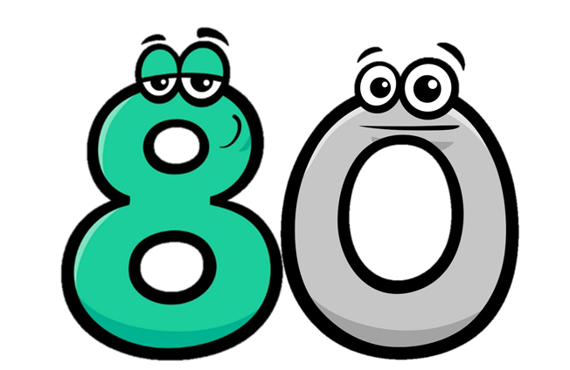
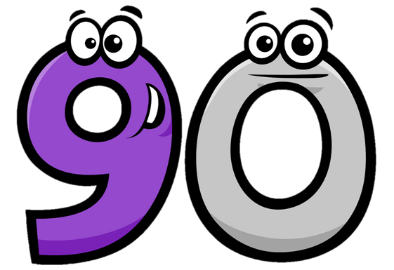
Twenty
/ˈtwenti/
Thirty
/ˈθɜːti/
Forty
/ˈfɔːti/
Fifty
/ˈfɪfti/
Seventy
/ˈsevnti/
Eighty
/ˈeɪti/
Ninety
/ˈnaɪnti/
Sixty
/ˈsɪksti/

Slide 17
Match
Forty
Thirty
Fifty
Twenty

Slide 18
Match
ninety
seventy
eighty
sixty

Slide 19
21
=
20
+
1
twenty-one
twenty
one
22
=
20
+
2
twenty-two
twenty
two

Slide 20
34
=
30
+
4
thirty-four
thirty
four
43
=
40
+
3
forty-three
forty
three

Slide 21
Look and say
15
fifteen
40
forty
20
twenty
45
forty-five
25
twenty-five
50
fifty
30
thirty
55
fifty-five
35
thirty-five

Slide 22
GRAMMAR

Slide 23
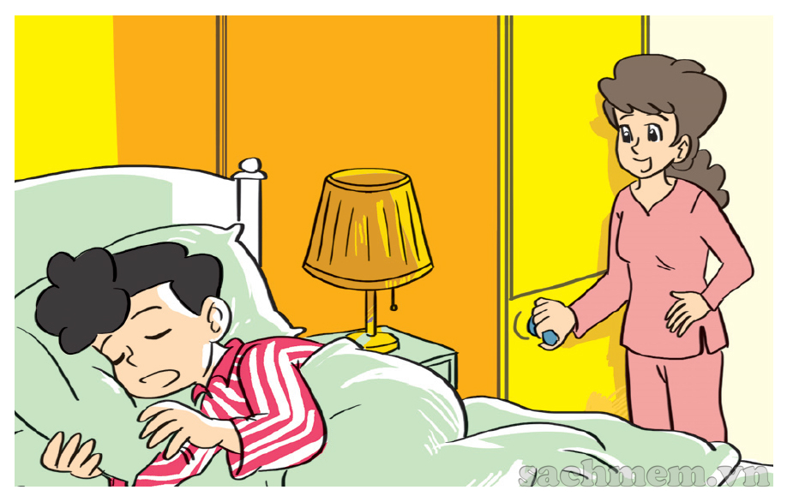
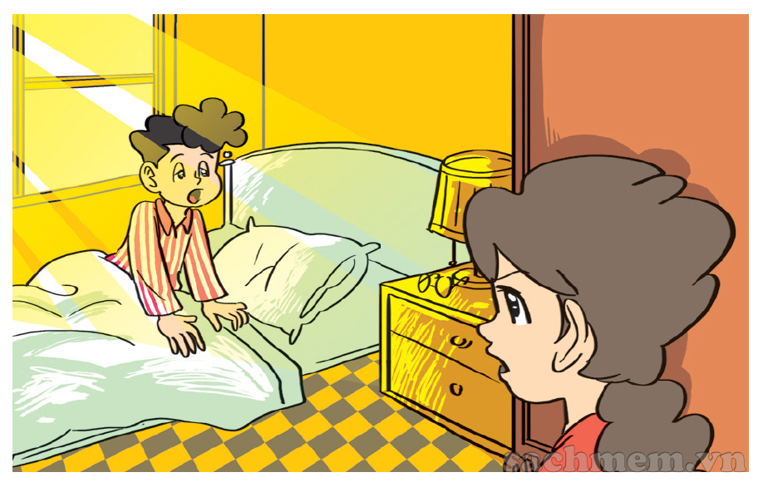
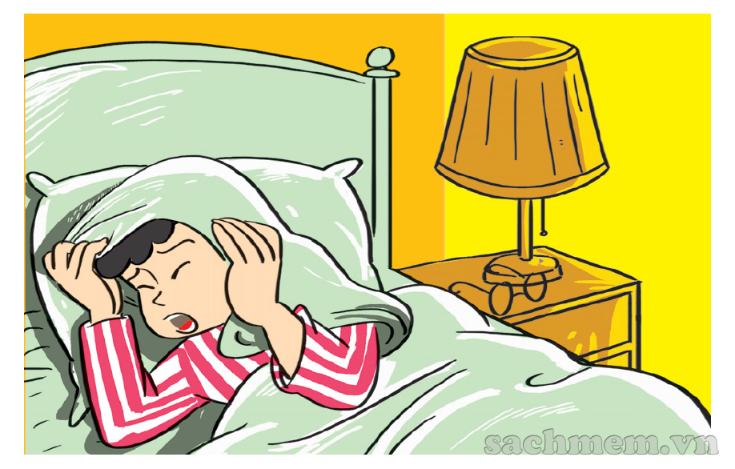
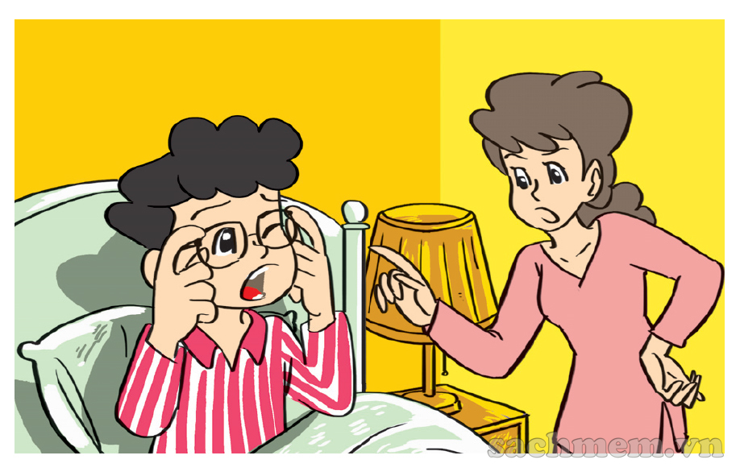

1. Look, listen and repeat.
What time is it, Mum?
It's time to get up, Phong.
It's seven o'clock
Today's Sunday and I
don't have to go to school.
But it's time
for breakfast.
Oh, yes, Mum.

Slide 24
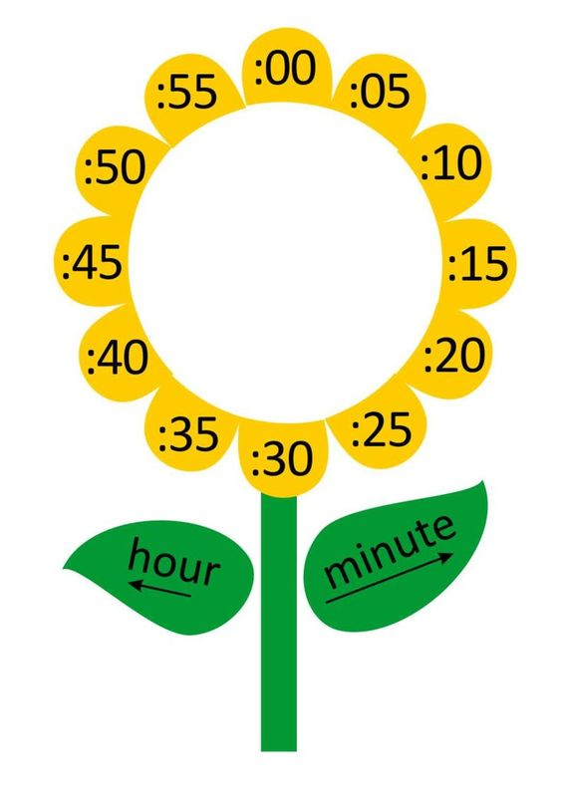
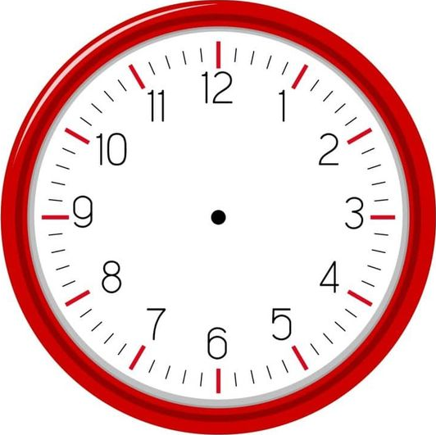

What time is it?
one
It's __________ o’clock.

Slide 25
What time is it?
two
It's __________ o’clock.

Slide 26
What time is it?
three
It's __________ o’clock.

Slide 27
What time is it?
six
It's __________ o’clock.

Slide 28
What time is it?
one
fifteen
It's _________________.

Slide 29
What time is it?
one
thirty
It's _________________.

Slide 30
What time is it?
one
forty
It's _________________.

Slide 31
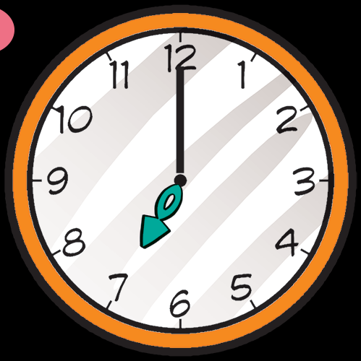
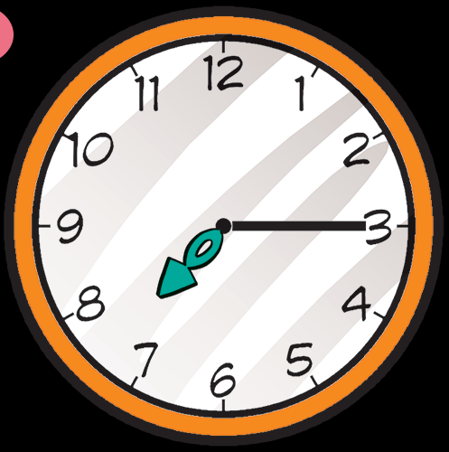
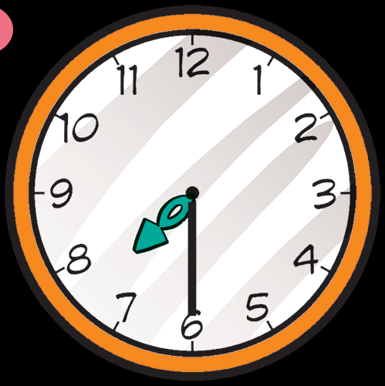
2. Point and say.
What time is it?
It's __________
It's __________
It's __________
seven o’clock.
seven fifteen.
seven thirty.

Slide 32

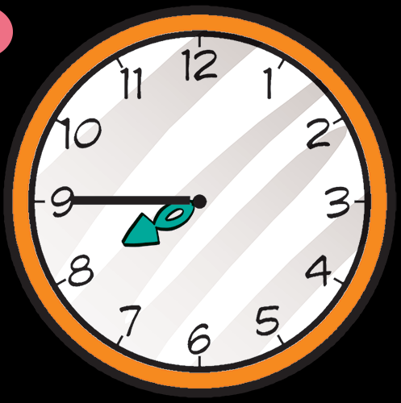
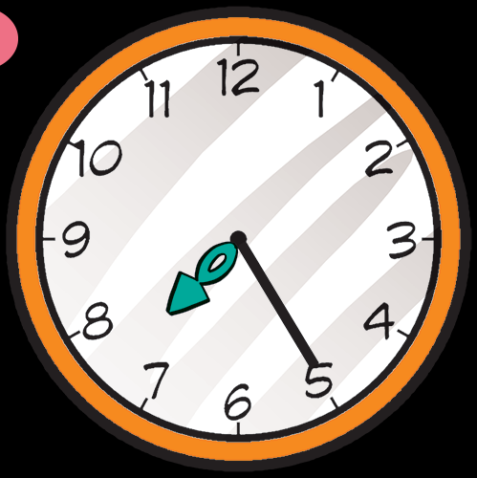
2. Point and say.
What tim is it?
It's ____________.
It's ______________.
seven forty-five
seven twenty-five

Slide 33


3. Listen and tick.
a
b
c
1

Slide 34
3. Listen and tick.
a
b
c
2

Slide 35
3. Listen and tick.
a
b
c
3

Slide 36
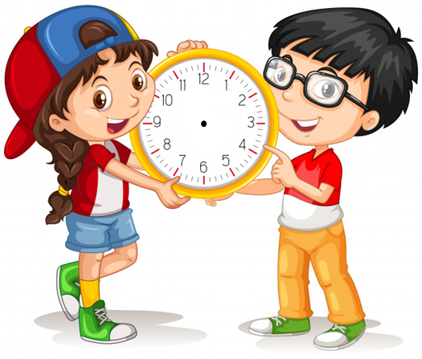
5. Look and write
What time is it?
What time is it?
It's four o’clock.
It's ten twenty.

Slide 37
5. Look and write
What time is it?
What time is it?
It's ten thirty.
It's eleven fifty.

Slide 38
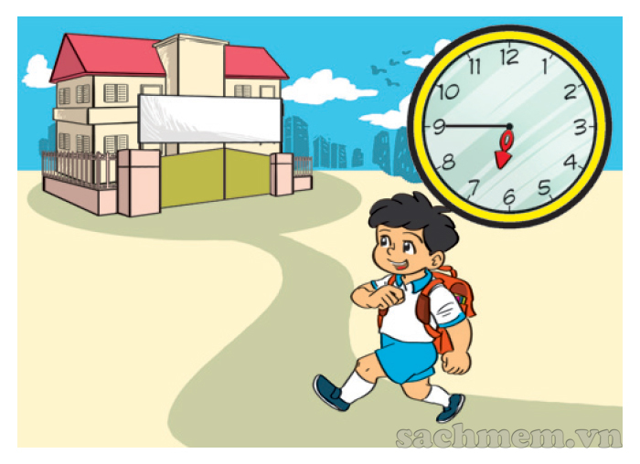
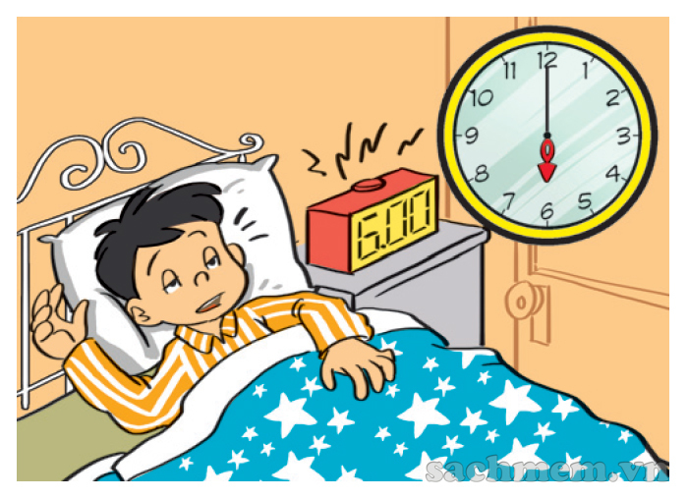
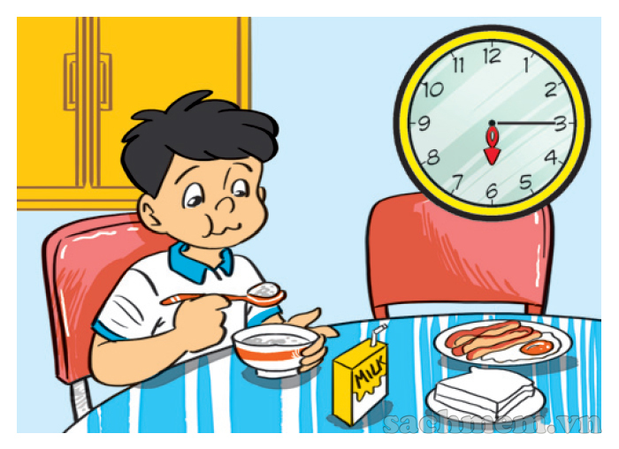
5. Let’s sing
1
2
3
a
b
c
What time is it?
It's six o'clock.
It's time to get up.
What time is it?
It's six fifteen.
It's time for breakfast.
What time is it?
It's six forty-five.
It's time for school.

Slide 39
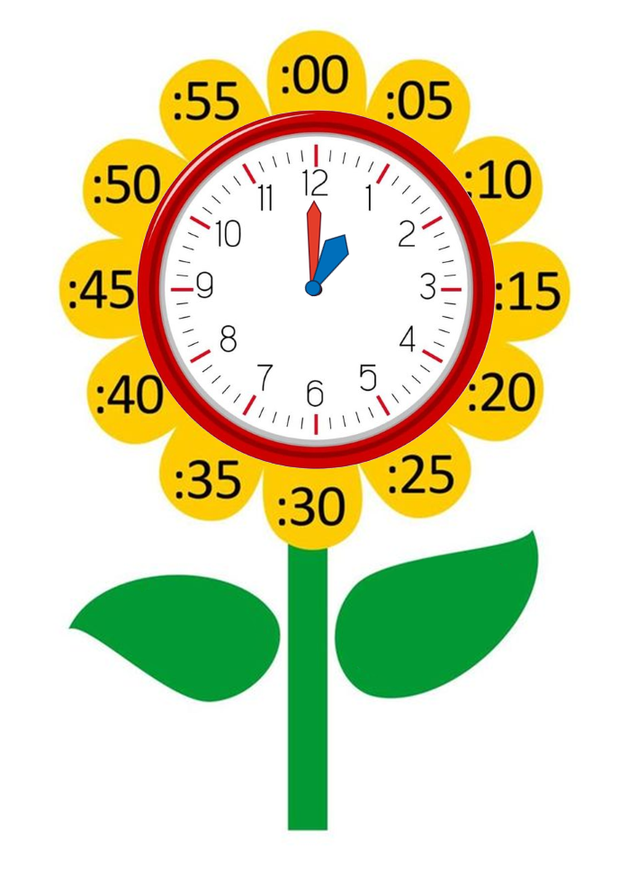
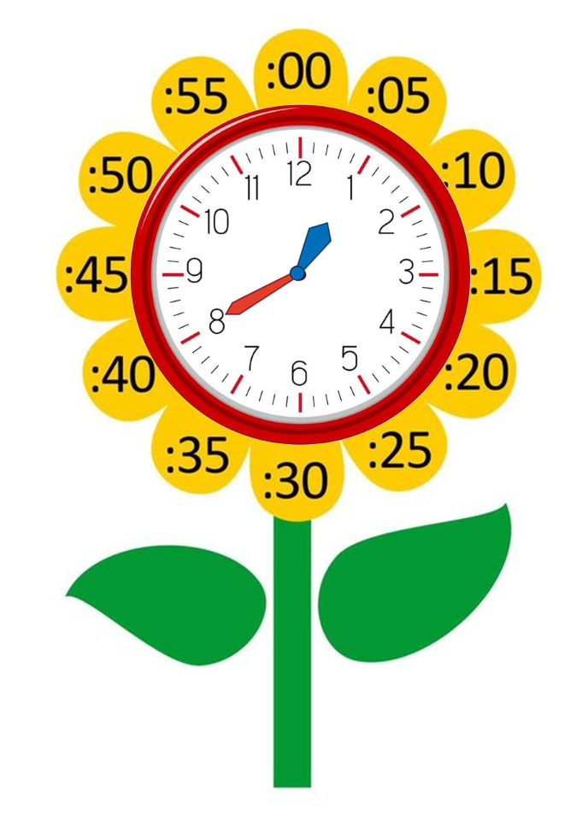
Model sentence
What time is it?
It's + số giờ + o’clock.
It's one o’clock.
It's + số giờ + số phút.
It's one forty.

