Slide 1
13
Unit
Where’s my book?
Lesson 2

Slide 2
Vocabulary

Slide 3


on
/ɒn/

Slide 4

under
/ˈʌndər/

Slide 5
near
/nɪr/

Slide 6
behind
/bɪˈhaɪnd/

Slide 7


wall
/wɔːl/

Slide 8



Vocabulary
in
on
under
wall
behind
near

Slide 9
Look read and circle
In
On
Under
In
Under
On
Behind
In
Under

Slide 10

Look read and circle
Under
Near
In
Wall
Bed
Poster
Behind
On
Near

Slide 11
Grammar

Slide 12


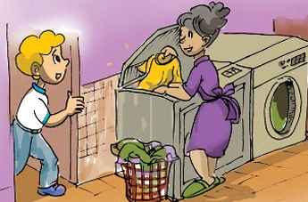
1. Look, listen and repeat
I don't know, dear.
Look in your bedroom.
Where are my posters, Mum?

Slide 13
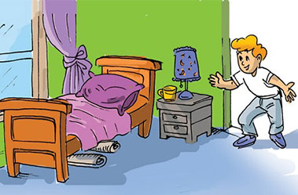
1. Look, listen and repeat
Oh, they're under my bed.
Thanks, Mum.

Slide 14






There is ___________.
a ball
a bed
a chair
a table
a poster
a picture
There are ___________.
balls
beds
chairs
tables
posters
pictures

Slide 15



2. Point and say
Where are the chairs?
Where are the balls?
They’re under the bed.
_____________________.
_____________________.
They’re near the table.

Slide 16



2. Point and say
Where are the posters?
Where are the coats?
They’re behind the door.
They’re on the wall.
_____________________.
_____________________.

Slide 17
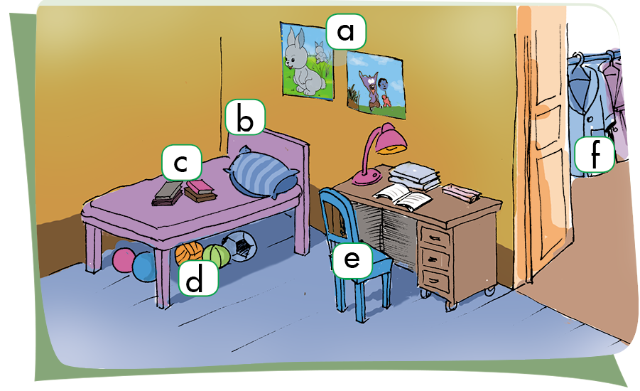


3. Let’s talk
a
Where are the posters?
They’re on the wall.

Slide 18
Let’s talk
b
Where is the bed?
It’s near the wall.

Slide 19
Let’s talk
c
Where are the books?
They’re on the bed.

Slide 20
Let’s talk
d
Where are the balls?
They’re under the bed.

Slide 21
Let’s talk
e
Where is the chair?
It’s near the table.

Slide 22
Let’s talk
f
Where are the coats?
They’re behind the door.

Slide 23
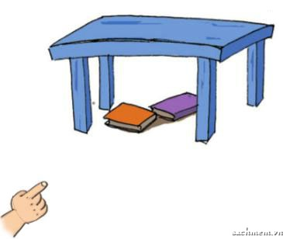
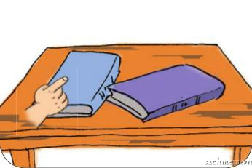
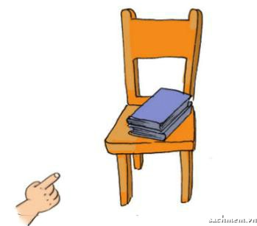
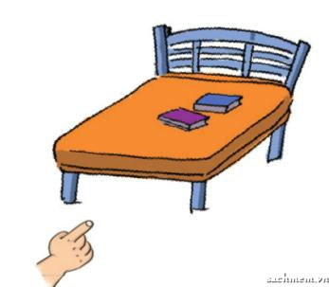
4. Listen and number.
1
2
a
2
b
4
3
4
c
1
d
3

Slide 24
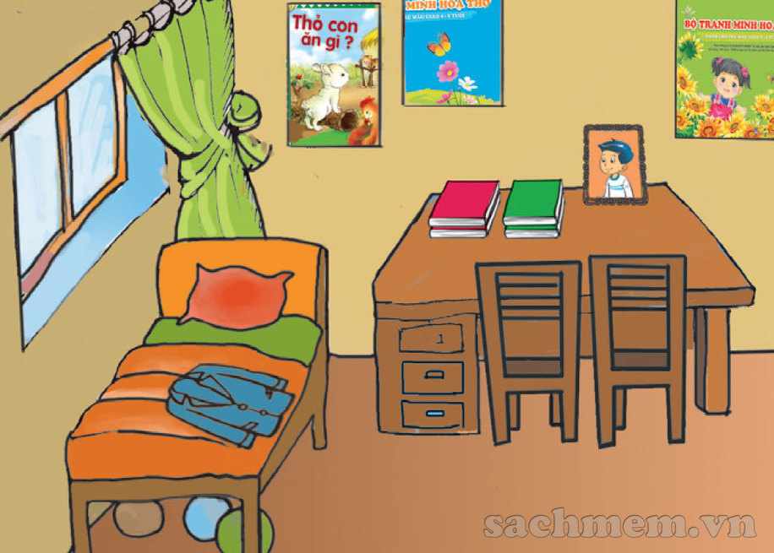
5. Read and complete
Hello! My name is Phong. Here is a picture of my room. This is my bed. My coat is on the bed. There are three balls under the bed. There are two chairs near the desk. There are four books and a photo on the desk. There are three posters on the wall.
Where is Phong's coat?
It is on the bed.
2. Where are the balls?
They are under the bed.
3. Where are the chairs?
They are near the desk.
4. Where are the books and Phong's photo?
They are on the desk.
5. Where are the posters?
They are on the wall.
_________________________________.
_________________________________.
_________________________________.
_________________________________.
_________________________________.

Slide 25
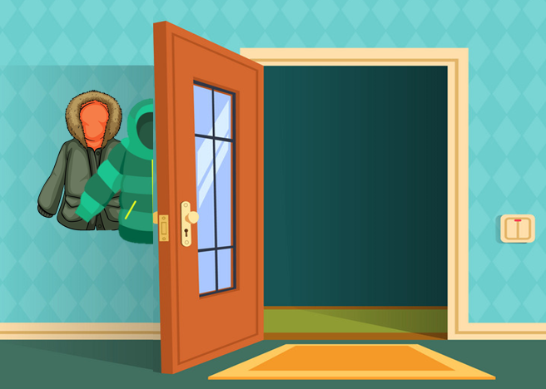

Model sentence
Where are the/my ________?
They’re _________.
behind the door
near the table
on the wall
on the table
under the bed

Slide 26
6. Write about your bedroom
There is __, __, __, __ and__.
There are __, __, __, __ and__.

