Slide 1
13
Unit
Where’s my book?
Lesson 1

Slide 2
VOCABULARY

Slide 3

Chair
/tʃer/

Slide 4

Table
/ˈteɪbl/

Slide 5

Bed
/bed/

Slide 6

Poster
/ˈpəʊstər/

Slide 7

Picture
/ˈpɪktʃər/

Slide 8


Coat
/kəʊt/

Slide 9

Ball
/bɔːl/

Slide 10
Vocabulary
chair
bed
table
coat
ball
poster
picture

Slide 11
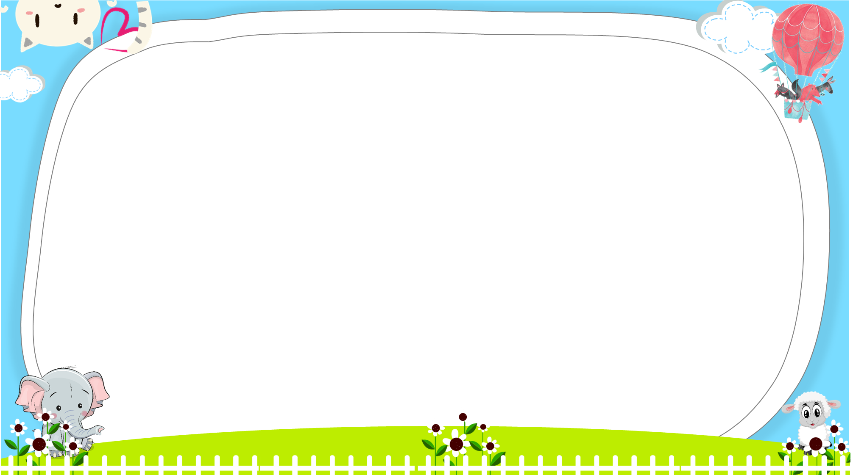





AND
GAME
PLAY
Notes:
Ms Huyền Phạm - 0936.082.789 – YOUTUBE: MsPham. Facebook: Dạy và học cùng công nghệ.

Slide 12



Look and tick
There is a ball.
Next
Notes:
Ms Huyền Phạm - 0936.082.789 – YOUTUBE: MsPham. Facebook: Dạy và học cùng công nghệ.

Slide 13
Look and tick
There is a poster.
Next
Notes:
Ms Huyền Phạm - 0936.082.789 – YOUTUBE: MsPham. Facebook: Dạy và học cùng công nghệ.

Slide 14
Look and tick
There is a coat.
Next
Notes:
Ms Huyền Phạm - 0936.082.789 – YOUTUBE: MsPham. Facebook: Dạy và học cùng công nghệ.

Slide 15
Look and tick
Is there a bed?
Yes, there is.
Next
Notes:
Ms Huyền Phạm - 0936.082.789 – YOUTUBE: MsPham. Facebook: Dạy và học cùng công nghệ.

Slide 16
Look and tick
Is there a picture?
Yes, there is.
Next
Notes:
Ms Huyền Phạm - 0936.082.789 – YOUTUBE: MsPham. Facebook: Dạy và học cùng công nghệ.

Slide 17
Look and tick
Is there a table?
No, there isn’t.
Next
Notes:
Ms Huyền Phạm - 0936.082.789 – YOUTUBE: MsPham. Facebook: Dạy và học cùng công nghệ.

Slide 18
Look and tick
Is there a chair?
No, there isn’t.
Next
Notes:
Ms Huyền Phạm - 0936.082.789 – YOUTUBE: MsPham. Facebook: Dạy và học cùng công nghệ.

Slide 19


Notes:
Ms Huyền Phạm - 0936.082.789 – YOUTUBE: MsPham. Facebook: Dạy và học cùng công nghệ.

Slide 20
GRAMMAR

Slide 21
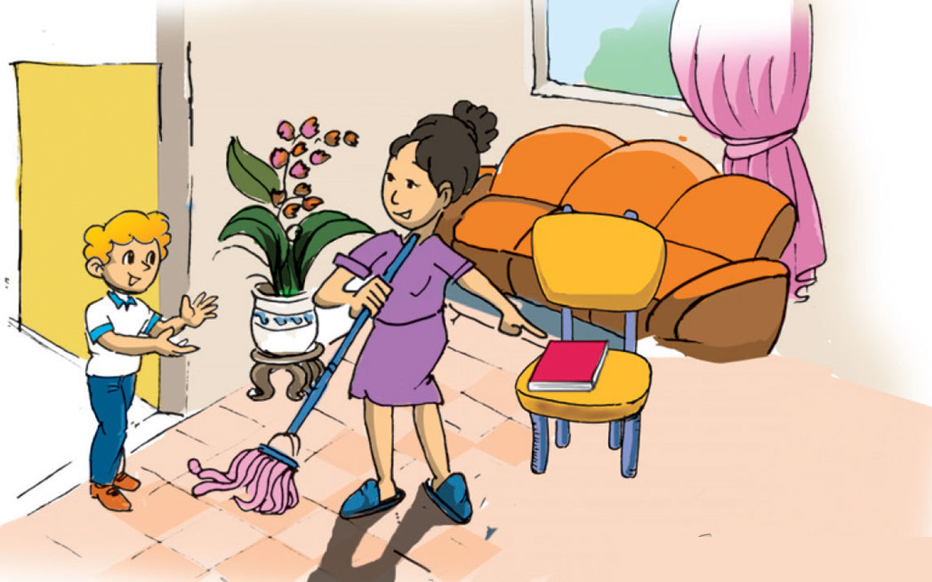
1. Look, listen and repeat
a
Where's my book, Mum?
I can't see it in my room!
It's here, dear. On the chair.

Slide 22
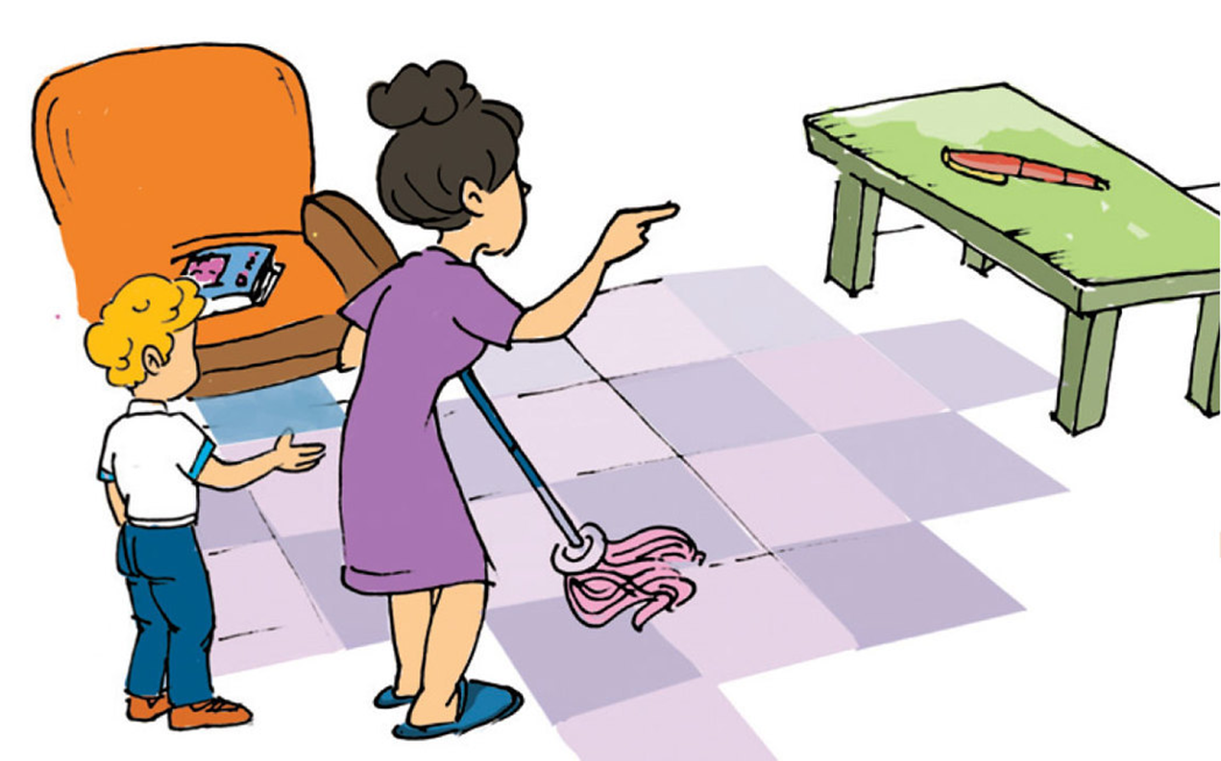

1. Look, listen and repeat
b
No, it's not on the chair.
It's there, on the table.
Is the pen there too, Mum?

Slide 23
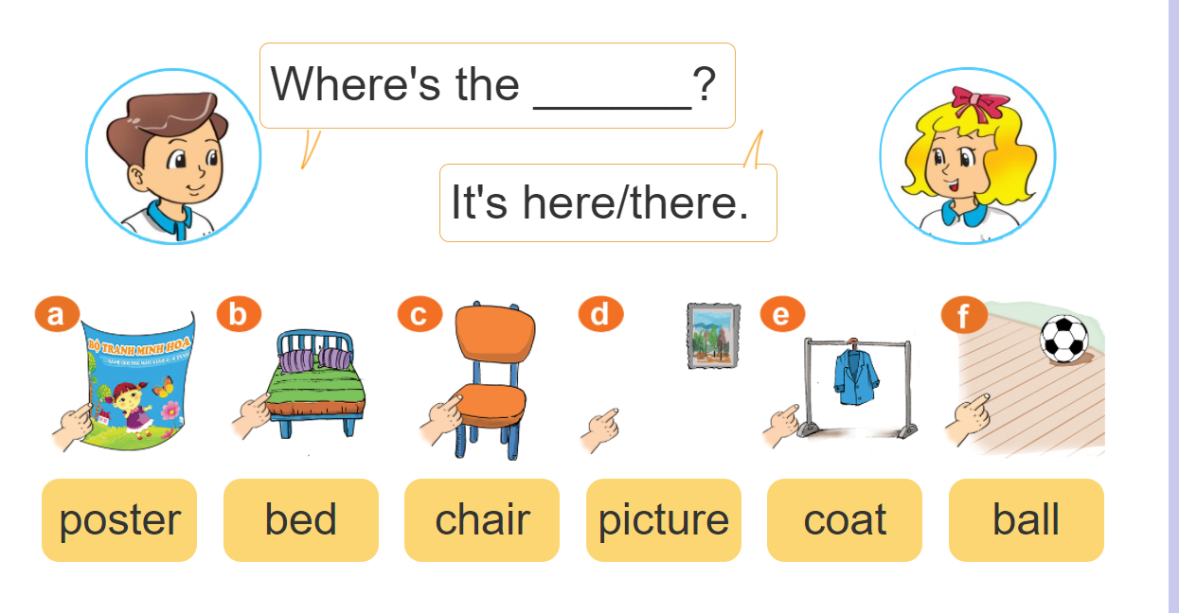
2. Point and say

Slide 24

2. Point and say
Where's my chair?
Where's my ball?
It’s here.
It’s there.

Slide 25
2. Point and say
Where's my bed?
Where's my poster?
It’s here.
It’s there.

Slide 26
2. Point and say
Where's my picture?
Where's my coat?
It’s there.
It’s here.

Slide 27
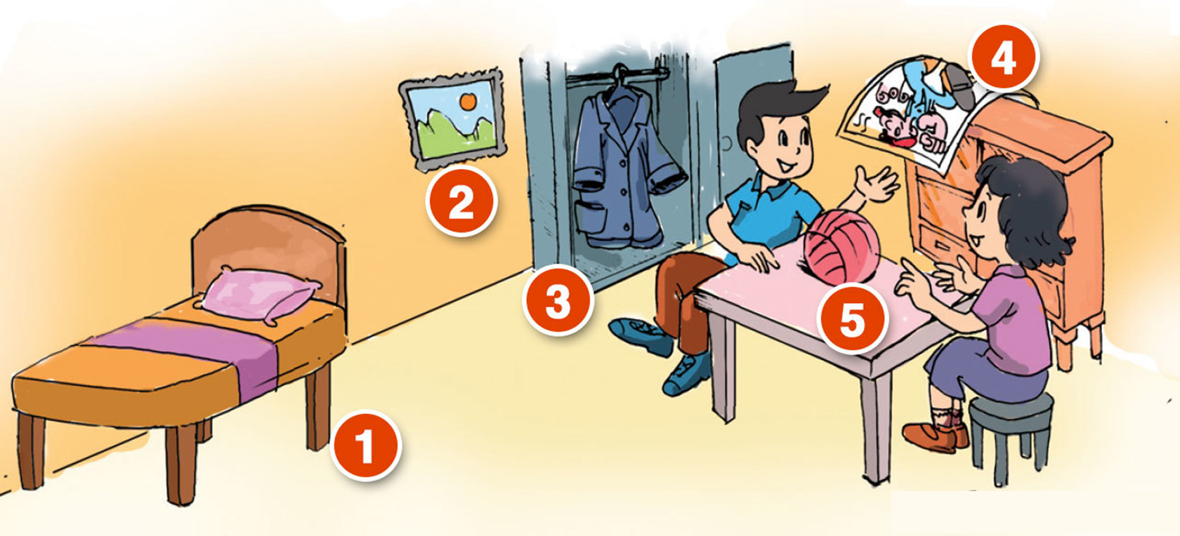
3. Let’s talk
Where's my picture?
Where's my bed?
It’s there.
It’s there.
4
Where's my ball?
2
It’s here.
3
5
1
Where's my coat?
Where's my poster?
It’s there.
It’s here.

Slide 28


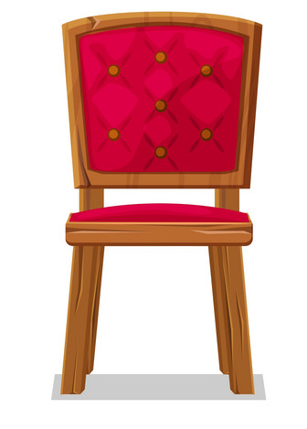

4. Listen and tick
1
2
3
a
a
a
b
b
b

Slide 29

5. Look and write: here / there
This is my bed.
It is here.
This is my desk.
It is here, next to the bed.
________
_______

Slide 30


5. Look and write: here / there
These are my school bags and books.
They are here, on the desk.
_____
Those are posters, pictures and maps.
They are there, on the wall.
______

Slide 31
Model sentence
Where’s my ________?
It’s here.
It’s there.
coat
ball
bed
table
poster
chair
picture

