Slide 1
Unit 10
What do you do at break time?
Lesson 3

Slide 2
Warm-up

Slide 3
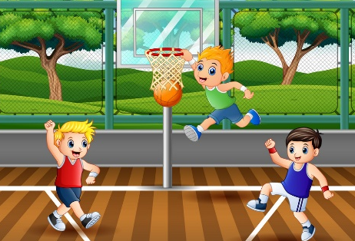
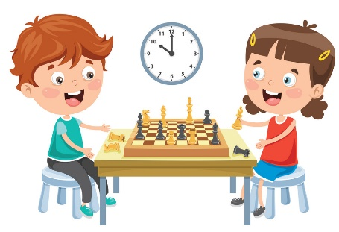
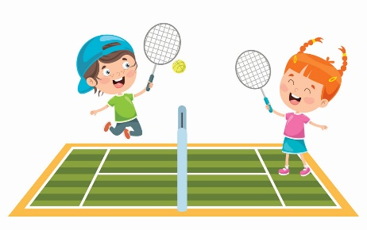
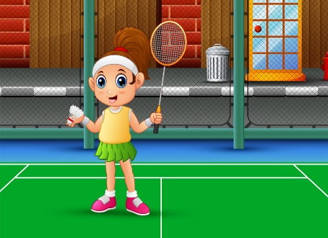
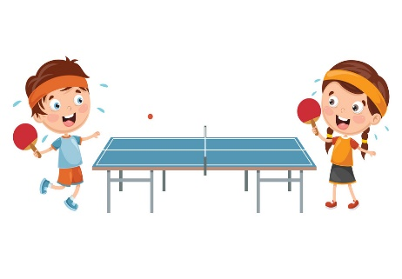

Structure
What do you do at break time?
(Bạn làm gì vào giờ ra chơi?)
I play _______. (Tớ chơi _____.)
basketball
chess
tennis
badminton
table tennis
football

Slide 4







2. Point and say
Do you like________?
(Bạn có thích ____ không?)
Yes, I do.
No, I don’t.
skipping
blind man’s bluff
skating
hide-and-seek

Slide 5

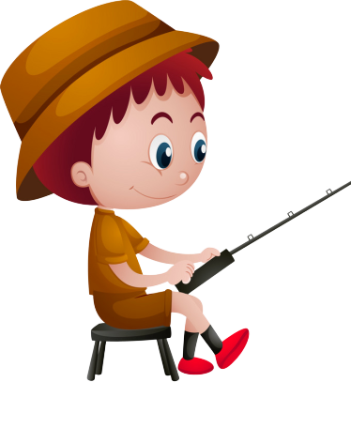


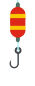

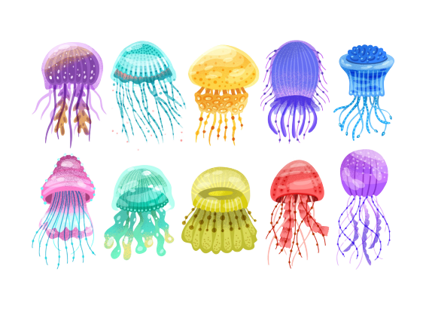




GO FISHING
Game
PLAY
EXIT
Notes:
Ms Huyền Phạm - 0936.082.789 – YOUTUBE: MsPham. Facebook: Dạy và học cùng công nghệ.

Slide 6












0
Score:
EXIT
7
8
6
9
2
4
1
10
5
3
13
12
11
14
15
Notes:
Ms Huyền Phạm - 0936.082.789 – YOUTUBE: MsPham. Facebook: Dạy và học cùng công nghệ.

Slide 7

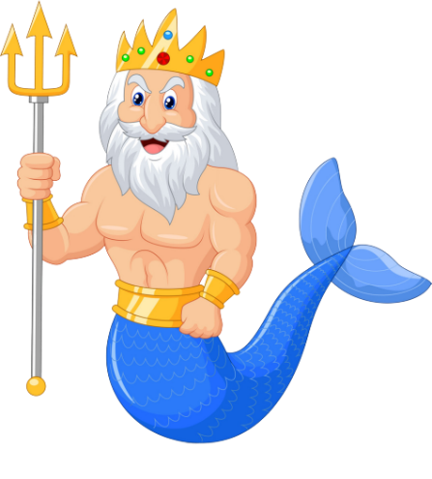



A
I play
hide-and-seek.
B
I play footbal.
C
I play
blind man’s bluff.
D
STOVE
What do you do at break time?
Notes:
Ms Huyền Phạm - 0936.082.789 – YOUTUBE: MsPham. Facebook: Dạy và học cùng công nghệ.

Slide 8

A
No, I don’t.
B
Yes, I do.
C
Yes, I am.
D
Climb
Do you like skating?
Notes:
Ms Huyền Phạm - 0936.082.789 – YOUTUBE: MsPham. Facebook: Dạy và học cùng công nghệ.

Slide 9
A
What do you do
B
What do you like
C
Do you like
__________ at break time?
I play football.
D
May
Notes:
Ms Huyền Phạm - 0936.082.789 – YOUTUBE: MsPham. Facebook: Dạy và học cùng công nghệ.

Slide 10
A
I play football.
B
I play basketball.
C
I play badminton.
D
Watch
What do you do at break time?
Notes:
Ms Huyền Phạm - 0936.082.789 – YOUTUBE: MsPham. Facebook: Dạy và học cùng công nghệ.

Slide 11

A
No, I am not.
B
Yes, I do.
C
No, I don’t.
Do you like
blind man’s bluff?
D
Next to
Notes:
Ms Huyền Phạm - 0936.082.789 – YOUTUBE: MsPham. Facebook: Dạy và học cùng công nghệ.

Slide 12
A
tennis
B
badminton
C
chess
Do you like ________?
No, I don’t.
D
Next to
Notes:
Ms Huyền Phạm - 0936.082.789 – YOUTUBE: MsPham. Facebook: Dạy và học cùng công nghệ.

Slide 13
A
I play skating.
B
I play skipping.
C
I play hide-and-seek.
D
She plays chess
in his free time.
What do you do at break time?
Notes:
Ms Huyền Phạm - 0936.082.789 – YOUTUBE: MsPham. Facebook: Dạy và học cùng công nghệ.

Slide 14
A
in break time
B
on break time
C
at break time
What do you do _______?
I play table tennis.
D
They likes sport.
Notes:
Ms Huyền Phạm - 0936.082.789 – YOUTUBE: MsPham. Facebook: Dạy và học cùng công nghệ.

Slide 15
A
Yes, I do.
B
No, I don’t.
C
I like badminton.
D
She should take some warm water.
Do you like badminton?
Notes:
Ms Huyền Phạm - 0936.082.789 – YOUTUBE: MsPham. Facebook: Dạy và học cùng công nghệ.

Slide 16
A
Yes, I am.
B
Yes, I do.
C
Yes, it is.
D
He shouldn’t watch much TV.
Do you like chess?
Notes:
Ms Huyền Phạm - 0936.082.789 – YOUTUBE: MsPham. Facebook: Dạy và học cùng công nghệ.

Slide 17
Phonics

Slide 18
1. Listen and repeat.
bl | blind | Do you like blind man's bluff?
sk | skating | I like skating.

Slide 19
2. Listen and write.
1. I don't like chess. I like ________________.
2. They like ____________.
blind man's bluff
skating

Slide 20
Practise

Slide 21
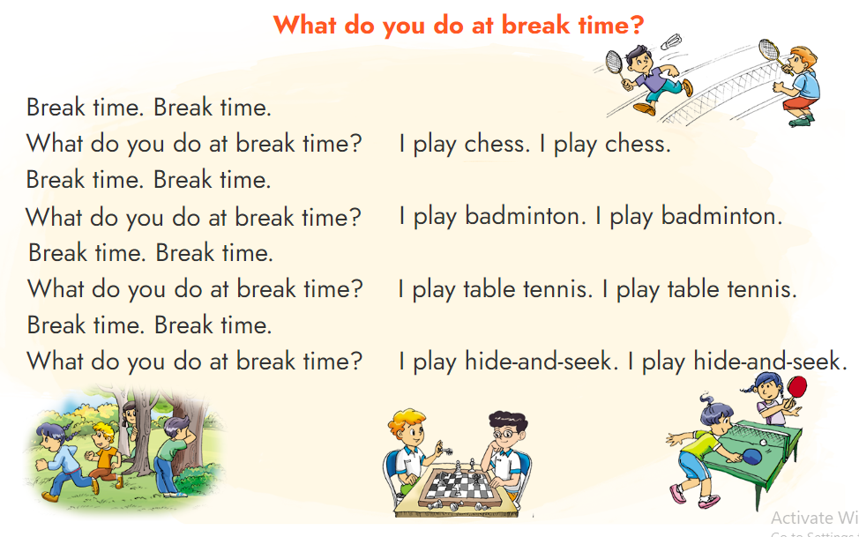

3. Let's chant

Slide 22
4. Read and match
1
What do you do at break time?
b
I play badminton.
2
Do you like football?
c
Yes, I do.
3
Let's play football.
a
Ok. Let’s play it
4
What do Mai and Linda like?
d
They like chess.
a
Ok. Let’s play it
c
Yes, I do.
b
I play badminton.
d
They like chess.

Slide 23
5. Write about you
Hi! My name is ________. I like ____________.
At break time, I play __________________.

Slide 24
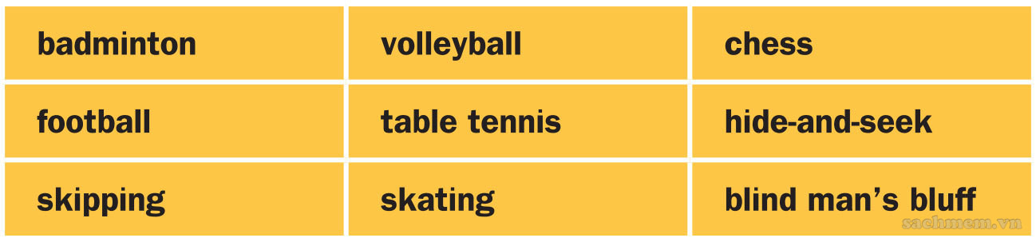
6 Project
Bingo

