Slide 1
Unit 10
What do you do at break time?
Lesson 2

Slide 2
VOCABULARY

Slide 3

Vocabulary
skipping
/ˈskɪpɪŋ/

Slide 4

Vocabulary
skating
/ˈskeɪtɪŋ/

Slide 5

Vocabulary
hide-and-seek
/ˈhaɪdəndˈsiːk/

Slide 6

Vocabulary
blind man’s bluff
/blaɪnd mænz blʌf/

Slide 7



Vocabulary
hide-and-seek
skipping
skating
blind man’s bluff

Slide 8
GRAMMAR

Slide 9
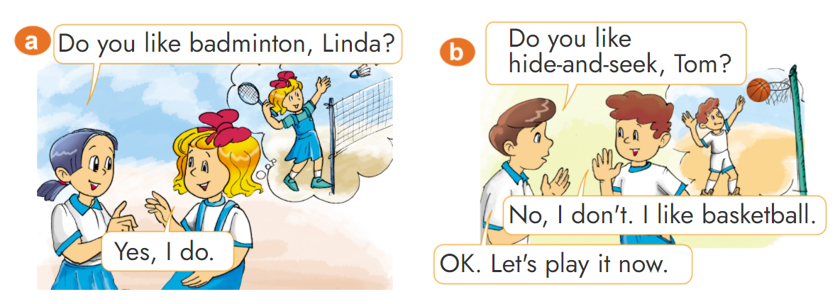

1. Look, listen and repeat.

Slide 10


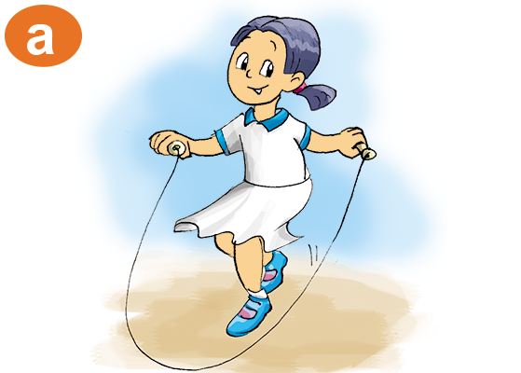
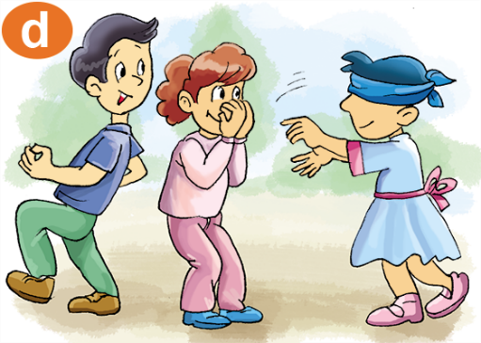

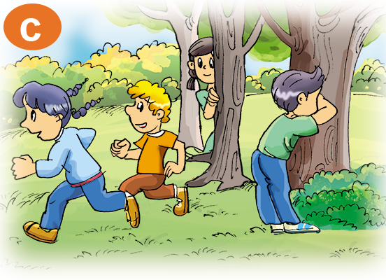

2. Point and say
Yes, I do.
Do you like________?
(Bạn có thích ____ không?)
No, I don’t.
skipping
blind man’s bluff
skating
hide-and-seek

Slide 11

3. Let’s talk
4
Do you like________?
Yes, I do.
No, I don’t.
3
1
2

Slide 12






Click hình chú Thỏ hoặc chú Rùa khi chọn đáp án.
Notes:
Ms Huyền Phạm - 0936.082.789 – YOUTUBE: MsPham. Facebook: Dạy và học cùng công nghệ.

Slide 13

Do you like ________?
Yes, I do.
blind man’s bluff
hide-and-seek
Notes:
Ms Huyền Phạm - 0936.082.789 – YOUTUBE: MsPham. Facebook: Dạy và học cùng công nghệ.

Slide 14
Do you like ________?
No, I don’t.
skating
skipping
Notes:
Ms Huyền Phạm - 0936.082.789 – YOUTUBE: MsPham. Facebook: Dạy và học cùng công nghệ.

Slide 15
Do you like________?
Yes, I do.
skating
hide-and-seek
Notes:
Ms Huyền Phạm - 0936.082.789 – YOUTUBE: MsPham. Facebook: Dạy và học cùng công nghệ.

Slide 16
Do you like ________?
No, I don’t.
hide-and-seek
skipping
Notes:
Ms Huyền Phạm - 0936.082.789 – YOUTUBE: MsPham. Facebook: Dạy và học cùng công nghệ.

Slide 17
What do you like hide-and-seek?
No, I don’t.
Yes, I do.
Notes:
Ms Huyền Phạm - 0936.082.789 – YOUTUBE: MsPham. Facebook: Dạy và học cùng công nghệ.

Slide 18
Do you like skipping?
No, I don’t.
Yes, I do.
Notes:
Ms Huyền Phạm - 0936.082.789 – YOUTUBE: MsPham. Facebook: Dạy và học cùng công nghệ.

Slide 19
Do you like blind man’s bluff?
Yes, I do.
No, I don’t.
Notes:
Ms Huyền Phạm - 0936.082.789 – YOUTUBE: MsPham. Facebook: Dạy và học cùng công nghệ.

Slide 20
Do you like skating?
Yes, I do.
No, I don’t.
Notes:
Ms Huyền Phạm - 0936.082.789 – YOUTUBE: MsPham. Facebook: Dạy và học cùng công nghệ.

Slide 21

Notes:
Ms Huyền Phạm - 0936.082.789 – YOUTUBE: MsPham. Facebook: Dạy và học cùng công nghệ.

Slide 22
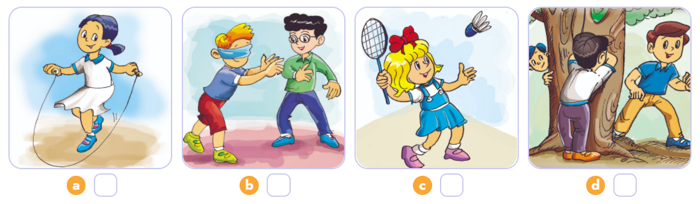
4. Listen and number.
4
2
1
3
1
2
3
4

Slide 23
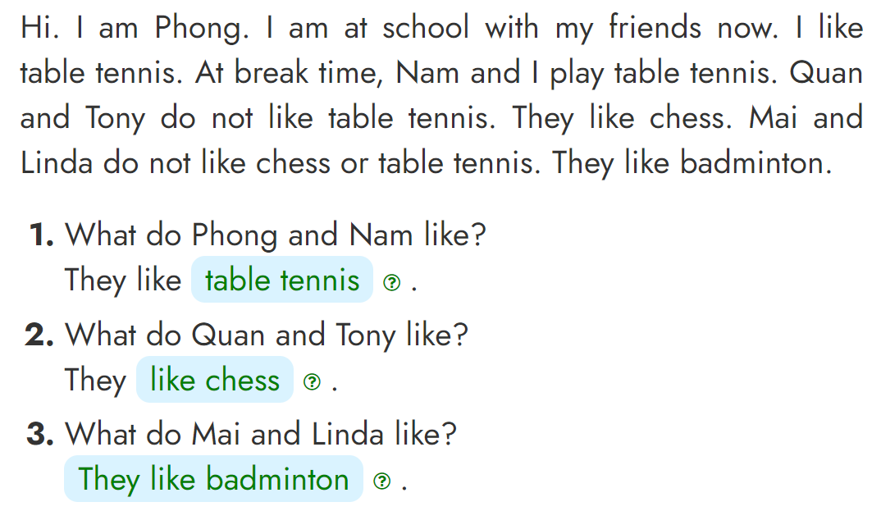
5. Read and write.
_______________
_____________
________________________

Slide 24
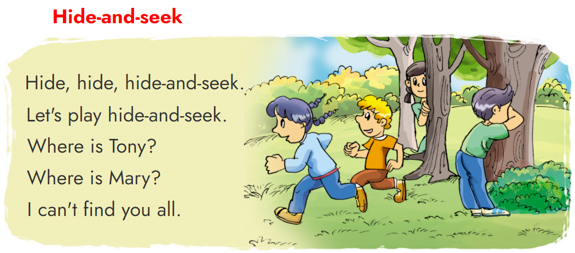
6. Let’s sing.

