Slide 1

Welcome to my class
Teacher: Nguyen Nha Phuong

Slide 2

Guessing game

Slide 3
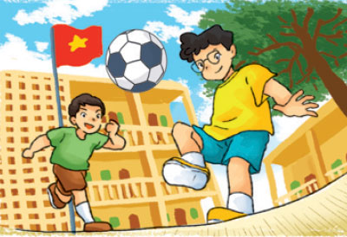
at school
a. at home
b. at school
c. at work

Slide 4
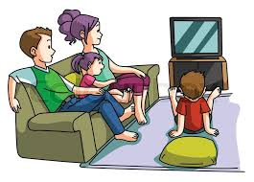
at home
a. at work
b. at school
c. at home

Slide 5
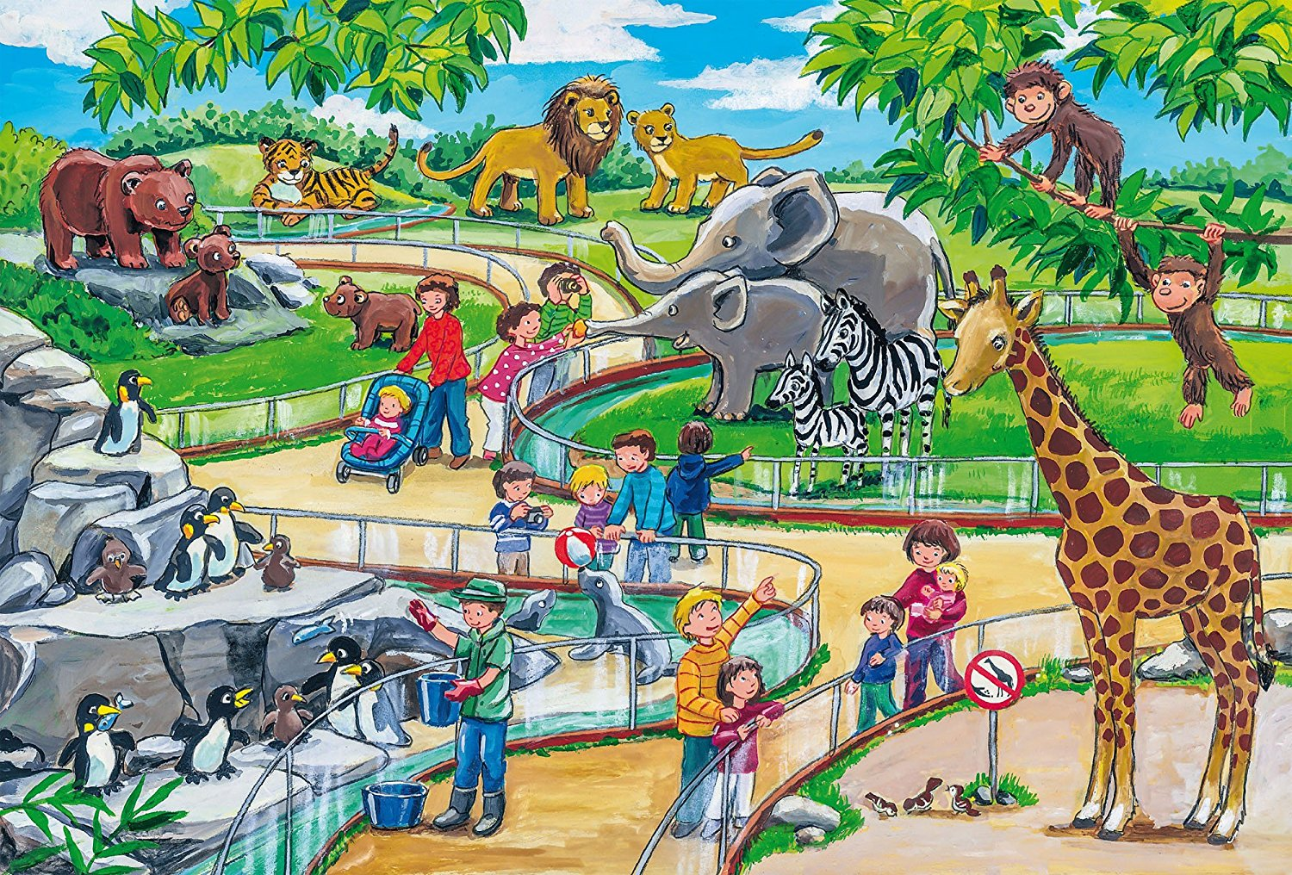
at the zoo
a. at the cinema
b. at the zoo
c. at home

Slide 6

In Japan
a. in China
b. in Viet Nam
c. in Japan

Slide 7

In the supermarket
a. in the cinema
b. in the library
c. in the supermarket

Slide 8

In the mountains
a. in the mountain
b. in the supermarket
c. in the library

Slide 9


At school
At home
At the zoo
In Japan
In the supermarket
In the mountains

Slide 10

Unit 5:
Where will you be this weekend? Lesson 1

Slide 11
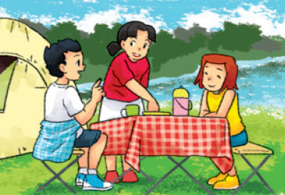


I. New words:
in the countryside
on the beach
by the sea

Slide 12
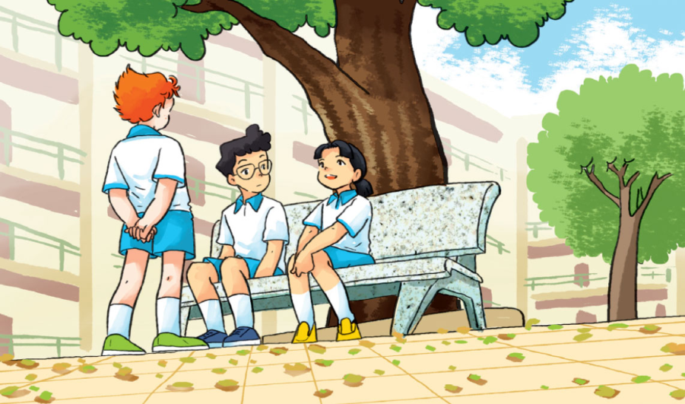
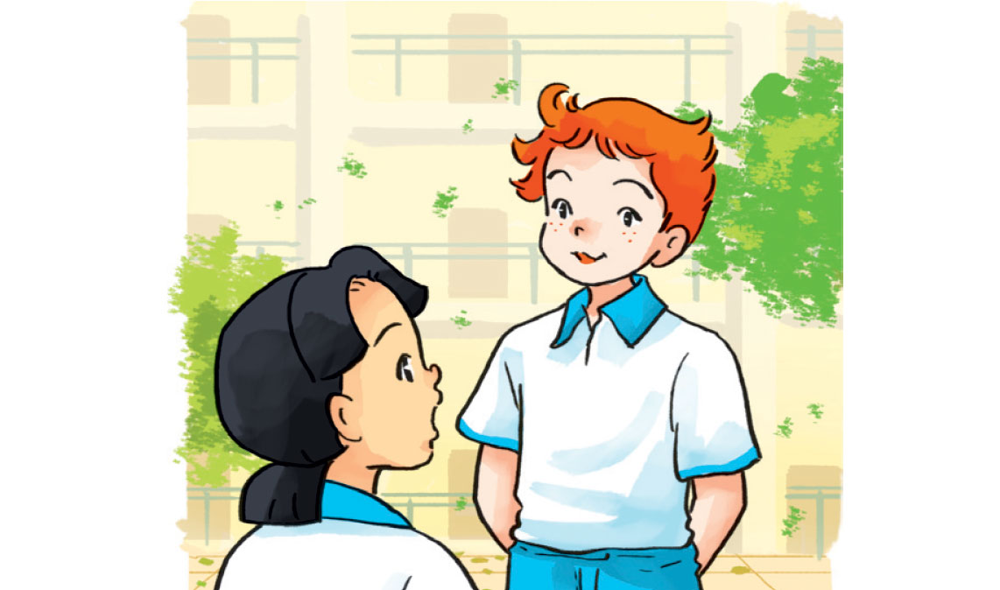
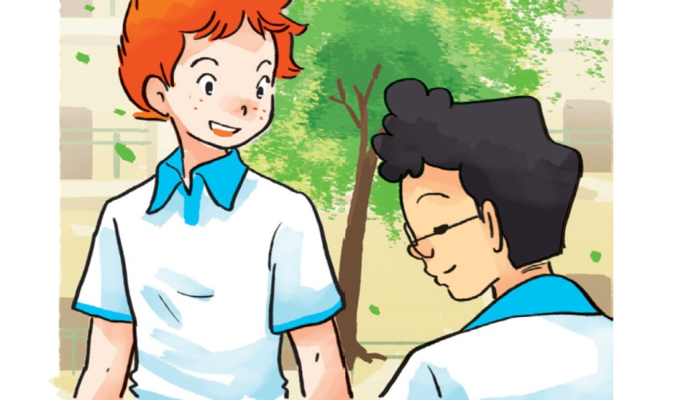
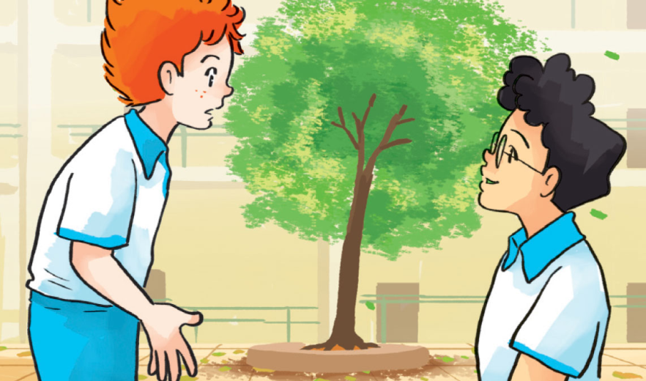
1. Look, listen and repeat
What about you, Tony? Where will you be on Saturday ?
I think my family and I will go for a picnic
Great! That will be
a lot of fun
What will you do this weekend ?
I think I’ll be in the mountains
I’ll be at home
What about you, Phong? Where will you be?
At home? Why?
Because I have to study

Slide 13
II. Sentence patterns:
Where will you be this weekend?
I think I’ll be in the mountains
* I’ll = I will

Slide 14
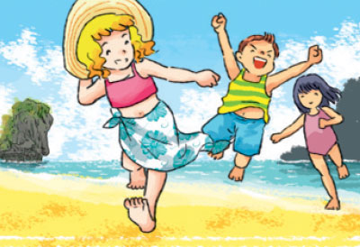
2. Point and say
( tomorrow/ next Sunday
next week / month/ … )
Where will you be this weekend?
I think I’ll be …
a
b
In the countryside
On the beach
c
d
At school
By the sea

Slide 15
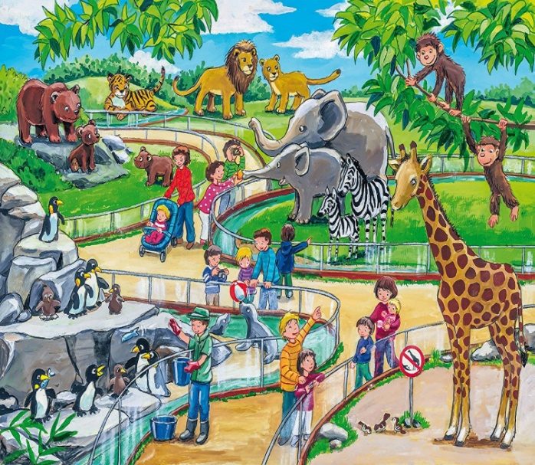

( tomorrow/ next Sunday
next week / month/ … )
Where will you be ......................?
I think I’ll be ................................
At school
At the zoo
At school
At home
At the zoo
In Japan
In the supermarket
In the mountains
In Japan
In the supermarket
In the mountains

Slide 16




Slide 17
Thursday, October 21st 2021 Unit 5: Where will you be this weekend? Lesson 1
Words:
In the countryside
By the sea
On the beach
III. Exercises:
W(2)
Q&A (p2)
Olm.vn
II. Models:
Where will you be this weekend?
I think I’ll be in the mountains.
* I’ll = I will

Slide 18

Thank you for your attention !

Slide 19

5. Read and match
1. Where will you be this weekend?
2. Where will Mai be tomorrow?
3. Where will Phong be next week?
4. Where will Peter and Linda be next month?
a. He’ll be in the mountains.
b. They’ll be by the sea.
c. I think I’ll be at home.
d. She’ll be on the beach.

Slide 20



What will Mai do this weekend?
a. go for a walk b. go to the zoo c. go for a picnic
2. Where will Tony be on Saturday?
a. in the countryside b. in the mountains
c. in the supermarket
3. Where will Phong be ?
a. at home b. at the zoo c. at school

Slide 21


Lucky Number
1
2
3
4
5
6
7
8

Slide 22


Slide 23

500$

Slide 24


Slide 25


Slide 26
800$

Slide 27
700$

Slide 29
600$

