Slide 1
Song: ordinal numbers
https://www.youtube.com/watch?v=0CWWNzprEQ4

Slide 2

Welcome to our class.

Slide 3

Unit 3
When’s your birthday?
Lesson 1

Slide 4
I. Words:
https://www.youtube.com/watch?v=G-XOinNcMQA&t=4s

Slide 5
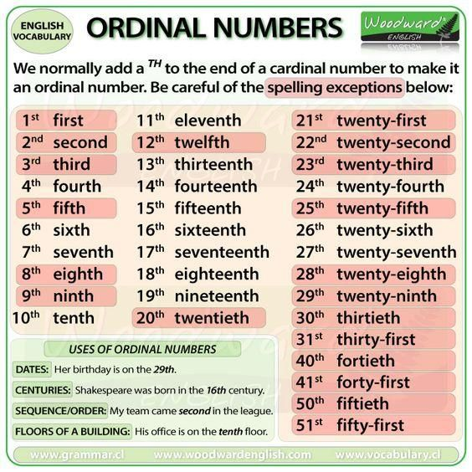
*Note:
Twelve → twelfth
Twenty →twentieth
Thirty → thirtieth

Slide 6
Dates of the month
first
second
third
1st
2nd
3rd
fourteenth
twenty-second
thirty-first
14th
22nd
31st

Slide 7
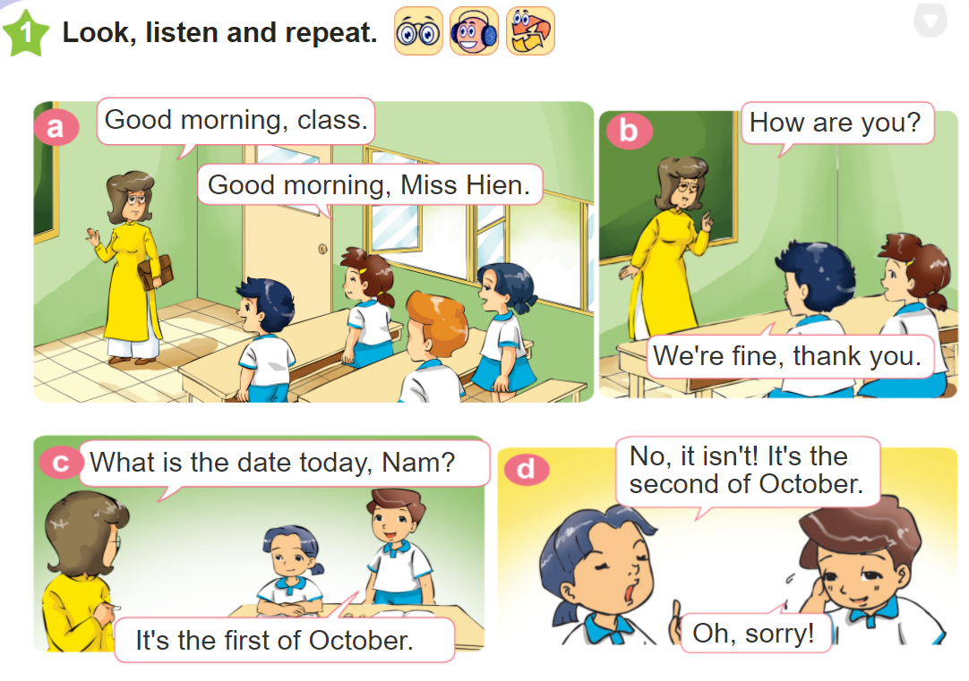


Slide 8
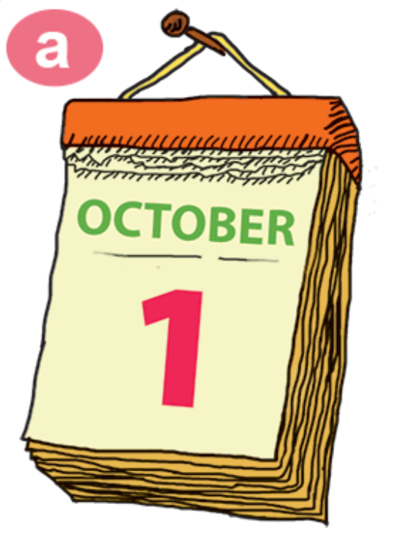
II. Sentence pattern:
What is the date today?
It’s the first of October.

Slide 9
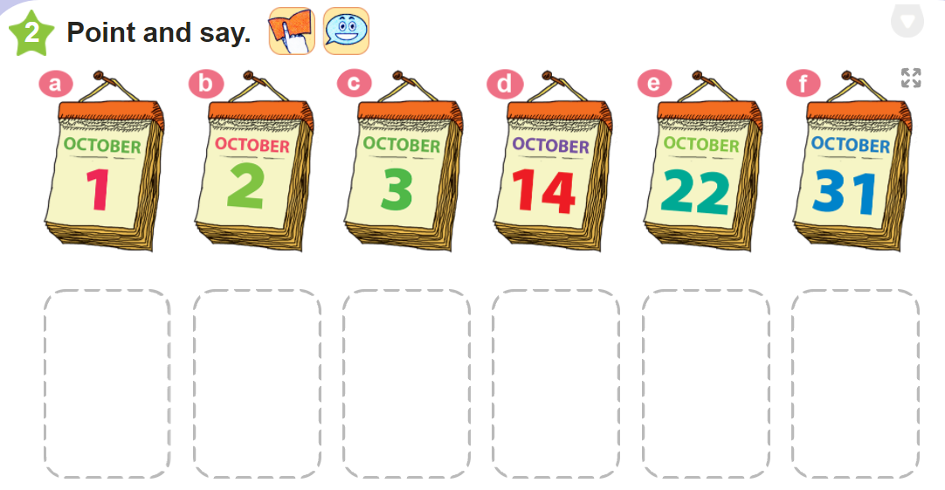
The first of October
The fourteenth of October
The thirty- first of October
The second of October
The third of October
The twenty-
second of October

Slide 10
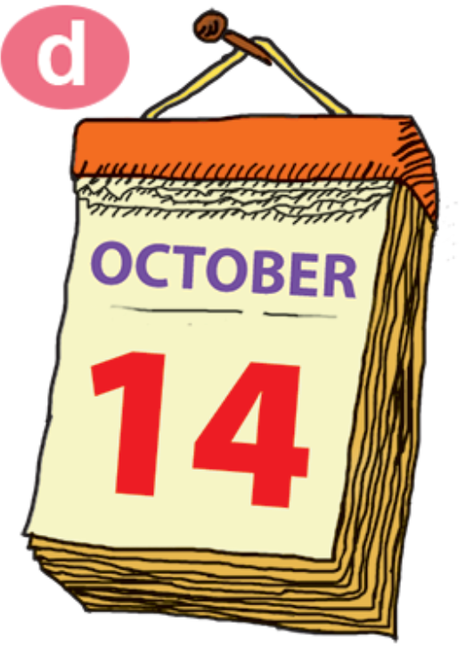
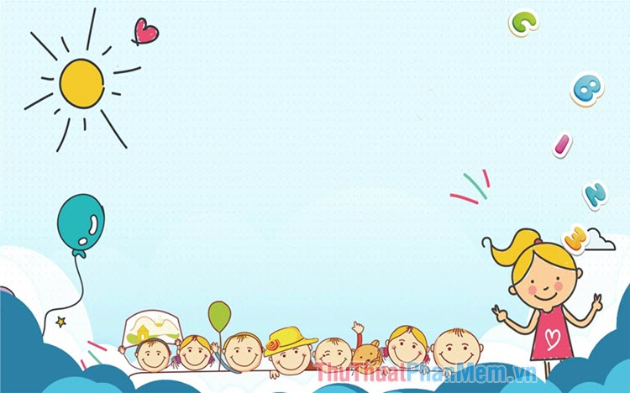

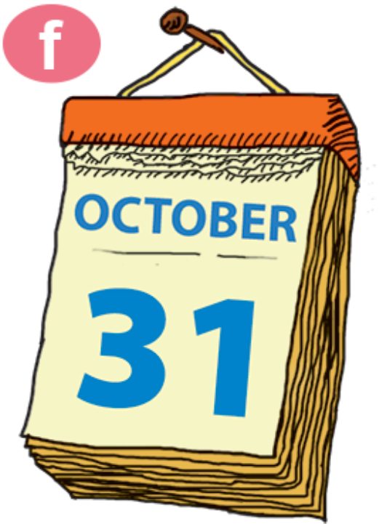
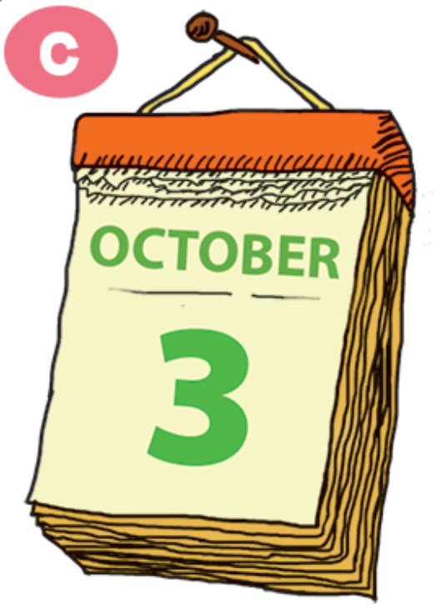
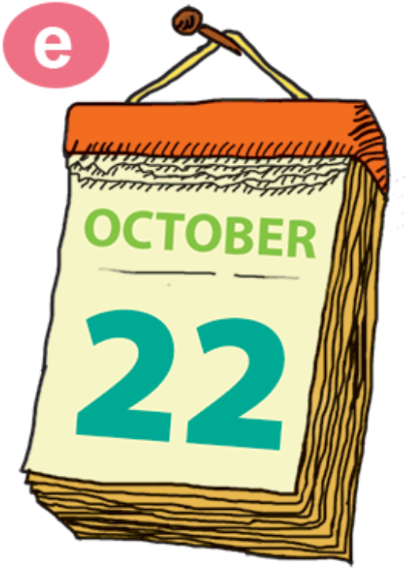

Slide 11
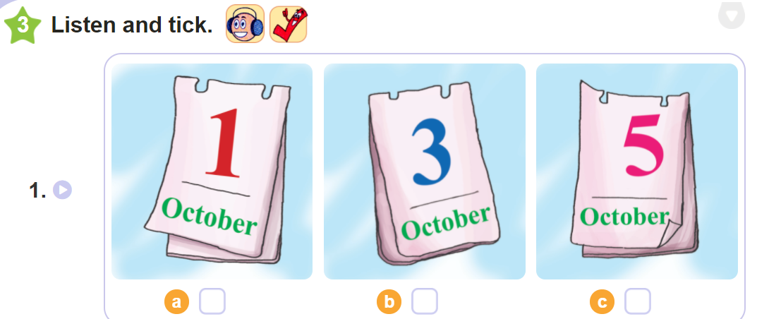

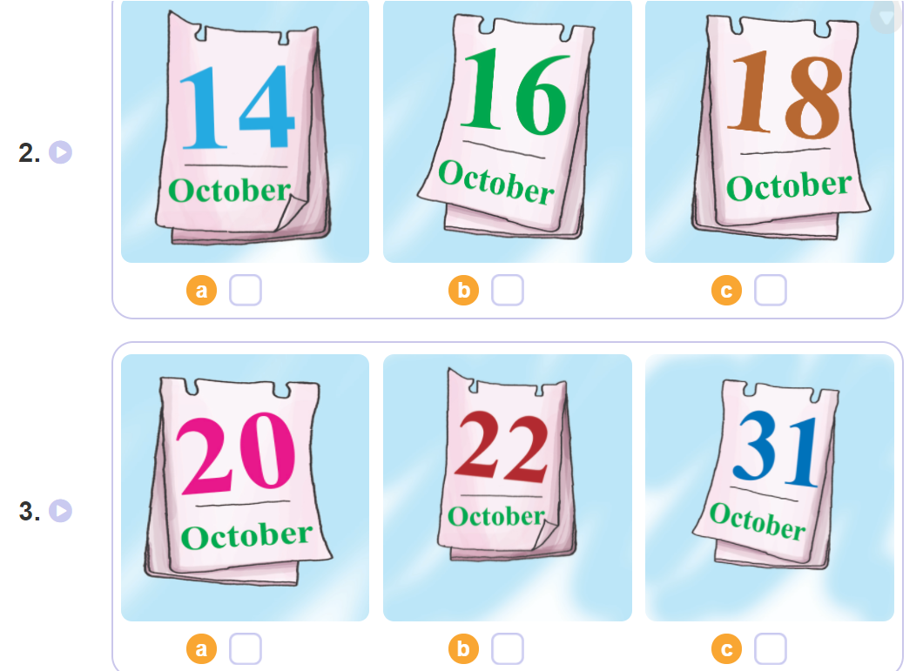

Slide 12
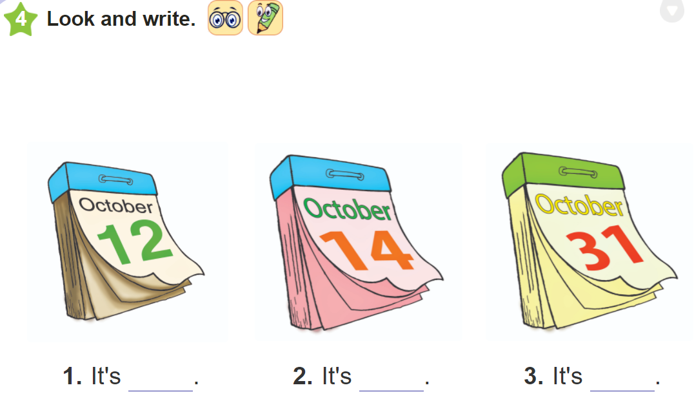
the twelfth
of October.
the fourteenth
of October.
the thirty-first
of October.

Slide 13
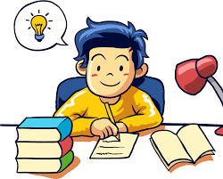
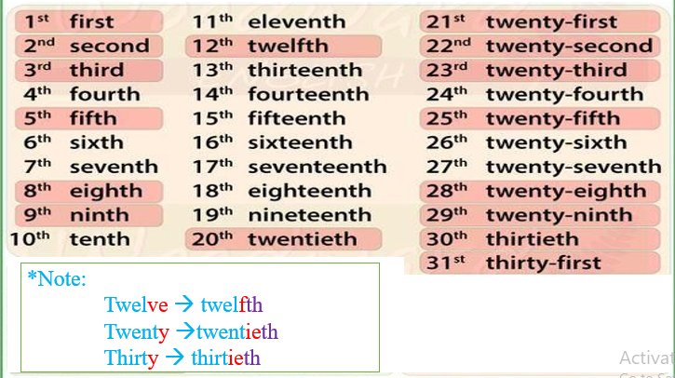
Monday, October 4th 2021
Unit 4: What is the date today?
Lesson 1
I. Words:
III. Exercises:
Luyện đọc thuộc số thứ tự
Tự đặt câu hỏi và TL với phần 2 (SKG)
Làm BT trên olm.vn
Nộp bài viết Unit 3: Lesson 1,2,3 lên azota
II. Sentence patterns:
What’s the date today?
It’s the first of October.

Slide 14


Slide 15
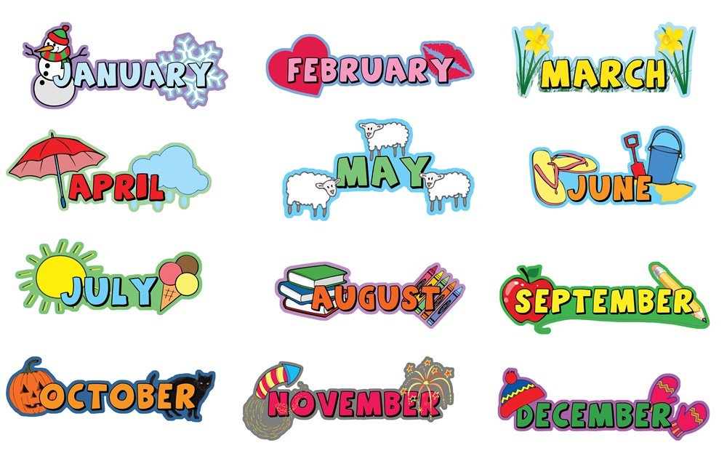
I. Words
12 months of year.

Slide 16
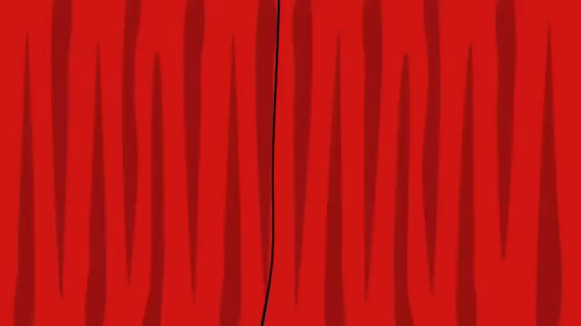

Slide 17



Lucky Number
1
2
3
4
5
6
7
8
9

Slide 18


Question 1
We don’t go to school
this day.
A
Monday
B
Thursday
C
Sunday

Slide 19
Question 2
The day before Thursday.
A
Friday
B
Wednesday
C
Tuesday

Slide 20
Question 3
The first day of the week.
A
Monday
B
Thursday
C
Friday

Slide 21
Question 7
The day after Monday.
A
Wednesday
B
Thursday
C
Tuesday

