Slide 1
Song:
https://www.youtube.com/watch?v=mXMofxtDPUQ

Slide 2
Welcome
4A3 students

Slide 3
Unit 3:
What day is it today?
Lesson 1

Slide 4
Monday
Tuesday
Friday
Wednesday
Saturday
Thursday
Sunday

Slide 5
Guessing game

Slide 6
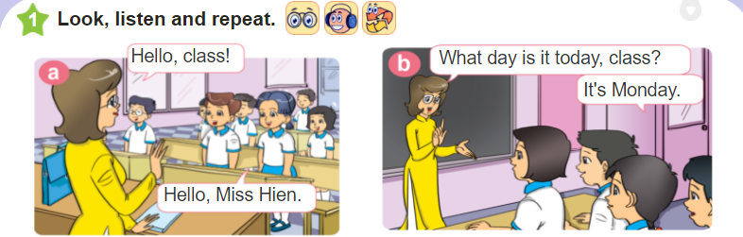
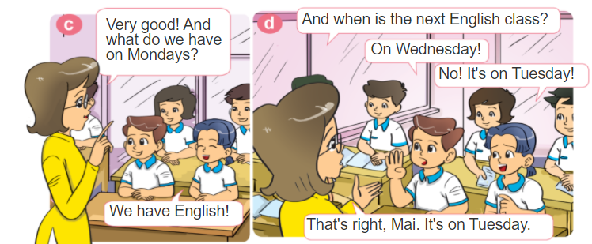

Slide 7
II. Sentence patterns:
What day is it today?
It’s Monday.

Slide 8

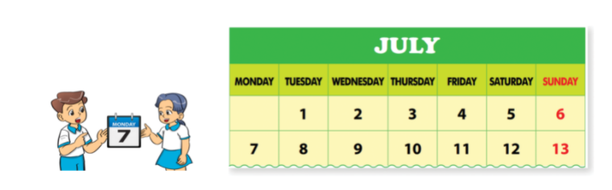
What day is it today?
It’s Monday.

Slide 9
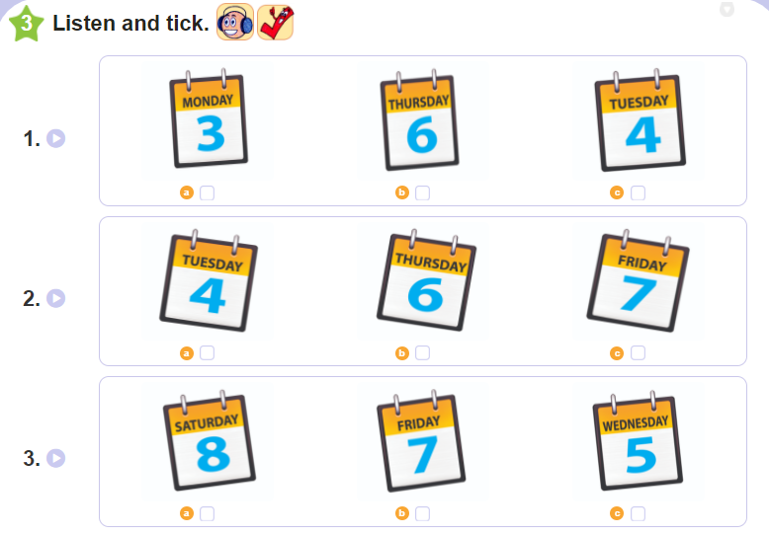

Slide 10
Tuesday, September 28th 2021
Unit 3: What day is it today?
Lesson 1
Words:
Monday
Tuesday
Wednesday
Thursday
Friday
Saturday
Sunday
II. Sentence patterns:
What day is it today?
It’s Tuesday.
III. Exercises:
W(2)
Q&A (p.2)
Olm.vn
Nộp bài viết vở U1,2 lên Azota

Slide 11

