Slide 1


Slide 2


Slide 3
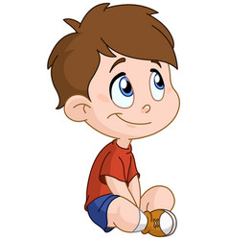
Guessing game

Slide 4

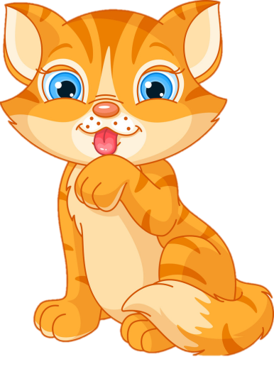
a cat

Slide 5
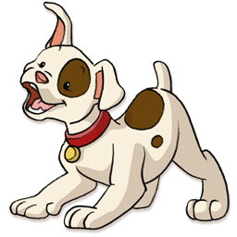

a dog

Slide 6


a fish

Slide 7


a bird

Slide 8

Name
Name
Name
Name
Name
Name
Name
Name
Unit 3:
This is Tony.
Lesson 1

Slide 9
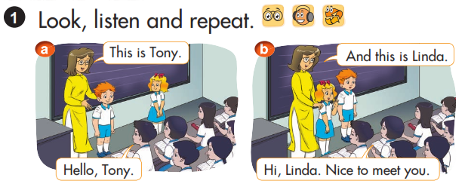


Slide 10
I. SENTENCE PATTERNS:
A: This is Linda.
B: Hello, Linda. Nice to meet you.

Slide 11
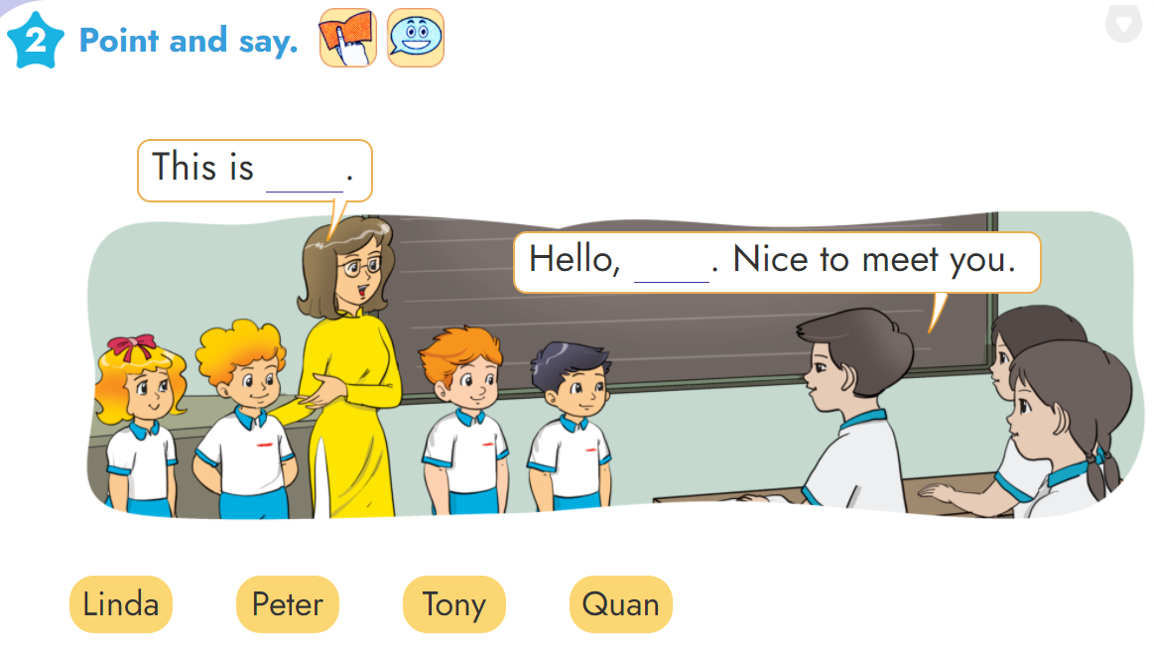

Slide 12
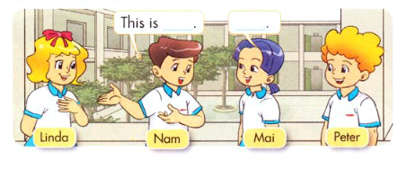
3. Let’s talk

Slide 13
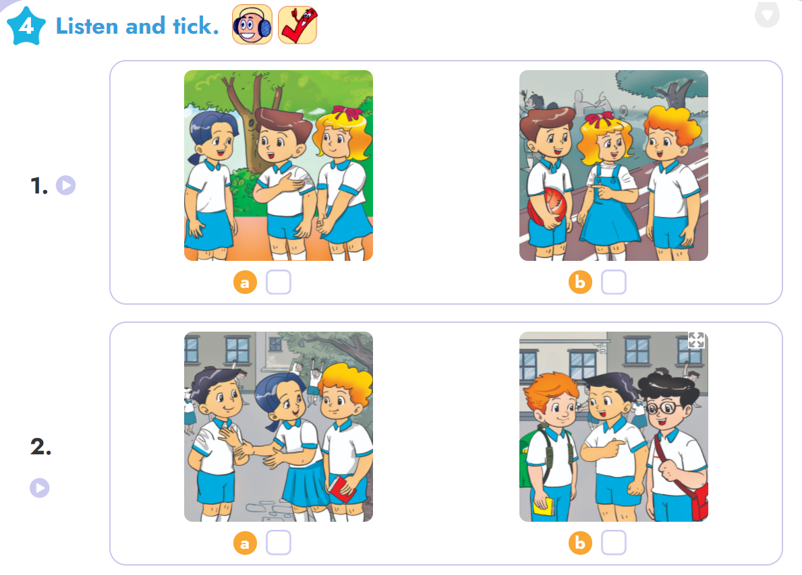


Slide 14
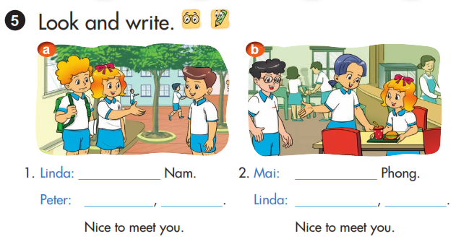
This is
This is
Hi
Nam
Hello
Phong

Slide 15
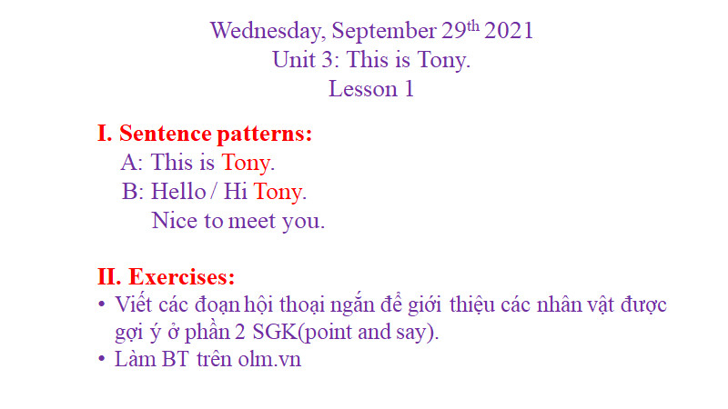

Slide 16
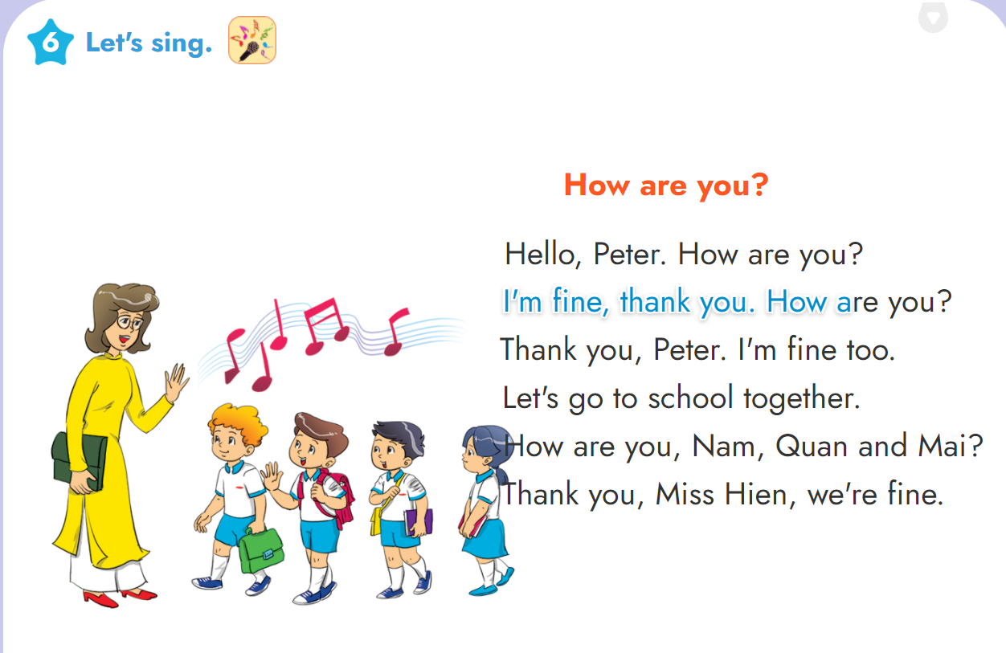

Slide 17

Good bye
See you later

