Slide 1
Let’s warm up together

Slide 2
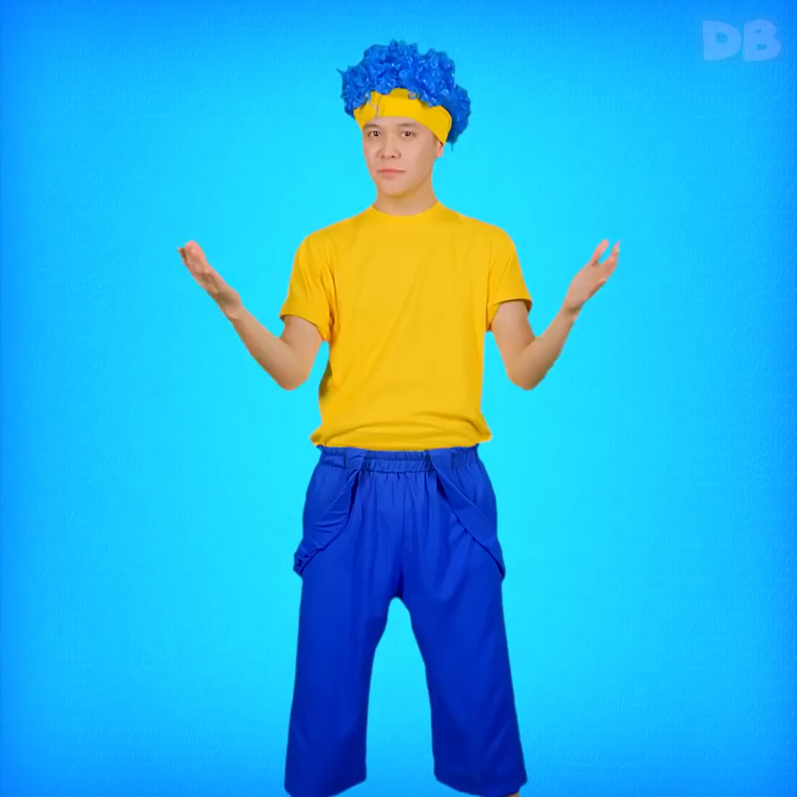

Slide 3





Unit 7 – Lesson 1
Number
Let’s start

Slide 4
Process
Step 1
Step 2
Step 3
Step 4
How to write number 1,2,3
Work book
How to pronounce number 1,2,3
Game

Slide 5



How many apples do you see?
Step 1

Slide 6
How many apples do you see?

Slide 7
How many apples do you see?

Slide 8
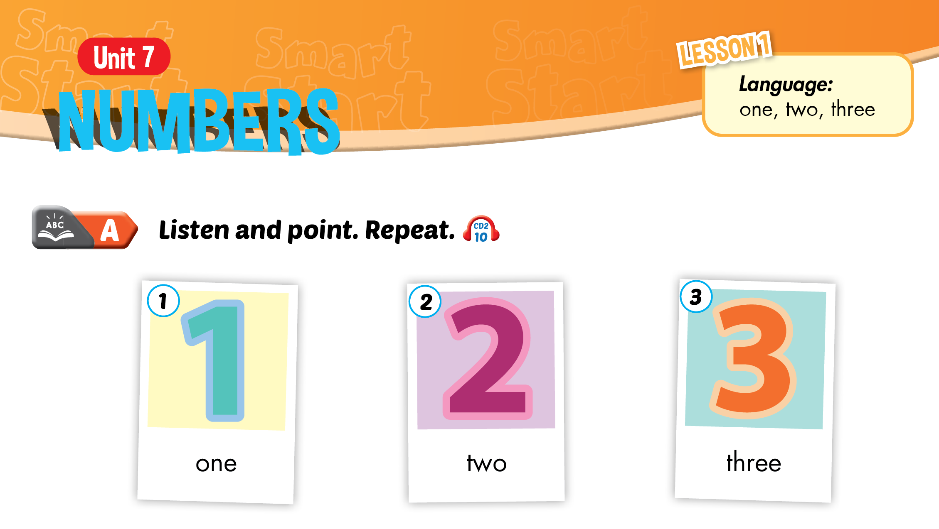


Slide 9
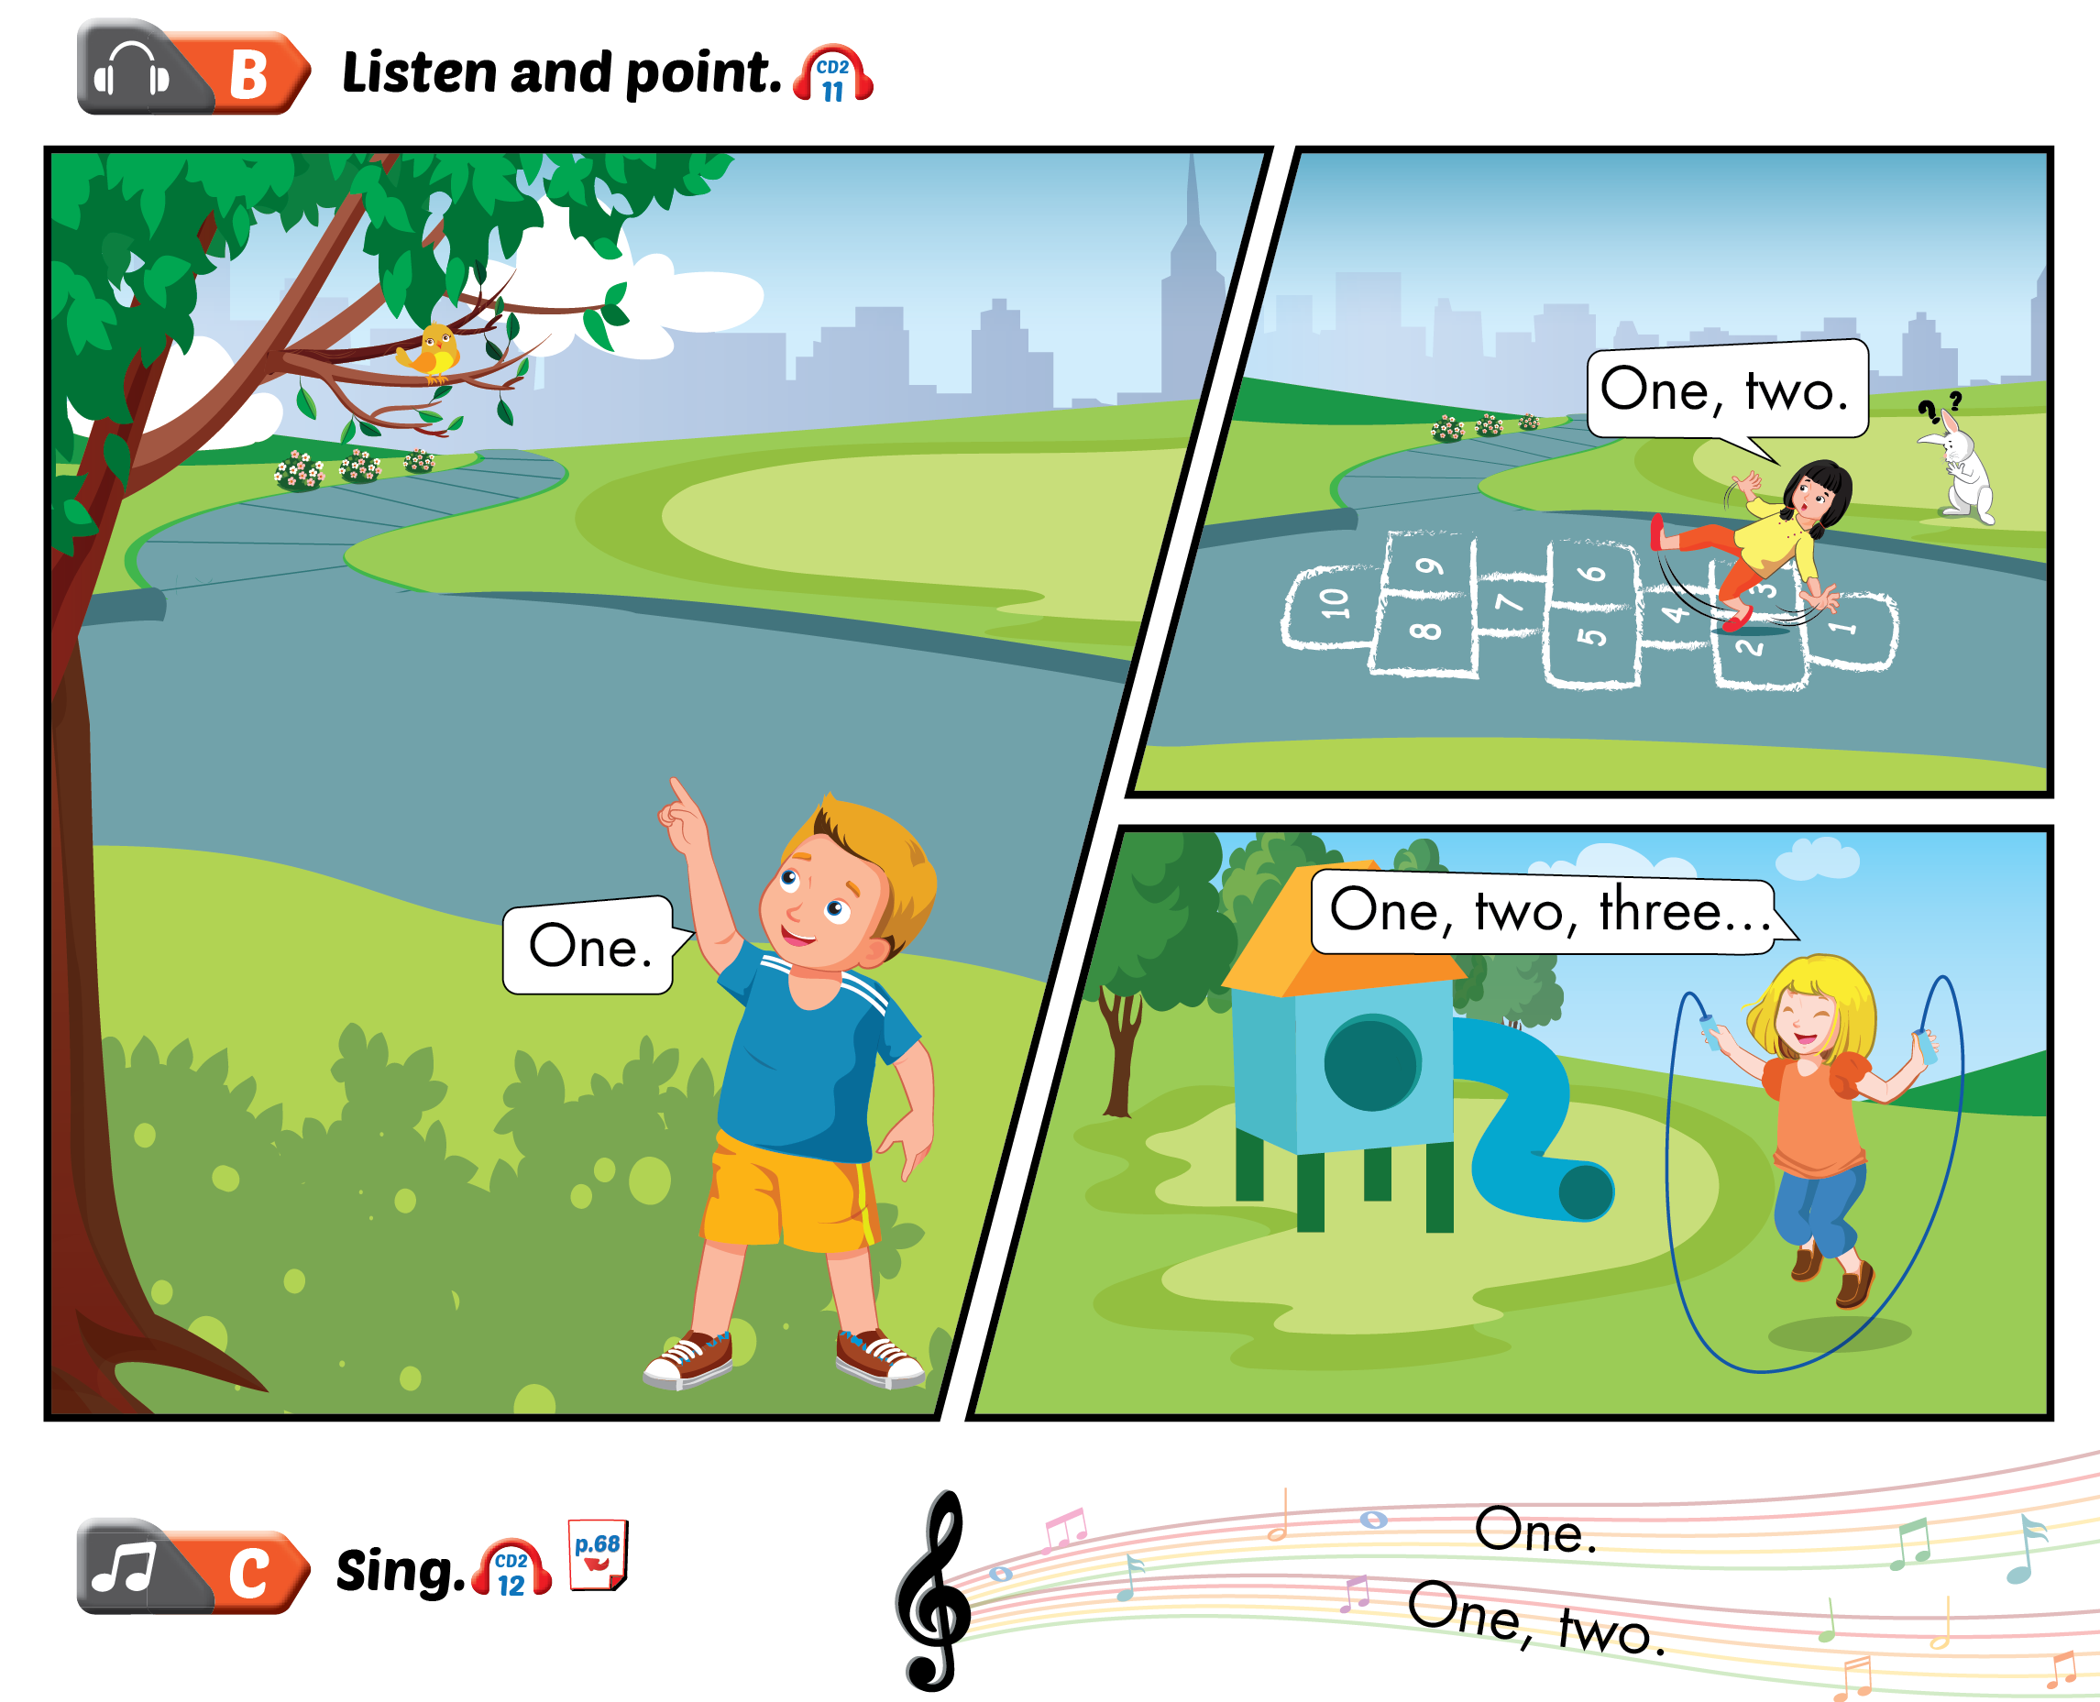

Slide 10

How can we write number 1,2,3?
Step 2

Slide 11










Slide 12



Step 3
Game
“Read my lips”

Slide 13

Practice
Step 4
Workbook
Page 42

Slide 14

“Boom cha cha
Time is up”
Thanks and goodbye

