Slide 1


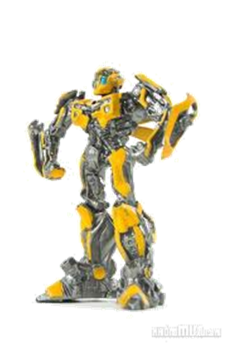
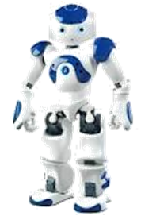
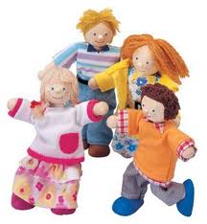
Warm up
five balls
1. You’ve got………………………
got two robbots
2. She’s …….………………………
3. They ……….………………………
‘ve got four dolls

Slide 2

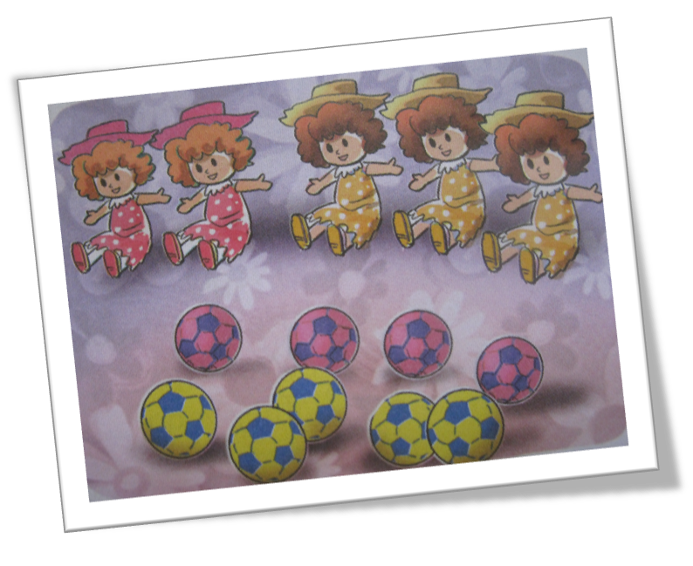

Unit 20 : Our toys (lesson 2)
1. Listen and repeat.
four five
You’ve got two dolls.
I’ve got three dolls.
We’ve got five dolls.
He’s got four balls.
She’s got five balls.
They’ve got nine balls.

Slide 3
Unit 20 : Our toys (lesson 2)
1. Listen and repeat.
four five
You’ve got two dolls.
I’ve got three dolls.
We’ve got five dolls.
He’s got four balls.
She’s got five balls.
They’ve got nine balls.
Notes:
3

Slide 4
Unit 20 : Our toys (lesson 2)
1. Listen and repeat.
four five
You………….. two dolls.
I…………… three dolls.
We………….. five dolls.
He…………. four balls.
She……………. five balls.
They………….. nine balls.

Slide 5
Unit 20 : Our toys (lesson 2)
1. Listen and repeat.
four five
You’ve got two dolls.
I’ve got three dolls.
We’ve got five dolls.
He’s got four balls.
She’s got five balls.
They’ve got nine balls.

Slide 6
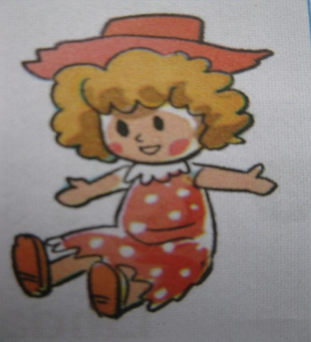
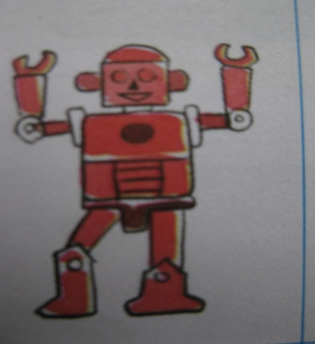
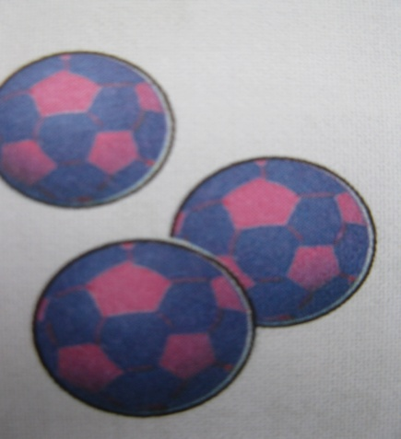
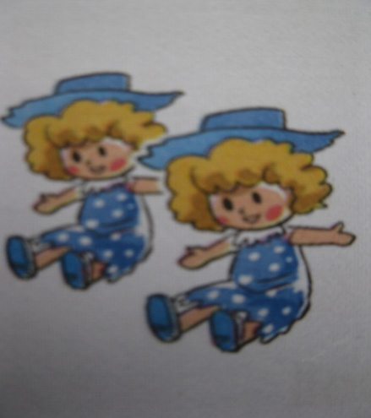
Unit 20 : Our toys (lesson 2)
1
2
3
4
Notes:
6

Slide 7
Unit 20 : Our toys (lesson 2)
1
2
3
4

Slide 8
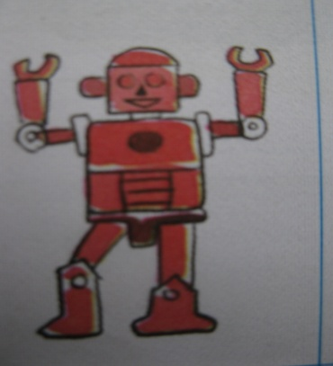




Unit 20 : Our toys (lesson 2)
2.Listen and tick.
1.Peter
2.Linda
3.Tom
4. Mary

Slide 9
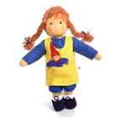
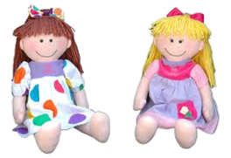
Unit 20 : Our toys (lesson 2)
Kim's game

