Slide 1


Slide 2



WARM-UP
Play game : Ai nhanh ai đúng?

Slide 3

Unit 19: Our Pets
Lesson 3 :3,4

Slide 4

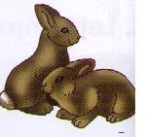
3.Write
How many … have you got?
How many rabbits have you got?
I’ve got ....................
I’ve got two rabbits.

Slide 5
3.Write
I’ve got ....................
I’ve got four rabbits.

Slide 6
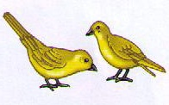
3.Write
Mime and guess
I’ve got ....................
I’ve got two birds.

Slide 7
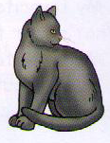
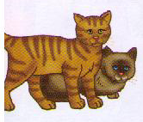
3.Write
Mime and guess
I’ve got ....................
I’ve got three cats.

Slide 8
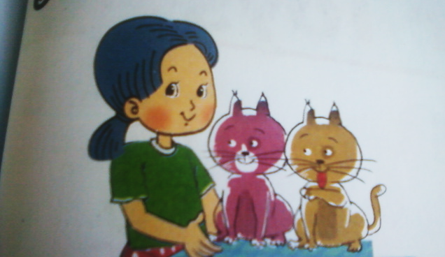
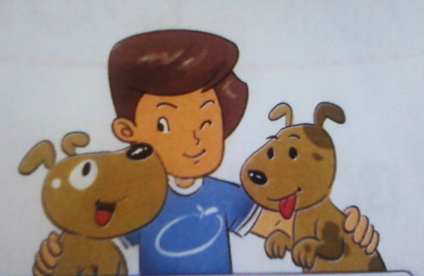
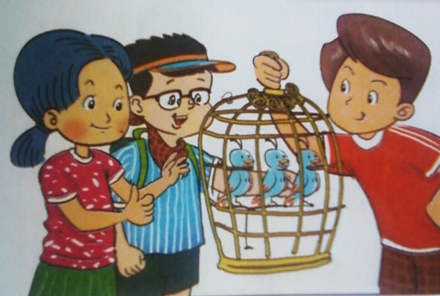
3.Write
1. I’ve got ………..
2. I’ve got ……………
3. They’ve got ……………………..

Slide 9
3.Write
1. I’ve got two cats.
2. I’ve got two dogs.
3. They’ve got three birds.

Slide 10
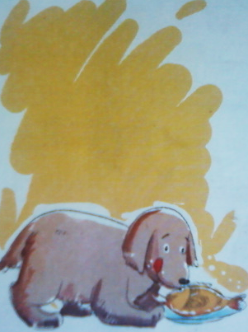
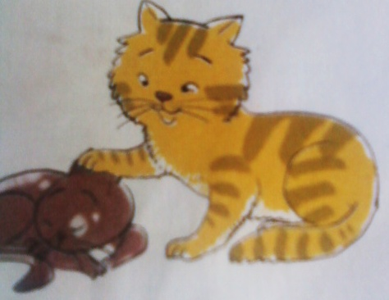
4.Let’s chant
Pets !Pets !Pets !
We’ve got pets.
I’ve got a dog.
He hasn’t got a dog.
He’s got a big cat.
And a small cat.
Pets !Pets !Pets !
We’ve got pets.

Slide 11
4.Let’s chant
Pets !Pets !Pets !
We’ve got pets.
I’ve got a dog.
He hasn’t got a dog

Slide 12
4.Let’s chant
He’s got a big cat.
And a small cat.
Pets !Pets !Pets !
We’ve got pets.

Slide 13
4.Let’s chant
Pets !Pets !Pets !
We’ve got pets.
I’ve got a dog.
He hasn’t got a dog.
He’s got a big cat.
And a small cat.
Pets !Pets !Pets !
We’ve got pets.

Slide 14
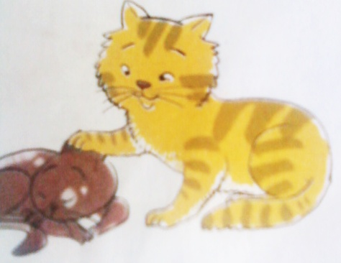
4.Let’s chant
Pets !Pets !Pets !
We’ve got pets.
I’ve got a dog.
He hasn’t got a dog.
He’s got a big cat.
And a small cat.
Pets !Pets !Pets !
We’ve got pets.

Slide 15
Play game :
Lucky number

Slide 16
Lucky number
1
2
3
4
5
6
7
8
7
2
8
5
3
5
10
1
4
6
10
8
1
2
3
4
6
7
9
9
Team A
Team B

Slide 17
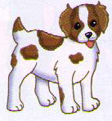
I’ve got …………
I’ve got three dogs.

Slide 18
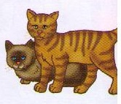
How many ……………. have you got ?
How many cats have you got ?

Slide 19
They’ve got ……………..
They’ve got three cats .

Slide 20

Lucky number

Slide 21
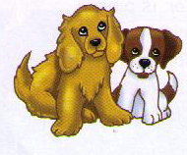
How many … have you got ?
How many dogs have you got ?

Slide 22
Lucky number

Slide 23
I’ve got ……………
I’ve got six birds.

Slide 24
They’ve got ……………
They’ve got six birds.

Slide 25

Homework:
Review the lesson
Prepare new lesson: unit 20: Our toys(lesson1:1,2)
Unit 19: Our Pets
Lesson 3 :3,4
3.Write
4.Let’s chant

