Slide 1
Kiểm tra bài cũ
1.Is / the /where / book ?
Where is the book?
2. On / It / the / is / table.
It is on the table.
3 .Lamp/ where / the / is ?
Where is the lamp ?
4. Next to / is / the / It /table.
It is next to the table.
5. There / a picture/is /on /the / wall.
There is a picture on the wall.
6. are / there / chairs / two/ the /behind / table
There are two chairs behind the table.

Slide 2

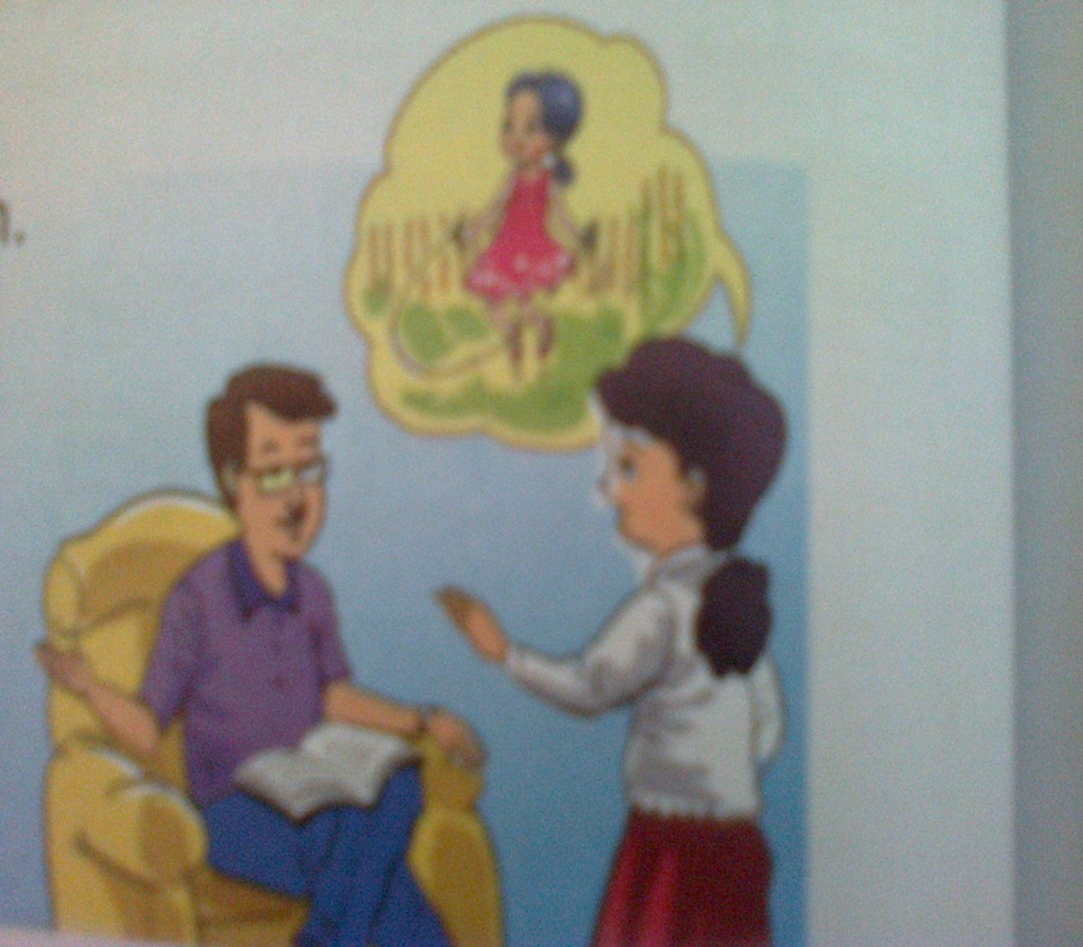
Unit 15 : AT HOME
Lesson 1
1. Look listen and repeat
Doing - làm
Skipping – nhảy dây

Slide 3

Unit 15 : AT HOME
1. Look listen and repeat
Mr Thanh : Where is Mai ?
Mrs Lan : She’s in the garden.
Mr Thanh : What’s she doing ?
Mrs Lan : She’s skipping.

Slide 4
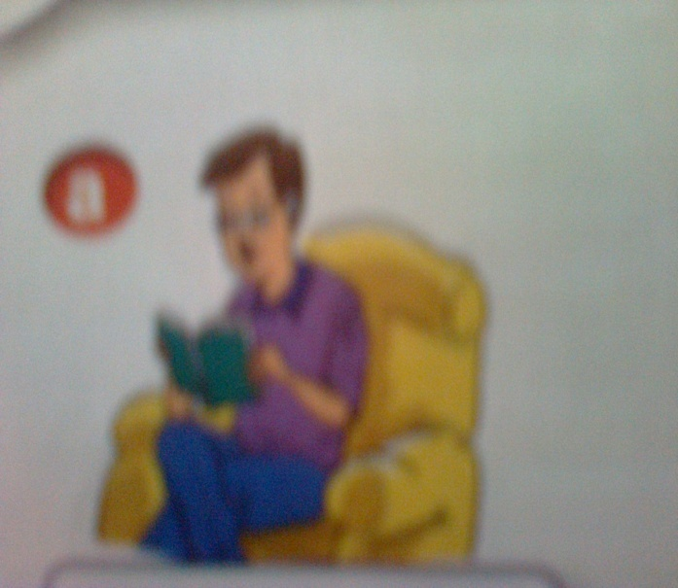
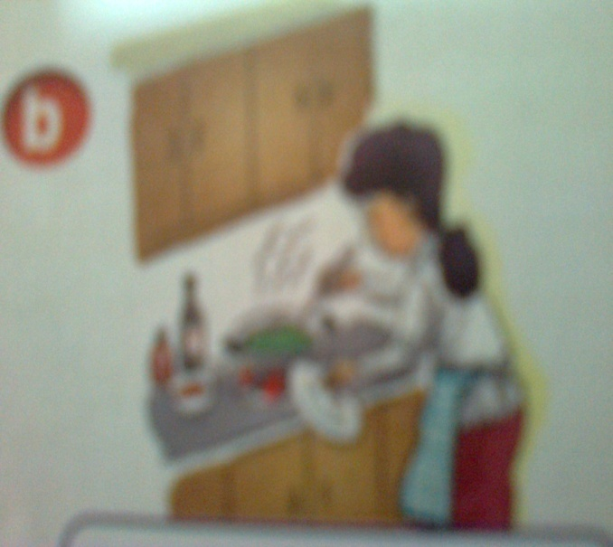
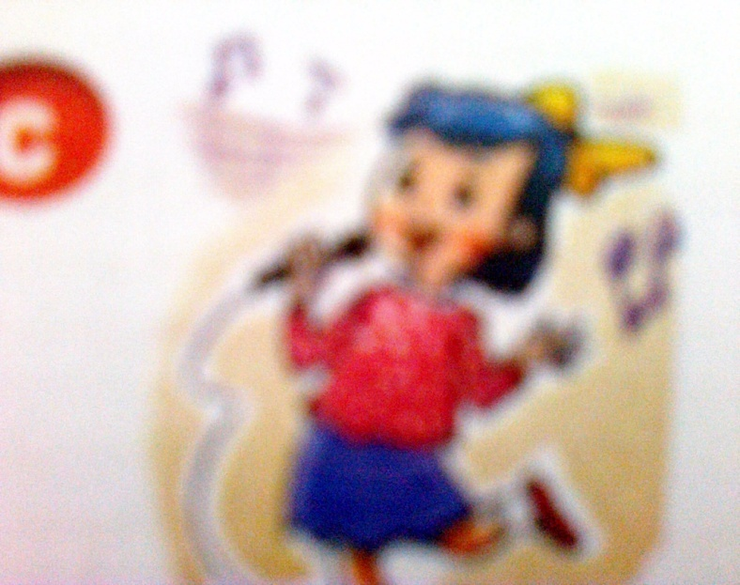
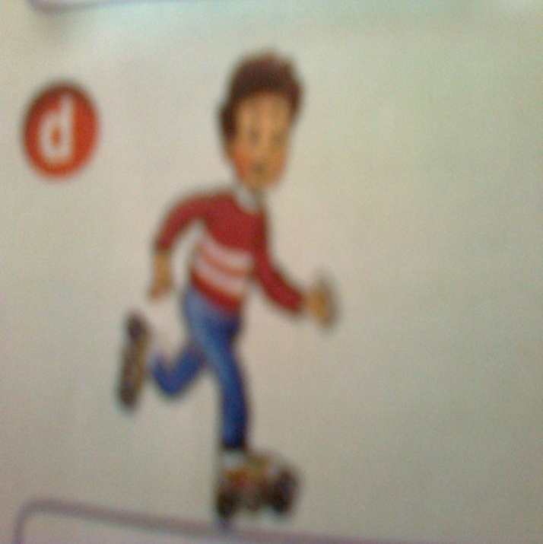
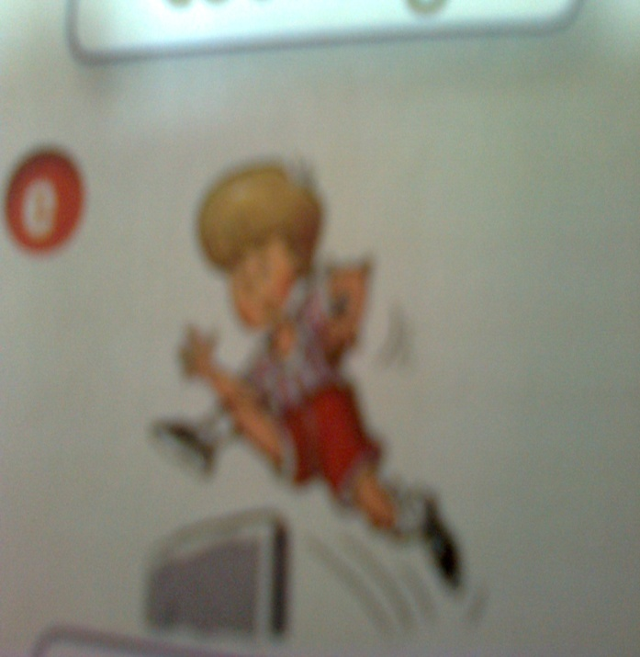
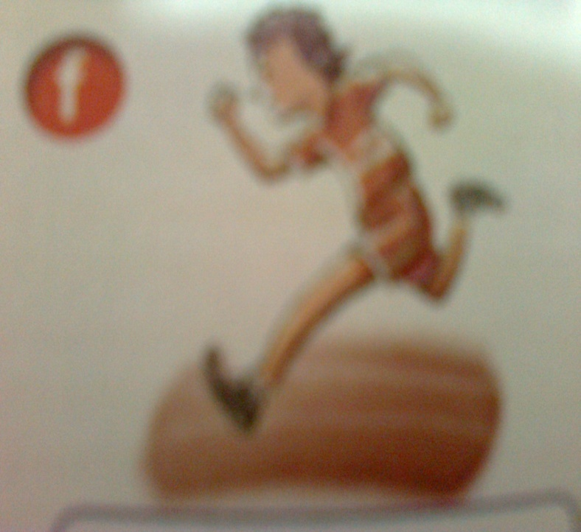
Unit 15 : AT HOME
2. Look and say
reading
cooking
singing
skating
jumping
running

Slide 5
Unit 15 : AT HOME
- Mâu câu : Hỏi và trả lời một ai đó đang làm gì .
What ‘s he / she doing ?
He / she’s + v(ing).
What is =what’s
He is = he’s
She is = she’s
V(ing ) = động từ thêm đuôi ing. ( ex : read +ing = reading)

Slide 6


Unit 15 : AT HOME
+ practice
What is he doing ?
- He’s reading.
What is she doing ?
- She’s cooking.

Slide 7
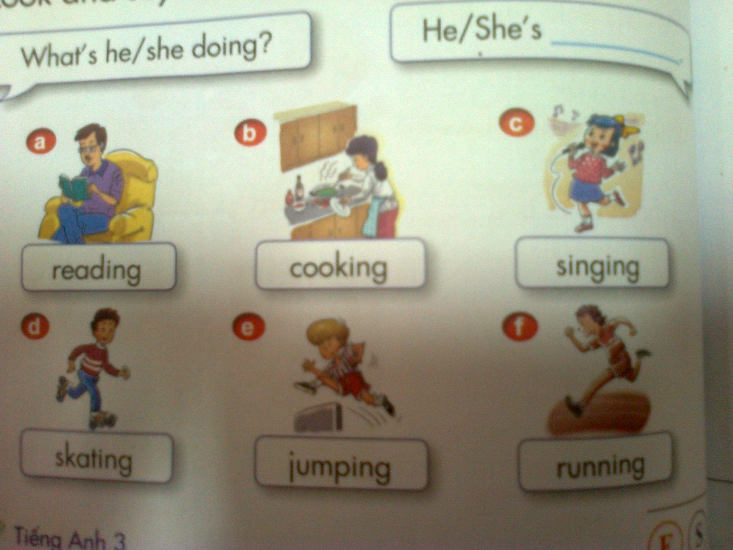
Unit 15 : AT HOME

Slide 8
Unit 15 : AT HOME
is
1. What …………Nam doing ?
2. ……..is playing chess.
He
is
3. What …………Van doing ?
4. …….. ………. Chatting .
She
is
5. What …………you doing ?
are
6. I ……..reading.
am

Slide 9

Homework
Learn by heart the vocabulary
and the pattern.

