Slide 1
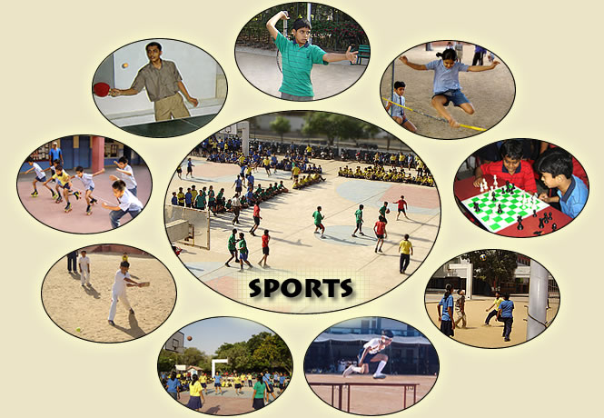
Unit 8. Sports and games
Lesson 3. A closer look 2

Slide 2
Grammar
THE PAST SIMPLE
Minh went to school yesterday.
Peter didn’t do his homework last night.
Did you tell him about the picnic?
went
didn’t do
Did you tell

Slide 3
I. FORMATION:
a) TO BE (WAS / WERE )
+ | I / He / She / It | was | at school yesterday.
 | We / You / They | were
- | I / He/ She / It | was not (wasn’t) | at the beach last week.
 | We / You / They | were not (weren’t)
? | Was | I / he / she / it | hungry?
 | Were | we / you / they
Yes, he was
No, he wasn’t
Yes, they were
No, they weren’t

Slide 4
b) ORDINARY VERBS
* Affirmative:
Work – worked – worked
Go – went – gone
Buy – bought – bought
S + | Regular VERB (-ed) | + ….
 | Irregular VERB (II)
Ex:
They worked in the garden yesterday.
He went to school yesterday.
I bought a new pair of shoes last night.

Slide 5
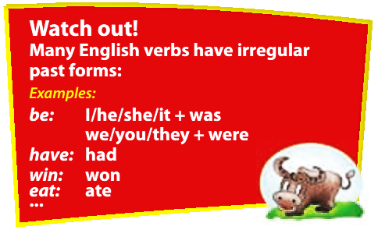

Slide 6
b) ORDINARY VERBS
* Negative:
S + | Did | + NOT | + Verb (in simple form) | + O / C
 | didn’t
Ex:
They didn’t work in the garden yesterday.
He didn’t go to school yesterday.
I didn’t buy a new pair of shoes last night.

Slide 7
b) ORDINARY VERBS
* Interrogative:
(Wh-) | Did + | S + | Verb (in simple form) | + O / C ...?
Ex:
Did he go to school yesterday?
Did they work in the garden yesterday?
Did you buy a new pair of shoes last night?
What did you buy last night?

Slide 8
b) ORDINARY VERBS
* Interrogative:
Ex:
Did he go to school yesterday?
Answer:
Yes, he did.
Yes, he went to school yesterday.
No, he didn’t.
No, he didn’t go to school yesterday.

Slide 9
SUMMARY:
ORDINARY VERBS
Affirmative:
S + | Regular VERB (-ed) | + O / C
 | Irregular VERB (II)
Negative:
S + | DID + | NOT | + Verb (in simple form) | + O / C
 | didn’t
Interrogative:
(Wh-) | Did + | S + | Verb (in simple form) | + O / C ...?

Slide 10
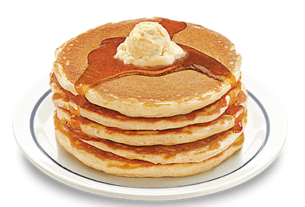
II. USES
WE USE SİMPLE PAST TENSE TO TALK ABOUT
1. Completed actions in the past.
My mom made some pancakes for us yesterday.
2. A series of completed actions in the past.
Yesterday I finished my work, walked to the beach, and found a nice place to swim.

Slide 11
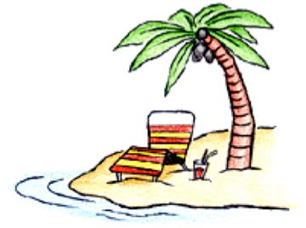
II. USES
WE USE SİMPLE PAST TENSE TO TALK ABOUT
3. Habitual or repeated actions in the past, often goes with Adverbs of frequency (always, usually, often, sometimes, seldom, never).
I always went to the beach when I lived in Nha Trang 5 years ago.

Slide 12
* Markers: (Dấu hiệu nhận biết thì quá khứ đơn)
Yesterday
Last (night / week / month / year / Christmas / Sunday / …)
Ago
In + past year (in 2010)
In the past
Since + S + V (since I was young)
When / while + Short actions in the past
(When I saw him, he was eating an apple)

Slide 13
RULES FOR ADDING –ed:
Add –ed to most verbs
Drop the “e” and add “ed” to verbs that end with “mute -e” (smile = smiled).
Change the “y” to “i” and add –ed to verbs that end with a consonant and “y” (vowel) (carry = carried, study = studied).
Double the consonant and add –ed to verbs that end with one vowel and one consonant ( drag= dragged, stop= stopped).
Be careful with verbs like Mix, Fix → Fixed.

Slide 14
The ways to pronounce _ed at the end of ordinary verbs
Cách đọc | Âm cuối | Ví dụ
/ d /
(các âm còn lại ngoài 2 nguyên tắc riêng dưới đây)
answered, played, begged, allowed
(nguyên tắc chung)
/ ɪd /
d, t
visited, needed, mended, wanted
(nguyên tắc riêng 1)
(đạn tịt)
k, x, s, p, ch, sh, f
looked, faxed, passed, stopped, watched, washed, laughed
/ t /
(nguyên tắc riêng 2)
[khi xuống sông phải coi chừng cô ấy (she) té (falls)]

Slide 15
1. Complete the sentences with did, was, or were.
was
1. The 2012 Olympic Games ____ held in London.
2. - Who _______ the first man on the Moon?
- Neil Armstrong.
3. - I _____ at the gym last Sunday, but I ______ not see you there.
- No, I _____ at my aunt’s house.
4. - _____ you climb Mount Fansipan when you _____ in Sapa?
- Yes, I ____. It ____ tiring, but very interesting.
was
was
did
was
Did
were
did
was

Slide 16
2. Write the correct form of the verbs to complete the conversation.
Nick: Hi there.
Sonny: Hello, Nick. Did you have a nice weekend?
Nick: Yeah, it (1. be) ____ OK. I (2. not do) _______ much. I just (3. sit) ____ at home and (4. watch) ________ TV. On Saturday afternoon, I (5. go) ______ fishing with my dad. How about you?
Sonny: Oh, I (6. have) ______ a good weekend.
Nick: Really? What (7. do) ______ you do?
Sonny: I (8. visit) _______ the museum with my family. Then we (9. eat) ___ at my favourite restaurant.
Nick: Did you watch football on Sunday?
Sonny: Oh, yeah. The player (10. score) ________ a fantastic goal.
was
didn’t do
sat
watched
went
had
did
visited
ate
scored

Slide 17
3. Work in groups. Ask and answer questions about last weekend.
Now let’s make a survey to find out what the members in your group did last weekend, then I’ll call some of you to report your survey.
Examples:
A: Did you do any sport last weekend?
B: Oh yes, and I was exhausted.
A: Really? What did you do?

Slide 18
Then make a table like this to take notes.
Name | Yesterday’s activities
1. Le Van Teo | Stayed at home Did the homework Helped mum with cooking Played chess ….
2.
3.
Model report: I ask Le Van Teo what he did last weekend. He told me that he stayed at home. He did his homework, helped his mum with cooking and played chess with his brother.

Slide 19
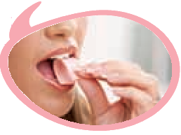

IMPERATIVES (thể mệnh lệnh)
Example:
It’s chewing gum.
Chew it.
Don’t swallow it.
It’s chewing gum.
Chew it.
Don’t swallow it.
a) Formation:
(+) Verb + (Object / Complement).
(-) Don’t + Verb + (Object / Complement).
b) Usage:
We use imperatives to tell someone to do something, or to give a direct order.

Slide 20
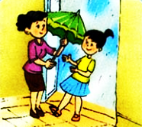




4. Write sentences to tell your friends what to do or not to do.
1. It’s raining. _____ your umbrella.
Take
don’t
3. It’s late now. Please____ up.
2. Please _____ _______.
litter
get
4. Exercising is good but _________ too hard.
5. It’s cold. ______ on your coat.
put
don’t train

Slide 21

5. Tell your friends what to do and what not to do at the gym.
Examples: - Change your clothes.
- Don’t talk loudly.
Some possible sentences:
Pay your fee first.
Put on your trainers/ sports shoes.
Listen to the instructor carefully.
Don‛t litter.
Don‛t eat or drink at the gym.

Slide 22
Please tell me what you have learnt today.
Yes, through the lesson we can now know when to use the Past Simple, when to Imperatives to make orders or rules.

Slide 23


HOMEWORK
- Revise the grammatical points:
+ The Past Simple.
+ Imperatives.
- Do exercise B1–7 (pages 10,11,12) in workbook
- Prepare for Unit 8: COMMUNICATION.
+

Slide 24

THANKS FOR YOUR ATTENTION!
Goodbye!
See you again!

