Slide 1
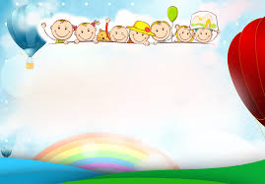
WARMLY WELCOME TEACHERS TO CLASS 7D

Slide 2
BRAINSTORMING
I. Warm- up
Vietnamese traditional art forms

Slide 3
Suggested answers:
Chèo
Múa rối nước
Tuồng
Vietnamese traditional art forms
Cải lương
Hát xẩm
Trầu văn
Hát xoan
Quan họ

Slide 4

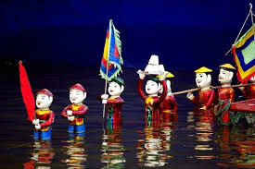
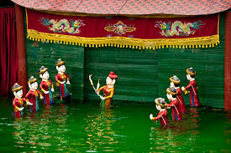
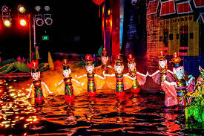
- What kind of traditional Vietnamese performance do you know about? - Do you know about water puppetry? Have you been to a water puppet show? If yes, did you like it? Why/Why not?

Slide 5
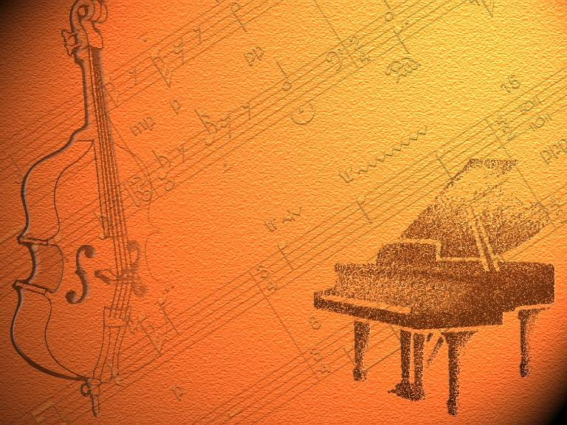

UNIT 4
MUSIC AND ARTS
Period 30
SKILLS 1

Slide 6

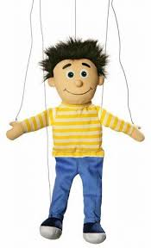
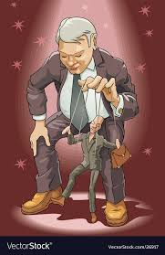
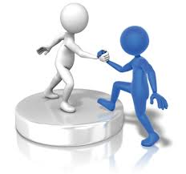
II. READING
1. New words

Slide 7
* Complete the sentences using the words in the box
supported / puppeteers /strings/ originated /water puppetry
The puppets are controlled by the …………….
behind a screen.
2. The Beatles band ……………. in Liverpool, England.
3. ……………….. is a traditional art form in Viet Nam.
4. The puppeteers use ……………. to control the puppets.
5. My family has ………………….. me in whatever I've wanted to do
puppeteers
originated
Water puppetry
strings
supported

Slide 8

2. Find the words in the text which mean.
special or different
Started
Showed or presented
From the countryside
Events or celebrations

Slide 9

3. Answer the following questions.
When did water puppetry begin?
Where does a water puppet show take place?
Who are the puppets controlled by?
What are the puppets made of?
What are water puppet shows normally about?
* GAME: Magic garden

Slide 10

III. SPEAKING
1. Match the types of music in A with the adjectives to describe them in B.
A | B
1. pop | old, emotional
2. folk music | b. Finely, exciting
3. Rock and roll | c. Quick
4. Hip-hop/ rap | d. Sad, melodic
5. blues | e. Popular, pleasant

Slide 11
* Game: tic tac toe
1. Give the names of two Vietnamese musical instruments.
2. Sing a song in English.
3. Who is your favorite singer? Why?
4. Talk for 30 seconds about what you see when you visit an art gallery.
5. How often do you go to a concert? Tell your partner about the last concert you went to.
6. Who is your favorite Vietnamese musician? Why?
7. Talk about 30 seconds about your favorite instrument.
8. Name one of your favorite painters.
9. Who can draw the best in your class? What does he/ she often draw?

Slide 12

THE “ Dos” IN SPEAKING
Confident, friendly, eye-contact with excitement
Try using high level words:
( food -> cuisine; I like -> I adore, I prefer….)
Elaborate on your answers with reasons and examples
Use linking words

Slide 13
For example:
Who is your favorite singer? Why?
Not good answer It’s Son Tung MTP, I like him. | Good answer The singer I adore the most is Son Tung MTP. Son Tung is a talented young singer and composer. He is well-known by his serious work and dedication to music. The songs such as “ Hay trao cho anh” or “ Em của ngày hôm qua” made the most viewed clips on Youtube. I love his effort in his career and I am his massive fan.

Slide 14


2. GROUP WORK
1. Give the names of two Vietnamese musical instruments.
2. Sing a song in English.
3. Who is your favorite singer? Why?
4. Talk about what you see when you visit an art gallery.
5. How often do you go to a concert? Tell your partner about the last concert you went to.
6. Who is your favorite Vietnamese musician? Why?
7. Talk about about your favorite instrument.
8. Name one of your favorite painters.
9. Who can draw the best in your class? What does he/ she often draw?

Slide 15
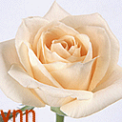
*CONSOLIDATION:
What is the text about?
Music B. Water puppetry C. musical instrument
2. When did it begin?
A. In the 11th century B.In the 12th century
C. In the 15th century
3. Where did it originate ?
In the villages of the Red River Delta of North Viet Nam.
In the villages of the Mekong River Delta.
In the villages of Highland.

Slide 16

iv. homework
Learn new words by heart.
Do exercises D1, D2, D3 (p.33, 34 in workbook).
Prepare SKILLS 2.

Slide 17

THANKS FOR YOUR LISTENING!

