Slide 1
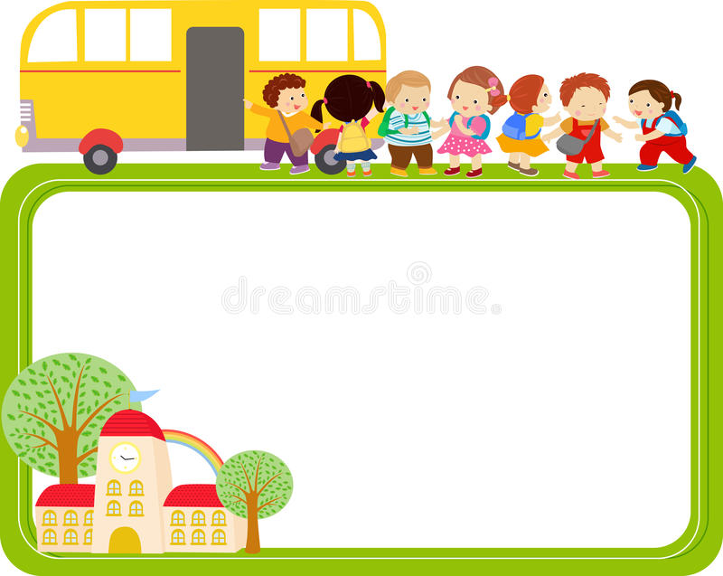



Warmly welcome teachers to class 7D .
Teacher: VU THI HA THANH

Slide 2
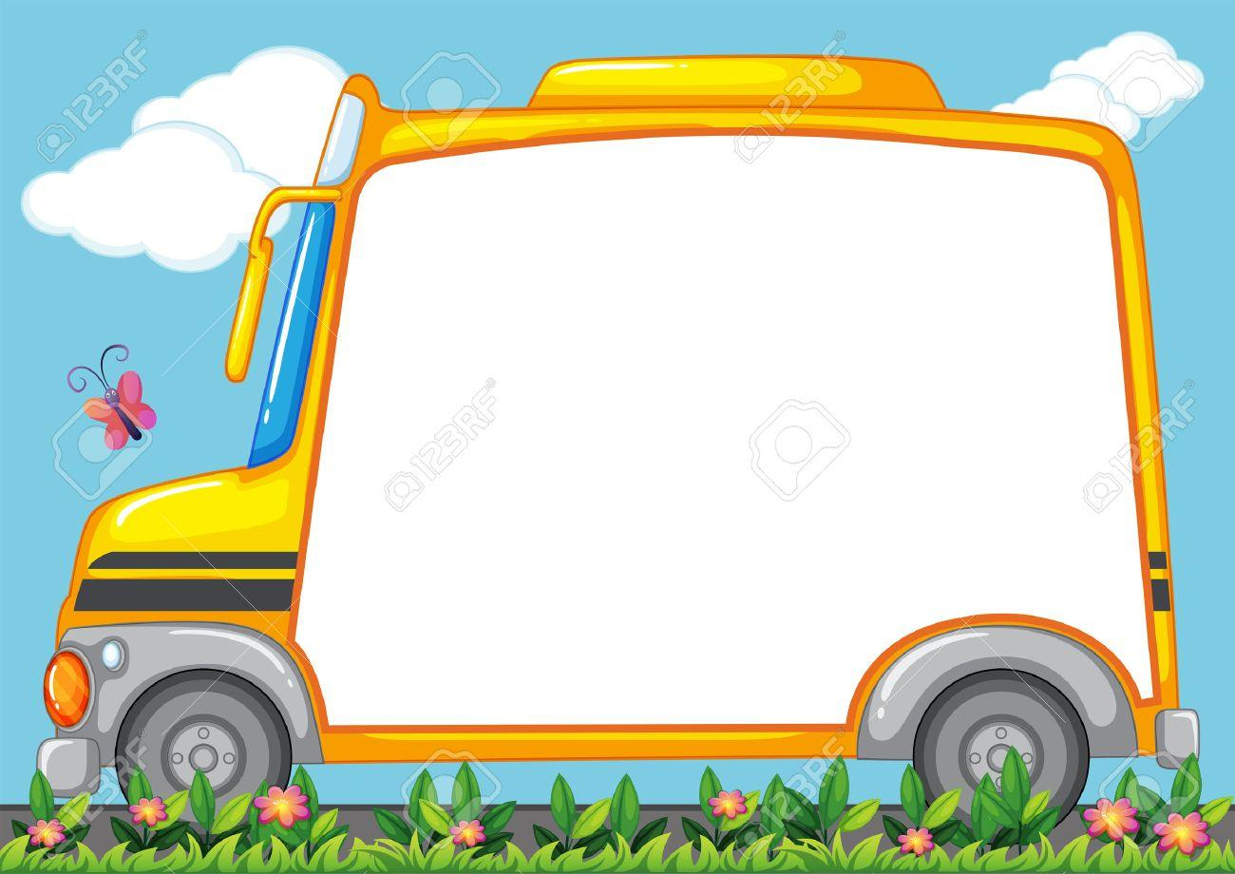


Slide 3


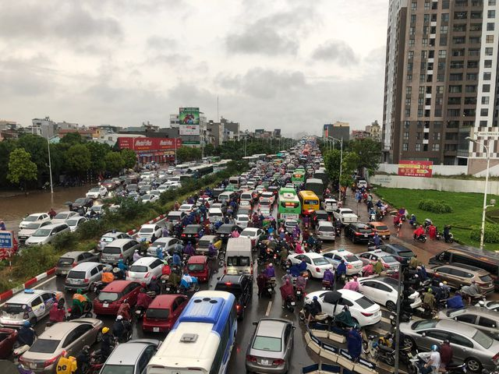
Traffic jam
/ˈtræf.ɪk ˌdʒæm/

Slide 4
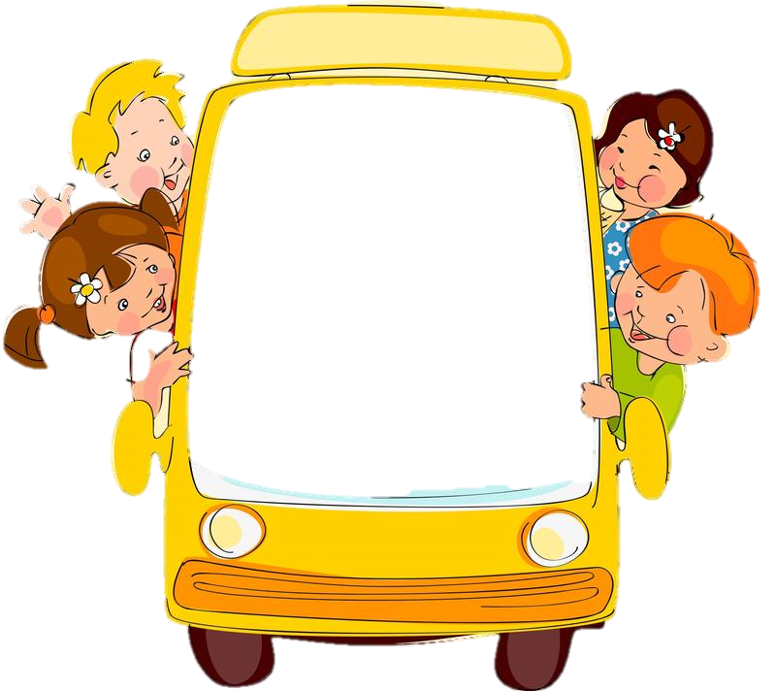
Except
/ɪkˈsept/

Slide 5
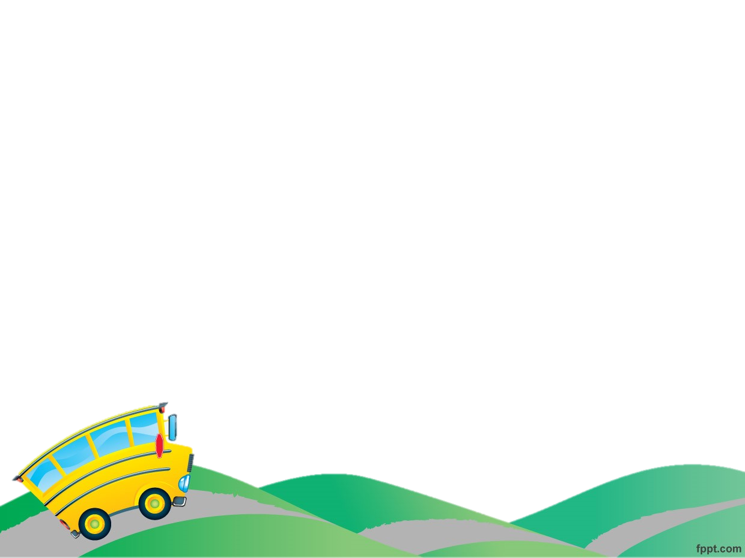
Complete the sentences with the words below
Traffic jams
except
Traffic light
There are always………………in big cities, especially in Hanoi and Ho Chi Minh City.
2. Workers go to work everyday …………Sunday

Slide 6

Choose the correct answer
1.What did Mai do yesterday afternoon?
A.She stayed at home with her brother.
B.She rode her bike around the lake.
C.She walked round the lake.
2.Oanh says that it’s healthy to __________.
A.cycle
B.walk
C.stay home
3.Mai used to go to school __________.
A.by car
B.on foot
C.by bicycle

Slide 7
Answer the questions
1. What did Mai do on Sunday morning?
2. How far is it from Mai's house to school?
3. Who does Mai usually go to school with?
4. Why does it sometimes take Mai longer to get to school?
5. How does she go to school when her dad is busy?

Slide 8
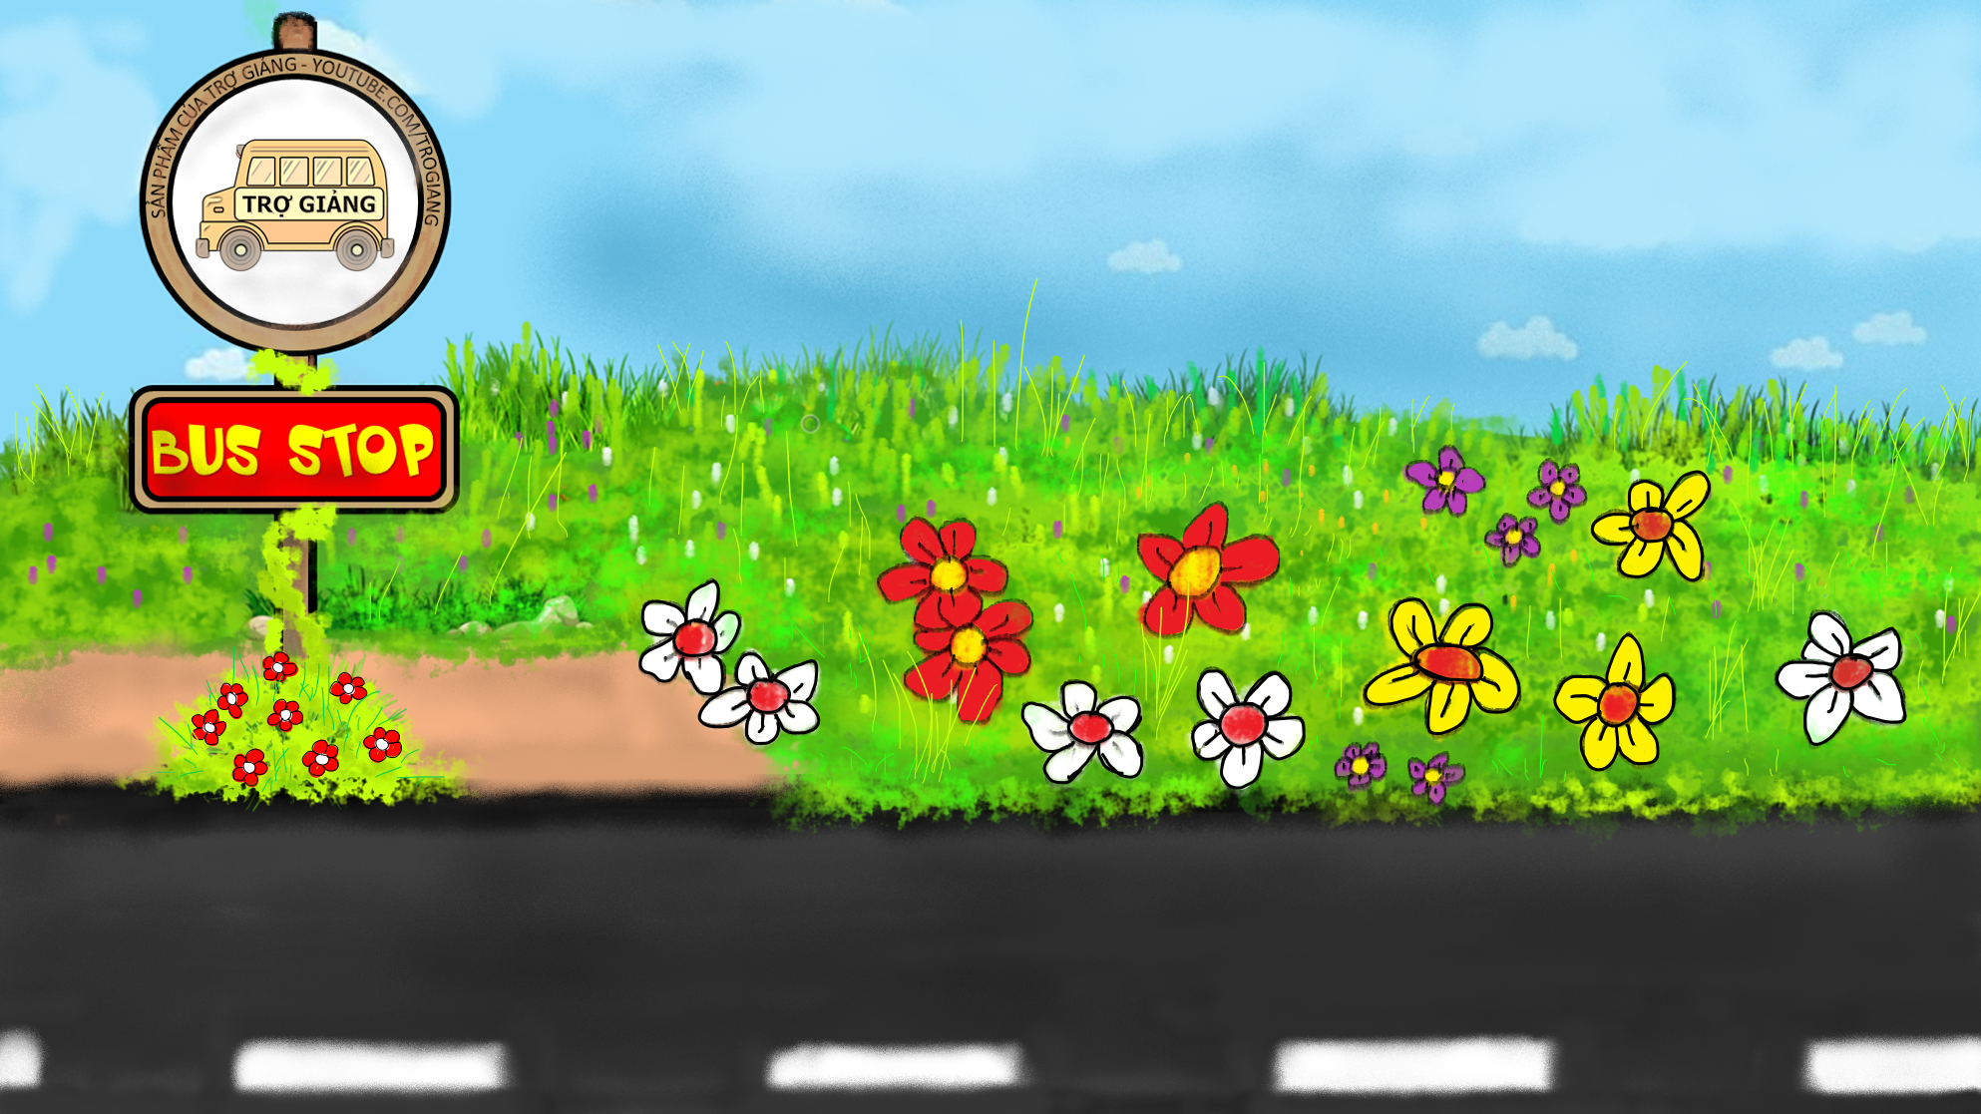





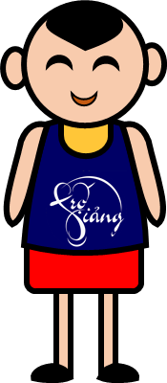

LUCKYBUS
PLAY

Slide 9
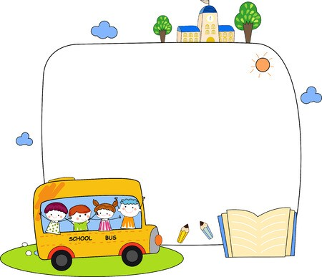
LUẬT CHƠI
Học sinh lần lượt trả lời các câu hỏi của lái xe
Trả lời đúng thì được lên xe
Trả lời sai thì không được lên xe

Slide 10
LUẬT CHƠI
Học sinh lần lượt trả lời các câu hỏi của lái xe
Trả lời đúng thì được lên xe
Trả lời sai thì không được lên xe

Slide 12
1. ride
a. A train
2. drive
b. A boat
3. fly
c. A bus
4. sail
d. A bike
5. get on
e. A car
6. get off
f. A plane

Slide 13
Choose the correct meaning for the expressions:
1.What does the expression “ hey” mean?
A. very excited and keen to do something
B. to get someone’s attention.
C. To support or agree with something
2. What does the expression “great idea” mean?
A. very excited and keen to do something
B. to get someone’s attention.
C. To support or agree with something
3. What does the expression “can’t wait” mean?
A. very excited and keen to do something
B. to get someone’s attention.
C. To support or agree with something

Slide 14
Make short role-plays with the expressions
Example:
A: How about cycling to school with me tomorrow?
B: Great idea!

Slide 15
Survey : Find someone in your class who never

Slide 16
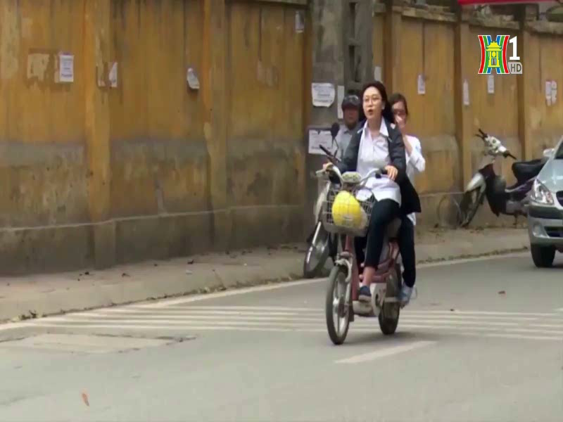

Slide 17
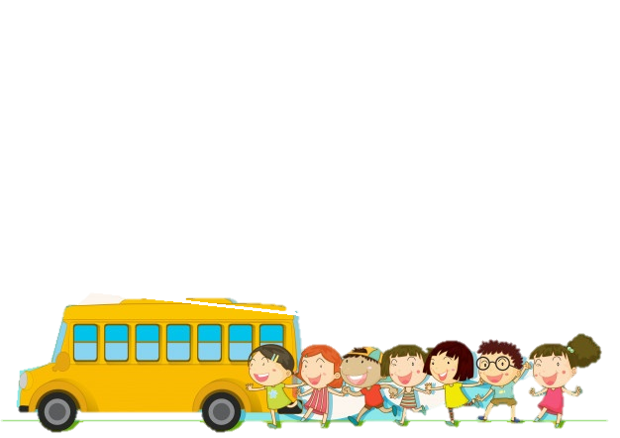
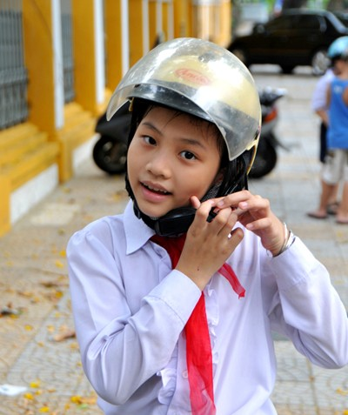
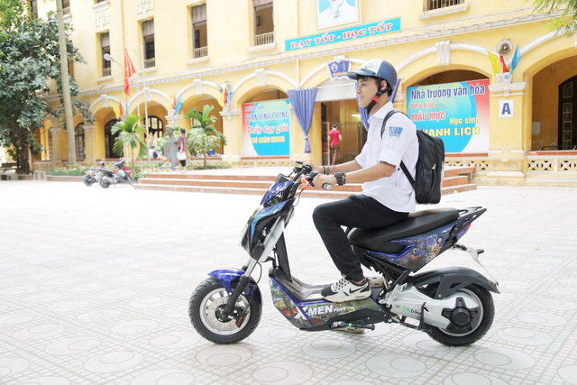
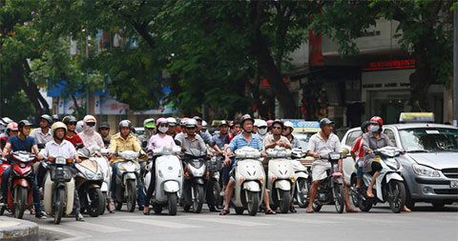
You should:
Always wear a helmet when you drive
Never drive too fast
Strictly obey the road signals

Slide 18
Consolidation: Choose the correct answer
1.How does Mai come to school when her father is busy ?
A. On foot B. By bus C. By taxi D. By car
2.What does the expression “Can’t wait” mean?
A. very excited and keen to do something.
B. to get someone’s attention.
C. to support or agree with something
D. can’t agree with something
3. Nam often ……..a car to work.
A. rides B. sails C. drives D. flies
4.What should you do when you drive a motorbike ?
A. Drive fast and carelessly
B. Wear a helmet
C. Drink beer or wine
D. blow the red light

Slide 19
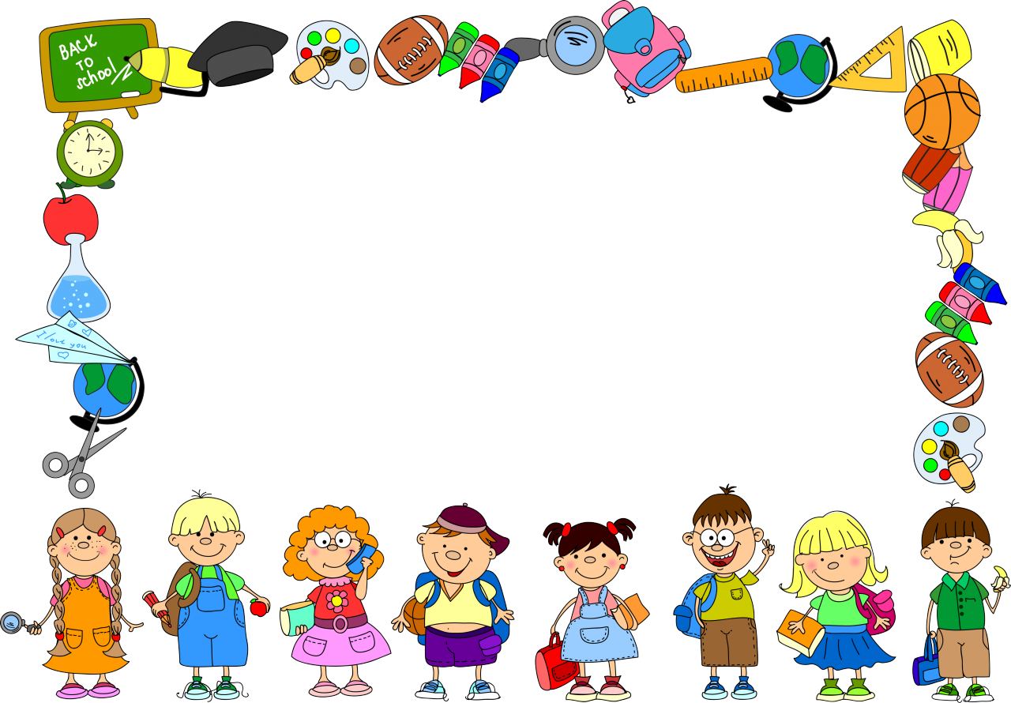
HOMEWORK
Learn by heart new words
- Practice the conversation again
- Prepare A closer look 1

Slide 20


Slide 21
THANKS FOR YOUR LISTENING!.
Teacher: VU THI HA THANH

