Slide 1

WELCOME TO OUR CLASS

Slide 2
I. Revision: Renewable energy song
Let’s listen to the song!

Slide 3

Unit 10. Sources of energy
Period 78: lesson 4. Skills 1

Slide 4

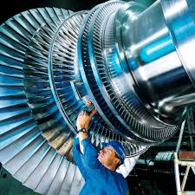
II. Reading
1. New words
- Fossil fuel (n)
: nhiên liệu hóa thạch
- Fortunately (adv) :
≠ unfortunately
may mắn
ko may mắn, rủi ro
- Generate (v):
phát ra
- Alternative (a):
Thay thế, khác
- Turbine (n):
tua bin
- Convert into (v):
biến đổi / chuyển hóa thành
3

Slide 5
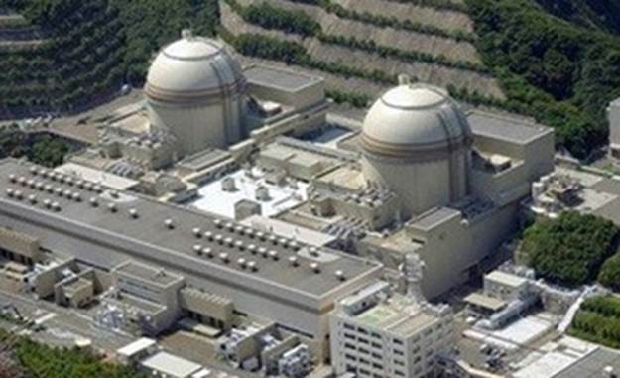
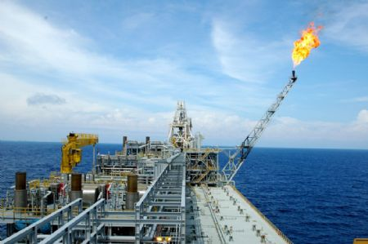
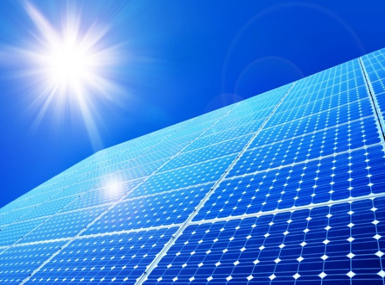
Ii. READING:
2. Look at the picture and discuss with a partner:
1. What are the main sources of energy in Viet Nam?
2, What types of energy sources will be used in the future?

Slide 6
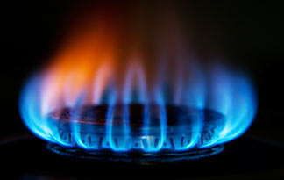
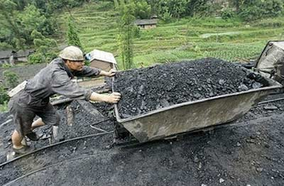
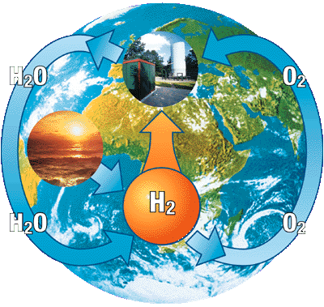

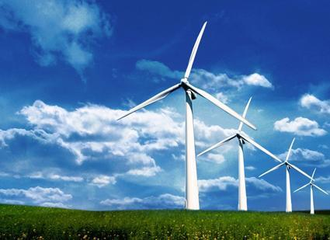
* Read the text and check:
1. What are the main sources of energy in Viet Nam?
2, What types of energy sources will be used in the future?

Slide 7

What is the main idea of each paragraph?
Paragraph 1
Paragraph 2
Paragraph 3
Hydro and nuclear power
Fossil fuels
Sun and wind power

Slide 8
3. Match the verbs with the nouns: (Ex. 3a / p. 44)
1. CREATE
A. MACHINERY
2. DRIVE
B. TURBINES
C. ENERGY
3. GENERATE
4. TURN
D. HOUSES
5. HEAT
E. ELECTRICITY

Slide 9

4.Answer the questions.
1.What types of energy sources are fossil fuels?
=> Fossil fuels are non-renewable sources of energy.
2. Are fossil fuels good or bad for environment?
=> They are bad for environment.
3.Why hydro power is limited?
=> Because dams can not be built in certain areas.
4. Can win and sun power replace fossil fuels in the future?
=> Yes, they can.

Slide 10

III. SPEAKING:

Slide 11


Let’s talk!!!
What is its advantage?
What type is it?
What is its disadvantages?
Sources of energy

Slide 12
Sources of energy | Types of energy | Advangtage(s) | Disadvantage(s)
oil/ coal/ natural gas | non-renewable | create energy generate electricity drive machinery | harmful to the environment
hydro | renewable | generate a great deal of energy | can not build dams in certain areas
nuclear | renewable |  | dangerous
solar | renewable | converted into electricity, heat or coal the houses | not available
wind | renewable | make electricity | not available
Cheap and plentiful
dams cannot be built in certain areas.
hydro
renewable
Generate a great deal of energy
A: What type of energy is oil?
B: It is non-renewable source of energy, because it can not easily be replaced.
A: What are its advantages and disadvantages?
B: It can be used to power machinery. But It also pollutes the
Comes from water
environment.

Slide 13

5. Talk about the advantages and disadvantages of each type of energy source
A: What type of energy is oil?
B: It is non-renewable source of energy, because it can not easily be replaced.
A: What are its advantages and disadvantages?
B: It can be used to power machinery, but it also pollutes the environment.
Example:
Oil is a non-renewable source of energy because it can not easily be replaced. It can be used to power machinery, but it also pollutes the environment .

Slide 14
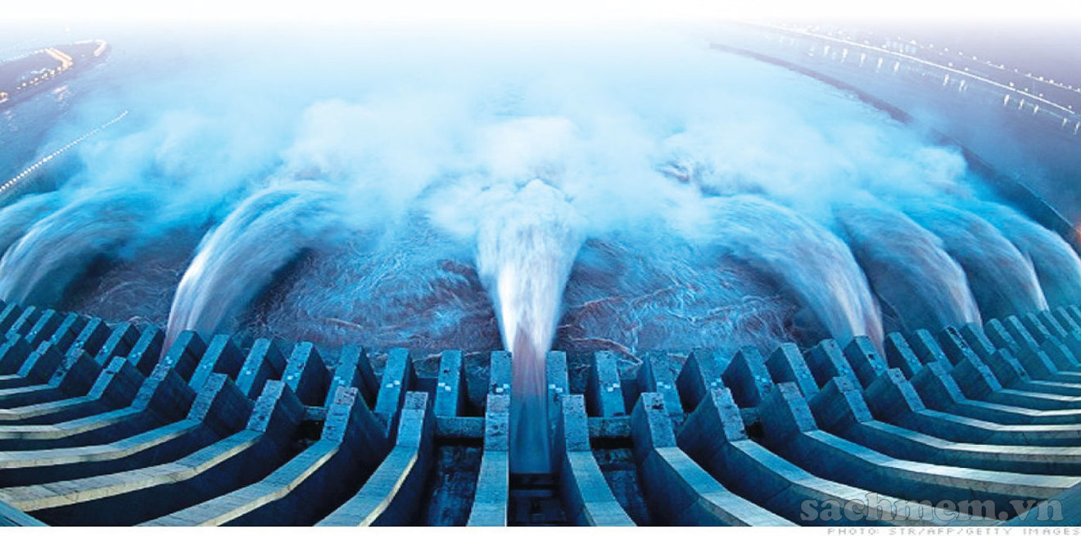
Example:
A: What type of energy is hydro power?
B: It is renewable source of energy, because it comes from water.
A: What are its advantages and disadvantages?
B: It can cheap and plentiful , but dams can only be built in certain areas.
Hydro power is a renewable source of energy because it comes from water. It is cheap and plentiful. Unfortunately, dams can only be built in certain areas.

Slide 15

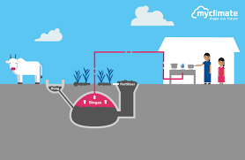

Slide 16

IV. Home work
Learn by heart new words and write each word 2 lines.
Do Ex D1,2 in workbook
Prepare: Skills 2

