Slide 1

WELCOME TO CLASS
UNIT1: MY HOBBIES
COMMUNICATION

Slide 2
Check homework
What do you like or not like doing/hobby? (using liking + V_ing).
How about your family, they like or not like what you do?

Slide 3




Slide 4

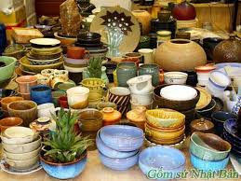
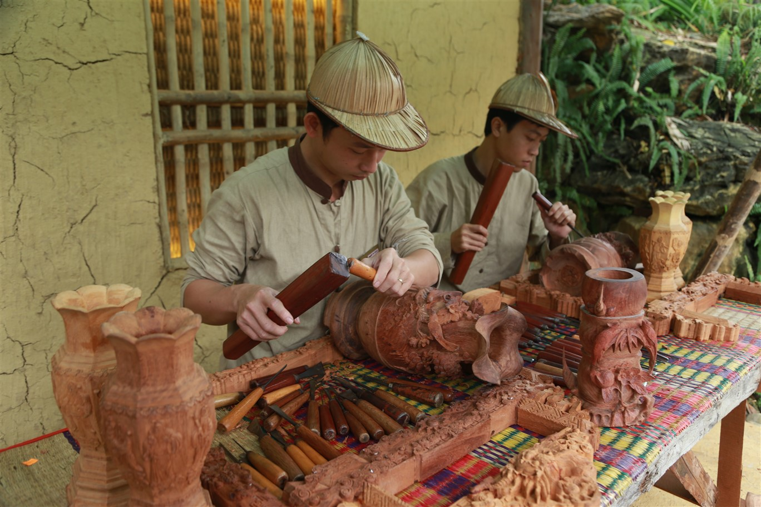
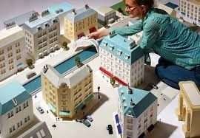
COMMUNICATION
Vocabulary :
- Pottery (n):
Đồ gốm.
- Carve (v):
Điêu khắc.
- Model (n):
Mô hình.
- Take up + sth…
Bắt đầu một thói quen mới.
He took up jogging after his doctor advised him to get some exercise.
What new sport should I take up in my free time?

Slide 5
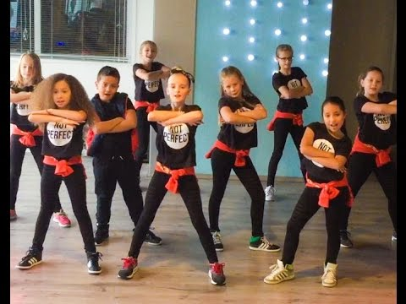
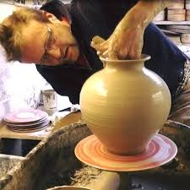
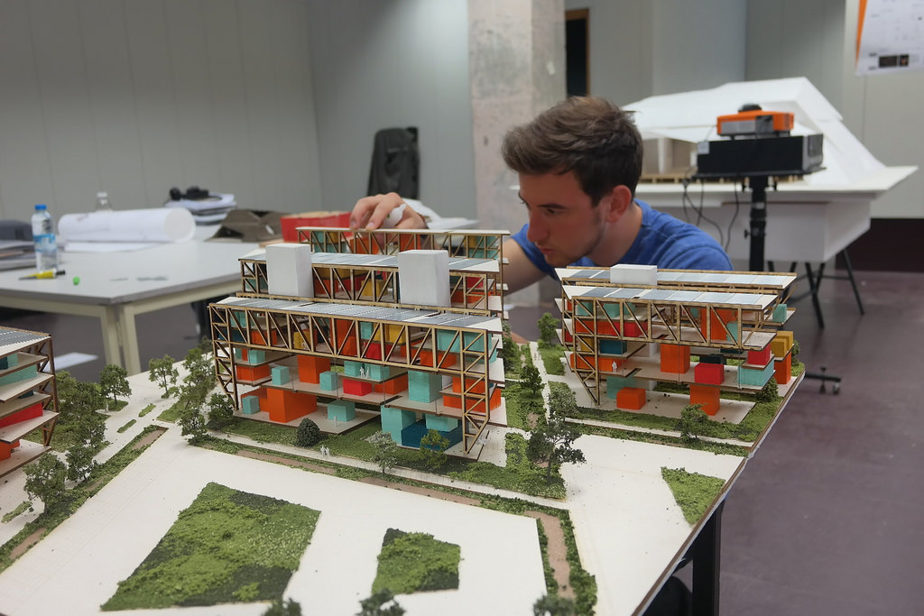
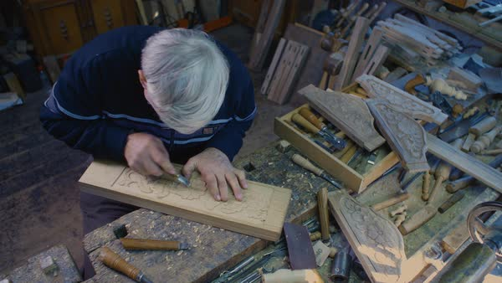
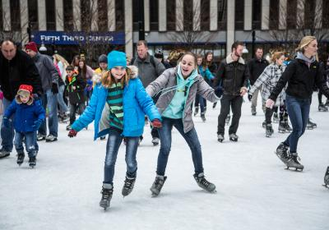

1. Match the activities with the pictures.
Making model
Making pottery
Ice-skating
dancing
Carving wood

Slide 6

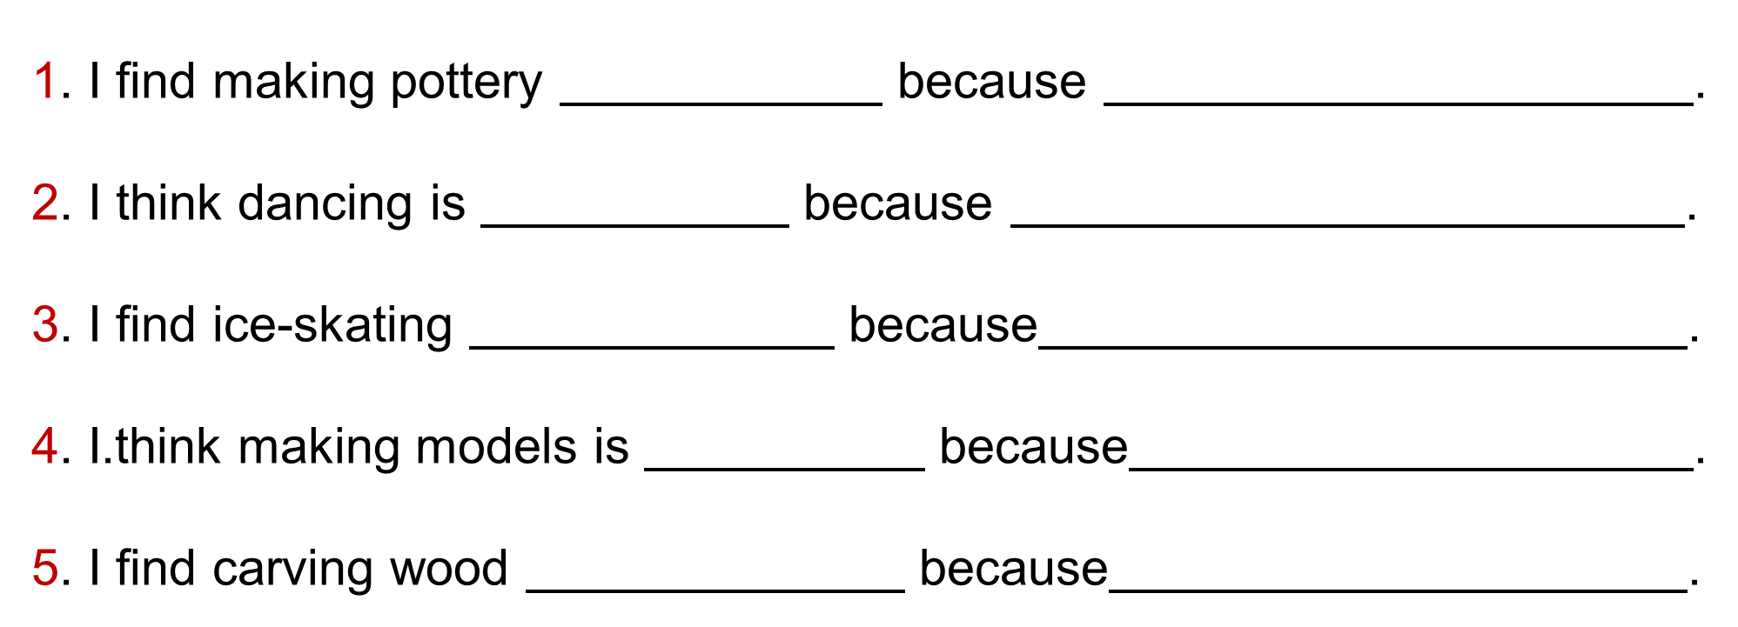
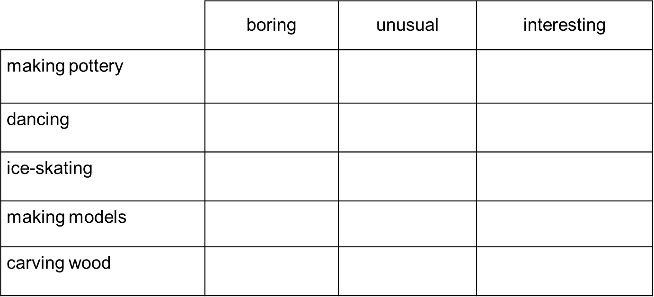
2. What do you think about the hobbies in 1? Look at the table below and tick the boxes. Then, complete the sentences below by writing the reason to explain your choice.

Slide 7
Structure:
S + find sth/ doing sth + adj.
S + think (that) sth/doing sth + tobe + adj.
Example:
I find jogging/ colecting doll interesting.
I think reading book is relaxing

Slide 8
Example:
✓
interesting
it's takes skills to make a pottery product

Slide 9




Slide 10



Slide 11
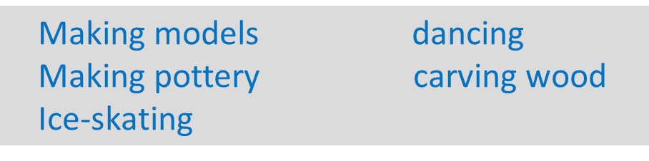
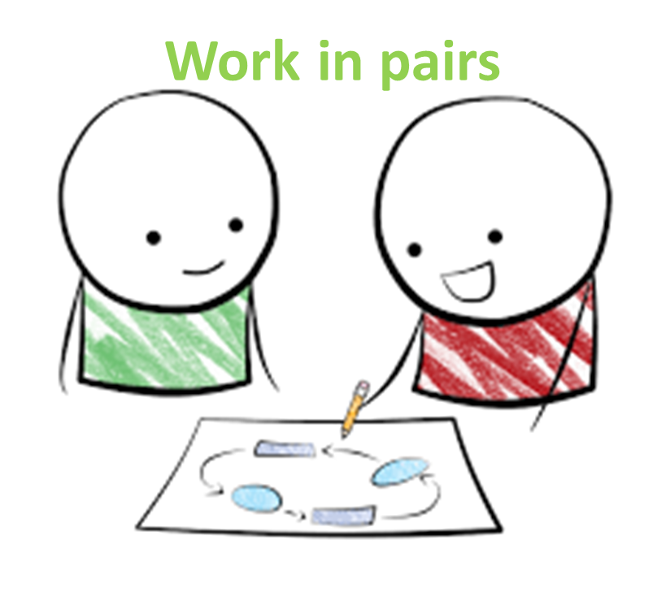
3. Now, interview a classmate about the hobbies in 1. Take notes and present your partner's answers to the class.
A: What do you think about ?/ How do you find ?
B: I think it is ./ I find it .
A: Why?
B: Because .
A: Will you take up in the future?
B: Yes, I will./ I'm not sure.

Slide 12
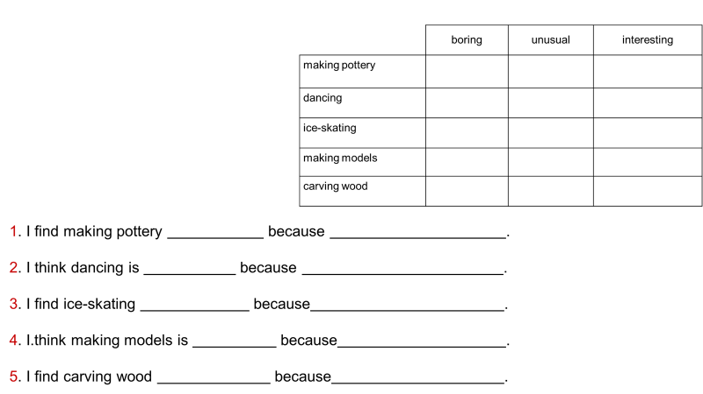
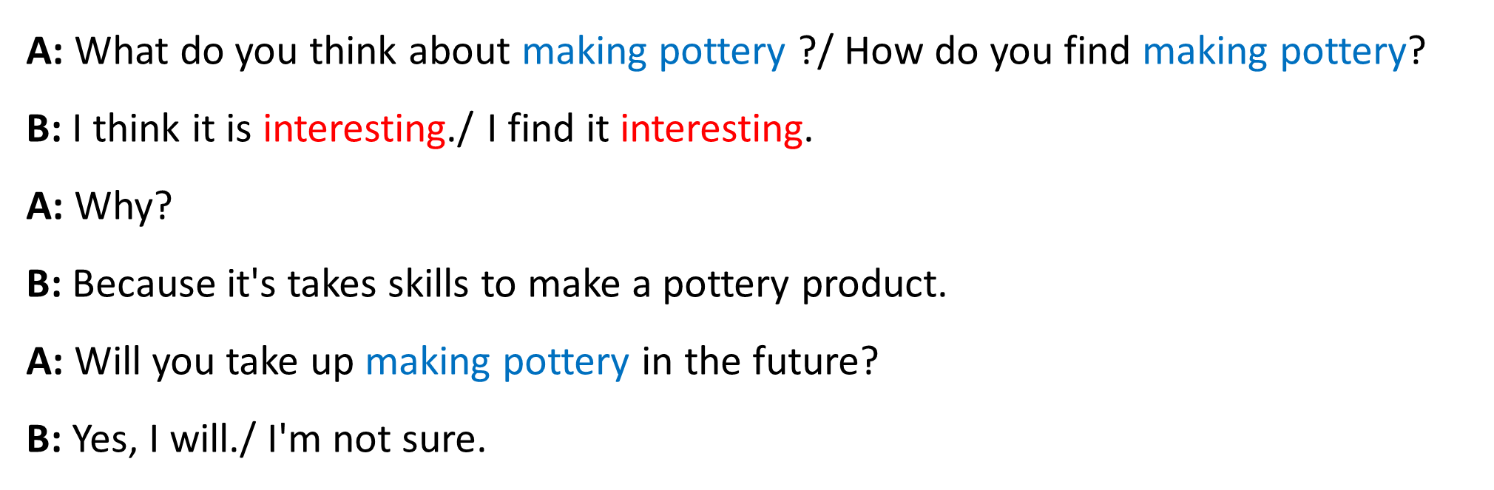
Example:
Making models dancing
Making pottery carving wood
Ice-skating

Slide 13
3. Now, interview a classmate about the hobbies in 1. Take notes and present your partner's answers to the class.
A: What do you think about ?/ How do you find ?
B: I think it is ./ I find it .
A: Why?
B: Because .
A: Will you take up in the future?
B: Yes, I will./ I'm not sure.

Slide 14
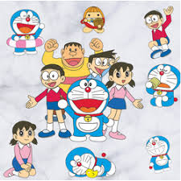
GOODBYE
GOODBYE

