Slide 1
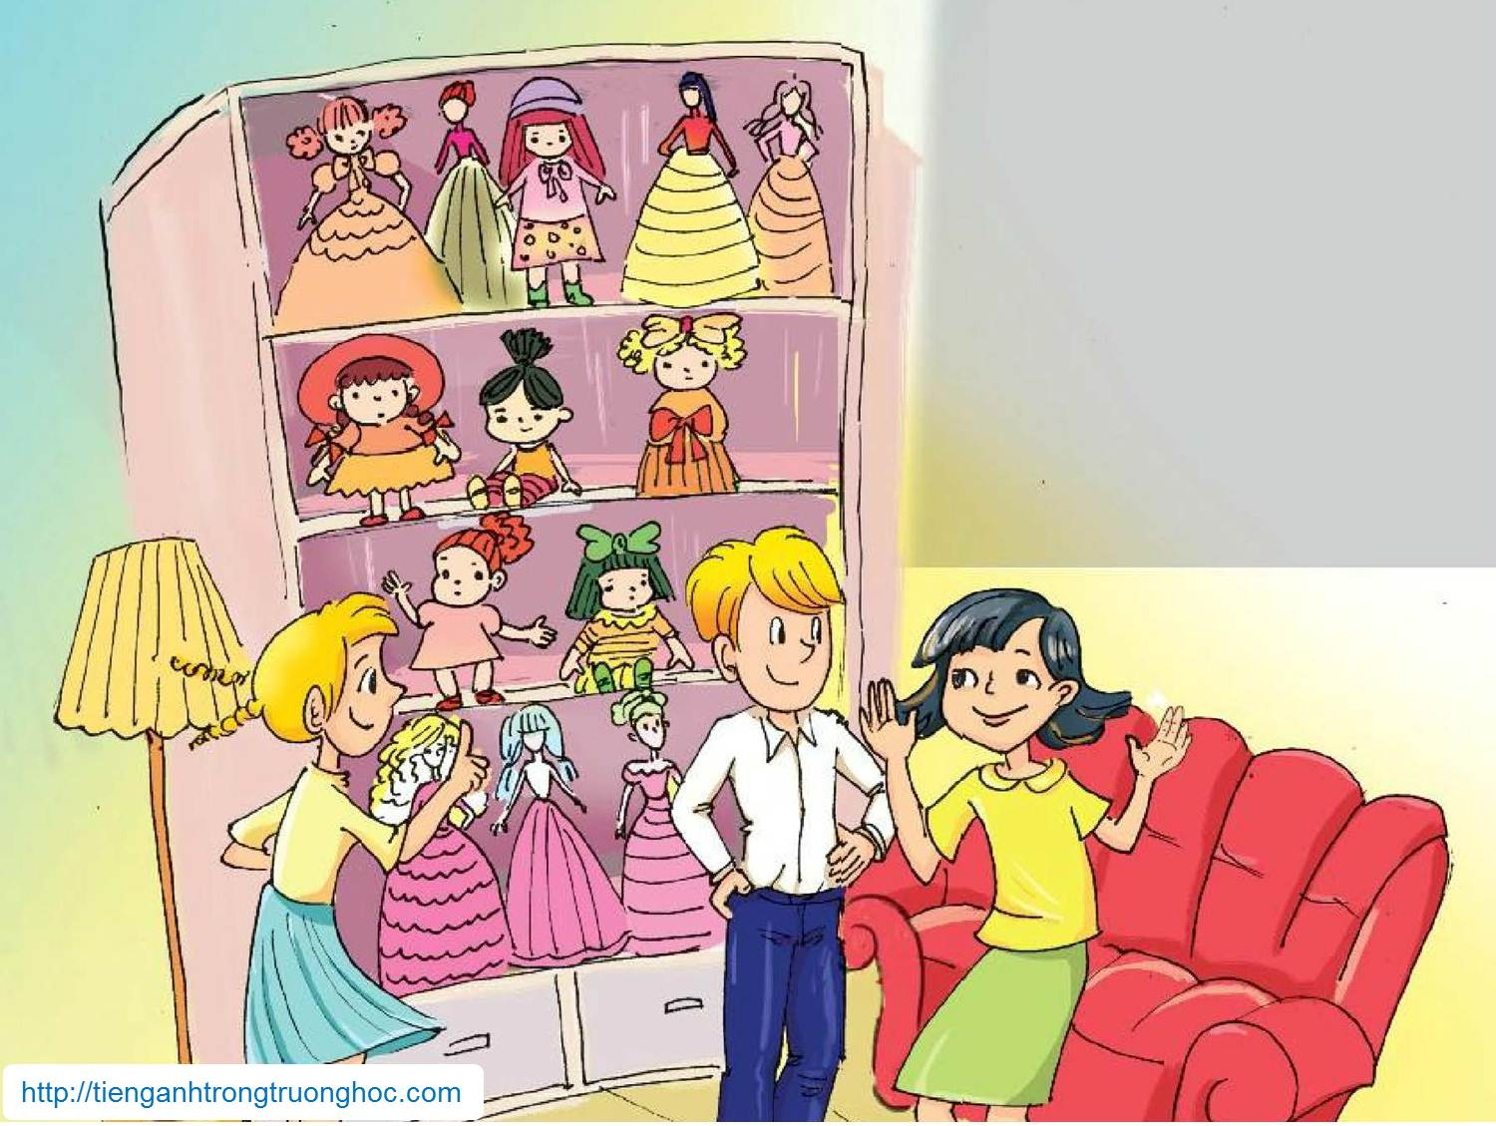
      UNIT 1: MY HOBBIES
      LESSON 1: GETTING STARTED
English 7

Slide 2

Warm up
Can you guess who they are?
Where are they?
What can you see on the shelf?
What may the hobby be?

Slide 3


I. Vocabulary
tầng trên
upstairs (n) /ˌʌpˈsteəz/
collecting /kəˈlɛktɪŋ/
unusual (a) /ʌnˈjuːʒʊəl/
special occasions/ˈspɛʃəl əˈkeɪʒənz/
piece of cake (idom) /piːs/ /ɒv/ /keɪk/
other countries (n) /ˈʌðə/ /ˈkʌntriz/
thu thập
bất thường
dịp đặc biệt
dễ ợt
các nước khác

Slide 4

Look out!
'It’s a piece of cake' is an idiom. Do you know what it means? Can you guess its meaning from the conversation? Can you think of any other idioms?
Remember, idioms usually have a different meaning than the normal meaning of each word.
Example
When I was asked to write a short poem by our new teacher, it was a piece of cake to me.
Don’t take it as a piece of cake, hiking is very tiring task.
The engineering interview proved to be a piece of cake.
You can’t achieve your big dream from these pieces of cake.
Juggling is not easy to perform, but its a piece of cake for Carl, I wonder how he does it so easily.

Slide 5

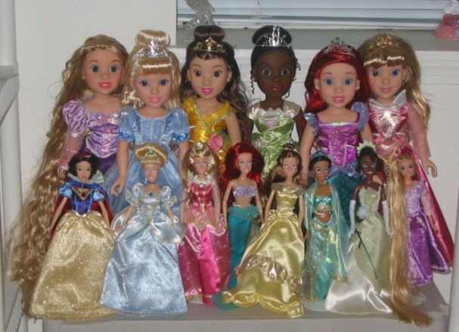

II. Listen and read
Activity 1a. Are the sentences below true (T) or false (F)?
1. Elena’s room is on the first floor.
2. There are a lot of dolls in Elena’s room.
3. Mi has the same hobby as Elena.
4. Elena’s grandparents usually give her dolls.
5. Nick thinks mountain climbing is more challenging than collecting things.
F
T
F
F
T

Slide 6
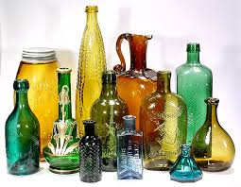
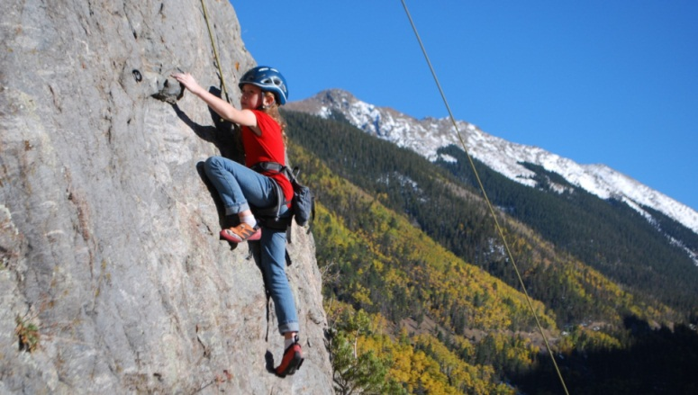
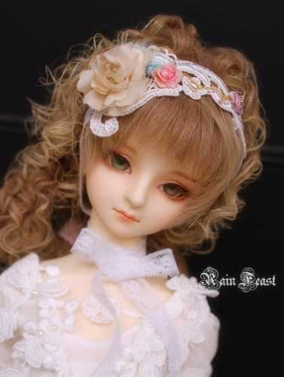
Activity 1b. Answer the following questions.
1. When does Elena receive dolls from her family members?
She receives dolls on special occasions.
2. Are her dolls the same?
No, they aren’t.
3. How does Mi collect bottles?
She keeps the bottles after using them.
4. Does Mi think collecting bottles costs much money?
No, she doesn’t.
5. Has Nick climbed mountains in other countries?
No, he hasn’t.

Slide 7
Activity 2. Listen and repeat.
cycling arranging flowers
taking photos skating
cooking playing the guitar
bird-watching playing board games
gardening

Slide 8
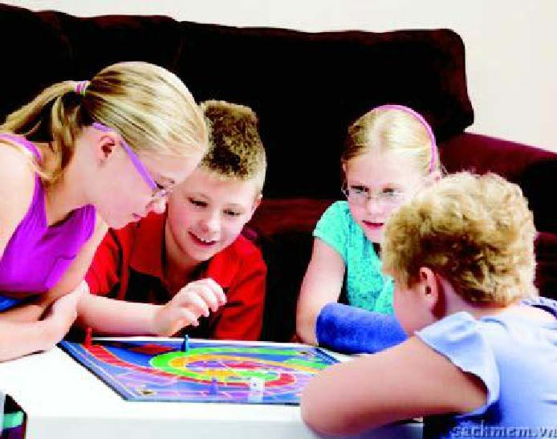
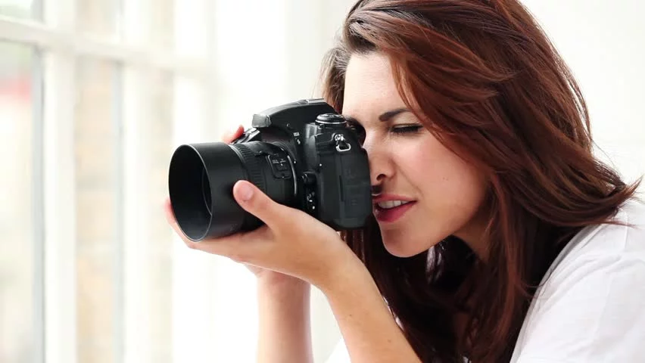
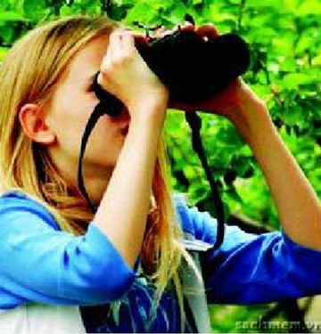
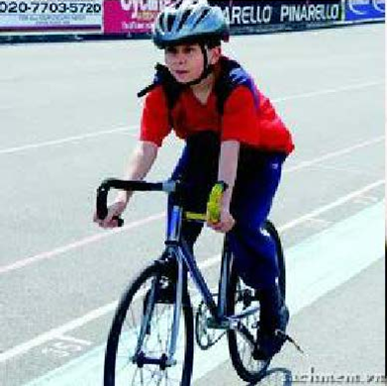
Activity 3. Choose the words/phrases in 2 that match the pictures below. Write them in the spaces.
1
2
playing board games
taking photos
3
4
bird-watching
cycling

Slide 9
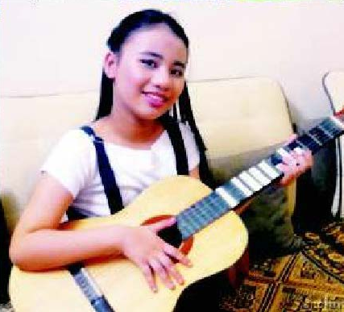
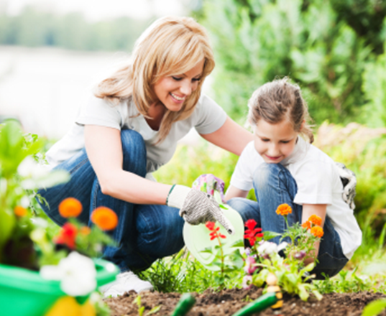
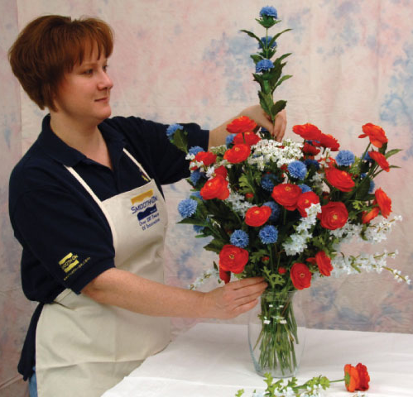
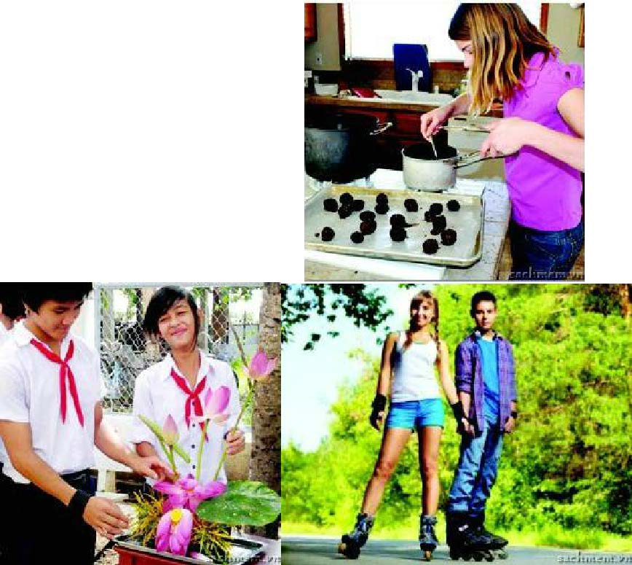
Activity 3.
1
5
6
playing the guitar
gardening
8
arranging flowers
7
9
cooking
skating

Slide 10
Activity 4. Work in pairs and complete the tables below. Do you think the hobbies in 3 are cheap or expensive, easy or difficult? Can you add some other hobbies to the lists?
Cheap hobbies | Expensive hobbies
playing board games, gardening, bird-watching, collecting old bottles, … | taking photos, cycling, playing the guitar, cooking, arranging flowers, collecting watches, …
Easy hobbies | Difficult hobbies
playing board games, gardening, bird-watching, collecting old bottles, taking photos, … | playing the guitar, cooking, arranging flowers, making short films, …

Slide 11
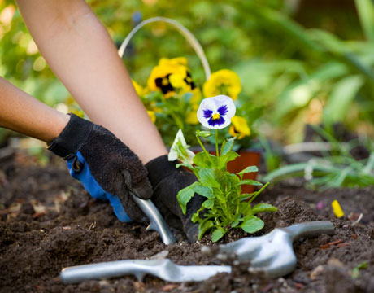
Activity 5a. Game: FIND SOMEONE WHO In three - five minutes, ask as many classmates as you can about which hobbies from 3 they like. Use the question 'Do you like …?'
Example:
A: Do you like gardening?
B: No, I don’t

Slide 12
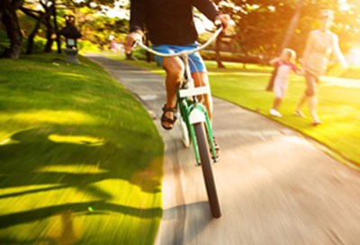
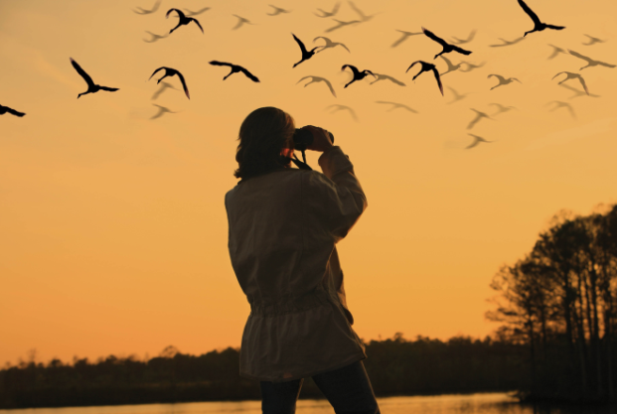
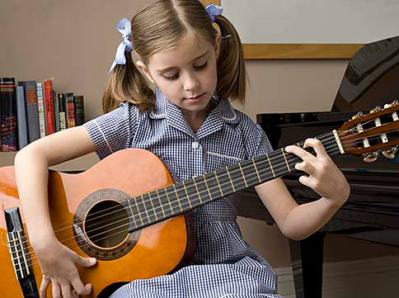
Activity 5a.
Student 1:
A: Do you like cycling?
B: Yes, I do.
Student 2:
A: Do you like bird- watching?
B: No, I don’t.
Student 3
A: Do you like playing guitar?
B: Yes, I do.

Slide 13
Activity 5b. In the table below, write your classmates’ names beside the hobbies they like. The student with the most names wins.
Find someone who likes …
cycling
arranging flowers
taking photos
skating
cooking
playing the guitar
bird-watching
playing board games
gardening

Slide 14

III. Homework
  Do exercise in your workbook.
  Prepare next lesson: A closer look 1.

