Slide 1

PERIOD 17: UNIT 3: MY FRIENDS
LESSON 2: A CLOSER LOOK 1

Slide 2
I. Vocabulary:
- Appearance /əˈpɪə.rəns/ (n)
Elbow /ˈelbəʊ/ (n)
Cheek /tʃiːk/ (n)
Blonde /blɒnd/ (adj)
Straight /streɪt/ (adj)
Curly /ˈkɜːli/ (adj)
Chubby /ˈtʃʌbi/ (adj)
Patient /ˈpeɪʃnt/ (adj)
dáng vẻ, ngoại hình
- khuỷu tay
- má
- vàng hoe
- thẳng
Xoăn
mũm mĩm, phinh phính
- kiên nhẫn

Slide 3
Checking vocabulary:
- Appearance /əˈpɪə.rəns/ (n)
Elbow /ˈelbəʊ/ (n)
Cheek /tʃiːk/ (n)
Blonde /blɒnd/ (adj)
Straight /streɪt/ (adj)
Curly /ˈkɜːli/ (adj)
Chubby /ˈtʃʌbi/ (adj)
Patient /ˈpeɪʃnt/ (n/ adj)
- dáng vẻ, ngoại hình
- khuỷu tay
- má
- vàng hoe
- thẳng
xoăn
mũm mĩm, phúng phính
- bệnh nhân/ kiên nhẫn

Slide 4

Singular Nouns | Plural Nouns
mouth | mouths
cheek | cheeks
hair | hair
Singular Nouns | Plural Nouns
mouth
cheek
hair

Slide 5
I. Vocabulary:
1.Create word web
ARMS
TAIL
HEAD
HANDS
BIG/SMALL
LONG/SHORT
EARS
FEET
HAIR
LEGS
EYES
NOSE

Slide 6
I. Vocabulary:
1.Create word web
FACE
FUR
FACE
BLACK/BLONDE/
CURLY/STRAIGHT
CHUBBY
ROUND/LONG
CHEEKS
HAIR

Slide 7
I. Vocabulary:
1.Create word web
ADJECTIVES | BODY PARTS
LONG/SHORT | ARMS, TAIL, HAIR, LEGS
BIG/SMALL | HEAD, HANDS, EARS, EYES, FEET, NOSE
ROUND/LONG | FACE
BLACK/BLONDE/ CURLY/ STRAIGHT | HAIR, FUR
CHUBBY | CHEEKS, FACE

Slide 8
II. Pronunciation
1.Listen and repeat
picnic
biscuits
blonde
black
big
patient
2.Listen and circle the word you hear
/b/ | /p/
band | play
brown | ponytail
big | picnic
bit | pretty

Slide 9
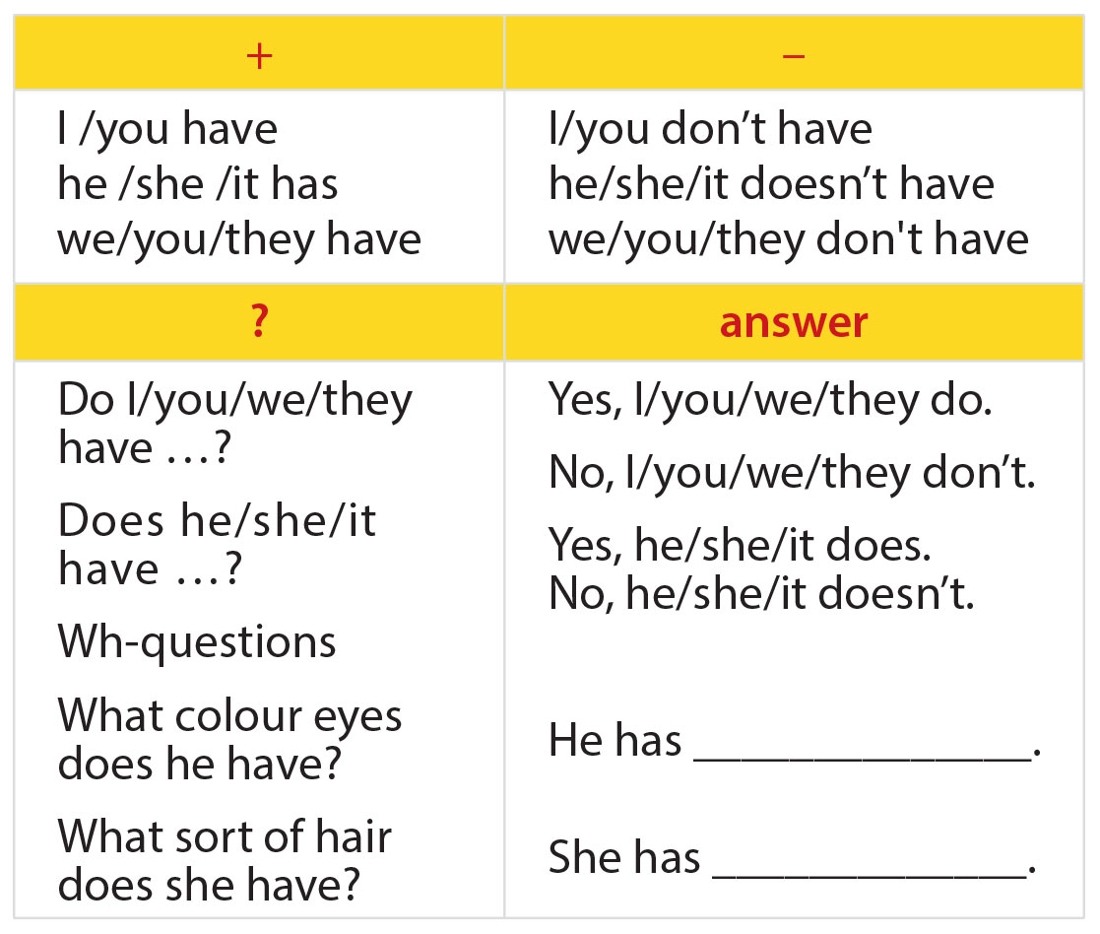
III. GRAMMAR
1. “have” for descriptions

Slide 10
 | I/YOU/WE/THEY | HE/SHE/IT
(+) | I/YOU/WE/THEY have a small head. | HE/SHE/IT has a small head.
(-) | I/YOU/WE/THEY don’t have a small head. | HE/SHE/IT doesn't have a small head.
(?) | Do I/YOU/WE/THEY have a small head? -Yes, I/YOU/WE/THEY do. -No, I/YOU/WE/THEY don't | Does HE/SHE/IT have a small head? -Yes, HE/SHE/IT does. -No, HE/SHE/IT doesn't.
WH-questions | -What color eyes do I/YOU/WE/THEY have? I/YOU/WE/THEY have black eyes. -What sort of hair do I/YOU/WE/THEY have? I/YOU/WE/THEY have curly hair. | -What color eyes does HE/SHE/IT have? HE/SHE/IT has black eyes. -What sort of hair does HE/SHE/IT have? HE/SHE/IT has curly hair.

Slide 11

III. GRAMMAR
1. Make the sentences
The girl/ short hair?
Does the girl have short hair?
No, she.
No, she doesn't.
2. Harry Potter/ big eyes?
Does Harry Potter have big eyes?
3. The dog/ a long tail.
The dog has a long tail.
4. And you, you/ a round face?
And you, do you have a round face?
Yes/ I. No/ I.
Yes, I do./ No, I don't.

Slide 12
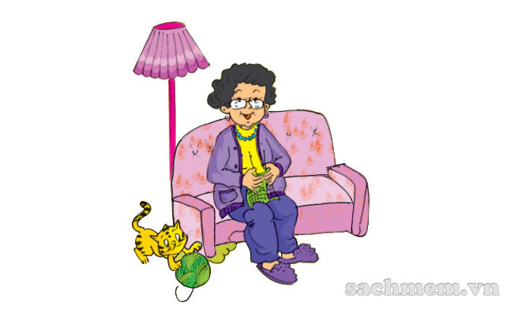
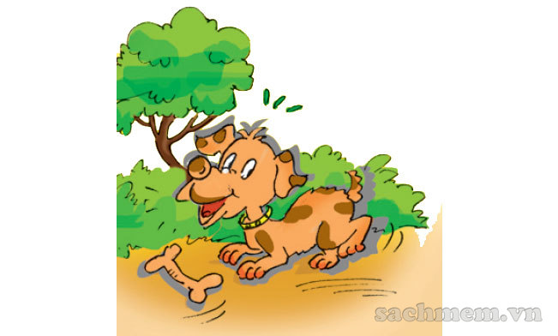
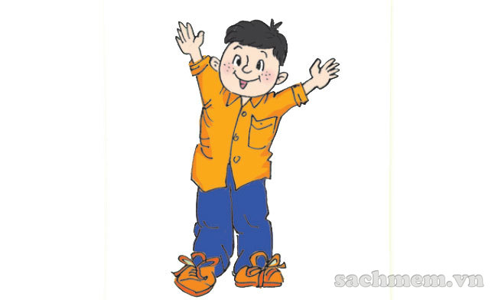
III. GRAMMAR
3. Listen and match
Phuc 2. Duong 3. Mai

Slide 13
III. GRAMMAR
3. Write “is” or “has"
1. My best friend _______(1) a round face and short hair. He isn't very tall but he ____(2) kind and funny. I like him because he often makes me laugh.
2. My best friend is Lucas. He _____(3) a brown nose. He ______(4)friendly! I like him because he's always beside me.
3. My best friend _____(5) short curly hair. She _____(6) kind. She writes poems for me, and she always listens to my stories.
has
is
has
is
has
is

Slide 14
II. HOMEWORK
Learn by heart the new words.
Do Ex. A1, A2, B1(page 16), B4 (page 17) in workbook.
Prepare: A closer look 2.

Slide 15
PERIOD 18: UNIT 3: MY FRIENDS
LESSON 2: A CLOSER LOOK 2

Slide 16
I. Vocabulary:
barbecue /ˈbɑː.bɪ.kjuː/ (n)
museum /mjuːˈziː.əm/ (n)
party /ˈpɑːti/ (n)
project /ˈprɒdʒekt/ (n)
tomorrow /təˈmɒrəʊ/ (n, adv)
món thịt nướng BBQ
- viện bảo tàng
- bữa tiệc
- dự án
ngày mai

Slide 17
Checking vocabulary:
barbecue /ˈbɑː.bɪ.kjuː/ (n)
museum /mjuːˈziː.əm/ (n)
party /ˈpɑːti/ (n)
project /ˈprɒdʒekt/ (n)
tomorrow /təˈmɒrəʊ/ (n, adv)
- món thịt nướng BBQ
- viện bảo tàng
- bữa tiệc
- dự án
- ngày mai

Slide 18
II. GRAMMAR
1. Review present continuous
PRESENT CONTINUOUS
(+) | S + tobe (am/is/are) + Ving Ex: I am going to school.
(-) | S + tobe + not + Ving Ex: I am not going to school
(?) | Tobe + S + Ving? Yes, S + tobe./ No, S + tobe + not. Ex: Are you going to school? Yes, I am/ No, I am not.
signal words | now, right now, at the present, at the moment, listen, look, watch

Slide 19
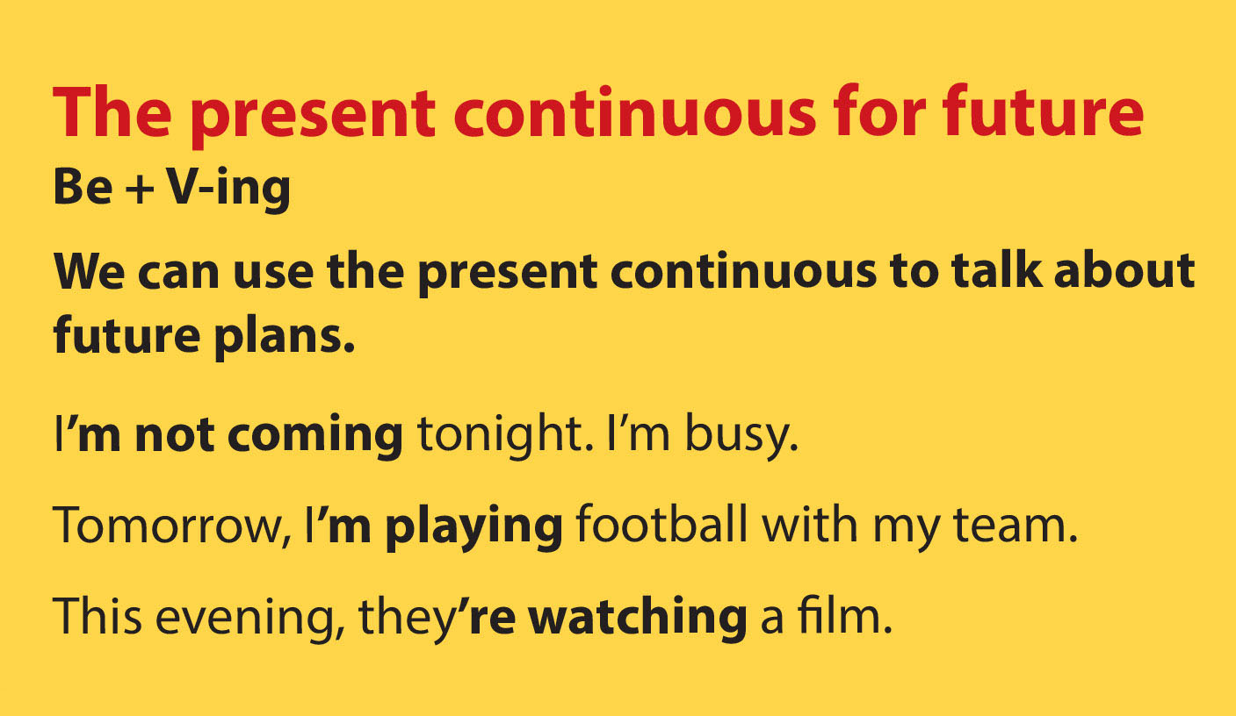
II. GRAMMAR
2. Present continuous for future
PRESENT CONTINUOUS FOR FUTURE
(+) | S + tobe (am/is/are) + Ving Ex: I am going to hospital tomorrow.
(-) | S + tobe + not + Ving Ex: I am not going to hospital tomorrow.
(?) | Tobe + S + Ving? Yes, S + tobe./ No, S + tobe + not. Ex: Are you going to hospital tomorrow? Yes, I am/ No, I am not.
signal words | This day/week/weekend... Tomorrow, today, tonight... These days

Slide 20
III. PRACTICE
1. Underline the present continuous. Which refers to the actions that are happening now/ future plan?
Duong: I don't know. They're coming over.
Mai: Hi, Phuc. Hi, Duong. This is my friend Chau.
Phuc & Duong: Hi, Chau. Nice to meet you.
Chau: Nice to meet you too.
Duong: Would you like to sit down? We have lots of food.
Mai: Oh, sorry, we can't. It's time to go home. This evening, we are working on our school project.
Duong: Sounds great. I'm going to the judo club with my brother. How about you Phuc?
Phuc: I'm visiting my grandma and grandpa.
ACTION NOW | PLANS FOR FUTURE
They are coming over. | This evening, we are working on our school project.
 | I'm going to the judo club with my brother.
 | I'm visiting my grandma and grandpa.
ACTION NOW | PLANS FOR FUTURE
 | This evening, we are working on our school project.

Slide 21
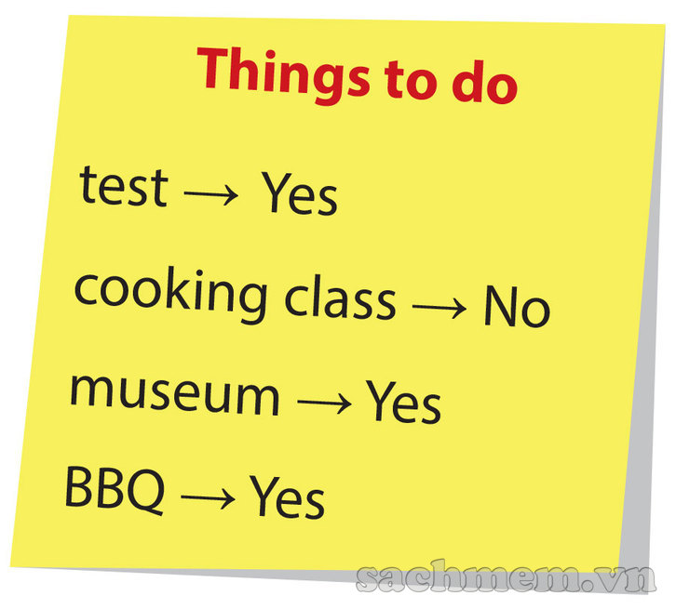
III. PRACTICE
2. Complete the sentences using present continuous for future
Example:
She's finishing her homework. (finish)
1.She ________ a test. (take)
2.She ________ to her cooking class. (go)
3.She __________ a museum. (visit)
4.She __________ a barbecue with her friends. (have)
IS TAKING
IS GOING
IS VISITNG
IS HAVING

Slide 22
III. PRACTICE
3. Write N for “Now” and F for “Future"
 | N | F
1.Listen! Is that our telephone ringing? | N
2.They're going to the Fine Arts Museum this Saturday. |  | F
3.Where's Duong? He's doing judo in Room 2A. | N
4.She's travelling to Da Nang tomorrow. |  | F
5.Are you doing anything this Friday evening? |  | F
6.Yes, I'm watching a film with my friends. | N
 | N | F
1.Listen! Is that our telephone ringing?
2.They're going to the Fine Arts Museum this Saturday.
3.Where's Duong? He's doing judo in Room 2A.
4.She's travelling to Da Nang tomorrow.
5.Are you doing anything this Friday evening?
6.Yes, I'm watching a film with my friends.

Slide 23
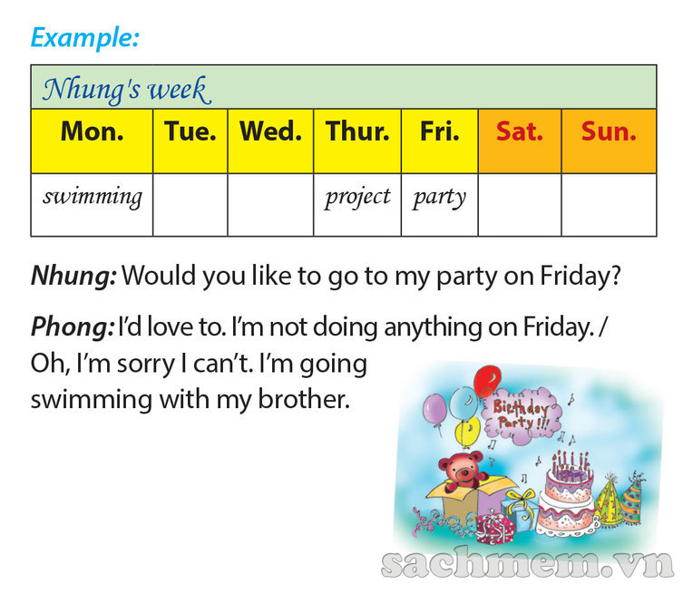
III. PRACTICE
4. Game

Slide 24
IV. HOMEWORK
Learn by heart the new words.
Do Ex.B4 (page 17), B5, B6 (page 18) in workbook.
Prepare: A closer look 2.

Slide 25
Cách phát âm đuôi “s”, “es”
Âm cuối | th, p, k, f, t, (thời phong kiến phương tây) | s, ss, ch, sh, x, ge, ce (sẵn sàng chung sức xin góp cơm) | b, d, g, n, l, v, m, r, y, u, e, o, a, i... (còn lại)
Đọc | /s/ | /iz/ | /z/
Ví dụ | Wants, fits, helps, cooks | Washes, watches, misses, fridges | Enjoys, loves, plays, arrives, needs

Slide 26
WORDS | /s/ | /z/ | /iz/
watches
tables
caps
phones
villas
mouths
houses
washes
chairs
boxes
toilets
fridges
clocks

