Slide 1


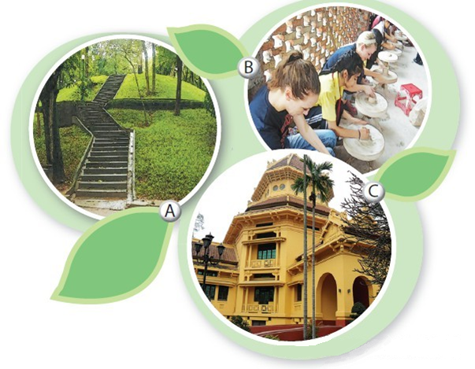
I. Listening
4Teen radio is asking different students about their places of interest.
Activity 1 Describe what you see in each picture. Do you know what places they are?
Listen and check your answers.
A. Ha Noi Botanical Garden
B. Bat Trang pottery village
C. Viet Nam National Museum of History

Slide 2
Vocabulary:
Artefact : /ˈɑː.tə.fækt/ đồ tạo tác, vật do con người làm ra
Chronologically /ˌkrɒn.əˈlɒdʒ.ɪ.kəl.i/ : theo thứ tự thời gian
primitive /ˈprɪm.ɪ.tɪv/ : nguyên thủy
Ceramics /səˈræm.ɪks/ gốm sứ
Pigeon /ˈpɪdʒ.ən/ : chim bồ câu

Slide 3
Activity 2 Listen to what these students say and decide if the statements are true (T) or false (F).
1. Tra is interested in history.
2. Nam likes making things with his hands.
3. Nam’s family owns a workshop in Bat Trang.
4. The trees in the garden only come from provinces of Viet Nam.
5. Hoa loves nature and quietness.
T
T
F
F
T
I love history
There are lots of trees from different countries
Sometimes I just sit on the bench, watching people dancing or playing sports. It’s a nice place for those who love nature and quietness.
Every time I go there, they teach me how to make things such as pots, vases, or bowls. I’m learning to paint on ceramics now.
My friend’s relatives live there and they own a workshop.

Slide 4



Activity 3 Listen again and complete the table. Use no more than three words for each blank.
Student | Place of interest | Activities
Tra | Viet Nam National Museum of History | Seeing various (1) _________ Looking round and (2) _________
Nam | Bat Trang pottery village | - Learning to (3) _________ and (4) _________
Hoa | Ha Noi Botanical Garden | Climbing up (5) _________ Reading (6) _________ Feeding (7) _________ (8) _________ people
artefacts
exploring Vietnamese culture
make things
paint on ceramics
the hill
books
pigeons
watching

Slide 5
Tra: I love history, so my place of interest is Viet Nam National Museum of History. There’s an extensive collection of artefacts tracing Viet Nam’s history. They’re arranged chronologically from primitive life to modern times. It’s also near Hoan Kiem Lake and the Old Quarter, so you can spend time looking round and exploring Vietnamese culture.
Nam: I’m fascinated by traditional handicrafts. At weekends, I usually go to Bat Trang, a pottery village not far from Ha Noi centre. My friend’s relatives live there and they own a workshop. Every time I go there, they teach me how to make things such as pots, vases, or bowls. I’m learning to paint on ceramics now.
Hoa: Ha Noi Botanical Garden is the place I like. There are lots of trees from different countries, a lake, and a small hill. I usually climb up the hill and read books at the top because there’s a large lawn. After that I go down and feed the pigeons. Sometimes I just sit on the bench, watching people dancing or playing sports. It’s a nice place for those who love nature and quietness.

Slide 6

II. Writing
Activity 4 If a visitor has a day to spend in your hometown/city, where will you advise him/her to go? What can they do there? Work in pairs, discuss and take notes of your ideas.
Places | Activities
Place 1: _______________ | _______________________
Place 2: _______________ | _______________________
Place 3: _______________ | _______________________

Slide 7

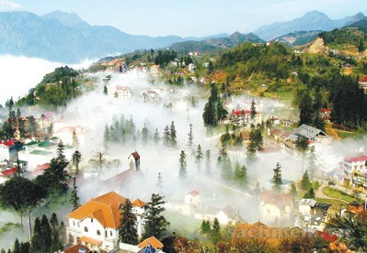
Activity 5: Imagine that your Australian pen friend is coming to Viet Nam and will spend a day in your hometown/city. He/She has asked for your advice on the places of interest they should go to and the things they can do there. Write an email to give him/her some information.
From:
To:
Subject: Places of interest in my hometown/city
Dear
Look forward to seeing you soon!
Best wishes,

Slide 8
Dear Mira,
It’s great to know that you’re coming to Viet Nam. What a pity you can only spend one day in Ha Noi. There are so many interesting places in the city, but I think within one day you should be able to visit three places. The rest place I suggest is Viet Nam National Museum of History. You like history, so it’s a must-see place. There’s an extensive collection of artefacts tracing Viet Nam’s history. They’re arranged chronologically from primitive life to modern times. The second place is Hoan Kiem Lake. It’s one of the symbols of Ha Noi. There you can enjoy the beautiful scenery and visit Ngoc Son Temple. You can also have a look at the Old Quarter. Wander around the old streets and some ancient houses to explore Vietnamese culture. Conveniently, these places are close to one another, so we can walk around easily. Tell me when you’re coming, so I can show you around these places.
Look forward to seeing you soon!
Best wishes,
Thuc Anh

Slide 9

III. Homework
  Learn vocabulary by heart.
  Redo exercises.
  Prepare the next lesson: Looking back - Project

