Slide 1

WELCOME TO OUR CLASS
Unit 1
Lesson 3: A closer look 2

Slide 2
I. Grammar: Complex sentences: review
Eg: Although she was tired, she finished knitting the scarf for her dad.
dependent clause
main clause
A dependent clause of concession
A dependent clause of purpose
A dependent clause of reason
A dependent clause of time

Slide 3
I. Grammar: Complex sentences: review
Eg: Although she was tired, she finished knitting the scarf for her dad.
A dependent clause of concession
1. DEPENDENT CLAUSES OF CONCESSION (MỆNH ĐỀ TRẠNG NGỮ CHỈ SỰ TƯƠNG PHẢN)
* Mệnh đề trạng ngữ chỉ sự tương phản là mệnh đề phụ chỉ sự tương phản của hai hành động trong câu.
* Mệnh đề này thường được bất đầu bằng các từ: though, although, even though in spite of, despite (mặc dù).

Slide 4
I. Grammar: Complex sentences: review
Eg: The artisan moulded the clay so that he could make a mask.
A dependent clause of purpose
2. DEPENDENT CLAUSES OF PURPOSE (MỆNH ĐỀ TRẠNG NGỮ CHỈ MỤC ĐÍCH)
*Mệnh đề trạng ngữ chỉ mục đích là mệnh đề diễn đạt mục đích của hành động ở mệnh đề chính.
* Mệnh đề bắt đầu bằng so that/in order that.

Slide 5
I. Grammar: Complex sentences: review
Eg: Since it was raining, they cancelled the trip to Trang An.
A dependent clause of reason.
2. DEPENDENT CLAUSES OF REASON (MỆNH ĐỀ TRẠNG NGỮ CHỈ LÍ DO)
*Mệnh đề trạng ngữ chỉ lí do là mệnh đề diễn đạt lí do của hành động ở mệnh đề chính.
* Mệnh đề bắt đầu bằng because, since , as.

Slide 6
I. Grammar: Complex sentences: review
Eg: When I have free time, I usually go to the museum.
A dependent clause of time.
2. DEPENDENT CLAUSES OF TIME (MỆNH ĐỀ TRẠNG NGỮ CHỈ LÍ DO)
*Mệnh đề trạng ngữ chỉ thời gian là mệnh đề diễn đạt hành động trong mệnh đề chính diễn ra khi nào.
* Mệnh đề bắt đầu bằng when, while, before, after, as soon as.

Slide 7
I. Grammar: Complex sentences: review
Dependent clauses
A dependent clause of concession
(Although, though, even though)
A dependent clause of purpose
( so that, in order that)
A dependent clause of reason (because, since, as)
A dependent clause of time (when,while, before, after, as soon as)

Slide 8
Ex1. Underline the dependent clause in each sentence below. Say whether it is a dependent clause of concession (DC), of purpose (DP), of reason (DR), or of time (DT).
1. When people talk about traditional paintings, they think of Dong Ho village.
2. My sister went to Tay Ho village in Hue so that she could buy some bai tho conical hats.
3. Although this museum is small, it has many unique artefacts.
4. This square is our favourite place to hang out because we have space to skateboard.
5. The villagers have to dry the buffalo skin under the sun before they make the drumheads.
DT
DP
DC
DR
DT

Slide 9
Ex 2:Make a complex sentence from each pair of sentences. Use the subordinator provided and make any necessary changes.
The villagers are trying to learn English. They can communicate with foreign customers. (in order that)
The villagers are trying to learn English in order that they can communicate with foreign customers.
2.We ate lunch. Then we went to Non Nuoc marble village to buy some souvenirs. (after)
After we had eaten lunch, we went to Non Nuoc marble village to buy some souvenirs.
3.This hand-embroidered picture was expensive. We bought it. (even though)
Even though this hand-embroidered picture was expensive, we bought it.
4.This department store is an attraction in my city. The products are of good quality. (because)
This department store is an attraction in my city because the products are of good quality.
5.This is called a Chuong conical hat. It was made in Chuong village. (since)
This is called a Chuong conical hat since it was made in Chuong village.

Slide 10
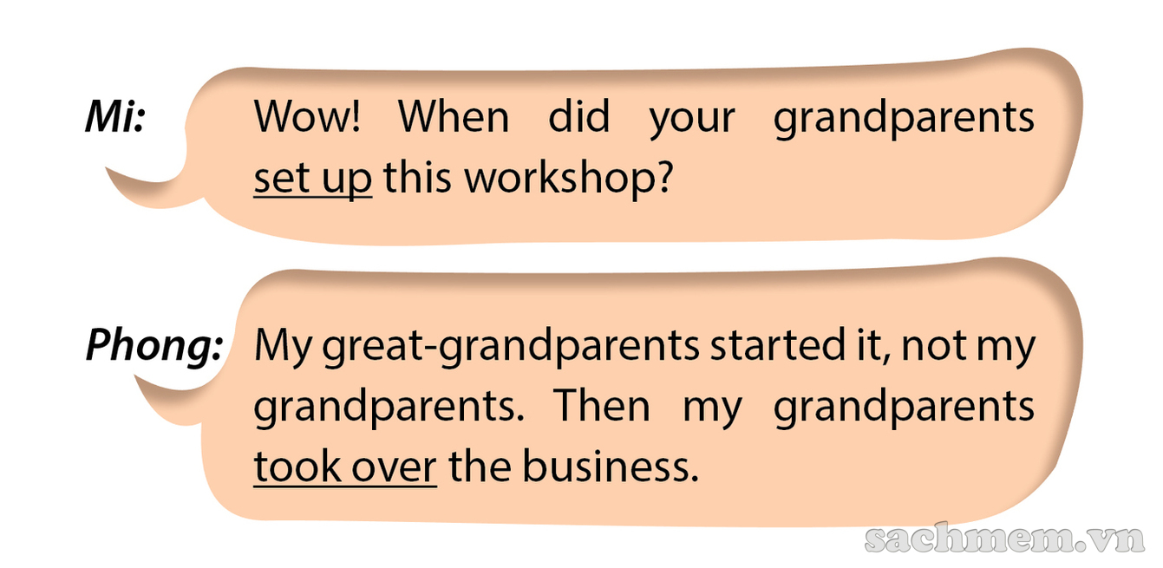
3. Read this part of the conversation from GETTING STARTED. Pay attention to the underlined part and answer the questions.
1.What is the meaning of the underlined verb phrases?
1. set up: start something (a business, an organisation, etc.)
take over: take control of something (a business, an organisation, etc.)
2.Can each part of the verb phrase help you understand its meaning?
No, the individual words in the verb phrase do not help with comprehension. This is why they are sometimes considered difficult.

Slide 11

II. PHRASAL VERBS

Slide 12

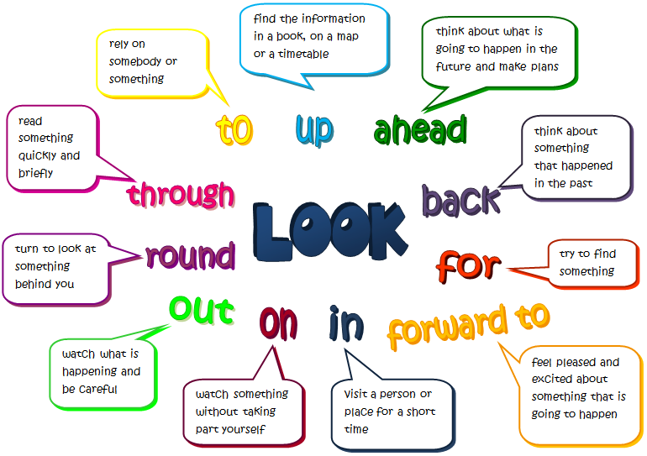

Slide 13
I- DEFINITION:
1- Form:
:
Verb + Particle (s) = Phrasal verb
Preposition:
on, in, at, after, off, with, about...
Adverb: over, up, down, into, away...
Go:
Go away, go on, go over, go off, go down with, go in for ...

Slide 14
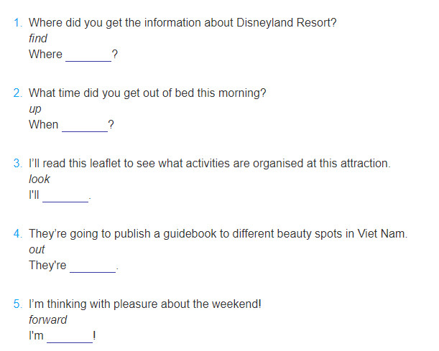
6. Complete the second sentence so that it has a similar meaning to the first sentence, using the word given.
1. Where did you find out about Disneyland Resort?
2. When did you get up this morning?
3. I'll look through this leaflet to see what activities are organised at this attraction.
4. They're going to bring out a guidebook to different beauty spots in Viet Nam.
5. I'm looking forward to the weekend!

Slide 15


2- Meaning:
Meaning of MAIN VERB
Meaning of PARTICLE
Meaning of PHRASAL VERB

Slide 16

Eat to live not live to eat.
She was wet because she was out in the rain.
➔ Let’s eat out today.
eat + out = eat out
Look! The bus is coming.
She is going down town.
There is a cat on the fence.
➔ She's so conceited. She always looks down on everybody.
look + down + on = look down on

Slide 17

II. CLASSIFICATION:
INTRANSITIVE:
Examples:
The patient passed away.
What time do you often get up?
The supermarket closed down because they didn't have many customers
2. TRANSITIVE :
Examples:
She took after her mother.
Jack made up the ghost story to prevent me.
Please take off your shoes when entering this room.

Slide 18

3. SEPARABLE:
Turn on the light = Turn the light on
I will pick up you at 7 p.m. = I will pick you up at 7 p.m.
She turned down my invitation = She turned my invitation down.
4. NON-SEPARABLE:
She was looking for the passport which she had lost.
( ≠ looking the passport for)
I can’t live on my teaching salary.(≠ live my salary on)
He ran away quickly. (≠ ran quickly away)
Note: - transitive: separable and non-separable.
- intransitive: non-separable

Slide 19


III. STUDY TIPS:
Try to guess the meaning- base on:
particle
context
Ex: The bomb went off when there were thousands
of people at the stadium.
2. Look up in a dictionary.
3. Make notes or put in sentences.

Slide 20

Up
1. An upward movement:
2. An increase, an improvement:
3. Completing, ending:
4. Approaching:
Examples:
We left early, just as the Sun was coming up.
Sales have gone up recently.
We used up all the eggs for this cake.
I waited for him but he never showed up

Slide 21

IV. PRACTICE:

Slide 22
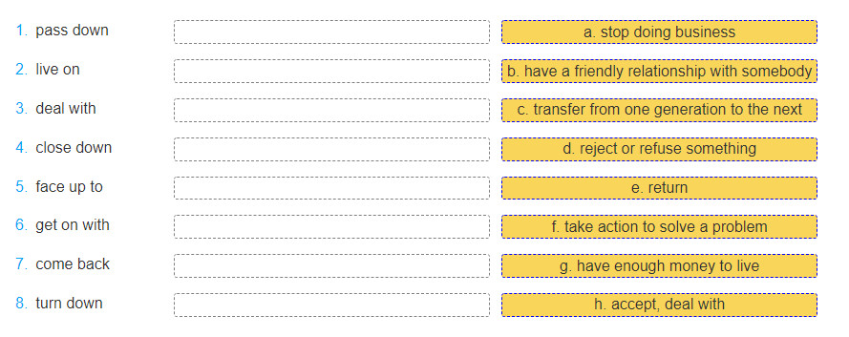
4. Match the phrasal verbs in A with their meaning in B.
1.c
2. g
3. f
4. a
5. h
6. b
7. e
8. d

Slide 23
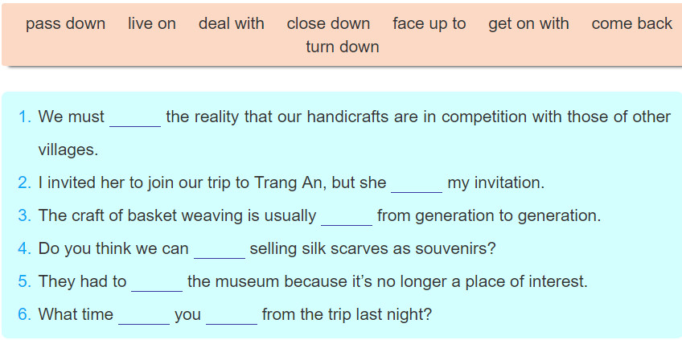
5. Complete each sentence using the correct form of a phrasal verb in 4. You don't need to use all the verbs.
face up to
turned down
passed down
live on
close down
come back
did

Slide 24

`
Thanks so much for your listening!

Slide 25

2. Use the correct form of phrasal verbs to fill in the blanks:
1. After months of discussions they finally………….…a decision.
2. You should……..…..your research paper before you hand it in.
3. I woke up when my alarm clock…….…. .
4. He invited a lot of his friends to the party but few of them….…….
5. She will go back to work if her mother……………the children.
turn up - arrive at - look after - go off - go over

Slide 26
2. Use the correct form of phrasal verbs to fill in the blanks:
1. After months of discussions, they finally arrived at a decision.
2. You should go over your research paper before you hand it in.
3. I woke up when my alarm clock went off.
4. He invited many friends to the party but few of them turned up.
5. She will go back to work if her mother looks after the children.
turn up - arrive at - look after - go off - go over

Slide 27
3. Choose the best answers:
1. When the bus stops, passengers………………. A. get on B. get off C. get in D. get on with
2. Sue was offered a job as a translator but she … A. gave it away B. turned it down C. made it up D. filled it in
3.If we ______wasting water , there will be a shortage of fresh water
A. go out B. go up C. go in D. go on
4. It’s dark in here. Please ….all the lights,.
A. Turn off B. cut off C. Turn on D. Go on

