Slide 1
Unit 1:
LOCAL ENVIRONMENT
Lesson 1: Getting started:
A visit to a traditional craft village

Slide 2
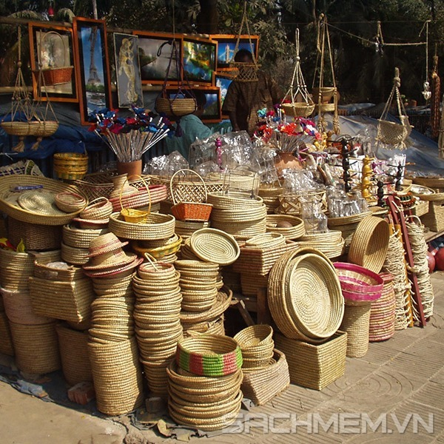
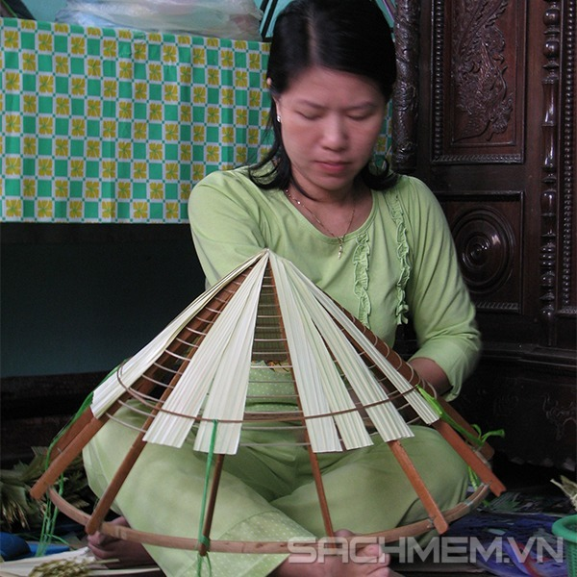
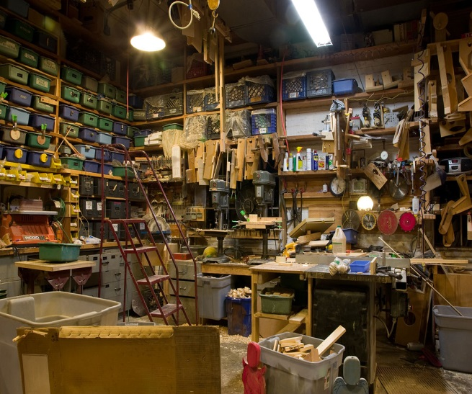
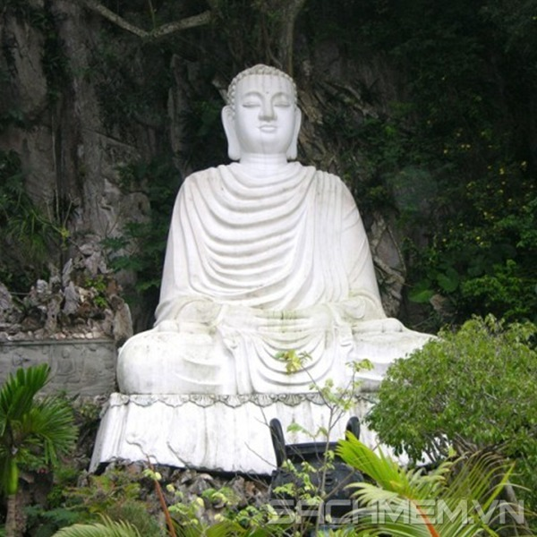
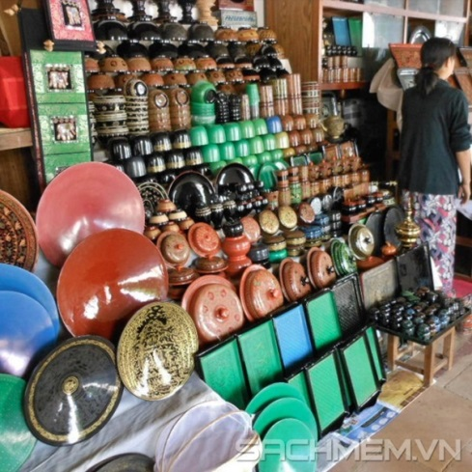
I. VOCABULARY
1. artisan (n) /ɑːtɪˈzæn/ thợ làm nghề thủ công
The artisans in my village can earn a living from basket weaving.
2. conical hat /ˈkɒn.ɪ.kəl hæt/ (n) nón lá
3. craft (n) /krɑːft/ nghề thủ công, kĩ năng nghề thủ công
4. attraction (n) /əˈtrækʃn/ điểm hấp dẫn
Moc Chau is well known as one of the most famous tourist attractions in northern Vietnam.
5.workshop (n) /ˈwɜːkʃɒp/ công xưởng, xưởng
6. lacquerware (n) /ˈlækəweə/ đồ sơn mài
7.handicraft (n) /ˈhændɪkrɑːft/ sản phẩm thủ công
8.sculpture (n) /ˈskʌlptʃə/ điêu khắc, đồ điêu khắc
9. pottery (n) /ˈpɒt.ər.i/ : đồ gốm
10. silk (n) /sɪlk/ lụa
11. (to) set up: thiết lập, xây dựng
12. (to) take over : tiếp quản

Slide 3

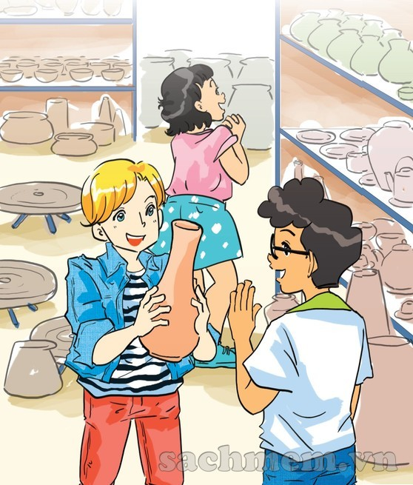
1. Who and what can you see in the picture?
2. Where are they?
3. What do you think the people in the picture are talking about?

Slide 4

A visit to a traditional craft village
...
Nick: There are so many pieces of pottery here, Phong. Do your grandparents make all of them?
Phong: They can’t because we have lots of products. They make some and other people make the rest.
Nick: As far as I know, Bat Trang is one of the most famous traditional craft villages of Ha Noi, right?
Phong: Right. My grandmother says it’s about 700 years old.
Mi: Wow! When did your grandparents set up this workshop?
Phong: My great-grandparents started it, not my grandparents. Then my grandparents took over the business. All the artisans here are my aunts, uncles, and cousins.
Mi: I see. Your village is also a place of interest of Ha Noi, isn’t it?
Phong: Yes. People come here to buy things for their house. Another attraction is they can make pottery themselves in workshops.
Nick: That must be a memorable experience.
Phong: In Viet Nam there are lots of craft villages like Bat Trang. Have you ever been to any others?
Mi: I’ve been to a conical hat making village in Hue!
Nick: Cool! This is my first one. Do you think that the various crafts remind people of a specific region?
Mi: Sure. It’s the reason tourists often choose handicrafts as souvenirs.
Phong: Let’s go outside and look round the village.
...

Slide 5
1.a. Can you find a word/phrase that means?
1. a thing which is skillfully made with your hands
2. start something (a business, an organization, etc.)
3. take control of something (a business, an organization, etc.)
4. people who do skilled work, making things with their hands
craft
set up
take over
artisans

Slide 6
1.a. Can you find a word/phrase that means?
5. an interesting or enjoyable place to go or thing to do
6. a particular place
7. make someone remember or think about something
8. walk around a place to see what is there
attraction
specific region
remind
look round

Slide 7
1.b. Answer the following questions?
1. Where are Nick, Mi, and Phong?
2. How old is the village?
3. Who started Phong’s family workshop?
4. Why is the village a place of interest in Ha Noi?
5. Where is the craft village that Mi visited?
6. Why do tourists like to buy handicrafts as souvenirs?

Slide 8
1.b. Answer the following questions?
1. Where are Nick, Mi, and Phong?
They are at Phong’s grandparents’ workshop in Bat Trang.
2. How old is the village?
It is about 700 years old.
3. Who started Phong’s family workshop?
His great-grandparents did.
4. Why is the village a place of interest in Ha Noi?
Because people can buy things for their house and make pottery themselves there.
5. Where is the craft village that Mi visited?
It is in Hue.
6. Why do tourists like to buy handicrafts as souvenirs?
Because the handicrafts remind them of a specific region.

Slide 9
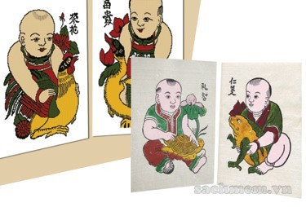
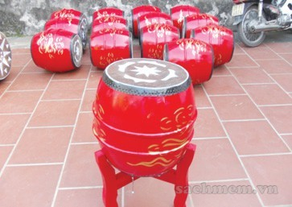
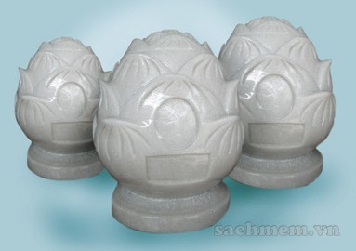
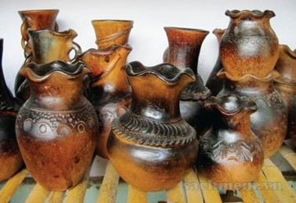
2. Write the name of each traditional handicraft in the box under the picture.
paintings pottery drums silk
lanterns conical hats lacquerware marble sculptures
A. paintings
B. drums
C. marble sculptures
D. pottery

Slide 10
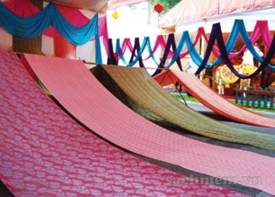
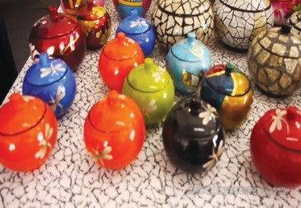
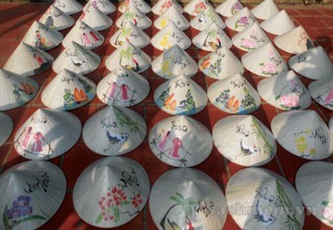
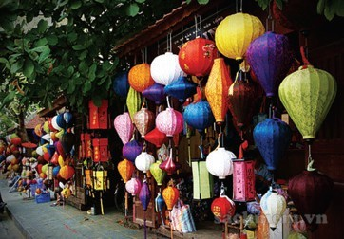
E.silk
F. lacquerware
/ˈlækəweə(r)/
G. conical hats
H. lanterns

Slide 11
3. Complete the sentences with the words/ phrases from 2
conical hat
1. The birthplace of the famous bai tho ……………….
is Tay Ho village in Hue.
2. If you go to Hoi An on the 15th of each lunar month, you can enjoy the lights of many beautiful ……………………….
3. Van Phuc village in Ha Noi produces different types of ……………. products such as cloth, scarves, ties, and dresses.
lanterns
silk

Slide 12
3. Complete the sentences with the words/ phrases from 2
4. On the Tet holiday, many Hanoians go to Dong Ho village to buy folk……………….. .
5. …………… products of Bau Truc, such as pots and vases, have the natural colours typical of Champa culture in Ninh Thuan.
6. Going to Non Nuoc marble village in Da Nang, we’re impressed by a wide variety of …………………………from Buddha statues to bracelets.
paintings
Pottery
marble sculptures

Slide 13
4. Quiz: WHAT IS THE PLACE OF INTERESTS?
a. Work in pairs to do the quiz.
1. People go to this area to walk, play, and relax.
2. It is a place where objects of artistic, cultural, historical, of scientific interest are kept and shown.
3. People go to this place to see animals.
4. It is an area of sand, or small stones, beside the sea or a lake.
5. It is a beautiful and famous place in the countryside.
1.park
2. museum
3. zoo
4. beach
5. beauty spot

Slide 14

- Learn by heart the new words - Prepare for the next lesson
Homework

