Slide 1
NGUYEN BINH KHIEM SECONDARY SCHOOL
WELL COME TO CLASS 7A3

Slide 2
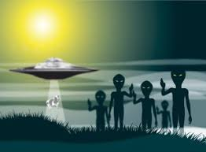
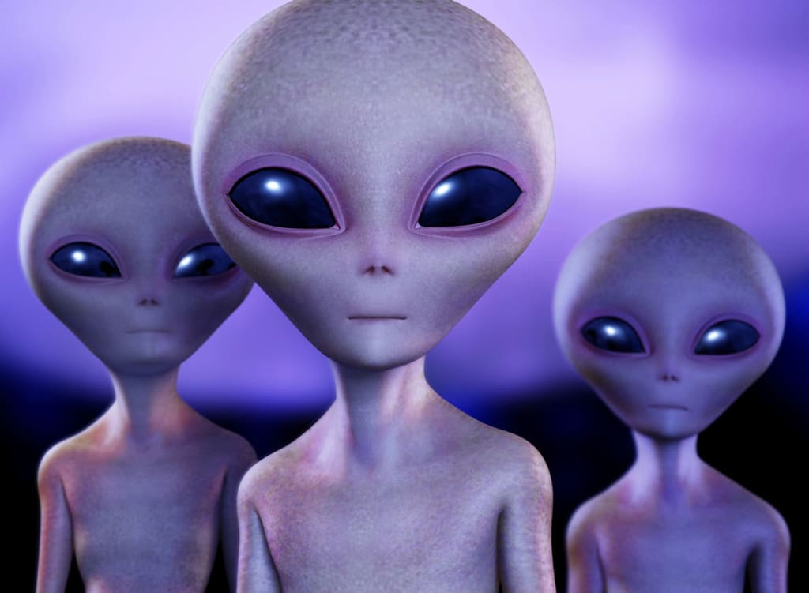
HANG MAN - CATCH THE ALIENS

Slide 3

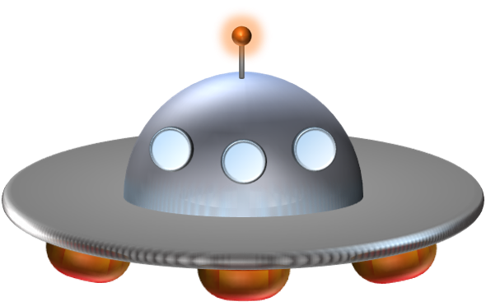

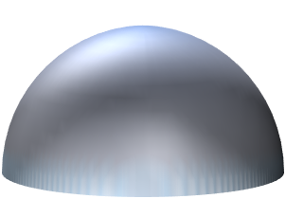


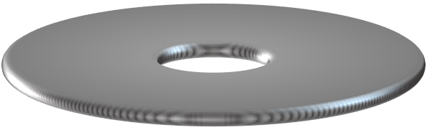

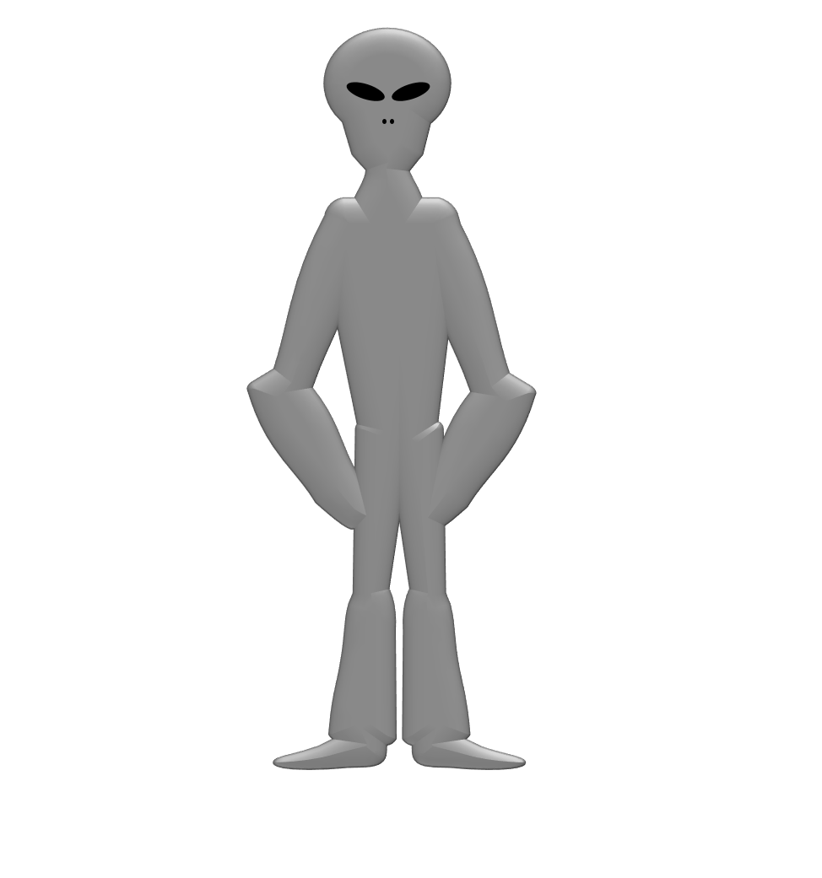



A
B
C
D
E
F
G
H
I
J
K
L
M
N
O
P
Q
R
S
T
U
V
W
X
F
O
O
D
A
N
D
Y
Z
BUILD
D
R
I
N
K
Notes:
Write the answer here

Slide 4

UNIT 5: VIETNAMESE FOOD AND DRINK
Period 34
LESSON 1 - GETTING STARTED

Slide 5

Use lexical items related to topic “Vietnamese food and drink”
Identify and locate specific details in the reading text
OBJECTIVES
Talk about favorite food and drink
Describe the taste of food and drink

Slide 6
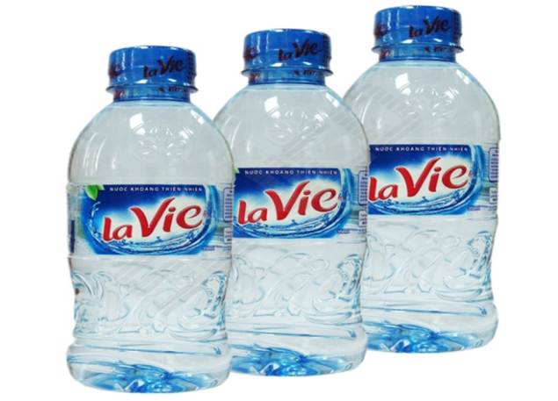
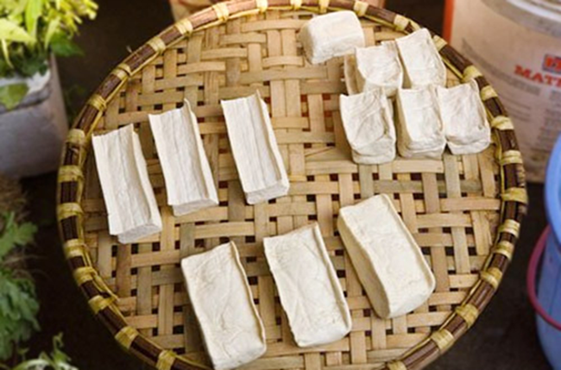
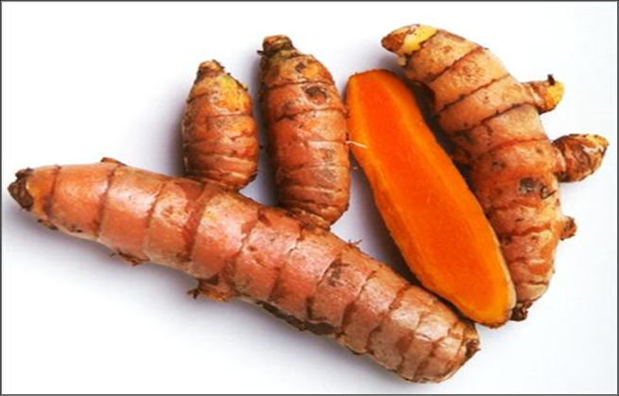
I. New words
mineral water (n)
/‘mɪnərəl ˈwɔːtə(r)/
nước khoáng
tofu (n)
/ˈtəʊfuː/
đậu phụ
turmeric (n)
/ˈtɜːmərɪk/
củ nghệ

Slide 7
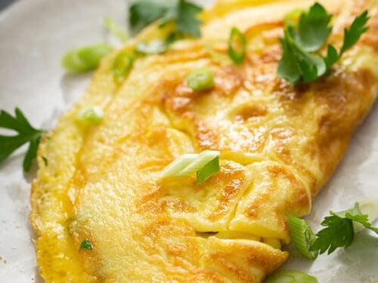
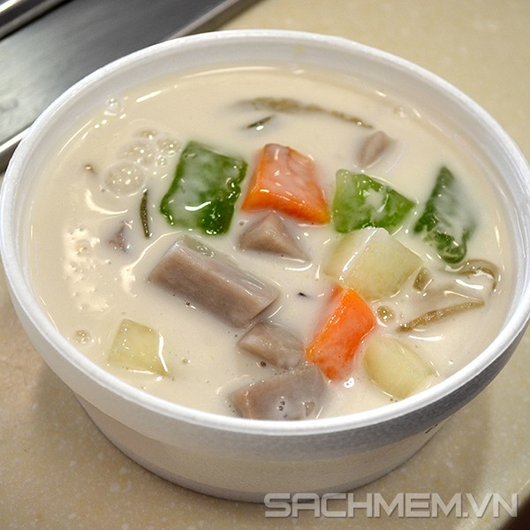
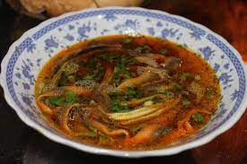
I. New words
omelette (n)
/ˈɒmlət/
trứng ốp-la
sweet soup (n)
/swiːt suːp/
chè
Eel soup (n)
/i:l suːp/
súp lươn

Slide 8
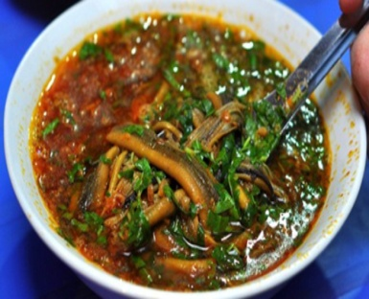
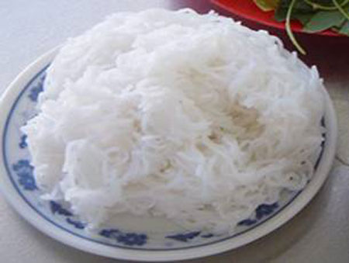
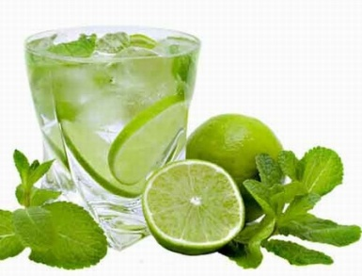
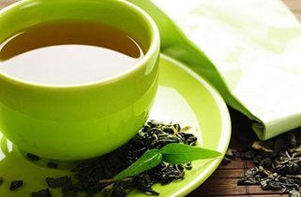
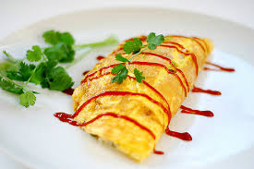
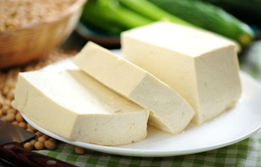
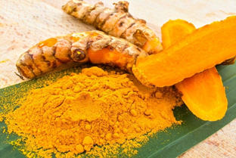
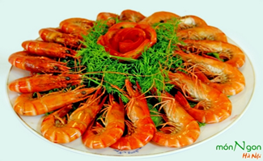
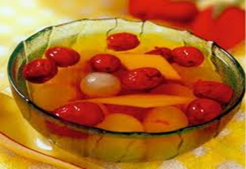
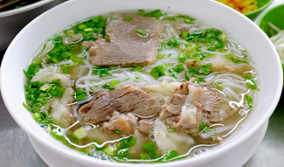
Checking: Ex2 (p49). Match the food and drink with the pictures
eel soup noodles tofu sweet soup beef noodle soup
lemonade green tea shrimp turmeric omelette
eel soup
omelette
1._______
2.______
3.______
4.______
5._____
noodles
lemonade
green tea
tofu
turmeric
sweet soup
beef noodle soup
6._____
7._____
shrimp
9._____
10._____
8._____

Slide 9
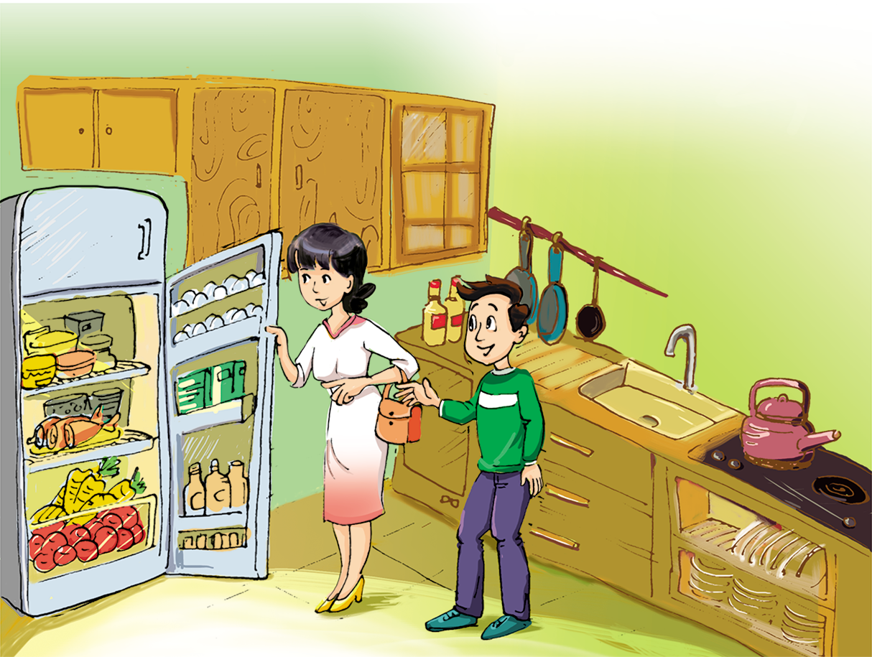
Dinner alone
Phong’s mum
Phong
What are there in the fridge?
Have you ever had dinner alone?
Where are they?

Slide 10

II. Listen and read
Dinner alone
Phong’s mum: Dad and I are going to the opera tonight and we won’t be home until 9 p.m. You’ll have to eat dinner alone. There’s some food for you in the fridge.
Phong: OK. Like what, Mum?
Phong’s mum: Some meat with tofu and some fried vegetables. I’m afraid there isn’t any bread left, but you can have noodles instead.
Phong: Er, but I usually have rice, Mum.
Phong’s mum: There’s some rice left from lunch. Just warm it up.
Phong: All right, Mum. What is there to drink?
Phong’s mum: There’s milk, juice, or mineral water.
Phong: How much milk is there?
Phong’s mum: Oh, I forgot... There isn’t any milk left. I’ll buy some tomorrow. You can have some orange juice instead. How many cartons do you want?
Phong: One... No, wait, two please.

Slide 11
Ex1. a. (p49) Read the conversation and answer the questions
1. Why must Phong eat dinner alone?
2. How much rice is left?
3. What should Phong do with the rice?
4. What will Phong’s mother buy tomorrow?
5. What can Phong drink instead of milk?

Slide 12
*Game: Lucky food and drink
Work in 2 teams (BOYS - GIRLS)
Choose the food or drink to open the question.
If you have correct answer, your team will get 10 points.
The team having more points will be the winner.

Slide 13
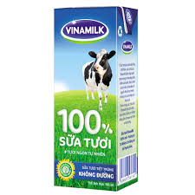

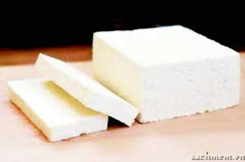
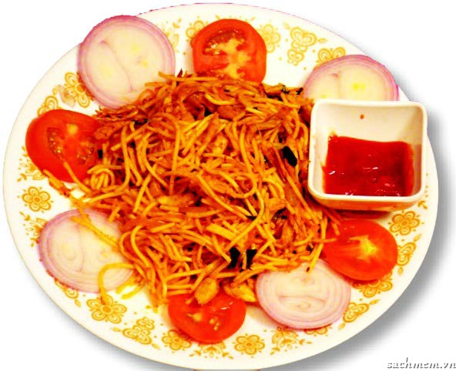

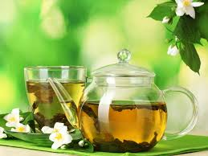

LUCKY FOOD AND DRINK
Team Girls
Team Boys
0
60
50
20
10
40
30
0
60
50
20
10
40
30

Slide 14
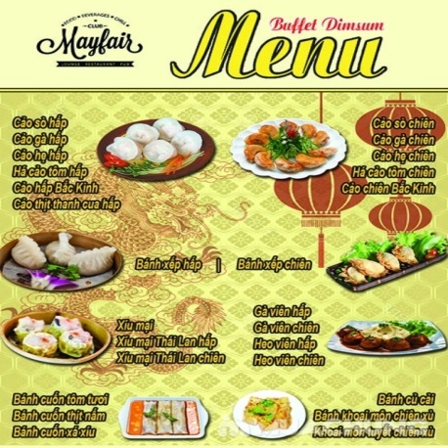
1.Why must Phong eat dinner alone?
Because his parents are going to opera tonight and they won’t be home until 9 p.m

Slide 15
2. How much rice is left?
There‘s some rice left from lunch

Slide 16
3.What should Phong do with the rice?
He should warm it up.

Slide 17
4. What will Phong’s mother buy tomorrow?
She will buy some milk.

Slide 18
5.What can Phong drink instead of milk?
He can have some orange juice instead of milk

Slide 19
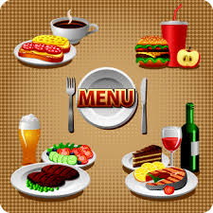

LUCKY PICTURE
LUCKY drink

Slide 20
LUCKY PICTURE
LUCKY food

Slide 21



Sorry!! You 've lost your turn.

Slide 22
Ex.1. a (p49) Read the conversation and answer the questions.
1.Why must Phong eat dinner alone?
2. How much rice is left?
3. What should Phong do with the rice?
4. What will Phong’s mother buy tomorrow?
5. What can Phong drink instead of milk?
Because his parents are going to opera tonight and won’t be home until 9 p.m
There is some rice left from lunch
He should warm it up.
She will buy some milk
He can have some orange juice instead of milk

Slide 23
Ex.1.b (p49). Find the words about food and drink in the conversation and put them in the correct column
Food | Drink

Slide 24
Phong’s mum: Dad and I are going to the opera tonight and we won’t be home until 9 p.m. You’ll have to eat dinner alone. There’s some food for you in the fridge.
Phong: OK. Like what, Mum?
Phong’s mum: Some meat with tofu and some fried vegetables. I’m afraid there isn’t any bread left, but you can have noodles instead.
Phong: Er, but I usually have rice, Mum.
Phong’s mum: There’s some rice left from lunch. Just warm it up.
Phong: All right, Mum. What is there to drink?
Phong’s mum: There’s milk, juice, or mineral water.
Phong: How much milk is there?
Phong’s mum: Oh, I forgot... There isn’t any milk left. I’ll buy some tomorrow. You can have some orange juice instead. How many cartons do you want?
Phong: One... No, wait, two please.
Food | Drink
meat
tofu
milk
juice
fried vegetables
bread
mineral water
noodles
rice
orange juice

Slide 25
Ex3 (p49). Think about your favorite food and drink. What questions can you ask about them? Ask and answer questions with a partner.
Example:
1. A: What’s your favorite food?
B: It’s beef noodle soup.
2. A: When do you usually eat it?
B: In the morning.

Slide 26

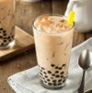




Ex4 (p49). Listen and repeat the adjectives
1. bitter 2. delicious
3. tasty 4. sweet
5. salty 6. spicy
7. fragrant 8. sour

Slide 27

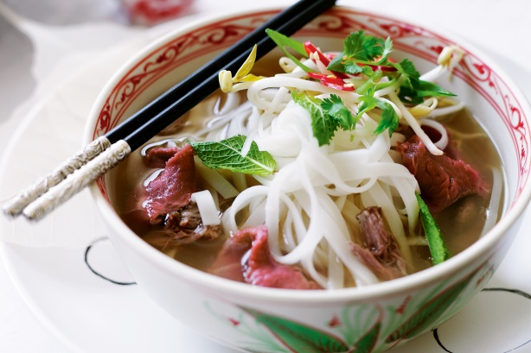
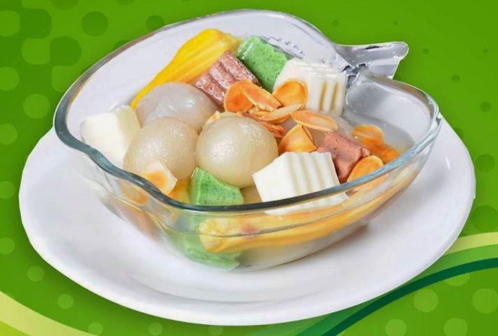

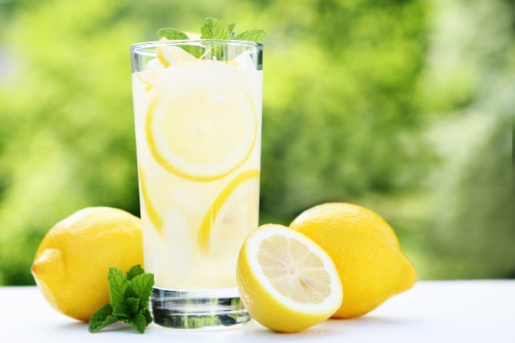
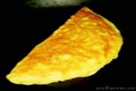
Use the adjectives to describe the food and drink in Ex.2
Green tea is bitter.

Slide 28
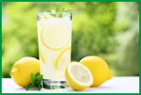

Beef noodle soup is fragant.
Beef noodle soup is tasty.
Beef noolde soup is delicious.
Green tea is bitter.
Sweet soup is sweet.
Lemonade is sour.
Omelette is tasty.
Eel soup is spicy.
Omelette is delicious.

Slide 29
Vocabulary
(tumeric, mineral water, omelette, eel soup, sweet soup, tofu)
Read for detailed information
WRAP-UP
Talk about favorite food and drink
Use adjectives to describe the taste of food and drink

Slide 30
III. Homework
Learn by heart new words.
Do exercises in workbook.
Practice asking and answering, describing about your favorite food and drink
Prepare: A closer look 1.

