Slide 1
UNIT 0 – MY WORLD
Lesson 0.4 My birthday is
(SB page 8)

Slide 2

Season song
Source: YouTube

Slide 3
Group work
Answer questions.
How many seasons are there in a year?
How many months are there in a year?
How many days are there in a week?

Slide 4

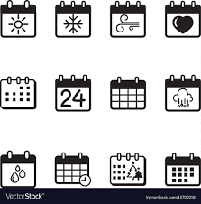
Objectives
I can:
ask and answer about the days, months, and seasons.
use cardinal numbers to count things and ordinal numbers to say about dates.

Slide 5

Time
365
12
7
4
year
months
days
seasons

Slide 6

Exercise 1 (SB page 8)
Write the missing days of the week.
Tuesday
Wednesday
Thursday
1. Monday | 2. _____ | 3. ________ | 4. _____
Saturday
5. Friday | 6. ______ | 7. Sunday

Slide 7

Spelling game!
Tuesday
T – U – E – S – D – A - Y

Slide 8


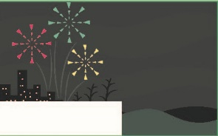
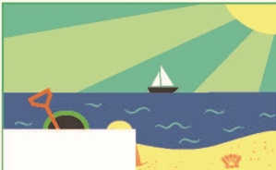
Exercise 2 (SB page 8)
Complete the calendar
August
February
May
November

Slide 9
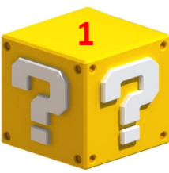
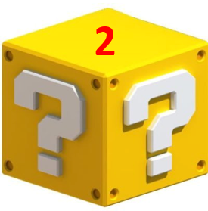

Super ears – Super hand
1. Which month goes after June?
July
2. Which month goes between January and March?
February
3. Which month is Christmas in?
December

Slide 10
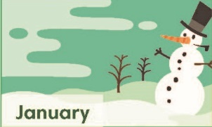
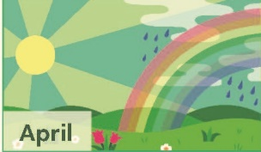

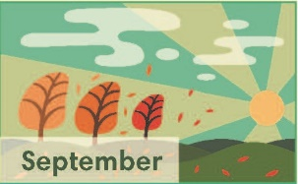
What season is it?
Winter
Spring
Summer
Autumn

Slide 11
Exercise 3 (SB page 8 )
In pairs, write the months for each season.
Summer
May June July
……….., …………., ….…...
Autumn
August September October
………………, ………………….……., ………………...
Winter
November December January
…………………..…, ……………….……., ………………...
Spring
February March April
……………….…, ……..……., ………...

Slide 12

Season quiz!
Which season is hot and sunny?
Which season has lots of snow and ice?
Which season is also called fall?
Which season has lots of rain and flowers blooming?
Which season do people wear shorts and T-shirts?
Which season does a school year start?
1. Summer
3. Autumn
5. Summer
2. Winter
4. Spring
6. Autumn

Slide 13
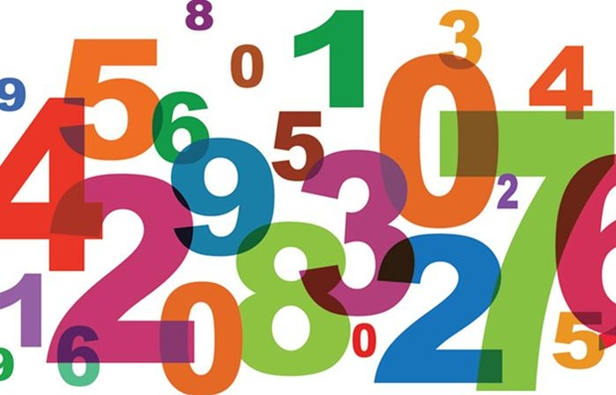
Numbers

Slide 14
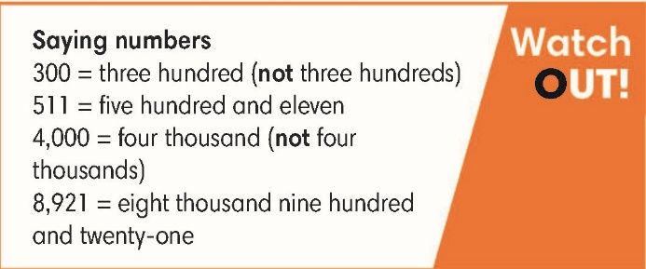
Exercise 4 (SB page 8)
Listen and write the numbers you hear.
Thirteen
Thirty
Nineteen
Ninety
One hundred and fifty – nine
Five hundred and twenty – six
Seven hundred and sixty – three
Two thousand, three hundred and sixty – one

Slide 15
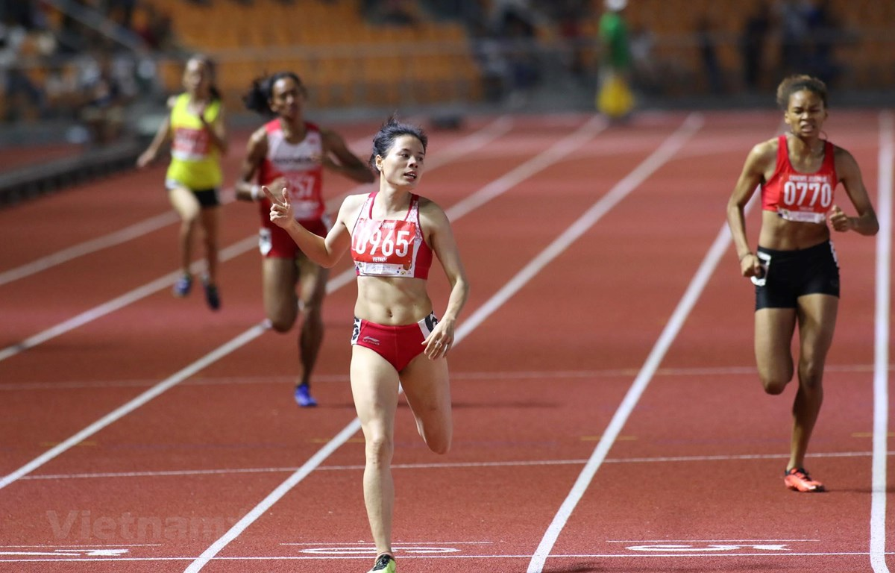
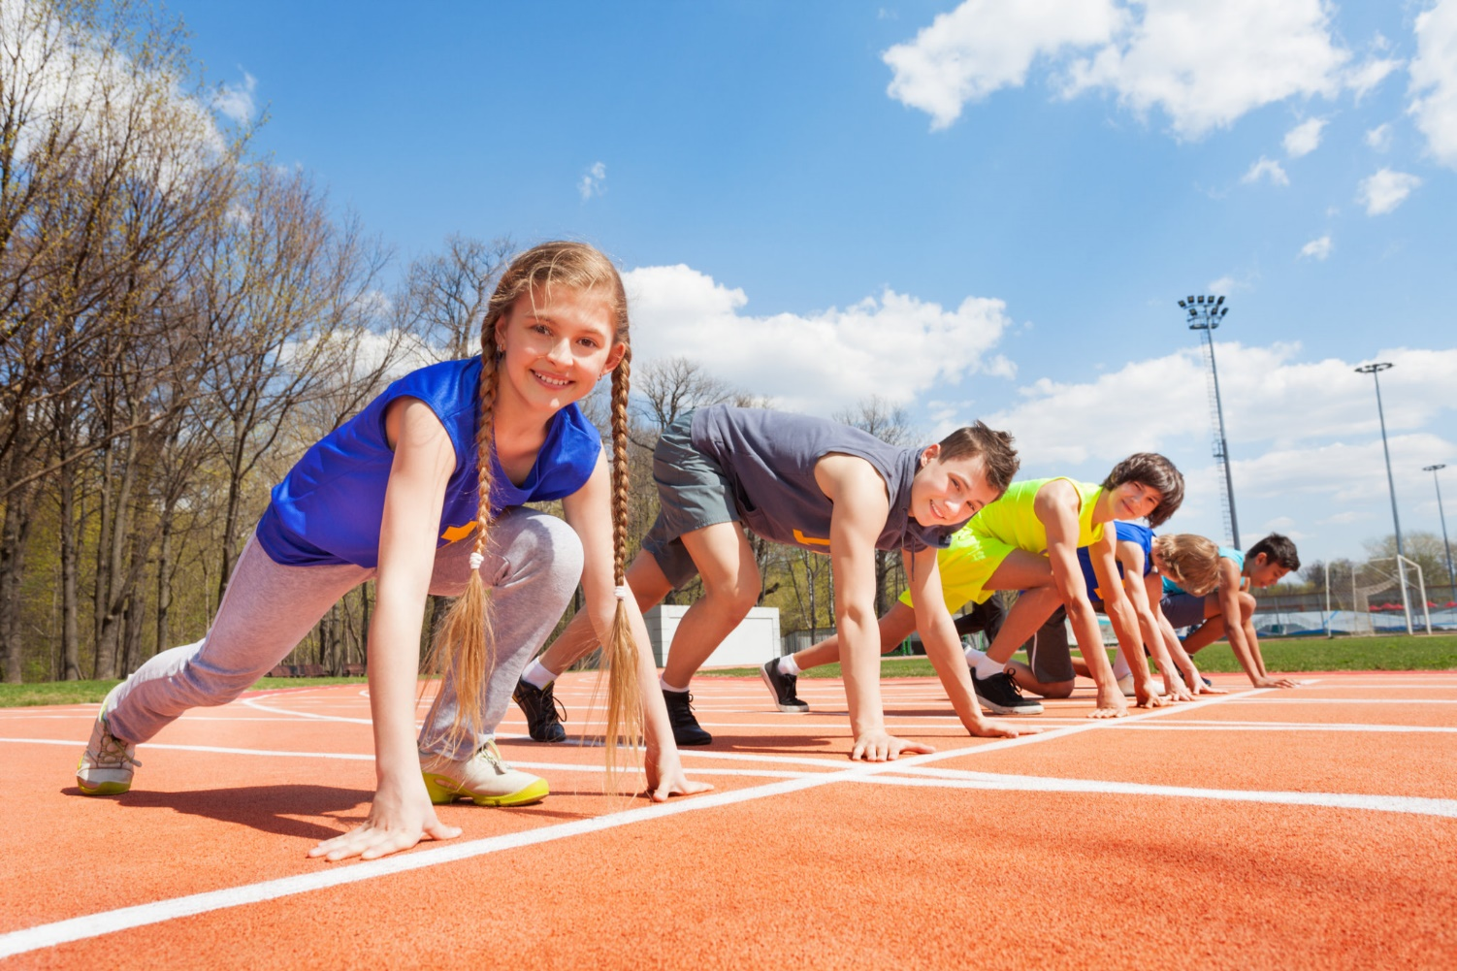
Five athletes
First
Second

Slide 16
Exercise 5 (SB page 8)
Write the ordinal numbers in words.
3rd | 4th | 15th | 26th
Third
Fourth
Fifteenth
Twenty - sixth

Slide 17
Exercise 6 (SB page 8)
Listen and choose the date you hear.
1 | a 1st January | b 11th January
2 | a 13th March | b 30th March
3 | a 29th July | b 20th July
4 | a 13th October | b 30th October
5 | a 21st December | b 23rd December

Slide 18
Exercise 7 (SB page 8)
Ask and answer questions.
What’s your favorite day of the week?
It’s …….
What’s your favorite month and season?
When’s your birthday?

Slide 19
Survey
Name Questions | A | B | C | D
1. What's your favorite day of the week?
2. What is your favorite month and season?
3. When's your birthday?

Slide 20


