Slide 1
UNIT 1 – MY WORLD
Lesson 0.3 In my class
(SB page 6)

Slide 2

Objectives
I can
make imperative and give classroom rule.
make sentences with object pronouns correctly.

Slide 3


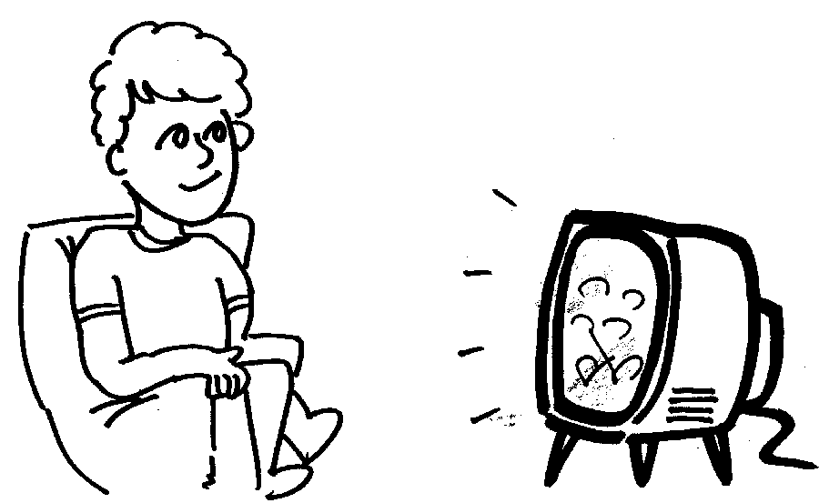

Complete the classroom rules for an English class.
Exercise 1 (SB page 7)
1
talk
3
watch
2
write

Slide 4
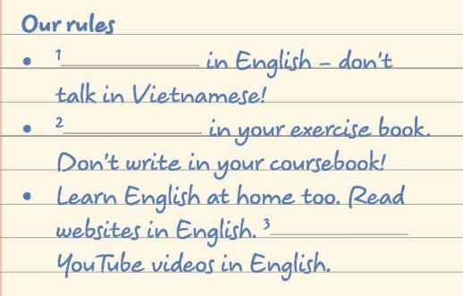

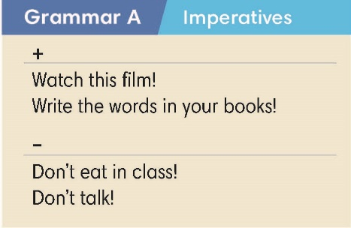
Exercise 2 (SB page 7)
Find examples of imperatives in Exercise 1.
Vinfinitive
should do
Don’t + V
Shouln’t do
Imperatives

Slide 5

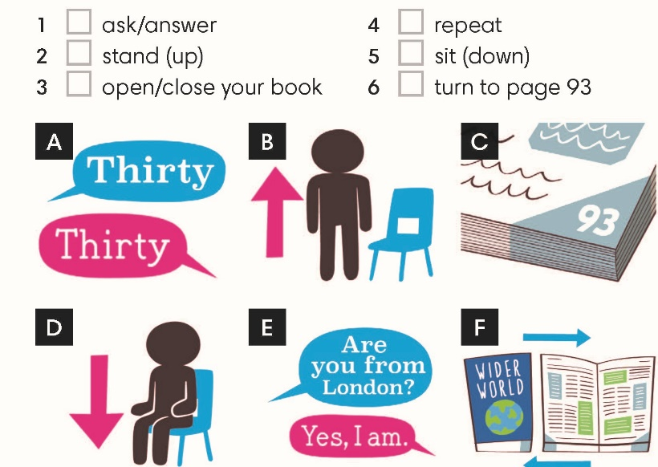
Exercise 3 (SB page 7)
Match verbs 1-6 with pictures A-F. Listen and follow the instructions
1. E
4. A
2. B
5. D
3. F
6. C

Slide 6


Class vote!
Work in groups. Write 6 rules for class.
Examples
Bring materials
Don’t eat

Slide 7

Exercise 5 (SB page 7)
Match questions 1-4 with answers a-d.
Listen and check.
1. What’s the English word for “thú vị”?
2. Excuse me, which page are we on?
3. What’s the spelling of exercise?
4. What’s the homework?
a. Exercise 5 on page 4.
b. Interesting.
c. E-X-E-R-C-I-S-E.
d. Page 9.

Slide 8

Be the Teacher
What is English word for “thành công”?
Challenge
Succeed

Slide 9


Object pronouns
Magda’s a nice girl. Talk to ___.
A.
her
B. she
C. it
Object pronoun
Receive action
Noun/name
After verb
I put the book on the table.
Subject pronoun
it

Slide 10
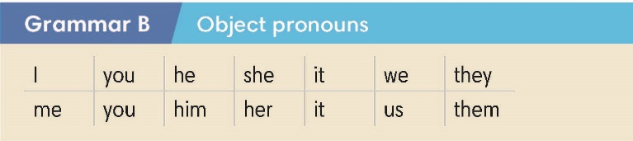
Exercise 4 (SB page 7)
Complete the sentences with object pronouns
2. me
3. us
4. him
5. it
6. you
7. them

Slide 11


