Slide 1
UNIT 1 – MY WORLD
Lesson 0.5 What’s your…?
(SB page 9)

Slide 2

Jumbled word
1. rwtine
2. ecmeedbr
3. nopeh
4. lccko
5. reunbm
6. uteiqons
winter
december
phone
clock
number
question

Slide 3



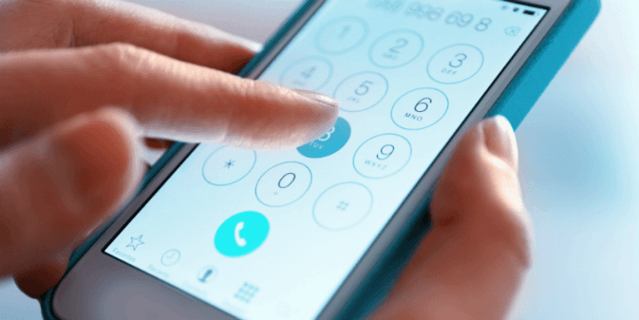
Objectives
I can
tell the time.
say phone numbers.
make correct questions.

Slide 4




Two - fifty
Ten to three
Hour - Minutes
Past / To
30’ = half past
15’ = a quarter to
day
night

Slide 5

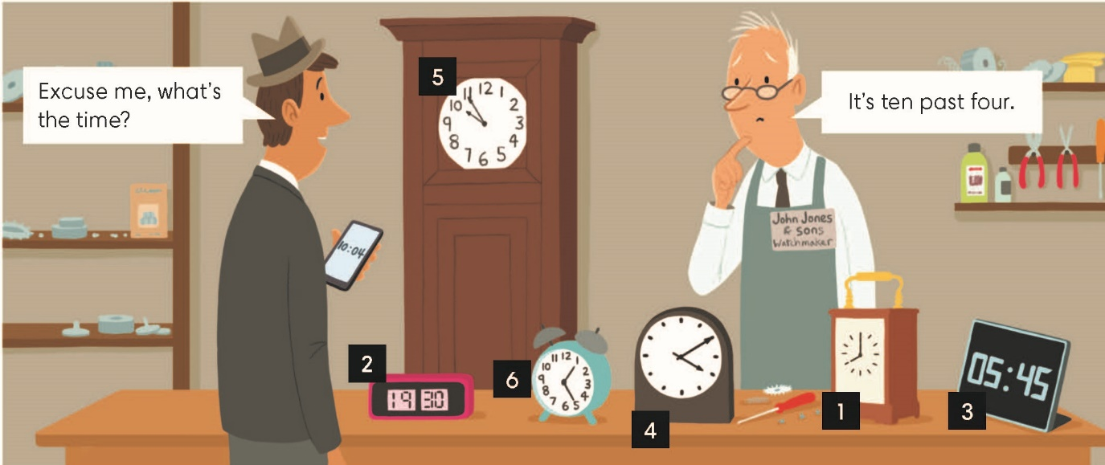
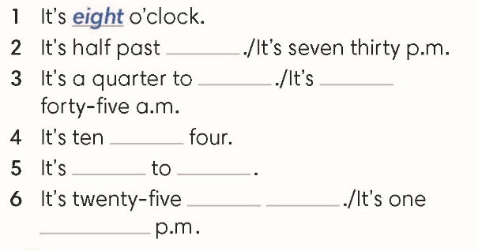
Exercise 1 (SB page 10)
In pairs, complete the time for the clocks in the picture
2. seven
3. six/five
4. past
5. five, ten
6. past one/ twenty- five

Slide 6
Exercise 2 (SB page 9)
Listen to the six short dialogues and write the times.
3.00 pm
1.45
5.10
8.40
7.30
11.15

Slide 7
Wh - question
What | Asking for information about something.
Where | Asking about places or positions
When | Asking about time
Who | Asking about person or people
How old | Asking about age

Slide 8
Wh - question
Wh – questions
What/Where/When How old | am | I?
 | is | he/she/it?
 | are | you/we/they?

Slide 9
Exercise 3 (SB page 9)
Make questions
1.
your
name
What
?
is
2. Where are you from?
3. When is your birthday?
4. Who is your best friend?
5. How old are you?
6. What is your favorite thing?
7. What is your phone number?

Slide 10
Exercise 4 (SB page 9)
Complete the interview with the questions in Exercise 3.
b.
c.
d.
e.
f.
g.
5
2
3
7
4
6

Slide 11
Exercise 6 - (SB page 11)
In pairs, ask and answer the questions in Exercise 3.
2. Where are you from?
3. When is your birthday?
4. Who is your best friend?
5. How old are you?
6. What is your favorite thing?
7. What is your phone number?

Slide 12
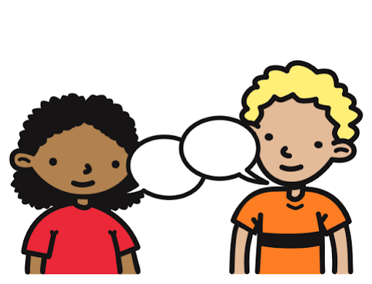
Saying phone numbers
…….
What’s your phone number?

Slide 13

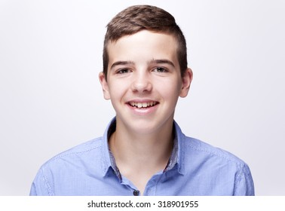
Exercise 5 (SB page 9)
In pairs, takes a turn to say phone numbers.
six nine double three-oh double five four.
69330 554

Slide 14


