Slide 1

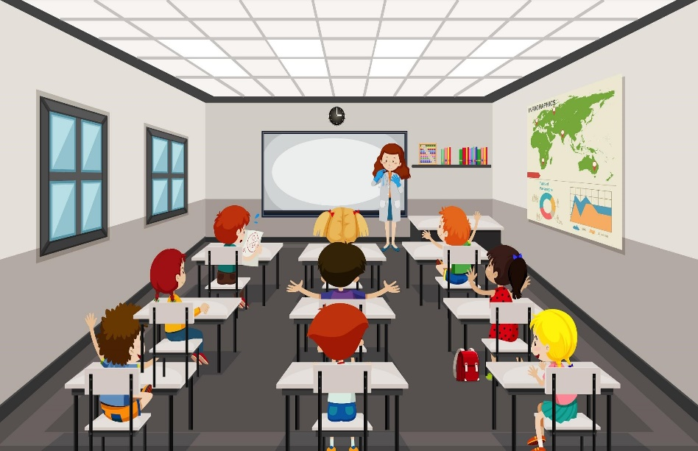

Welcome to our class
TEACHER: VU THU THUY

Slide 2

PHÁT ĐỘNG CUỘC THI TIẾNG ANH QUỐC TẾ TOEFL Junior Challenge năm học 2022-2023.
-Dành cho học sinh lớp 6 đến lớp 9.
-3 vòng thi.
-Vòng 1: triển khai bài thi trải nghiệm tiếng Anh quốc tế TOELF JUNIOR trực tuyến và miễn phí.
-Vòng 2: vòng thi cấp thành phố. Học sinh nộp lệ phí, để được cấp Phiếu điểm TOEFL JUNIOR quốc tế. Cơ hội để các em được tuyển thẳng/ưu tiên xét tuyển vào nhiều trường PTTH chất lượng.
-Tại vòng chung kết quốc gia-vòng 3-Học sinh tiếp tục được Ban tổ chức tài trợ toàn bộ lệ phí thi và được cấp chứng chỉ điểm quốc tế TOELF ITP.
-Các con tham gia, đăng ký với Giáo viên Tiếng Anh-cô Vũ Thu Thủy-0986777886 hoặc GVCN. Trân trọng.

Slide 3


*Shark attack
- 2 teams.
- to find the hidden words. C R A Z Y
The team which finds the word first will be the winner
.

Slide 4






Unit 2: My house
Lesson 5 – Skills 1

Slide 5

Objectives
Read for specific information about rooms and furniture.
Describe one room and positions of things in the room.
Notes:
Our lesson today has 2 main objectives:

Slide 6



This is Nick. He is having a trip to Da Lat.
He is staying in a hotel with a special name.
Guess the letters.
C
2
3
4
5
1
R
A
Z
Y
Notes:
This is Nick. He is having a trip to Da Lat. He is staying in a hotel with a special name. Guess the letter.s.
Yeah! It’s CRAZY.
And to be more specific, Nick is staying in a room at the Crazy house hotel in Da Lat.

Slide 7
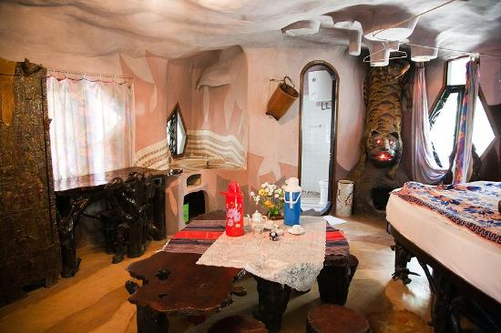
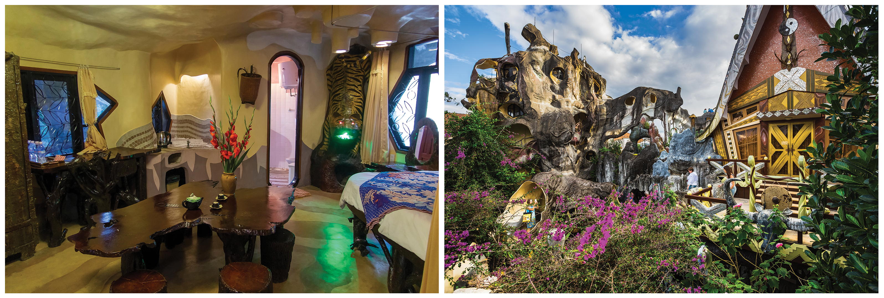
email addresses
Before we read the text, can you guess?
To: phong@webmail.com;
mi@webmail.com
Subject: A room at the Crazy House Hotel
Hi Phong and Mi,
How are you? I'm in Da Lat with my parents. We are staying at the Crazy House Hotel. Wow! It really is crazy.
There are ten rooms in the hotel. There’s a Kangaroo Room, an Eagle Room, and even an Ant Room. I’m staying in the Tiger Room. It’s called the Tiger Room because there’s a big tiger on the wall.
You should visit here, it's great.
See you soon!
Nick
1. Is it an email or a letter?
=> It’s an email.
2. What is the text about?
=> Nick's room at the Crazy House Hotel.
Notes:
Before we read the text, can you guess?

Slide 8


Reading skill: Predicting
Predicting makes reading easier.
Before reading, look at the pictures, design and tittle to guess the topic of the text.
Think about what you know about the topic.
Notes:
Predicting is an important reading skill because it makes reading easy.
How to predict? Look at the pictures, design and tittle to guess the topic of the text.

Slide 9

To: phong@webmail.com;
mi@webmail.com
Subject: A room at the Crazy House Hotel
Hi Phong and Mi,
How are you? I'm in Da Lat with my parents. We are staying at the Crazy House Hotel. Wow! It really is crazy.
There are ten rooms in the hotel. There’s a Kangaroo Room, an Eagle Room, and even an Ant Room. I’m staying in the Tiger Room. It’s called the Tiger Room because there’s a big tiger on the wall.
The tiger is between the bathroom door and the window. The bed is under the window, but the window is a strange shape. I put my bag under the bed. There’s a lamp, a wardrobe and a desk. You should stay here when you visit Da Lat. It’s great.
You should visit here, it's great.
See you soon!
Nick
Ex.3 - Read the email and answer these questions
Look at the questions and underline key words
1. Who is Nick in Da Lat with?
1
→ His parents.
2
2. How many rooms are there in the hotel?
→ There are ten rooms.
3. Why is the room called the Tiger room?
3
→ Because there's a big tiger on the wall.
4
4. Where is Nick’s bag?
→ Under the bed.
Notes:
Underline keywwords and answer these questions

Slide 10
Enter the link in the chat box.
Go to Liveworksheet and choose the things in the Tiger room
To: phong@webmail.com;
mi@webmail.com
Subject: A room at the Crazy House Hotel
Hi Phong and Mi,
How are you? I'm in Da Lat with my parents. We are staying at the Crazy House Hotel. Wow! It really is crazy.
There are ten rooms in the hotel. There’s a Kangaroo Room, an Eagle Room, and even an Ant Room. I’m staying in the Tiger Room. It’s called the Tiger Room because there’s a big tiger on the wall.
The tiger is between the bathroom door and the window. The bed is under the window, but the window is a strange shape. I put my bag under the bed. There’s a lamp, a wardrobe and a desk. You should stay here when you visit Da Lat. It’s great.
You should visit here, it's great.
See you soon!
Nick
a window
a wardrobe
a cooker
a cupboard
a shelf
a lamp
The tiger is between the bathroom door and the window. The bed is under the window, but the window is a strange shape. I put my bag under the bed. There’s a lamp, a wardrobe and a desk. You should stay here when you visit Da Lat. It’s great.
a desk
a tiger
Room’s name
To describe a room, what should we include?
Things and their position in the room
Notes:
https://www.liveworksheets.com/c?a=s&g=6&s=English&t=5qx1gfk7sh5&mn=u&m=d&sr=y&is=y&ia=y&ms=uz&l=zp&i=dcdscds&r=qf&db=0&f=dzduzntz&cd=p8tm7bec3pw8xniiighnknpknpte2ngnxglzgxg
The top 3 quickest students with all the correct answers will be the winners.
Are you ready?

Slide 11
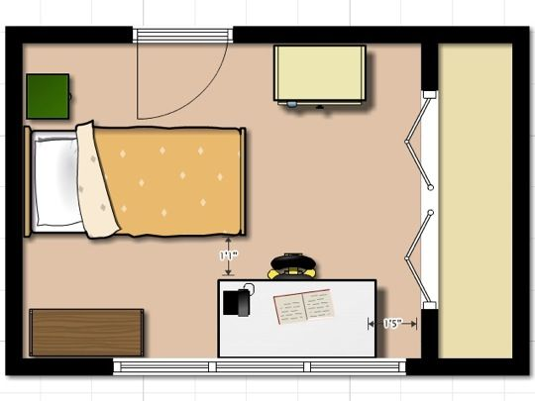
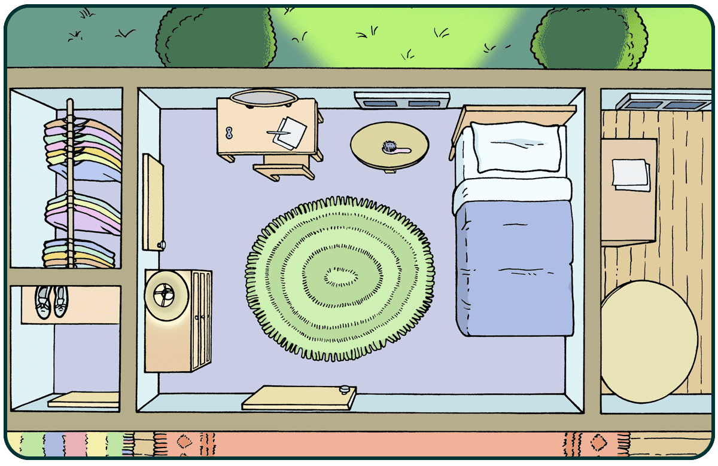
To attract more people, the Crazy House Hotel is going to add a new room.
In group of 6,
Draw a plan for the new room and talk about it.
Example:
window
desk
wardrobe
bed
Notes:
Đường link truy cập Jamboard:
https://jamboard.google.com/d/1jYWy_xYbl9lyKLxLFg31klcqRQQRgriIvQpRkr_18Q8/edit?usp=sharing
These are two examples.

Slide 12
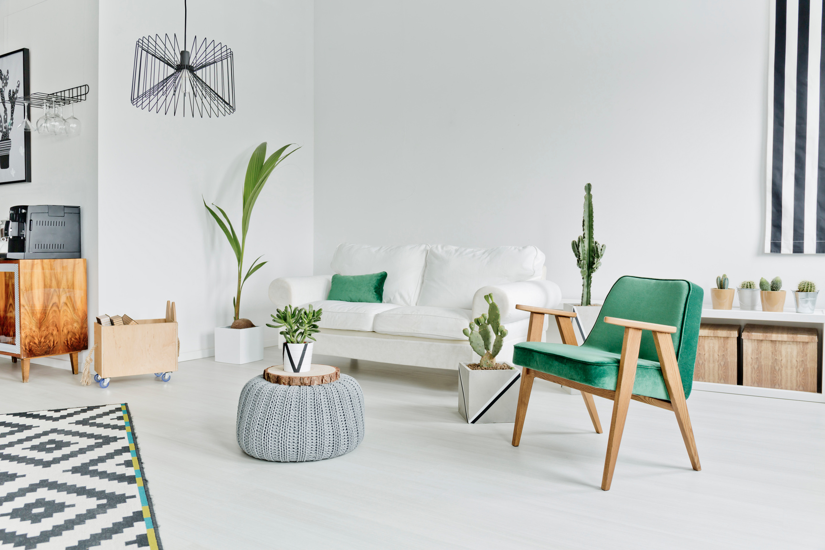
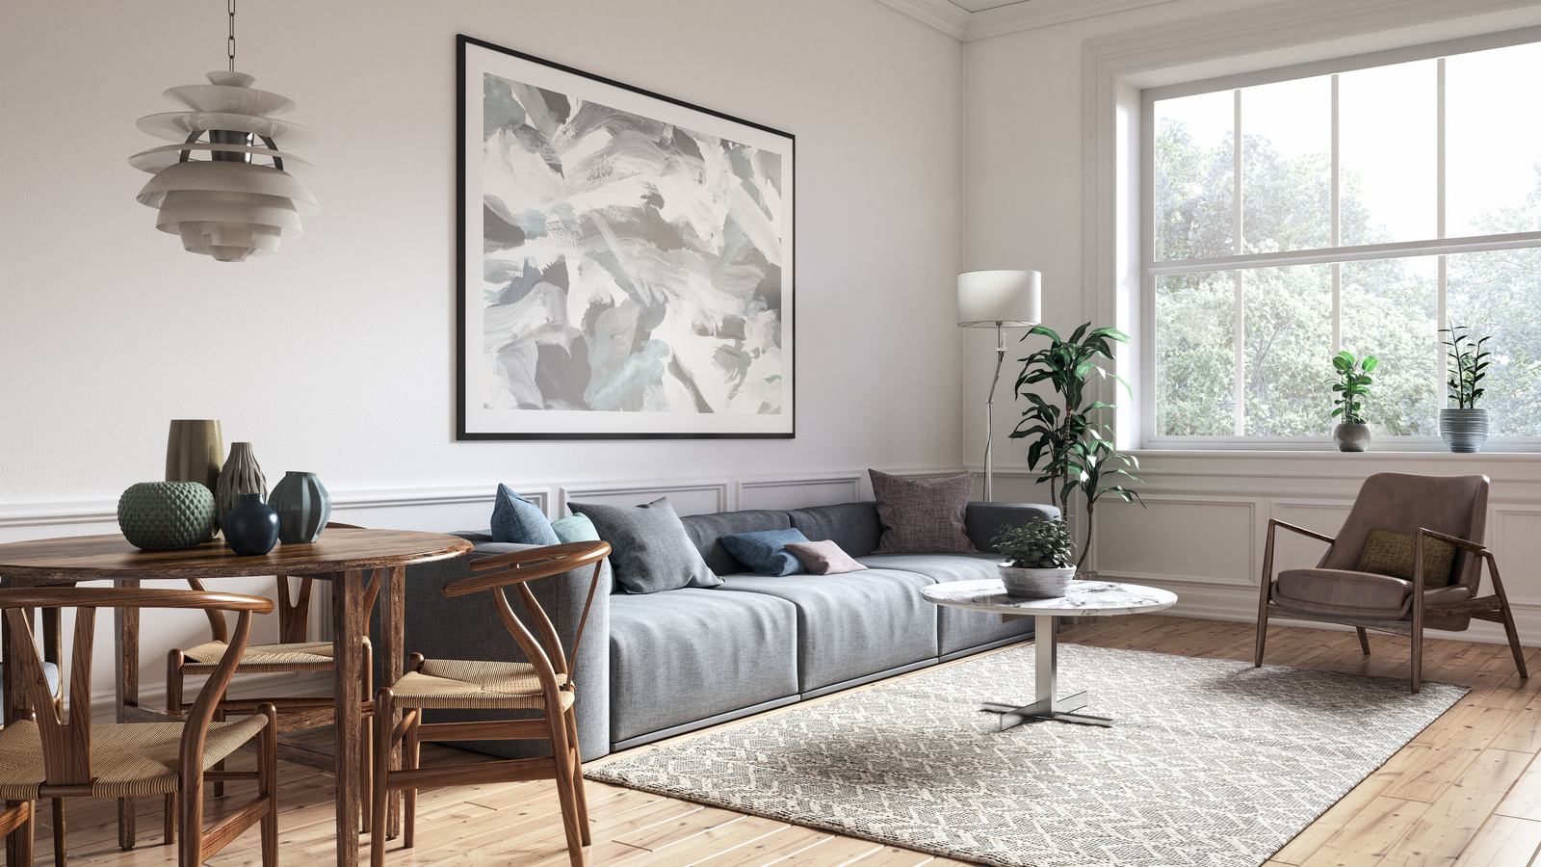
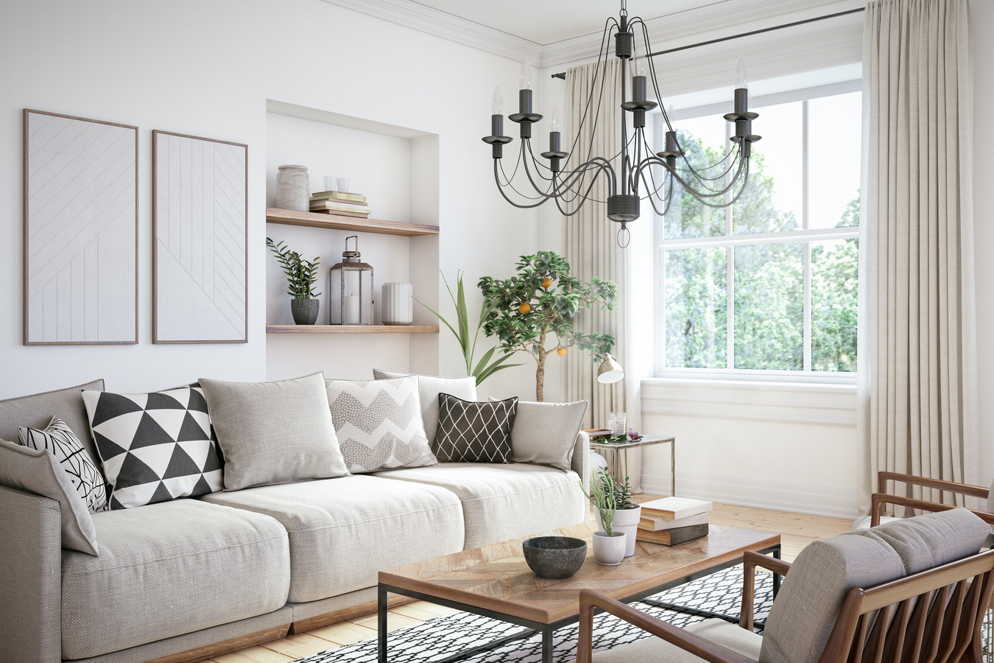
Procedure of group work
Step 1: Go to the private room and join your group
Step 2: Decide the role of each person in your group:
Who is leader? (trưởng nhóm)
Who are room designers? (người thiết kế phòng)
Who are presenters? (người thuyết trình)
Step 3: Go to Google Jamboard and create the new room
(8 minutes)
Your Room number in Teams is your Group number
Notes:
Step 1: Go to the private room and join the group => Step 2: Decide the role of each person in the group: Who is leader? (trưởng nhóm), Who are room designers? (người thiết kế phòng), Who are presenters? (người thuyết trình) => Step 3: Go to Google Jamboard and create the new room (8 minutes). Your Room number in Teams is your Group number

Slide 13

Show time!

Slide 14
Wrap-up
1. What skills have you learned today?
Reading & speaking
2. What is the main topic of the text?
Nick’s room at the Crazy House hotel
3. To describe a room, what should we include?
Room’s name & things in the room

Slide 15
Presentation check-list
 | Yes | No
1. Does the talk have 3 parts: Opening, body and closing?
2. Does the speaker give a name for the new room?/ Is there a photo/picture/drawing of it?
3. What things are there in the room? Where are they?
4. What prepositions do they use?
5. Does the speaker use the present simple?
6. Does the speaker talk in the limited time (2 mins)?
Notes:
Gửi lên google doc để học sinh feedback

Slide 16



Homework
* Learn the vocabulary.
* Write the exercises in your notebook.
* Prepare for next period: Unit 2: Lesson 6 – skills 2.

Slide 17



Thank you for your attendance
Goodbye ! See you again !

