Slide 1

WELCOME TO CLASS 8A2
Teacher – Vu Thu Thuy

Slide 2

REVISION

Slide 3

OBJECTIVES
-Students are reviewed about present tense
-You can practice with them.

Slide 4
GRAMMAR
Present simple for the future

Slide 5
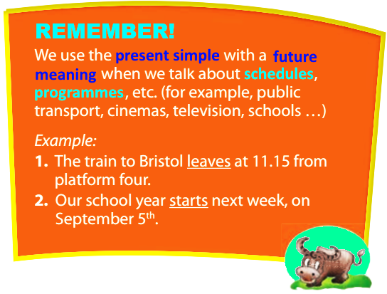
Work in groups. Discuss the questions.
Click
- The debating Competition takes place in the Main Hall on April 3rd.
- The bus for the excursion to the chocolate factory leaves at 8.00 a.m on April 14th.
1. What time do the sentences refer to: the present or the future?
The future
2. What tense are the verbs in the sentences?
The present simple

Slide 6

EXERCISES

Slide 7

Use the verbs in the box in present simple tense to complete the sentences:
Arrive, be, have, leave, open, retire, return, rise, start, visit.
The plane from London to Paris ……………………………………in fifteen minutes.
The Music Festival ………………………….on the first Saturday of next month.
Mr. Nam……………………………………breakfast with the president of the United States tomorrow.
As you are in Paris now, the sun…………………………a minute earlier tomorrow.
The train (not)……………………………in London at 11 tonight as it departed late.
There……………………another bus to Canberra in half an hour.
Mr. and Mrs. Wilson…………………to California this weekend.
My brother…………………work in Liverpool next Monday.
We……………………the Golden Gate Bridge in San Francisco on day 6.
I think that Julia’s father…………………………in two years.
leaves
opens
has
rises
Doesn’t arrive
is
return
starts
visit
retires

Slide 8

Choose the best answer to complete each of the following sentences:
The Statue of Liberty is a major monument in New York which …………..freedom.
Attracts B. symbolizes C. decides D. understands
2. Like the Kangaroo and koala, the platypus is a ……………animal in Australia.
Scenic B. tailless C. foreign D. unique
3. David uses English as his mother………………because he comes from the UK.
Tongue B. mouth C. nose D. cheek
4. The Sydney Opera house is an………….of Australia’s creative and technical achievement.
Orchestra B. emblem C. icon D. armorial
5. The government of New Zealand has done a lot to …………the culture of the Maori.
Preserve B. surround C. puzzle D. pronounce
6. Coming to Scotland, visitors can drive through vast green……………
Lochs B. stations C. castles D. pastures
7. How is your holiday in New Zealand? ………………………………….
A. Really B. Awesome C. Absolutely right D. Sure

Slide 9
8. The flight number 781 to Melbourne……………….at 9 o’clock tomorrow morning.
Arrives B. is arriving C. has arrived D. will arrive
9. Some documentary say that people …………………the Glastonbury Festival since the beginning of the 19th century.
Celebrated B. were celebrating
C. have celebrated D. celebrate
10. We……………on the Great Ocean Road, an Australian National Heritage at the moment.
A. Will drive B. drive C. have driven D. are driving

Slide 10
Complete the sentences with the correct form of the verbs in present tenses (present simple, present continuous or present perfect):
A koala (spend)…………………………………………….about 18-20 hours sleeping in tree forks.
It’s only my first week in Wales, and I (see)……………………………………………..so many interesting things already.
The number of kiwis in this area (decrease)…………………………………quickly.
The Aborigines (live)……………………………………………….in Australia for more than 40.000 years.
Most European citizens (not have)……………………………………………to apply for a visa to visit Canada.
At the moment, thousands of people (gather)……………………………………..in Trafalgar Square, London to celebrate St Patrick’s Day.
spends
Have seen
Is decreasing
Have lived
Don’t have
Are gathering

Slide 11
WRAP UP
-Students are reviewed about present tense well.
-You can practice with them fluently.

Slide 12

HOMEWORK
-Practice more at home

Slide 13


