Slide 1

WELCOME TO CLASS 8A2
Teacher – Vu Thu Thuy

Slide 2
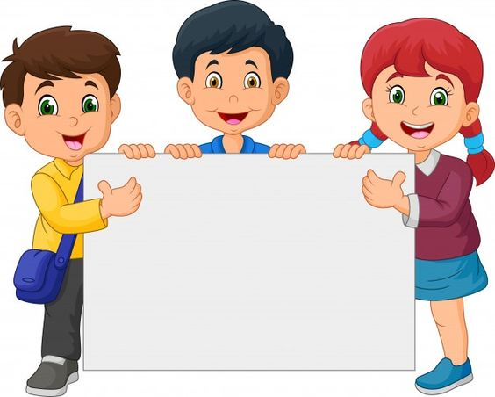
PERIOD 98
REVISION 2

Slide 3
1. Read the passage and mark T or F.
Texting is a new way of exchanging information, and it is becoming more and more popular among the young. In fact, texting is clearly affecting language. There are no rules for it. We are creating a new aspect of vocabulary and opening up a new kind of playful and direct communication. Naturally, texting is fun and that’s fine, but some people are worried about the effects it might have on a child’s ability to read and write. But not everyone is so worried. An expert says, “Every time a new medium comes along it has an effect on language … But this doesn’t destroy the existing language, it adds to it.” In text messages, many words come from shorthand created in email, such as CUS (See you soon) and so on. Someone says, “Mostly they are original, but sometimes you get a clash of meanings. For example, LOL can mean both Laugh Out Loud and Lots of Love. That could lead to some misunderstandings.”

Slide 4
T
There are no rules for texting.
2. Texting is always affecting language in a bad way.
3. Everyone is worried about texting.
4. A child should not write text messages.
5. A child is said to enrich a language.
6. Sometimes, there is more than one way of understanding a message.
F
F
F
T
T

Slide 5
II. SPEAKING: Choose one of the questions that interests you the most.
1. What form of communication is used most widely today?
2. What form of communication do you think will be used the most in 2100?
3. What is the most important invention of the past hundred years?
4. Who is the greatest person in the history of science?
5. What would life be like on Mars in 100 years’ time?

Slide 6

III. LISTENING: Listen and choose the correct answer
Nick: I had a disastrous morning.
Mike: Oh, what happened?
Nick: I couldn’t find my mobile phone so I went out to find a phone bo­x. It took me half an hour to find a phone box that worked — the first three were all out of order. After that, I dialed Tom’s number and heard the phone ringing, but then there was a silence!
Mike: And then?
Nick: I dialed again and got a wrong number. The third time I had - crossed line — I could hear two people having a personal conversation. The fourth time, I managed to speak to Tom, and we exchanged a few words, then we were cut off and we lost the connection. I got very angry
Mike: And...?
Nick: When I tried again later, he wasn’t in the office.
Mike: But Nick, tell me, what did you want to tell your brother so urgently?
Nick: That my home telephone is out of order. Tom is the Head of the Telecom Department.

Slide 7
1. How many times did Nick try to phone his brother?
A. Three B. Four C. Five
2. Mike asked Nick ___________.
A. why he got very angry B. what he wanted to tell Tom
C. if he had the wrong number
3. Where was Tom when Nick phoned the last time?
A. He was out. B. He was busy. C. He was at home.
4. Nick wanted to get in touch with Tom because ___________.
A. his landline telephone was out of order
B. they were cut off C. he had a crossed line
5. Nick had a communication breakdown because of ___________.
A. a language barrier B. cultural differences
C. a lack of communication channels
⃝
⃝
⃝
⃝
⃝

Slide 8
IV. WRITING: Write an online message to a friend and tell him about the problems you have had recently with your Ipad
+ time-consuming + flat battery
+ weak signal + no connection
Hi Nam,
I got an iPad. It is very interesting but also makes me confused. It is also time-consuming because there are much information I would like to know and I spend much time on it. And the battery is flat, I just can use it in 5-6 hours. Sometimes the wifi is not very good and Í will have no connection with Internet. I think I could be due to the problem with the wifi connection output of my iPad. When I open 2-3 applications at the same time, the touch screen is not very sensitive and sometimes the iPad stands by. If I have free time, I will have it repaired in Apple shop.

Slide 9
Homework
Learn by heart the new words.
Speak with your friends
Prepare for the next..

Slide 10


