Slide 1

CLASS 8A2
Teacher – Vu Thu Thuy

Slide 2



Period 105
UNIT 12: LIFE ON OTHER PLANETS
LESSON 7: LOOKING BACK & MINI-TEST

Slide 3


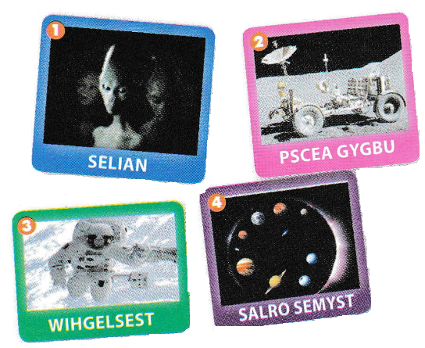

1. Aliens
2. Space buggy
3. Weightless
4. Solar system
All Call
Student Demo

Slide 4
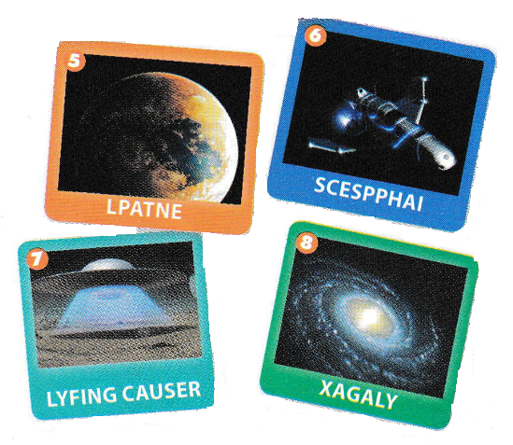
5. Planet
6. Spaceship
7. Flying saucer
8. Galaxy
All Call
Student Demo

Slide 5

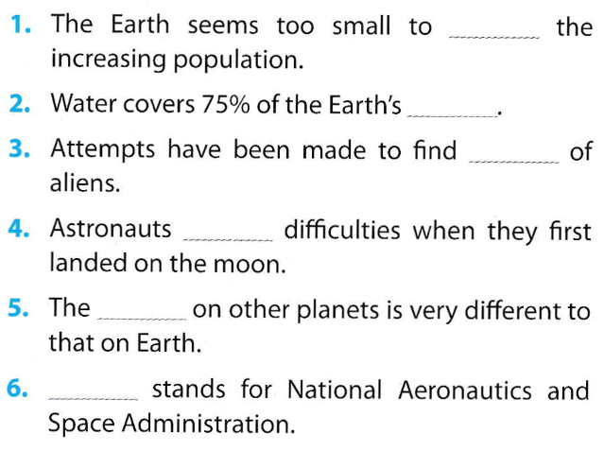
surface climate NASA traces experienced accommodate
accommodate
surface
traces
experienced
climate
NASA
All Call
Student Demo

Slide 6


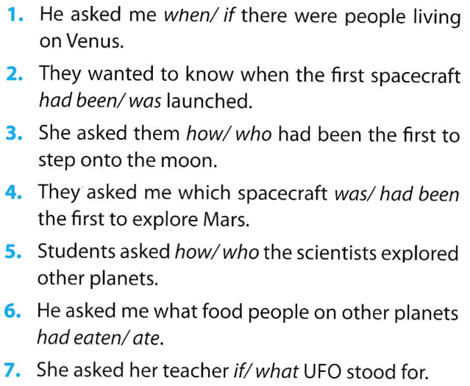
All Call
Student Demo

Slide 7





He asked me how I would react if I saw an alien.
The teacher aske me which planet was most suitable for human life.
My friend asked me when humans had first landed on the moon.
She asked me what the difference between a planet and a star was.
They asked if there was water on Mars.
All Call
Student Demo

Slide 8


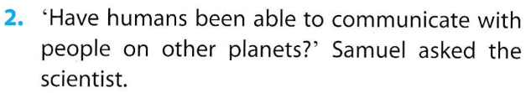

The teacher aske her students what the essencial conditions for human life were.
Samuel asked the scientist if humans had been able to communicate with people on other planets.
Nick asked the journalist if the Roswell UFO incident had taken place in the U.S. in June 1947.
All Call
Student Demo

Slide 9

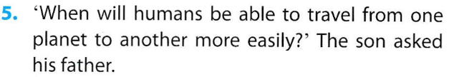

Vanessa asked her uncle who the witness in the Roswell UFO incident had been.
The son asked his father when humans would be able to travel from o planet to another more easily.
Diane asked her mother why people couldn’t move to Mars immediately.
All Call
Student Demo

Slide 10


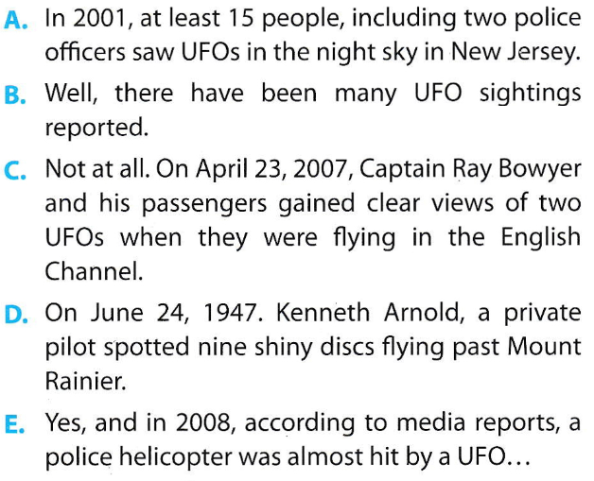
All Call
Student Demo

Slide 11
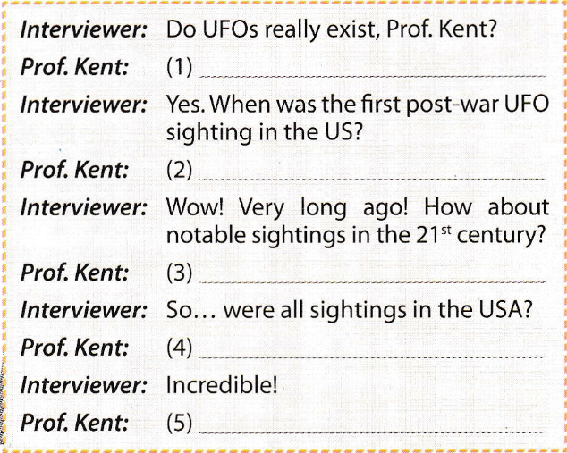
B
D
A
C
E
All Call
Student Demo

Slide 12
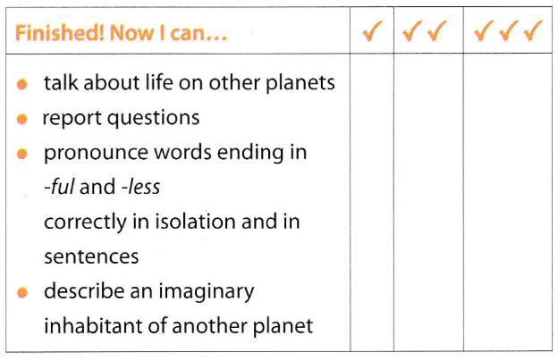
All Call
Student Demo

Slide 13


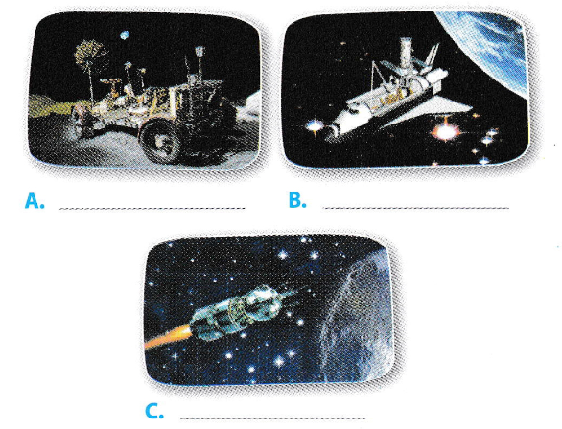
space buggy space shuttle Vostok spacecarft
space buggy
space shuttle
Vostok spacecarft
All Call
Student Demo

Slide 14


There are: space buggy, space shuttle, Vostok spacecraft.
Answers 2 and 3:
- A space buggy may be used by astronauts to travel on the surface of the Moon and carry out research.
- The space shuttle were used by NASA to bring astronauts on missions in space. They were also used to help assemble the International Space Station. There were five space shuttles built in a total.
-Vostok 1, a spacecraft which was launched on 12 Apri 1961, taking Yuri Gagarin, a cosmonaut, from the Soviet Union into space.
* Cosmonaut is astronaut. The word is used by the former Soviet Union
All Call
Student Demo

Slide 15


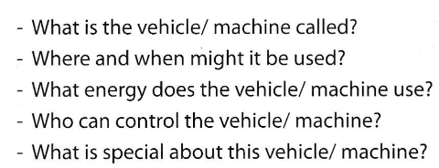
All Call
Pair
Student Demo

Slide 16

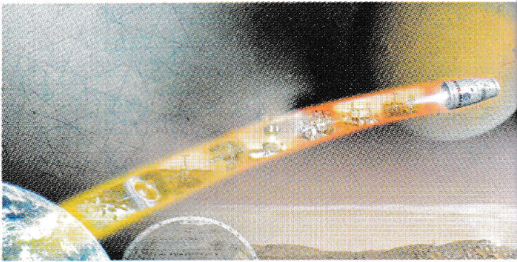
All Call
Student Demo

Slide 17

MINI-TEST

Slide 18

Choose the word or phrase that best completes each unfinished sentence below
1. The flight _____ at 6.10 has been delayed.
a. leave b. leaves c. leaving d. left
2. This is the first time she _____ rice paddies.
a. will see b. sees c. has seen d. saw
3. Would you mind_____ I borrowed your dictionary?
a. if b. when c. that d. Ø
4. We ______ lots of photos on vacation.
a. had b. took c. did d. made

Slide 19
Homework
Learn by heart the new words.
Speak with your friends
Prepare for the next lesson-Revision.

Slide 20


