Slide 1

CLASS 8A2
Teacher – Vu Thu Thuy

Slide 2



PERIOD 104
UNIT 12: LIFE ON OTHER PLANETS
LESSON 6: SKILLS 2

Slide 3



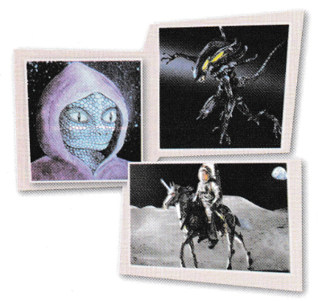
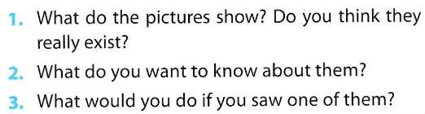
ALIENS
All Call
Pair
Student Demo

Slide 4
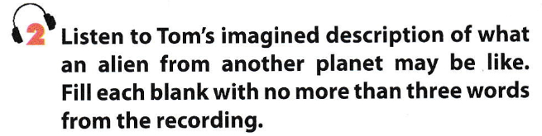
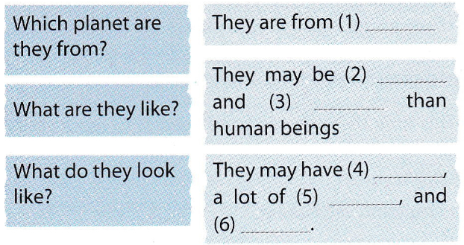
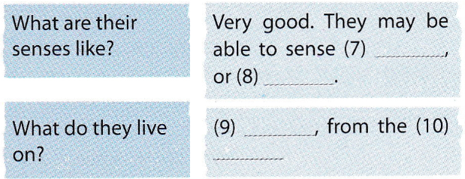

Jupiter
much bigger
more powerful
lots of hair
thick skin
four eyes
happiness
fear
Energy
rocks
All Call
ABProgram + StartA + AV1
Student Demo

Slide 5

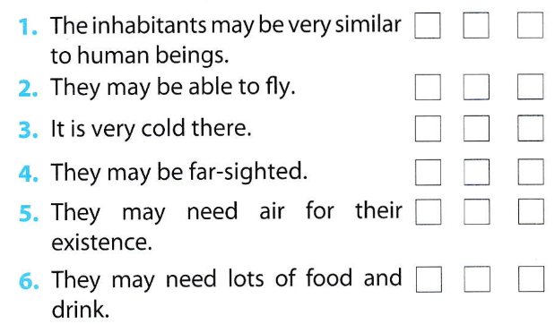
✓
✓
✓
✓
✓
✓
All Call
ABProgram + StartA + AV1
Student Demo

Slide 6

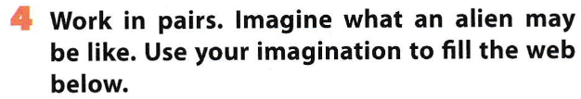
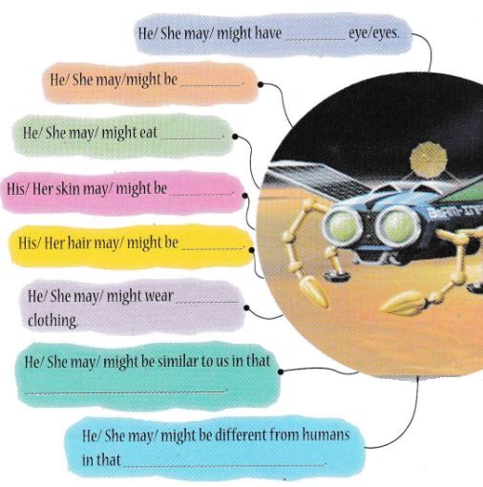
All Call
Pair
Student Demo

Slide 7

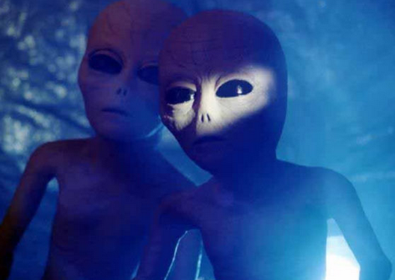
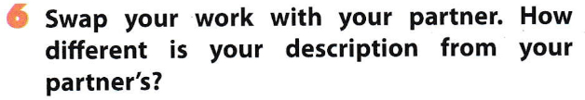

Slide 8
Homework
Learn by heart the new words.
Speak with your friends
Prepare for the next lesson –unit 12-looking back & mini-test.

Slide 9


