Slide 1

WELCOME TO CLASS 7A1
Teacher – Vu Thu Thuy

Slide 2

REVISION

Slide 3
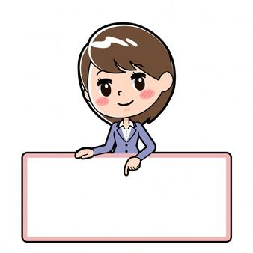
OBJECTIVES
-Students can practice on “it” indicating distance and used to.

Slide 4
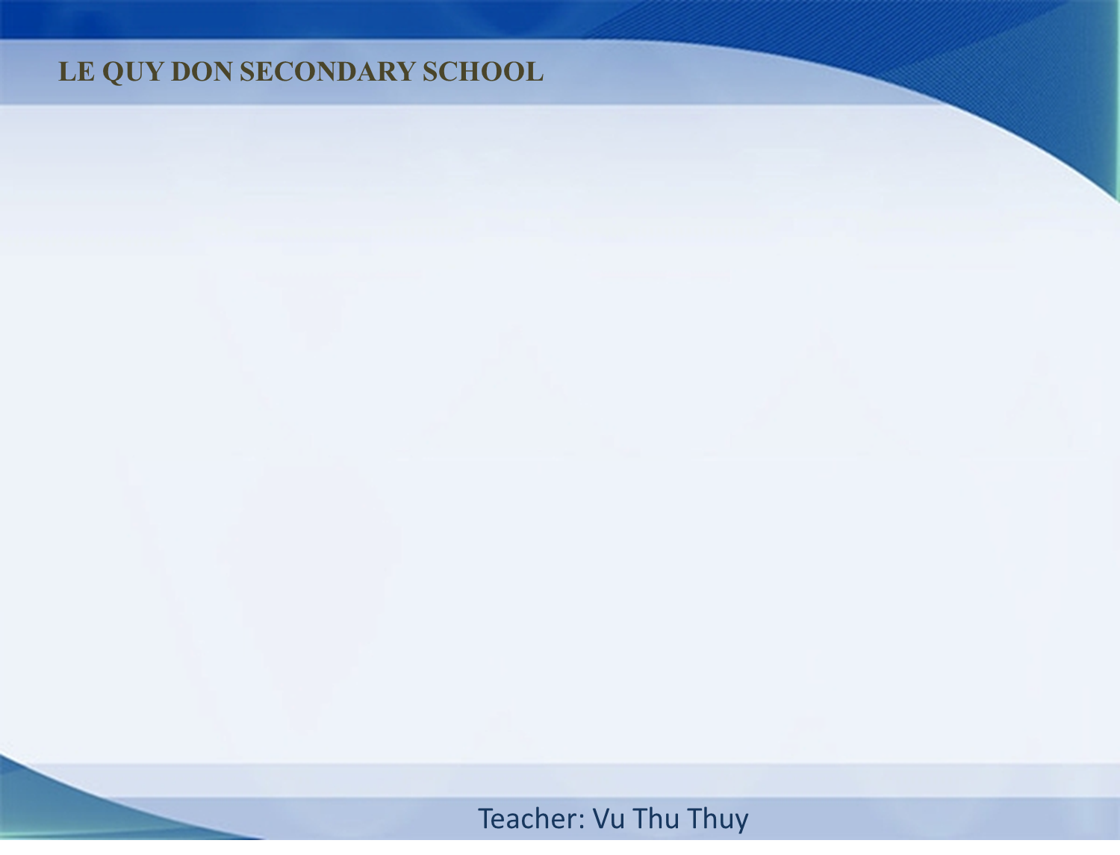
Câu khẳng định | It + is + (about) + (a number) + unit of length + (from N place to N place)
 | It + is + adj+ distance
Câu phủ định | It + isn’t + adj+ distance
Câu hỏi | How far is it from N place to N place?
It is about 10 kilometers from my house to my school

Slide 5

Câu khẳng định | S + used to + V
Câu phủ định | S + didn't + use to + V
Câu hỏi | Did + S + use to + V?
I used to play basketball, but now I like playing video games

Slide 6
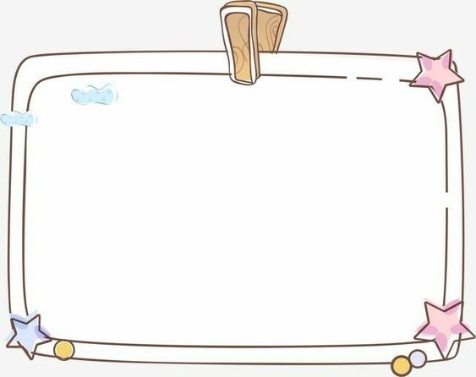
-Students write 5 sentences, using “it” indicating distance.
-Write 5 sentences, using “used to”.

Slide 7

I. Write sentences with it. Use these cues
Example:
my house/500 metres/nearest shop
→ It is about 500 metres from my house to the nearest shop.
1.700 metres/my house/Youth Club
->……………………………………………………………………
2.five km/my home village/nearest town
->…………………………………………………………………..
3.120 km/Ho Chi Minh City/Vung Tau
->…………………………………………………………………..
4.384,400 km/the Earth/the Moon
->…………………………………………………………………..
5.not very far/Ha Noi/Noi Bai Airport
->…………………………………………………………………..
It is 700 metres from my house to the Youth Club.
It is five km from my home village to the nearest town
It is 120 km from Ho Chi Minh City to Vung Tau
It is 384,400 km from the Earth to the Moon
It is not very far from Ha Noi to Noi Bai Airport

Slide 8

II. Circle the correct answer:
1.Peter (used to/ use to) drive to work but now he doesn’t.
2. I didn’t (used to/ use to) eat with chopsticks when I lived in America.
3. Did they (used to/ use to) work in a big factory before their retirement?
4. Mr Lam (used to/ use to) work in Japan for 3 years.
5. My classmates didn’t (used to/ use to) like me.
6. There (used to/ use to) be a lot of trees along this street.

Slide 9

III. Complete the sentences with the correct form of “used to” and the verb in bracket.
1. I _______________ (not like) flying, but I love it now.
2. We _______________ (be) friends, but we don’t get on now.
3. _______________ (John/ work) for IBM before he came here?
4. Winters _______________(not/ be) as cold as they are now.
5. She _______________ (live) with her mother, but now she lives with her father.
Didn’t use to like
Used to be
Did John use to work
Did not use to be
Did not use to live

Slide 10
WRAP UP
-Students can practice on “it” indicating distance and used to fluently.

Slide 11

HOMEWORK
- Practice more at home
- Do exercise in workbook.

Slide 12


