Slide 1


Slide 2

REVISION 2
(UNITS 10 – 11 – 12)
Lesson 2 : SKILLS

Slide 3
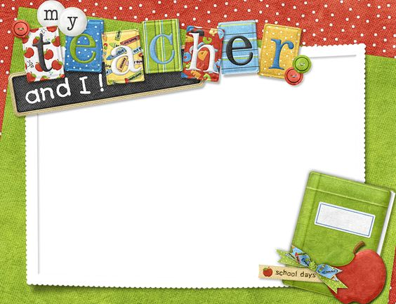
OBJECTIVES
-Students are reviewed about Reading, speaking, listening, writing.
-Can do exercises with them.

Slide 4

I. Reading
HUNGER
1. Which of the causes of hunger below do you think is the most serious in your country? Tick (✓) it.
Overpopulation
Wars
Weather - relater disasters
✓
✓

Slide 5
2. Read the text and choose the best answer for each question
HUNGER
Hunger has become a serious problem in many parts of the world.
The first cause of hunger is the fast growth of population. The Earth is no longer able to feed its more than seven billion people. There is not enough land for growing food.
The change of climate also brings to the Earth more weather-related disasters such as storms and droughts ... They heavily destroy crops.
Wars are still happening. People are fighting, or running away from home. There's nobody to work on the field or in the factory to produce food.
Technology is working hard to help solve part of this problem. In the future, we will have warning systems to reduce the loss from natural disasters. Low-cost means of transport will also be used to carry food to area-in-need.
1. Drought is an example of__________.
A. weather-related disasters
B. a human activities
C. climate
2. One possible consequence of a war is that____________.
A. people will buy food from other countries
B. people cannot work to produce food
C. more disasters will happen
3. The problem of hunger can be solved with the help of ______.
A. expensive means of transport
B. technology
C. wars
A.
B.
B.

Slide 6

II. Speaking
3. Game
A. Choose one of the words in the list below, keep it to yourself.
B. Ask questions to find out which word A has chosen. Your questions should not contain any of the words in the list.
Example:
A: (has chosen the word 'coal)
B: Is it a noun?
A: Yes, it is.
B: Does it have colour?
A: Yes, it does.
B: What colour is it?
A: It's black.
B: It's 'coal'.
coal | hunger | sunlight | ride
teleporter | energy | transport | pollute

Slide 7

III. Listening
4. Which option (A, B, or C) do you think is closest in meaning to the word 'footprint'?
A. the effects
B. the environment
C. our actions
A.

Slide 8

5. Listen to the conversation and answer the questions.
1. What word is Phong searching for?
2. Does this word have only one meaning?
3. Does Phong explain the meaning of this word to Nam?
4. What happens if we take care of the trees around us?
He is searching for the meaning of “footprint”.
No it doesn’t.
Yes, he does.
There will be a lot of greenery around you.

Slide 9

IV. Writing
6. Imagine an ideal means of transport for YOUR area. Write a short description of it.
In your writing, you should mention:
• the name you give to it
• what it is like
• what kind of energy it uses
• why it is good for your area
Example :
I wish I had a flying car. It is like a car but I can fly. The car will use solar energy. It catches the sunlight from the roof solar panel and generate power. It is good for the environment and saves energy.

Slide 10
WRAP UP
-Students are reviewed about Reading, speaking, listening, writing correctly.
-Can do exercises with them well.

Slide 11

HOMEWORK
-Practice more at home
-Prepare for Revision 3

Slide 12


