Slide 1


Slide 2

REVISION 1 (UNITS 10 – 11 – 12)
Lesson 1 : LANGUAGE

Slide 3
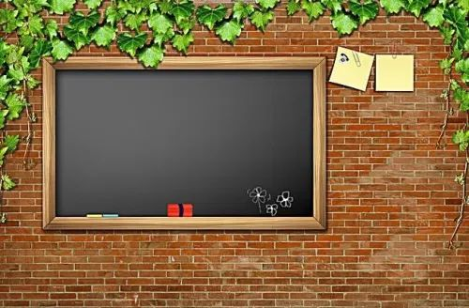
OBJECTIVES
-Students are reviewed about pronunciation, vocabulary, grammar.
-Can do exercises with them.

Slide 4


I. Pronunciation
1. Listen to the conversation and mark the rising or falling intonation for each question.
Nick: Phong. The idea of riding to school on a monowheel is so exciting.
Phong: What's a monowheel?
Nick: It's a single-wheel bike.
Phong: Single-wheel ? How do you ride it?
Nick: You just sit inside the wheel and pedal.
Phong: Hm ...! Is it easy to fall?
Nick: I suppose so, but you should take adventures, shouldn't you?
Phong: No, not me. Why do you like it?
Nick: Can't you imagine ? I can see people looking at me with admiration. Wow!

Slide 5

II. Vocabulary
2. Form a suitable word from the word stem to fill the sentences.
1. Have you found a __________to that math problem? (solve)
2. Natural sources cannot provide enough energy to support this __________world. (crowd)
3. Do you know that we have __________cars? They don't need a driver. (drive)
4. Of all the__________in the world, which one do you like best? (invent)
5. Playing outside is__________than staying inside. (health)
solution
crowded
driverless
inventions
healthier

Slide 6

3. Choose A, B, or C to complete sentences.
1. In Mongolia, dung is a kind of_____________. People use it for cooking and heating.
A. energy source
B. footprint
C. accommodation
2. To save money, we learn to_____________ some daily products like coca cola bottles.
A. keep
B. reuse
C. produce
3. In the green future, vehicles will be powered by___________.
A. solar energy
B. coal
C. gas
4. I am dreaming of a____________, which can take me to another place in seconds in any weather.
A. three-wheel bicycle
B. teleporter
C. sport car
5. Clean water which is___________ through pipes is called piped water.
A. supplied
B. given
C. run
A.
B.
B.
A.
C.

Slide 7
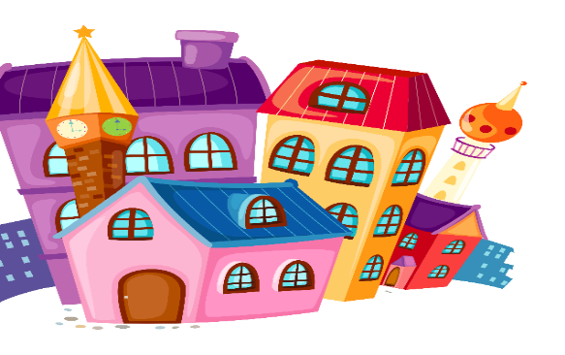
III. Grammar
4. Use the verbs in brackets in the future simple active (will do) or the future simple passive (will be done) to complete the sentences.
1. Children_________ to school in a jet pack. (fly)
2. Solar panels_________ to produce energy. (use)
3. All the slums in this area _________ for new multi-storey buildings. (demolish)
4. We _________ robots to help us with some our housework. (have)
5. I hope someone_________ a machine to do homework for me. (invent)
will fly
will be used
will be
demolished
will have
will invent

Slide 8

IV. Everyday English
_____ a. On a tree?
_____ b. Maybe. But that’s my DREAM.
_____ c. Phong, tell me your dream.
_____ d. Slow but you can save energy. And my house is not far from school.
_____ e. And ... will you still go to school?
_____ f. Sure. But not on a crowded bus. I’ll pedal to school on a monowheel.
_____ g. I will have a small wooden house on a tree.
_____ h. A monowheel is slow.
_____ i. Yes, where I can be away from noise and I can hear birds singing.
_____ j. You sound unrealistic.
3
10
1
8
5
6
2
7
4
9

Slide 9
WRAP UP
-Students are reviewed about pronunciation, vocabulary, grammar correctly.
-Can do exercises with them well.

Slide 10

HOMEWORK
Practice more at home
Prepare for Revision 2

Slide 11


