Slide 1
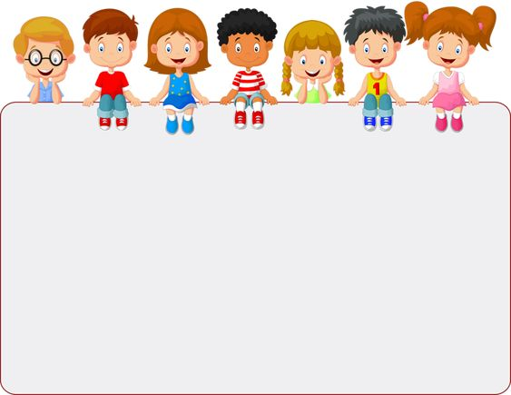
WELCOME TO CLASS 7A1
Teacher – Vu Thu Thuy

Slide 2

Unit 12: An overcrowded world
Period 105: Looking back + Mini-test

Slide 3



Warmer

Slide 4
vocabulary
1. Match the words with their definitions.
overcrowded
poor
peaceful
spacious
5. busy
too many people
to have very little money
calm and quiet
a large area where it is easy to move
a lot of things happening

Slide 5
2. Write a sentence for each of the following words.
Example:
Crime is a problem in big cities.
crime
When people need money badly, they may commit crime.
1. ______________________________________
______________________________________
healthcare
Good healthcare helps people to stay healthy, and to live longer.
2. ______________________________________
______________________________________
disease
Disease spreads more quickly in overcrowded areas.
3. ______________________________________
______________________________________
poverty
In most big cities there are many wealthy people. but poverty is still a problem.
4. ______________________________________
______________________________________
education
In the public school system, education is compulsory from age six to age sixteen.
5. ______________________________________
______________________________________

Slide 6
Grammar
3. Put an appropriate tag question at the end of each sentence. Then match the questions to their answers.
Questions | Answers
1. We have more tourists this year, __________? | a. No, there are fewer than last year!
2. You got stuck in a traffic jam on the way home, __________, Mum? | b. Yes, they do, particularly big cities in China.
3. There will be a solution to this shortage of clean water, __________? | c. I hope there will.
4. We should do something to reduce poverty, ____________? | d. Yes, we should. But how?
5. Big cities suffer more from air pollution, __________? | e. Yes, as always, dear.
don’t we
didn’t you
won’t it
shouldn’t we
don’t they

Slide 7
4. Look at the situation and complete the effects with more, fewer or less.
Situation. A new factory will be built in my neighbourhood.
more
The factory will bring _______________ jobs to local people.
_______________ people will move here to work in the factory.
These people will need _______________ water and electricity.
There will be _______________ space for children to play.
More
more
less

Slide 8
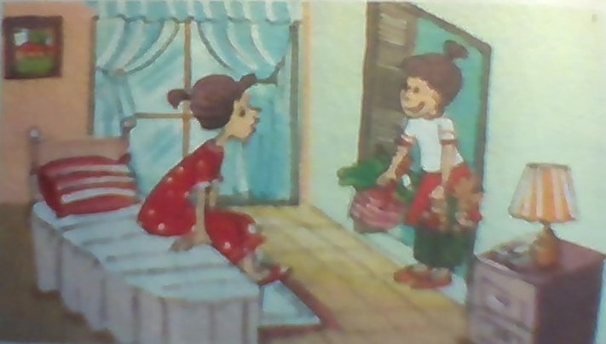
Communication
5. I’ve got more!
Work in groups. Look at the situations and talk about their possible effects.
Example:
Situation: A cousin is moving in to share your room for two months.
Effects: - I will lose my privacy.
- I can have more fun.
- I will have less space of my own.
Situation 1. The karaoke next to your house is attracting more and more young people coming.
Situation 2. A flea market has been established in your neighbourhood.

Slide 9


Finished! Now I can ...
use words to describe overcrowded places and the effects of overcrowding form comparisons of quantifiers use tag questions write about the population change

Slide 10


Slide 11
Divide the class into groups of four or five.
Each group searches for an under-populated place.
Note down some facts about the place:
which place it is;
what life is like there;
what can be the cause(s) of this small population.
Then each group presents their project to the class.

Slide 12

MINI-TEST

Slide 13

Choose the word that has the underlined part pronounced differently from the others
1. a. canoe b. water c. sugar d. island
2. a. resort b. hotel c. except d. rescue
3. a. sight b. tribe
c. seaside d. magnificent
4. a. railway b. daily c. airport d. train
5. a. island b. florist c. stream d. sight

Slide 14

HOMEWORK
-Practice more at home
-Prepare for the next lesson, revision.

Slide 15


