Slide 1
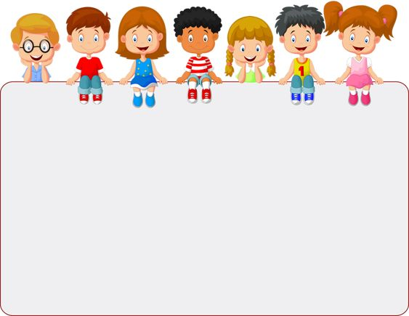
WELCOME TO CLASS 7A1
Teacher – Vu Thu Thuy

Slide 2

Unit 12: An overcrowded world
Lesson 5: Skills 1

Slide 3



Warmer

Slide 4
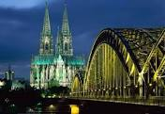
LONDON

Slide 5
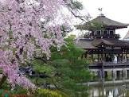
TOKYO

Slide 6
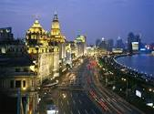
SHANGHAI

Slide 7
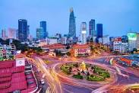
MANILA

Slide 8
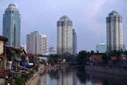
JAKARTA

Slide 9
Match the city with the country
Philippines Japan England
Vietnam China Laos
Indonesia
CITY | COUNTRY
London
Shanghai
Tokyo
Manila
Vientiane
Hanoi
Jakarta
England
China
Japan
Philippines
Laos
Vietnam
Indonesia

Slide 10
Which is the biggest city in the world?
- Mexico city is the biggest city in the world.

Slide 11
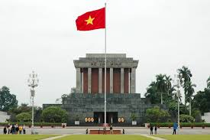
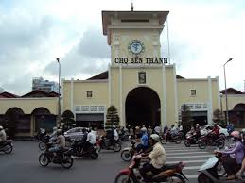
Is Ha Noi bigger than Ho Chi Minh city?
- No, It isn’t.

Slide 12
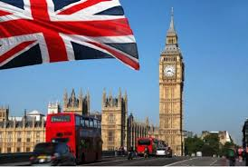
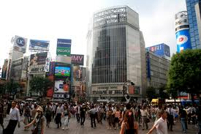
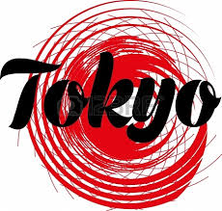
Which is bigger: London or Tokyo?
- Tokyo is bigger.

Slide 13
Reading
1. Look at the list of cities below. Which do you think has the largest population? Share your ideas with your partner.
London Jakarta
Tokyo Shanghai Manila
Example:
A: I think London is number one, isn’t it?
B: I don’t think so. I think Shanghai is the biggest.

Slide 14
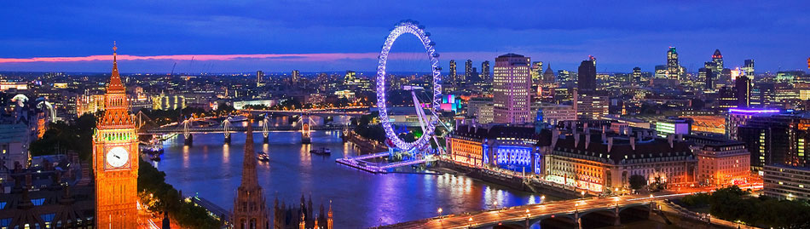
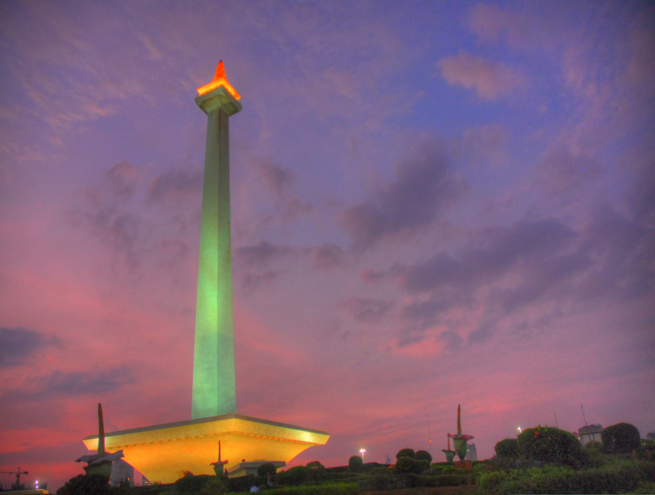
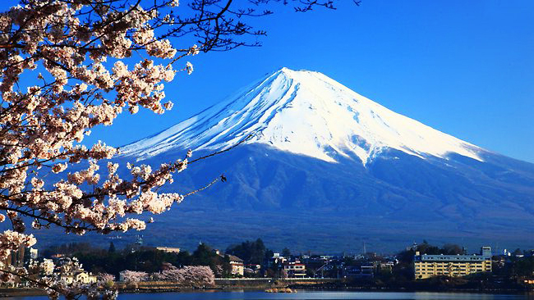
London: 1577,3 km²
Jakarta: 661,52 km²
Tokyo: 2,190,90 km²

Slide 15
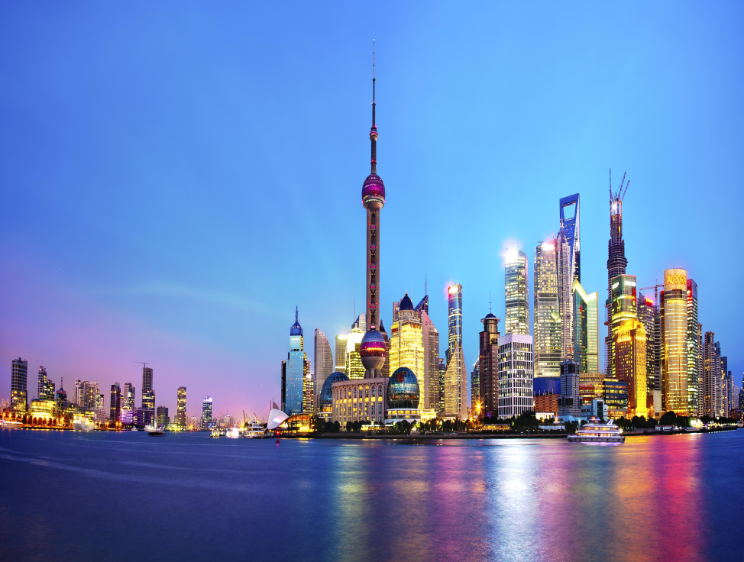
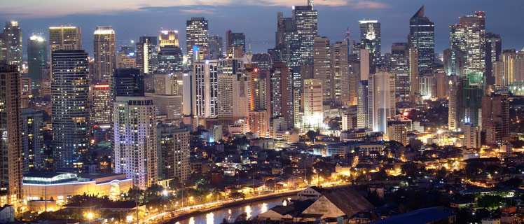
Shanghai: 6,340,5 km²
Manila: 38,55 km²

Slide 16
Capital | Country
London
England
Jarkata
Indonesia
Tokyo
Japan
Beijing
China
Game
Manila
Philippines
Washington,D.C.
The USA
Berlin
Germany
Paris
France
Seoul
Korea
Bangkok
Thailand
Mexico City
Mexico
Kuala Lumpur
Malaysia
Moskva
Russia

Slide 17
3. Read the passage again. Choose the correct heading for each paragragh.
The rise of megacities!
1. _____________________________________
Chances are, you are reading this article in a big city. Population growth is far faster than ever before and that is especially true in cities like Tokyo and Shanghai.
2. _____________________________________
People from the countryside move to cities to find work and a better standard of living. These cities are so large they have been named megacities. The largest is Tokyo, followed by Shanghai, Jakarta, and Manila. Some way behind is London, with a relatively small 15 million people.
_____________________________________
However, life in cities is not always better. Homelessness is a big problem. When people do have homes, they are often in slums where disease and poor healthcare are problems.
_____________________________________
Problems affect richer people too. Traffic blocks roads for hours in cities like Bangkok and Mexico City. Air pollution is so bad in some cities that people do not want to go out.
Population explosion
Which are the biggest?
Problems for the poor
Issues for everyone

Slide 18
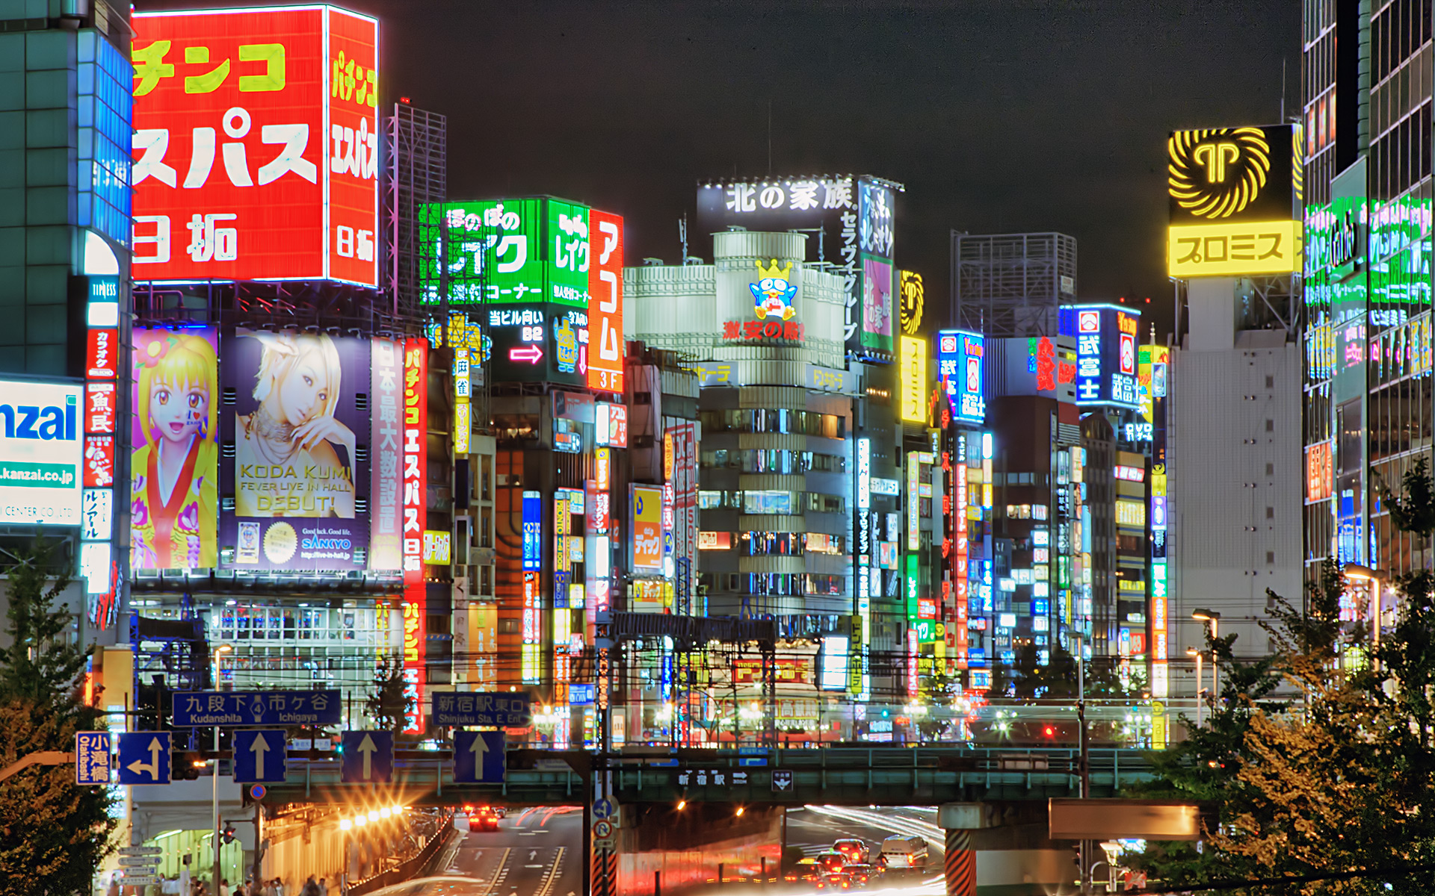

Slide 19
4. Read the passage again and choose the best answer A, B, or C.
The world’s population is __________.
A. growing slowly
B. staying the same
C. growing quickly
Tokyo has __________ people.
A. below 15 million
B. around 15 million
C. much more than 15 million
Problems in big cities affect __________.
A. poor people
B. people who live in slums
C. everyone
Some problem that poor people face in cities include __________.
A. traffic and air pollution
B. healthy problems and stress
C. having no home or living in slums
When air pollution is bad, people __________.
A. only go out at night
B. don’t go out
C. move to smaller cities

Slide 20
speaking
5. Work in groups. Look at the places below and discuss some possible disadvantages that people using them may have.
an overcrowded school
an overcrowded bus
an overcrowded block of flats
* These verbs and expressions can help.
- One disadvantage of ... is ...
- It’s difficult to ...
- It will be ...
Share your ideas with the class

Slide 21

HOMEWORK
-Practice more at home
-Prepare for the next lesson, unit 12-skills 2.

Slide 22


