Slide 1

ENGLISH 6
Teacher – Vu Thu Thuy

Slide 2

PERIOD 98-LESSON 2-
GRAMMAR-PAGE 82

Slide 3
WARM UP
LET’S DO THE QUIZ!

Slide 4

1. What country is bigger?
Russia
America

Slide 5
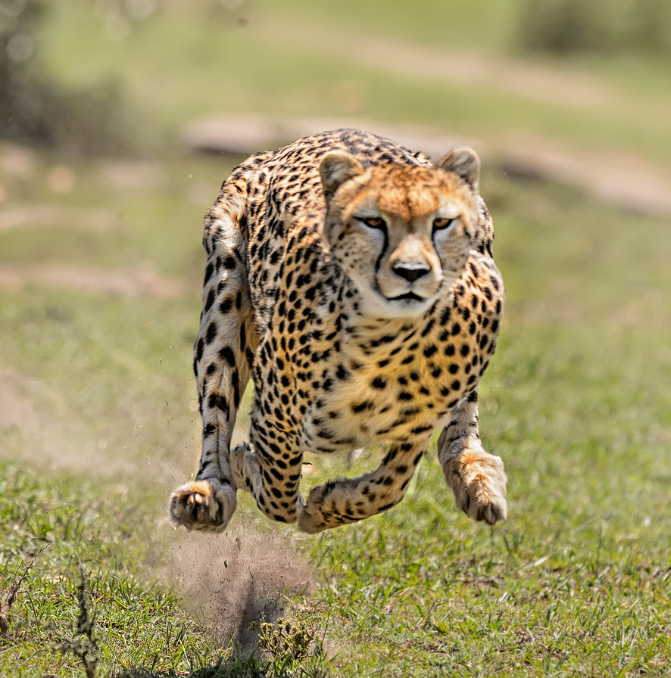
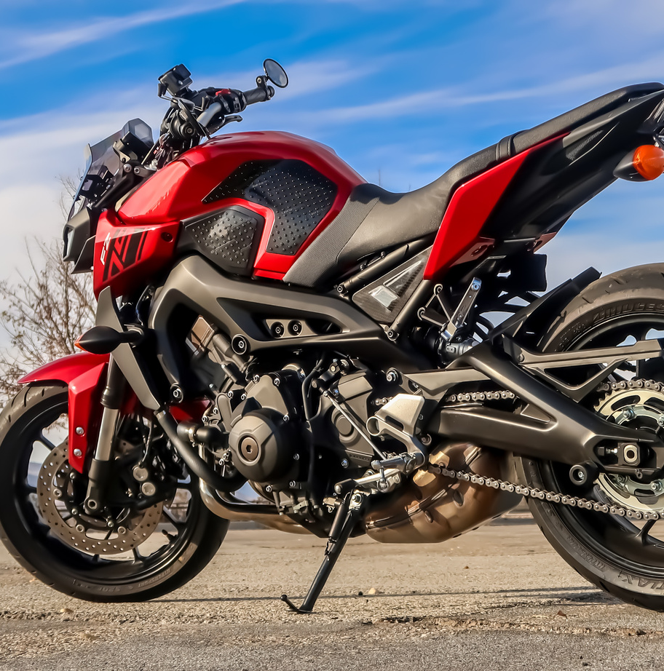
1. What is faster?
cheetah
motorbike

Slide 6
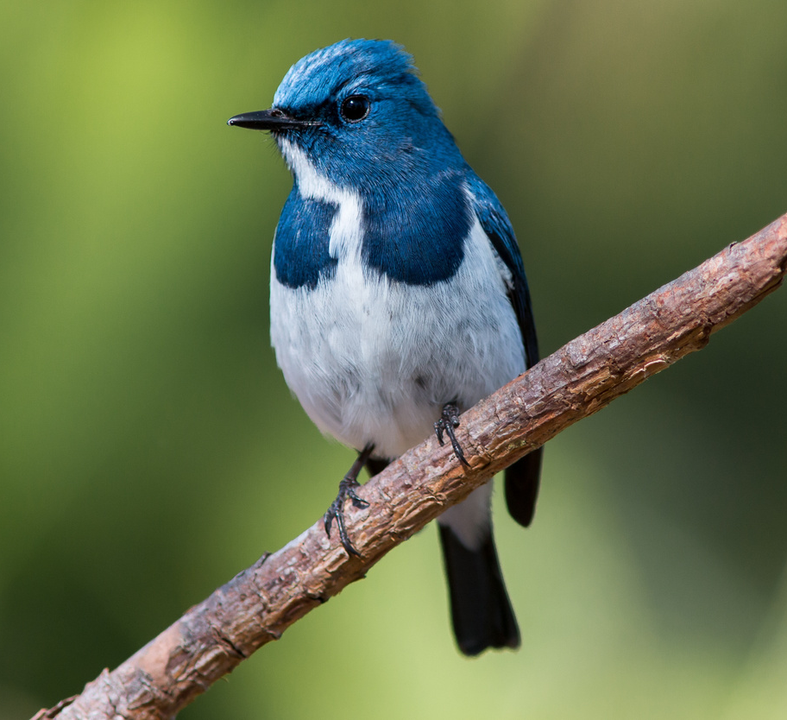
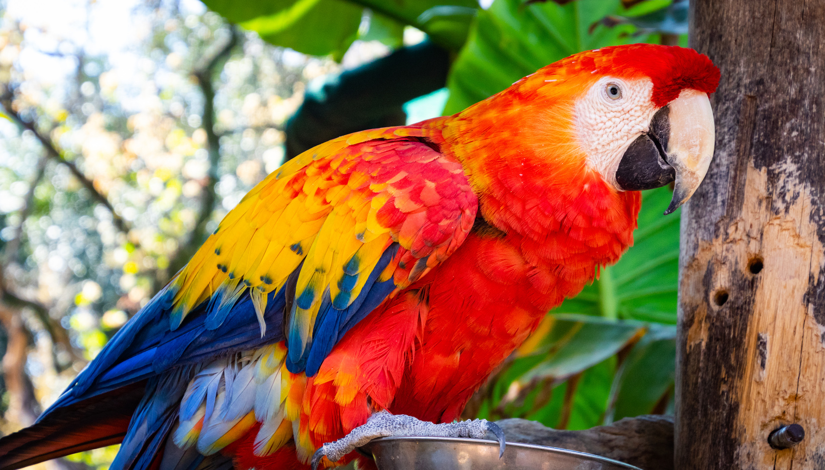
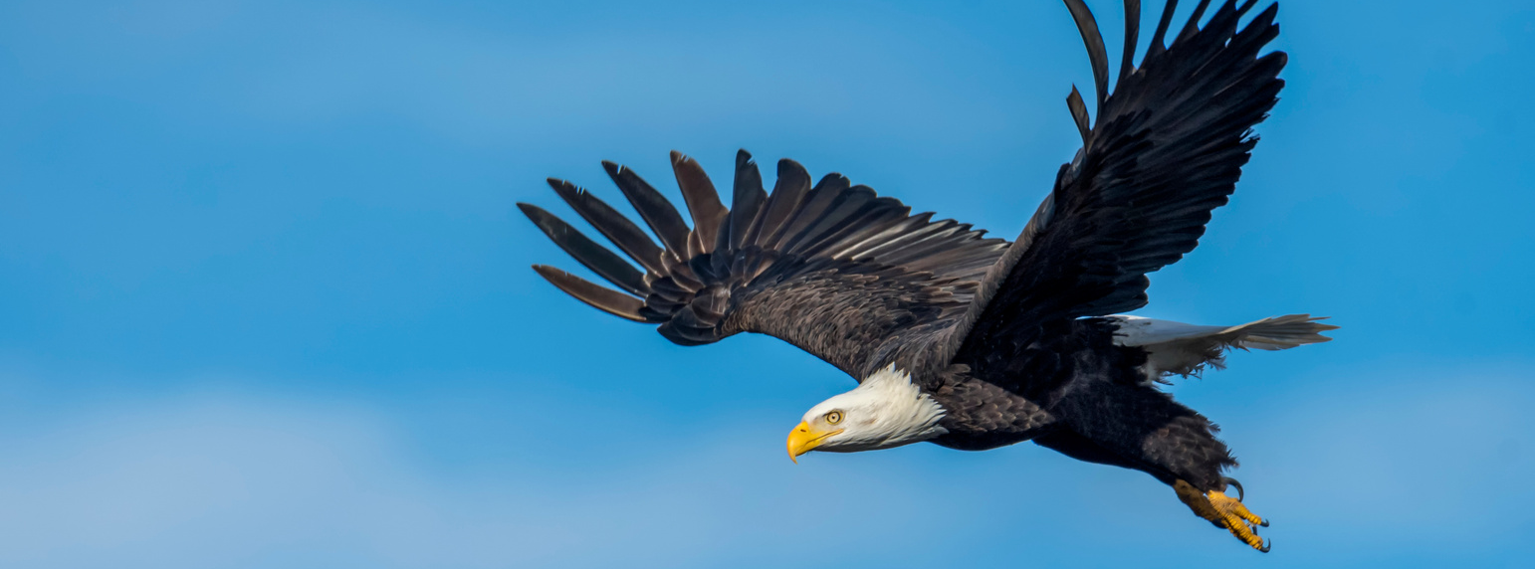
2. What is the biggest bird?
parrot
blue bird
eagle

Slide 7
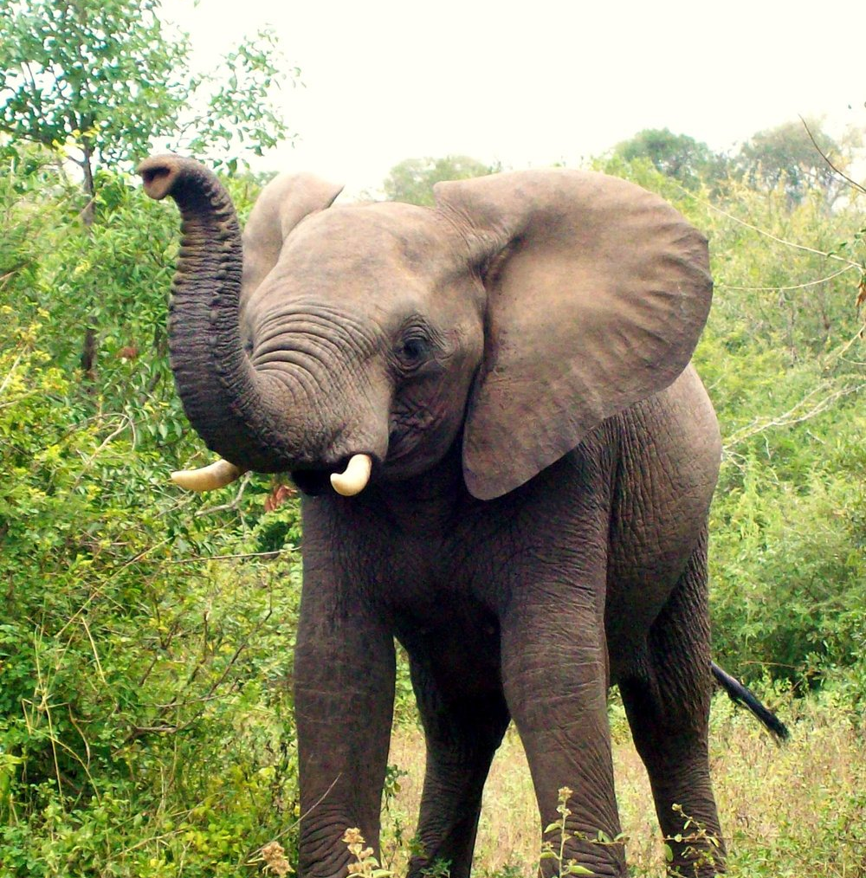
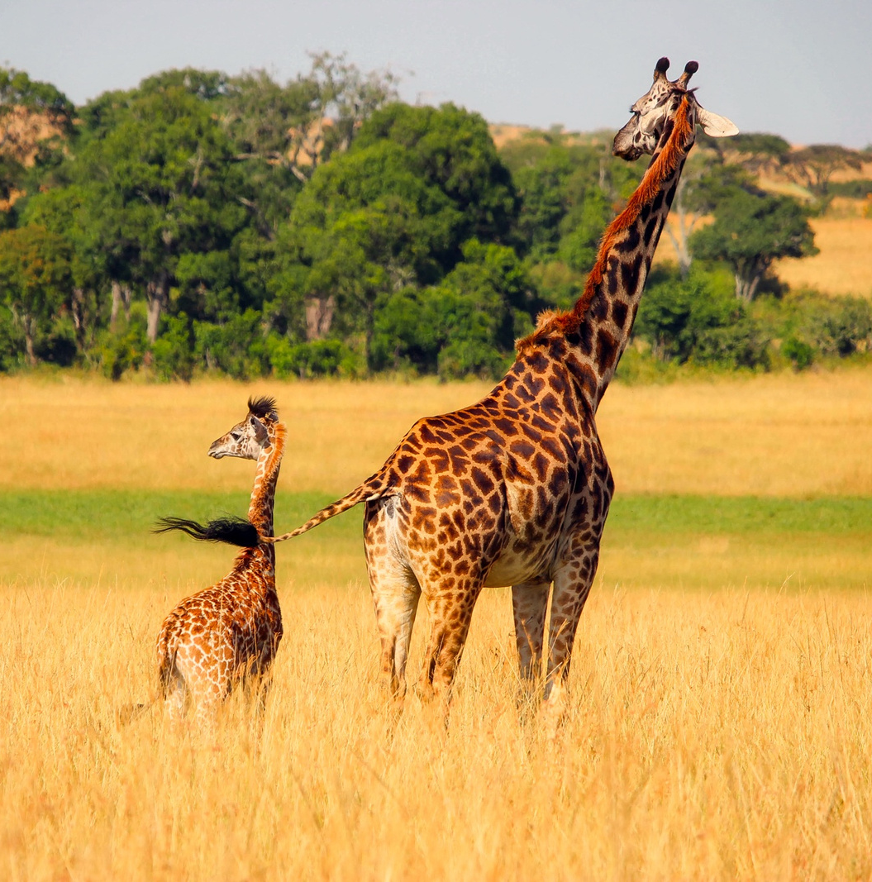
3. What animal is taller?
elephant
giraffe

Slide 8
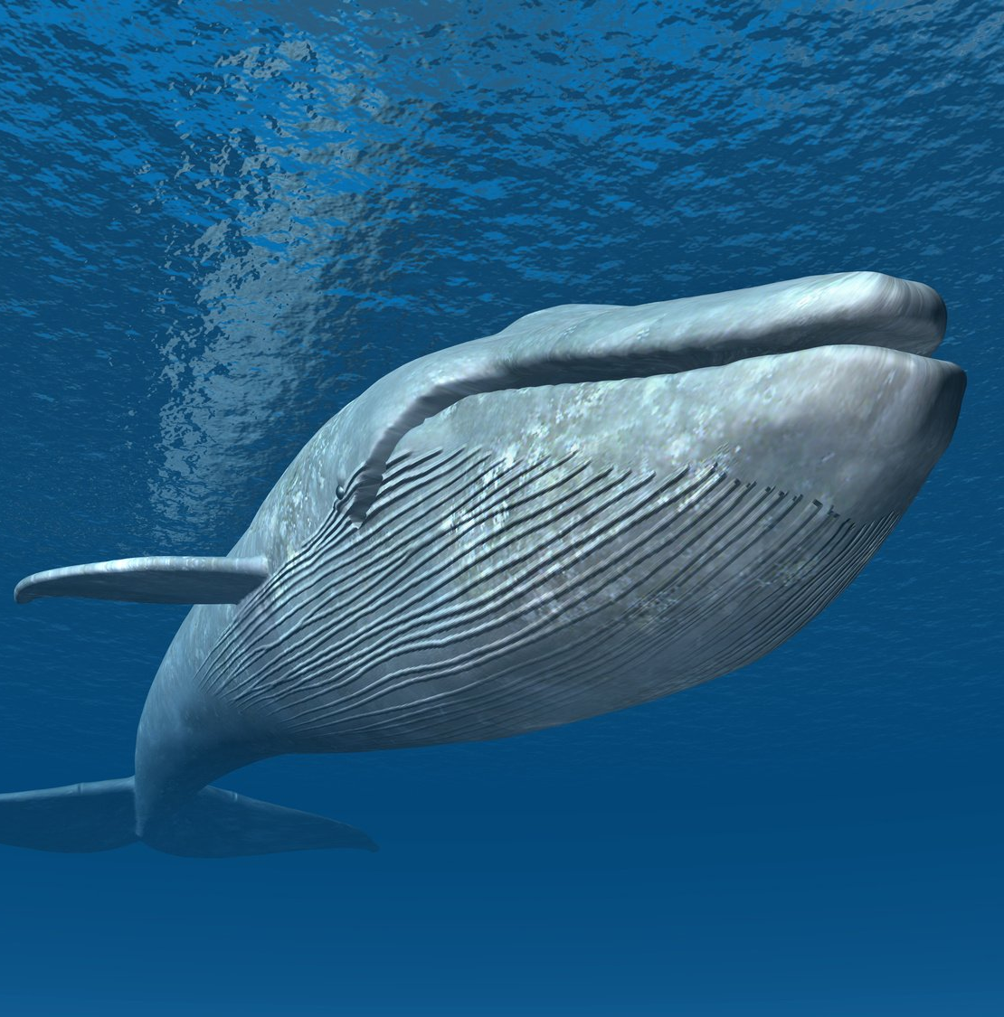
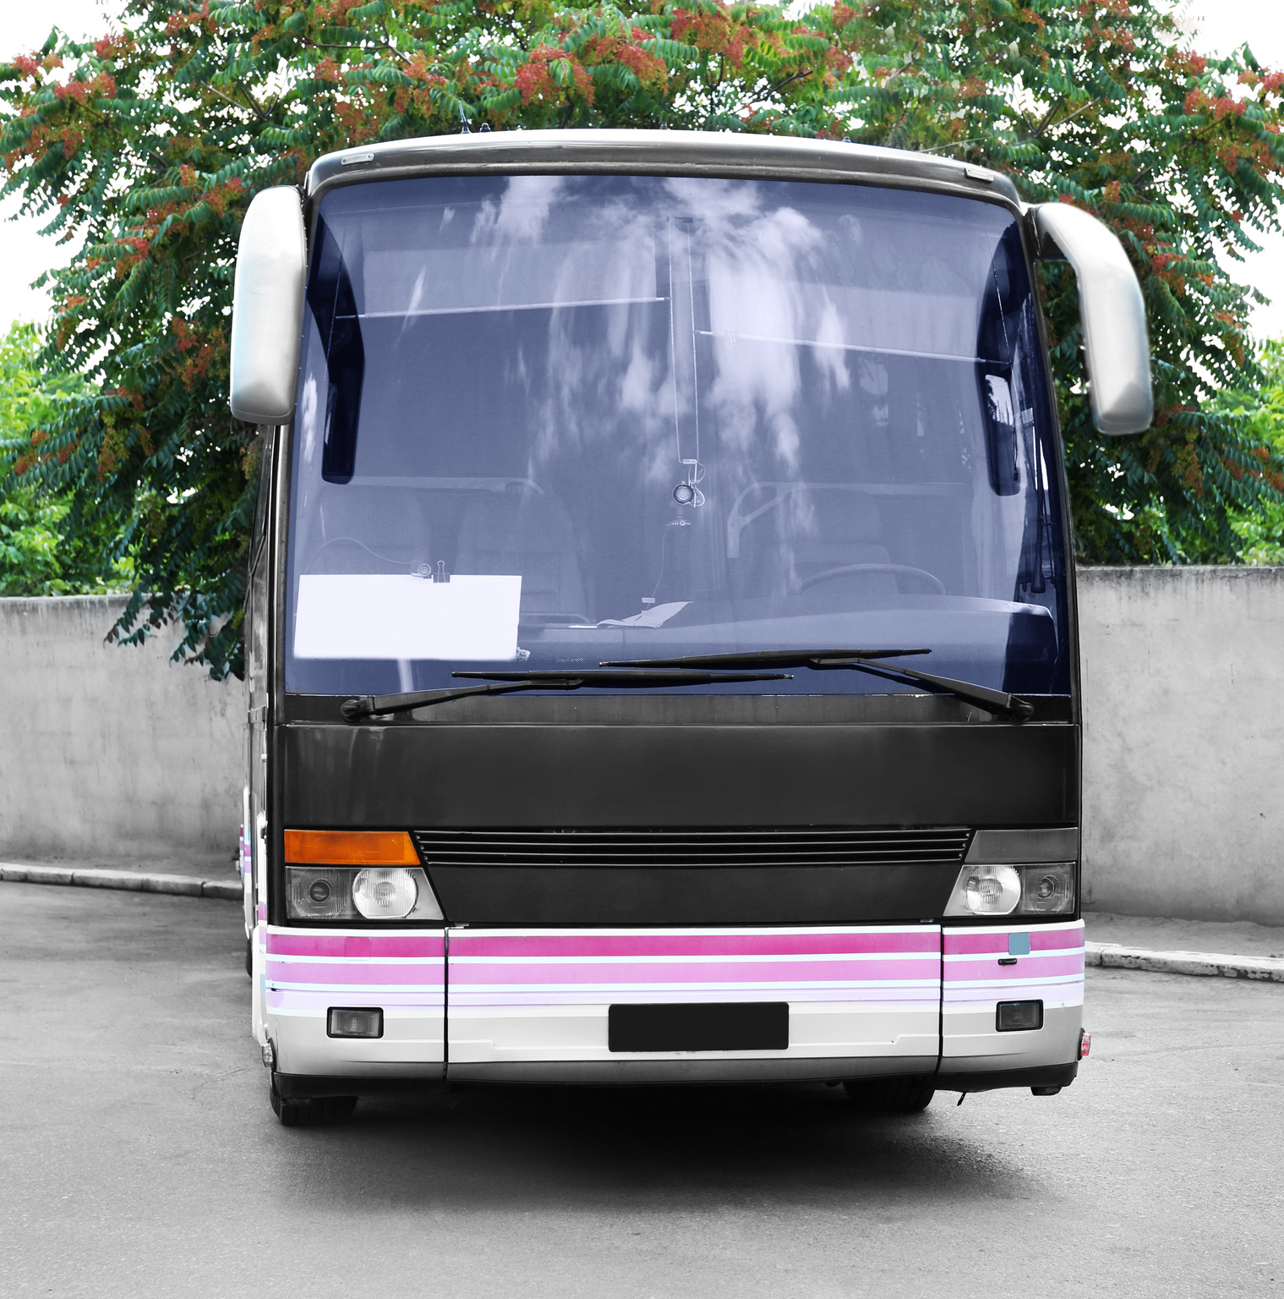
4. What is heavier?
blue whale
bus

Slide 9



5. What planet is the biggest?
Mercucy
Mars
Jupiter

Slide 10
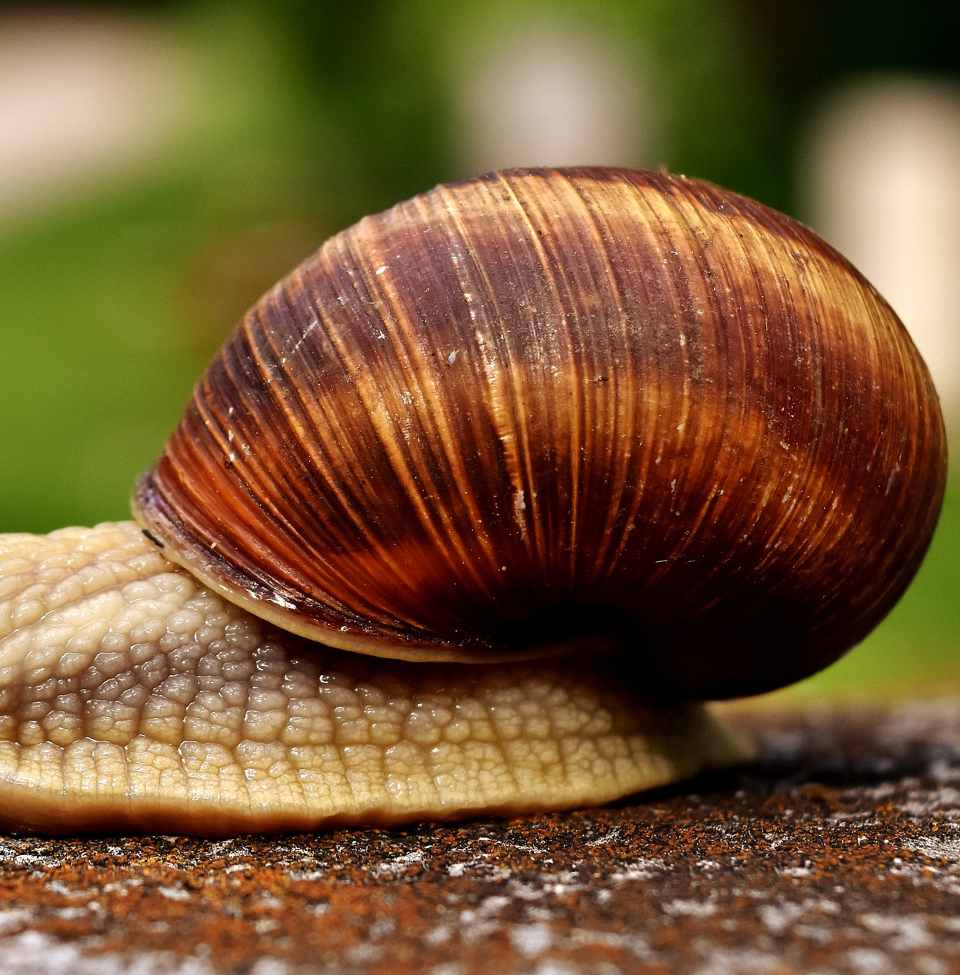
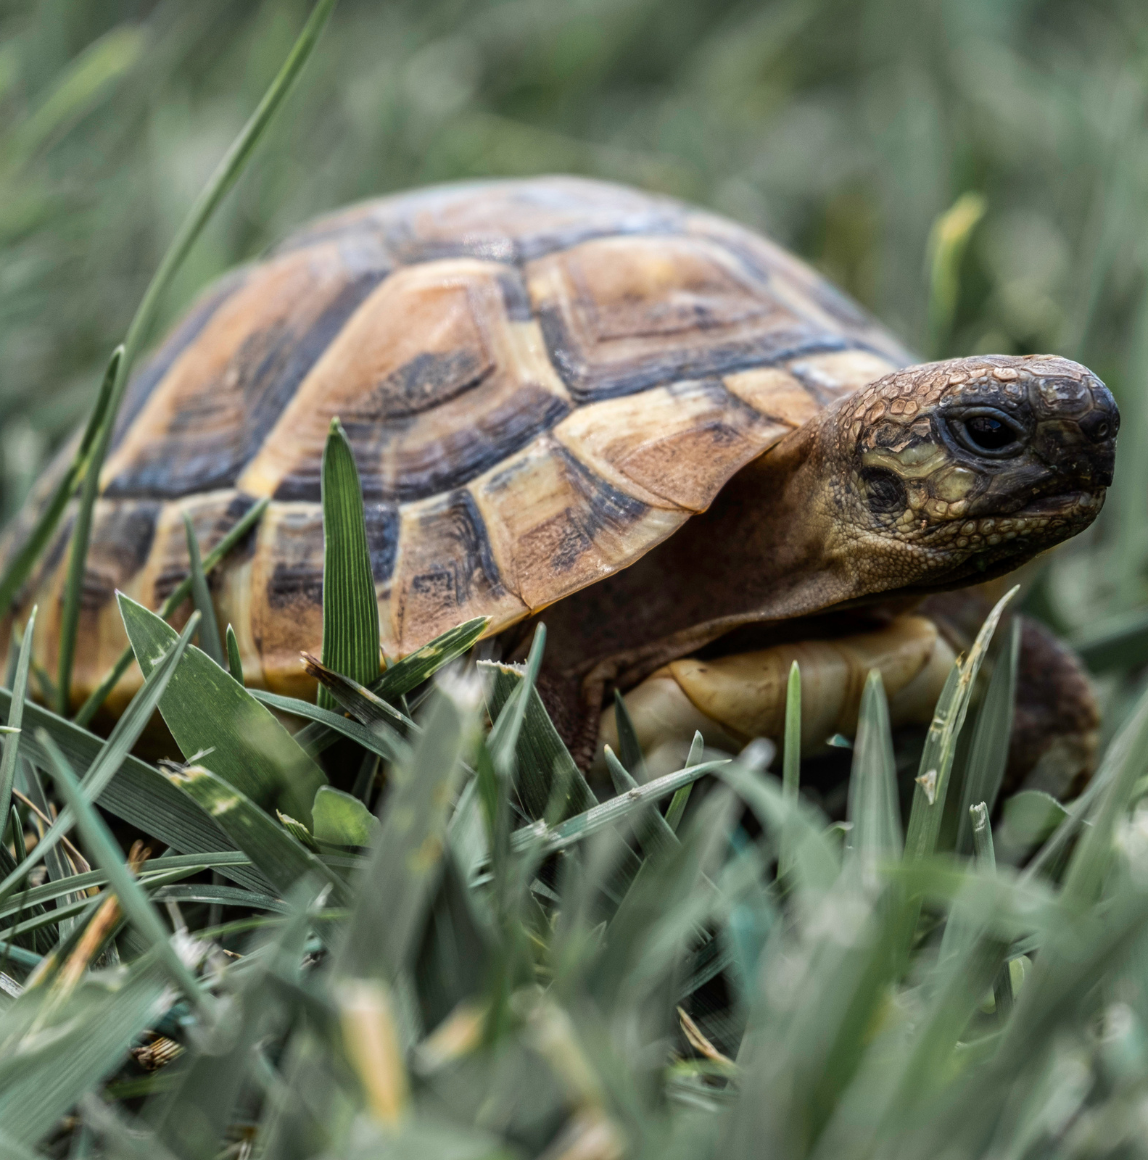
6. What is slower?
snail
tortoise

Slide 11

7. What country is the biggest?
Canada
Russia
America

Slide 12

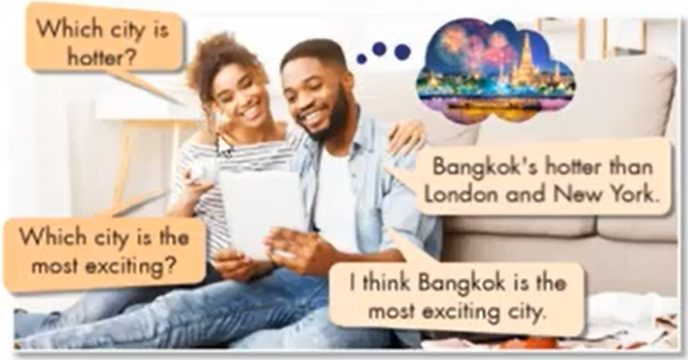
Grammar
a. Listen and repeat.
Comparative and superlative
adjectives
Which city is hotter?
We use comparative adjectives to compare two things.
We use superlative adjectives to say that the subject has more of something or better than any other.
Bangkok’s hotter than London and New York.
Which city is the most interesting?
I think Bangkok is the most exciting city.

Slide 13


Tính từ
COMPARATIVE
SUPERLATIVE
1 âm tiết
tall - taller
tall – the tallest
1 âm tiết kết thúc bằng “e”
nice - nicer
nice – the nicest
2 âm tiết kết thúc ( er,et,ow,y)
clever – cleverer
clever – the cleverest
happy - happier
happy – the happiest
3 âm tiết trở lên
intelligent – more intelligent
intelligent – the most intelligent
1 âm tiết có 1 nguyên âm kẹp giữa hai phụ âm
big - bigger
big – the biggest

Slide 14
Tính từ đặc biệt
SUPERLATIVE
COMPARATIVE
good
better
the best
bad
worse
worst
many/much
more
the most
little
less
the least
the furthest /
the farthest
far
further/farther

Slide 15
b. Fill in the blanks.
Adjectives | Comparatives | Superlatives
exciting |  | The most exciting
old | older
cheap
expensive | more expensive
boring | more boring
peaceful |  | the most peaceful
crowded |  | The most crowded
noisy
1._________________
more exciting
2._________________
the oldest
3._________________
cheaper
the cheapest
4._________________
5._________________
the most expensive
6._________________
the most boring
7._________________
more peaceful
8._________________
more crowded
9._________________
noisier
10.________________
the noisiest

Slide 16
c. Fill in the blanks.
____________________________________________________________________________________________________________________________________________________________________________________________________________________________________________________________________________________________________________________________________________________________________________________________________________________________________________________________________________________________________________________________________________________________________________________________________________
bigger
1. Tokyo is _______________ (big) than London.
2. Ho Chi Minh city is ______________________( crowded) city in Vietnam.
the most crowded
3. Janet thinks that Vienna is_________________(peaceful) than Barcelona.
more peaceful
4.The _________________ ( cold) city in the world is in Russia.
coldest
5. Luke thinks Rio de Janeiro is ________________( modern) than Caracs.
more modern

Slide 17
d. Now, compare your city with another city. Share with your partner.
My city is ___________than ______________

Slide 18
WRAP UP

Slide 19

Unit 10
CITIES AROUND THE WORLD
Lesson 5: GRAMMAR
Comparative and Superlative (Câu so sánh hơn và câu so sánh nhất)
Ms Phương
Zalo: 0966765064
Tính từ
So sánh hơn
So sánh nhất
1 âm tiết hoặc 2 âm tiết kết thúc bằng et, er, ow,y
S1+ tobe ( am/is/are) + Tính từ+er+ than + S2
S+ tobe ( am/is/are) + the tính từ+est....
Có 2 âm tiết trở lên ( tính từ dài)
S1+ tobe ( am/is/are) + more + tính từ + than + S2
S+ tobe ( am/is/are) + the most + tính từ
good – better – the best little – less – the least
bad – worse – the worst
many/much – more – the most
Tính từ đặc biệt.
far – farther/further – the farthest/the furthest

Slide 20

Learn how to use the comparative and superlative adjectives to compare things.
- Do exercises on page 59 (WB).
- Prepare for the new lessons – Pronunciation and Speaking on page 83 (SB).
HOMEWORK

Slide 21


