Slide 1


Slide 2



PERIOD 96
UNIT 12: LIFE ON OTHER PLANETS
LESSON 3: A CLOSER LOOK2

Slide 3
Extra vocabulary
Appropriate (a) = suitable
Powerful (a) = có sức mạnh
NASA (n) : Cục hàng không và vũ trụ hàng không

Slide 4
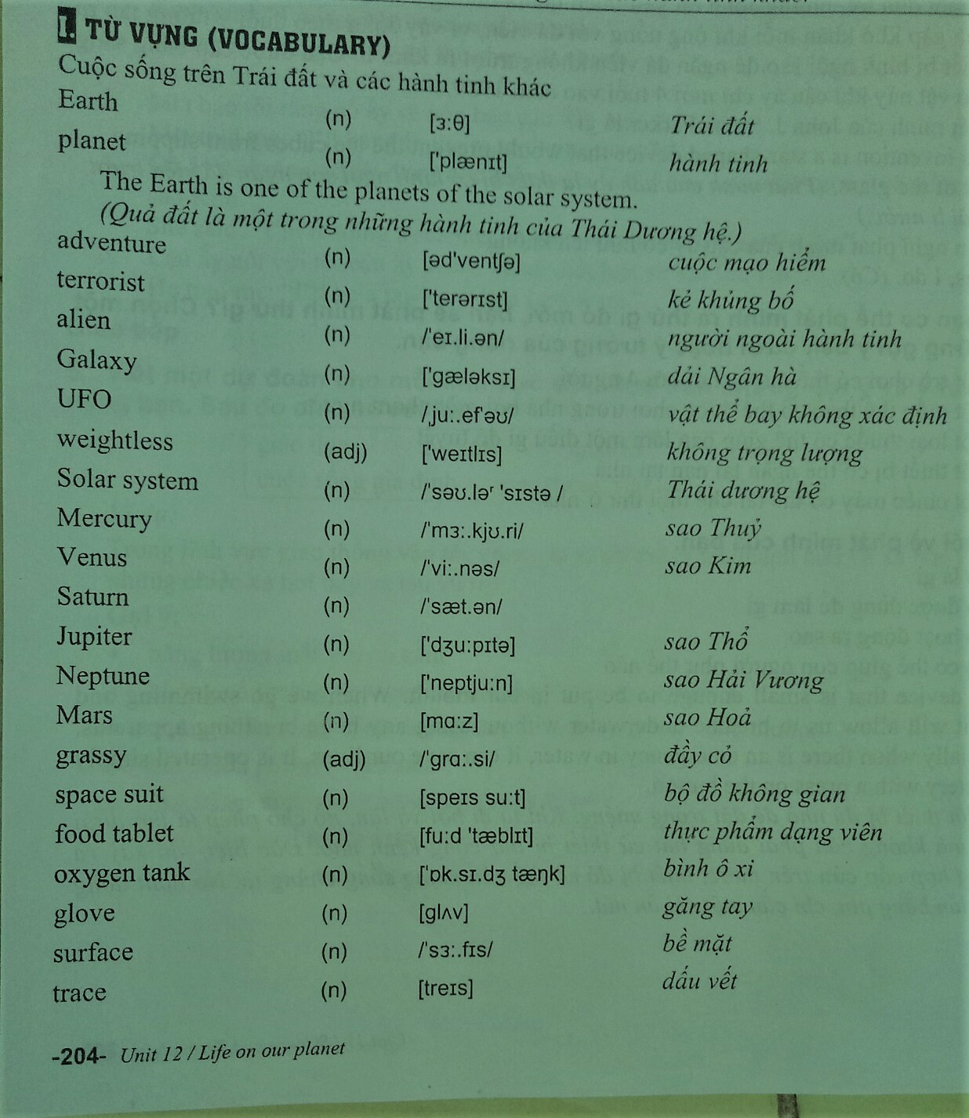

Slide 6
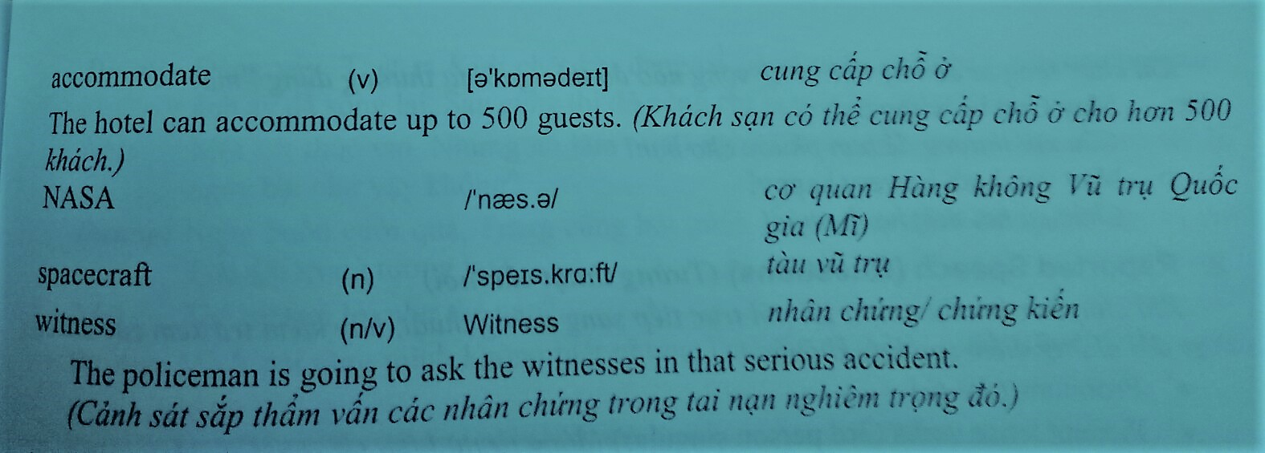

Slide 7



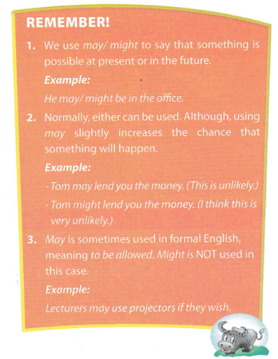

All Call
Student Demo

Slide 8
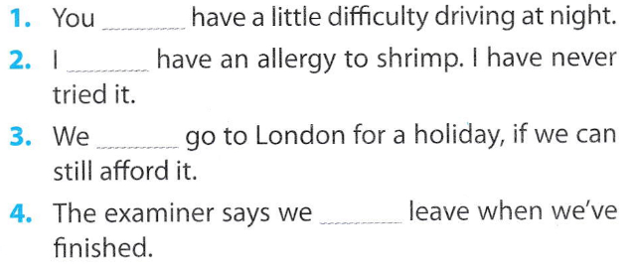
may/might
may/might
may/might
may
All Call
Student Demo

Slide 9
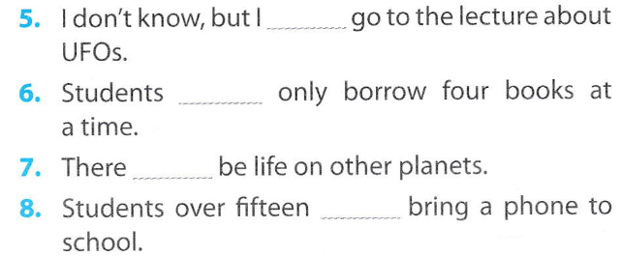
may/might
may
may/might
may
All Call
Student Demo

Slide 10
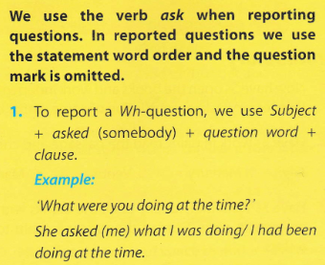
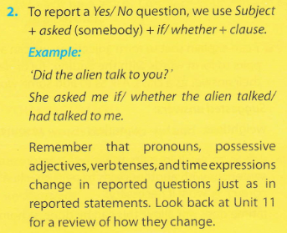
All Call
Student Demo

Slide 11
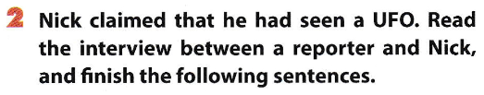
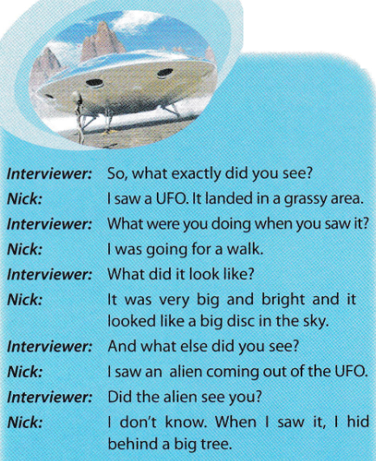

Slide 12
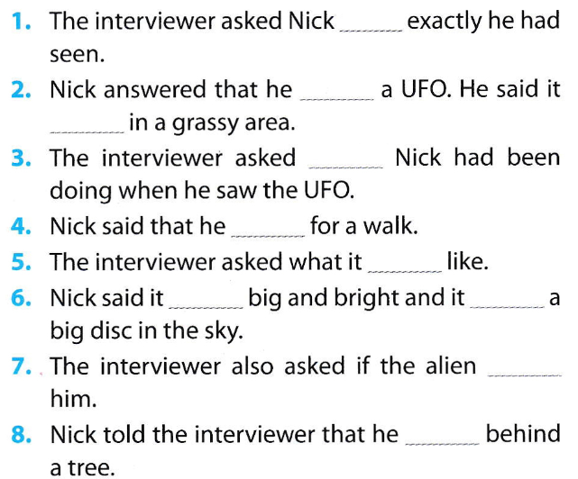
what
had seen
had landed
what
had been going
had looked
had been
had looked like
had seen
had hidden
All Call
Student Demo

Slide 13

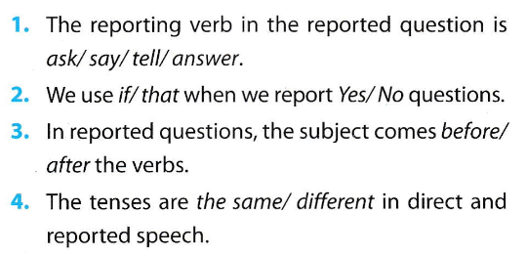
All Call
Student Demo

Slide 14


The interviewer asked if he went for a walk every day.
He asked how Nick had felt when he had seen the alien.
He asked what the alien had looked like.
He asked why Nick hadn’t taken a photo of the alien.
The interviewer asked how long the UFO had stayed there.
The interviewer asked if Nick had seen any UFOs since then.
All Call
Student Demo

Slide 15
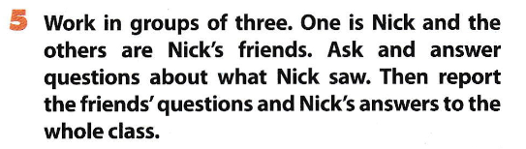
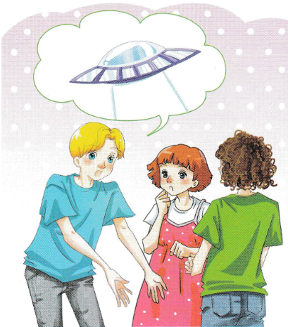
All Call
Pair
Student Demo

Slide 16
Homework
Learn by heart the new words.
Speak with your friends
Prepare for the next lesson-Practice

Slide 17


