Slide 1

WELCOME TO CLASS 6
Teacher – Vu Thu Thuy

Slide 2
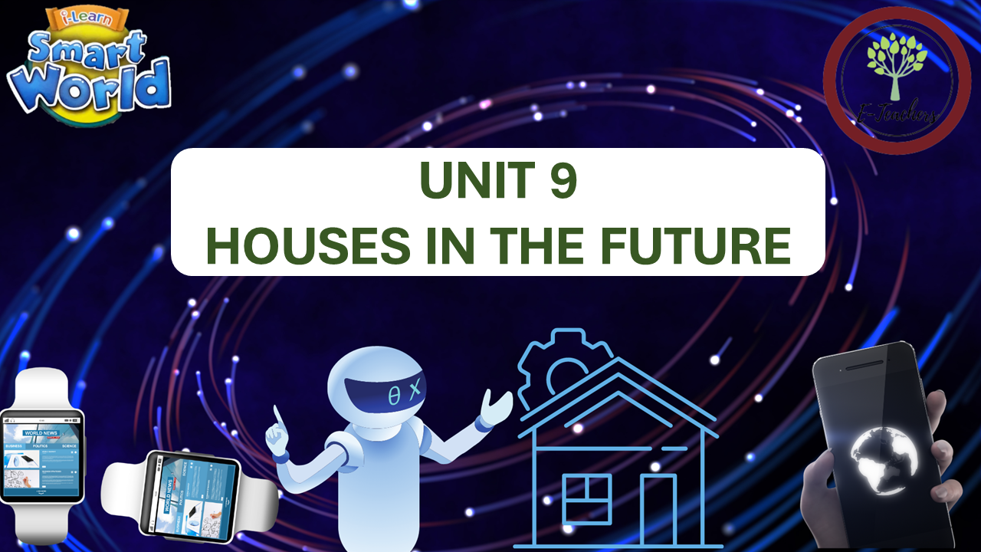
PERIOD 93-REVIEW
(PAGE 102+103)

Slide 3

OBJECTIVES
-Students are reviewed about vocabulary & grammar of unit 9.
- Reading, listening, pronunciation skills.

Slide 4

Ms Phương
Zalo: 0966765064
WARM-UP

Slide 5
VOCABULARY REVIEW
n
nhà dưới lòng đất
1. earthsraper
adj
2.eco-friendly
thân thiện với môi trường
n
3. megacity
siêu đô thị
Ms Phương
Zalo: 0966765064
n
4. sea
biển
n
nhà thông minh
5. smart home
adv
ngầm dưới đất
6.underground
n
máy in 3D
7. 3D printer
n
8.automatic food machine
máy làm thức ăn tự động
n
thiết bị
9. device
n
10. drone
máy bay không người lái
n
11. robot helper
người máy giúp việc

Slide 6
n
màn hình
12.screen
adj
thông minh
13. smart
n
phi hành gia
14.astronaut
Ms Phương
Zalo: 0966765064
n
trái đất
15. the earth
v
nổi
16. float
n
trọng lực
17. gravity
n
18.lock
khóa lại
n
19.the moon
mặt trăng
n
20.space station
trạm không gian
n
21.spacesuit
bộ quần áo vũ trụ

Slide 7

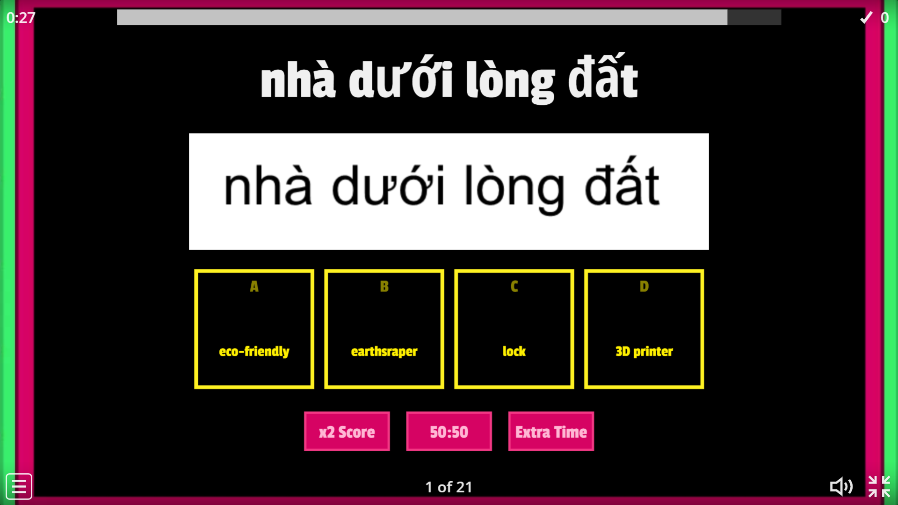
PRACTICE ONLINE VOCABULARY
Ms Phương
Zalo: 0966765064

Slide 8
GRAMMAR REVIEW
1. FUTURE SIMPLE ( THÌ TƯƠNG LAI ĐƠN)
Nói về ý kiến, phỏng đoán những sự việc xảy ra trong tương lai.
Cấu trúc : (+) Khẳng định : S+ will + V(inf)
(-) Phủ định : S+ won’t + V(inf)
(?) Câu hỏi : (Wh) + Will + S+ V(inf)?
- Từ chỉ thời gian trong thì tương lai : tomorrow, next week, next month, next year, tonight, in the future.
Ms Phương
Zalo: 0966765064

Slide 9
2. INDEFINITE QUANTIFIERS. ( ĐỊNH LƯỢNG TỪ)
Small quantifiers : Lượng nhỏ
Some ( một vài, một chút) – Đứng trước danh từ đếm được số nhiều hoặc danh từ không đếm được – trong câu khẳng định.
A few ( một vài) : Đứng trước danh từ số nhiều đếm được.
Large quantifiers : Lượng lớn
many : Nhiều – Đứng trước danh từ đếm được số nhiều
A lot of / lots of : ( nhiều) – Đứng trước danh từ số nhiều đếm được hoặc không đếm được , thường dung trong câu khẳng định.
Ms Phương
Zalo: 0966765064

Slide 10
3. Might : Có thể, có lẽ
Usge: Là một động từ khuyết thiếu nói về khả năng việc gì đó có thể xảy ra nhưng không chắc chắn.
Form :
(+) S + might + V(inf)
(-) S + might not + V(inf)
(?) Từ để hỏi + might + S + V(inf)?
Ms Phương
Zalo: 0966765064

Slide 11


Listening
You will hear Jenny talking to her friend, Tom, about a TV show she watched. For each questions, choose the correct answer( A,B, or C). You will hear the conversation twice.
0. What was TV show about?
life in the future
technology in the future
media in the future
What will be the bigges change?
many people will move to the country.
All cities will become megacities.
Lots of people will live in very large cities.

Slide 12
Listening
You will hear five short converstions. You will hear each conversation twice. There is one question for each conversation. For each question, choose the correct answer ( A,B,C or D)
2. Where will some cities be?
on lakes
on the sea
in the sky
3. Earthscrapers will be..........
cheap
eco-friendly
expensive
4. People will also live in.....
ice houses
tiny homes
smart homes
5. People will also have......
drones
3D printers
robot helpers.

Slide 13
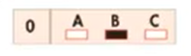
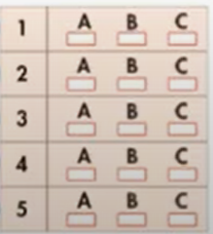
Reading
Read about the three devices of the future. Choose the correct answer (A,B, or C)
HOMES IN THE FUTURE
ROBOT HELPERS
Today, we have to do many chores a home. House of the future will have smart devices to help us to these things. For example, we will have robot helpers to clean and do other jobs around the house. We can study and relax.
Example:
0. Which machines will help us when we are hungry?
C
Which machines will make T-shirts?
Which machines will do the housework?
Which machines will order food for us?
Which machines won’t clean plates and dishes?
Which machines will make tables and chairs?
A
B. SMART KITCHEN DEVICES
Kitchens in the future will have smart devices to make any kind of food we want. After we eat, they will clean the dishes and automatically order more groceries. Drones will then deliver these goods from the supermarket.
B
C
C
C. 3D PRINTERS
Now, we have to buy all kinds of things in stores. In the future, we will have 3D printers at home. They print objects we need or want, like furniture, clothes, and even toys.

Slide 14
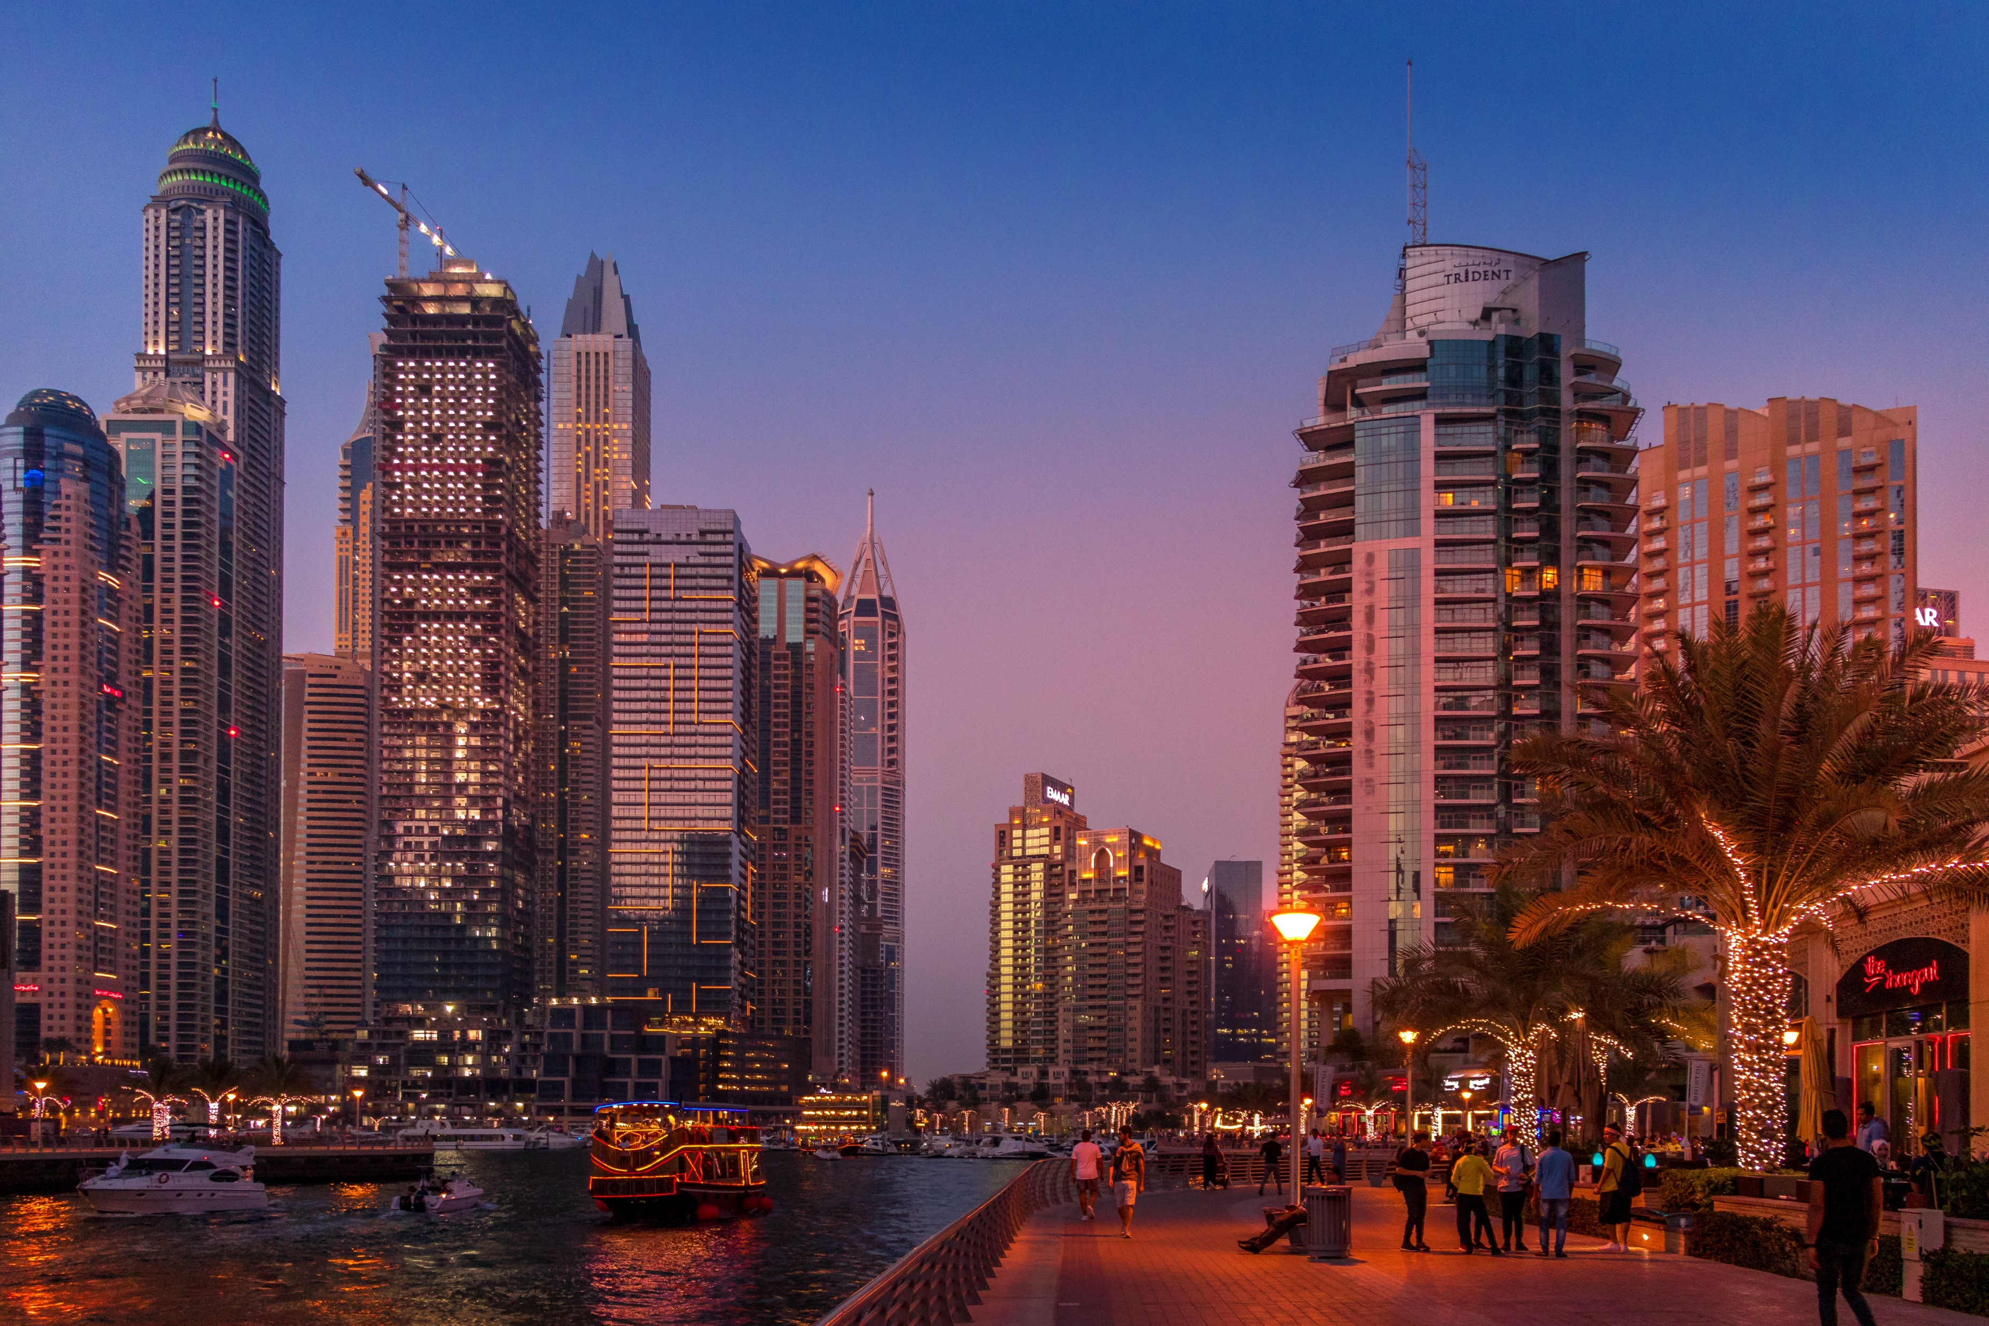
Vocabulary
Fill in the blanks with the words from the box.
smart home lock megacity robot helpers space station Moon underground 3D printer
1.I think living in a(n) ____________will be really cool. You can control everything in your house through your phone.
2. I think Ho Chi Minh city will become a(n) ______________soon. There are about nine million people living there.
3. I hope we will have ______________soon. With them, we won’t need to do chores anymore!
4. I like to look at the ______________at night. It’s so beautiful.
5. I don’t want to live__________________. It’s be so dark and sad.
6. Don’t forget to ___________the door and give the key to me.
7. You can print lots of cool things with a(n)_______________.
8. Astronauts usually stay on the ______________for about six months.
smart home
megacity
robot helpers
Moon
underground
lock
3D printer
Moon

Slide 15
Grammar
Write full sentences using the words below.
Where/you/think/people/live/future?
___________________________________________________________________
2. We/might/have/automatic food machines.
___________________________________________________________________
3. I /think/a few/ people/live/earthscarpers.
___________________________________________________________________
4. A lot of/ people/live/cities/on/sea.
___________________________________________________________________
5. How/astronauts/sleep/space?
___________________________________________________________________
6. What/you/think/homes/be like?
___________________________________________________________________
7. I/think/many people/have/robot helpers.
___________________________________________________________________
8. They/have to/use/special/toilet.
___________________________________________________________________
Where do you think people will live in the future?
We might have automatic food machines.
I think few people will live in earthscrapers.
A lot of people will live in cities on the sea
How do astronauts sleep in space?
What do you think homes will be like?
I think many people will have robot helpers
He has to use a special toilet.

Slide 16
PRONUNCIATION
Circle the word that has the underlined part pronounced differently from others.
1. A. magazin B. apartment C. computer D. technology
2. A. gravity B. technology C. astronaut D. printer
3. A. future B. machine C. helper D. robot
Circle the word that has the underlined part pronounced differently from others.
4. A. stops B.bags C. cleans D. has
5. A. units B. topics C. parks D. ways
6. A. bins B. cups C. trees D. papers

Slide 17
WRAP-UP
Vocabularies, grammar points within the unit
Pronunication and useful language

Slide 18
HOMEWORK
Learn new words and practice with the new language of Unit 9.
- Do the exercise in the Workbook (Pages 70 & 71)
- Write a paragraph about your favorite home in future.
- Be well-prepared for the next lesson Unit 10 Lesson, page 78

Slide 19


