Slide 1
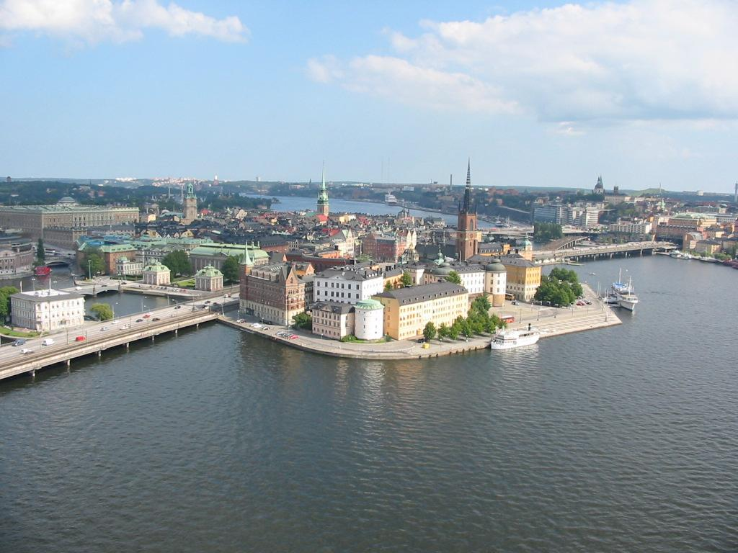
Welcome to our class

Slide 2

Oral test
Choose a city . Imagine you have just arrived in that city and use your notes to tell about your city .

Slide 3
English 6
Period 74 Unit 9 : CITIES OF THE WORLD
Lesson 6 : Skill 2

Slide 4
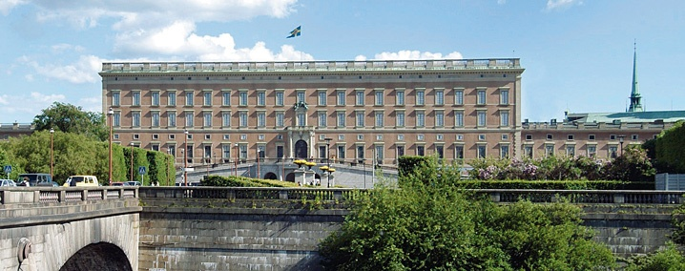
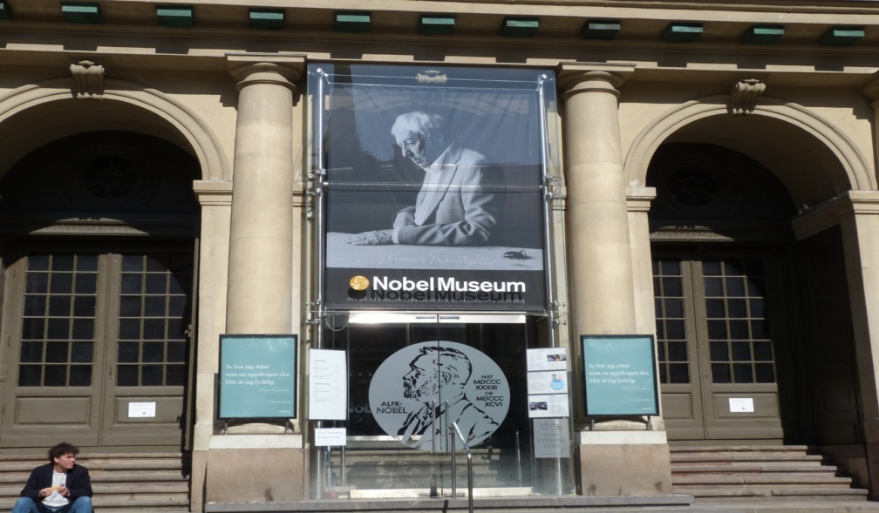
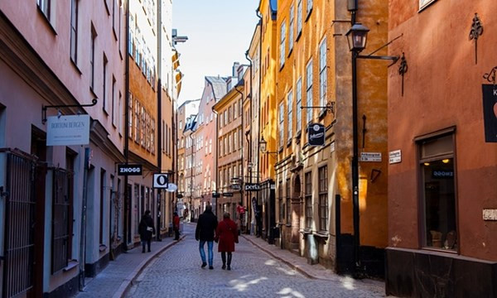
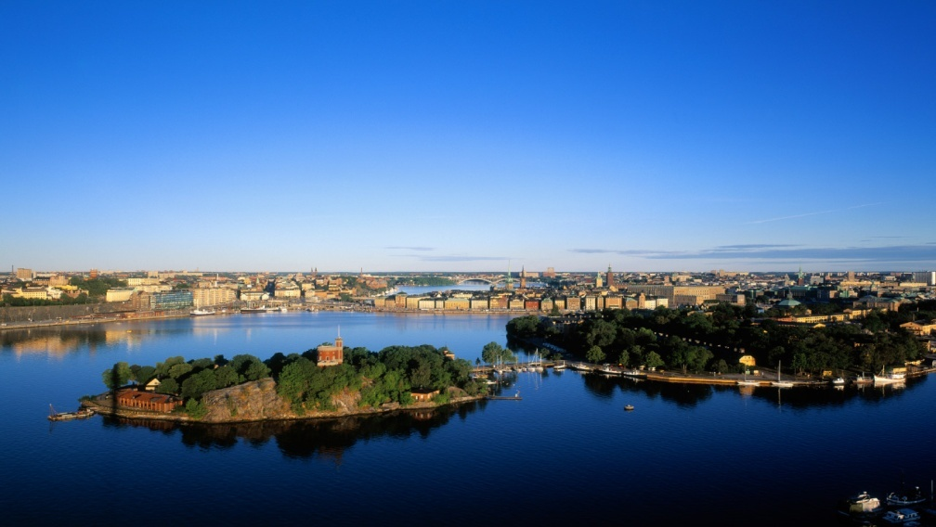
∗ Look at the pictures. What do you see?
a
Royal Palace
b
Nobel museum
c
Old Town
d
The city of Stockholm

Slide 5

LISTENING
1. Look at the pictures. What do you see?
2. Listen and tick ()True( T ) or False ( T)

Slide 6
New words:
1. Nobel peace prize (n) : giải Nobel hòa bình
2.Present (a) : hiện diện
3. Prime Minister (n) : Bộ trưởng đầu tiên
4. Prizewinner (n) : người được giải
5. Diploma (n) : văn bằng, chứng chỉ
6. Medal (n) : huân chương
7. Award (v) : thưởng , tặng
(n): phần thưởng

Slide 7


T
F
The Royal Palace is one of the largest palaces in EUROPE.
2. The biggest part of Stockholm is the Old Town.
3. Today, the Old Town doesn’t have any café ,restaurant or shops.
4. The Nobel Peace Prize is awarded in Stockholm.
5. The Nobel Prize is presented by the Swedish Prize Minister.
The oldest , not the biggest, part of Stockholm is the Old Town.
Today, the Old Town is a place with café, restaurant, shops and museum
All Nobel prizes, except for the Nobel Peace Prize, are awarded in Stockholm
It is presented by the Swedish King

Slide 8
3. Listen again to the talk and fill in the gaps.
14
The city of Stockholm covers __________ islands.
It has _________ years of history.
There are about ________people living in the Old Town today.
Nobel prizewinners receive their awards on _______________.
The award consists of a Nobel diploma, a medal, and ______________ Swedish crowns.  
700
3,000
10 December
10 million

Slide 9
Tape script :
Sweden’s capital city is built on 14 islands and has a 700 year-old history.
The oldest part of Stockholm is the Old Town. Here you can visit the Royal Palace, one of Europe’s largest and most dynamic palaces. There are about 3000 people living in the Old Town today and it’s a place with café, restaurants, shops and museum, including the Nobel Museum.
Stockholm is also the city where Nobel Prizes, except for the Nobel Peace Prize, are awarded each year.
On the 10 December, the day when Alfred Nobel died,
the Nobel Prize winners receive their awards from the Swedish King – a Nobel diploma , a medal, and 10 million Swedish crowns per prize.

Slide 10
WRITING
A holiday postcard
Study kills
Think about the 5 Ws and 1 H and include the answers in your postcard :
Who?
What?
When?
Where?
Why?
How?

Slide 11
4. Rearrange the words to make sentences.
Stockholm / fantastic / is /!
2. Da lat / we’re / in /!
3. A good time / we’re / having / here /!
4. Love / I / Disneyland /!
5. Must / come /you /!
6. You / wish /I /were /here /!
Stockholm is fantastic!
We’re in Da Lat!
We’re having a good time here!
I love Disneyland!
You must come!
I wishgg you were here!

Slide 12
5. Write a postcard. Use the notes about the city you have chosen in Speaking 4, page 32.

Slide 13

Homework
Learn by heart all the new words
Do exercises in workbook

Slide 14



Thanks for your attending

