Slide 1
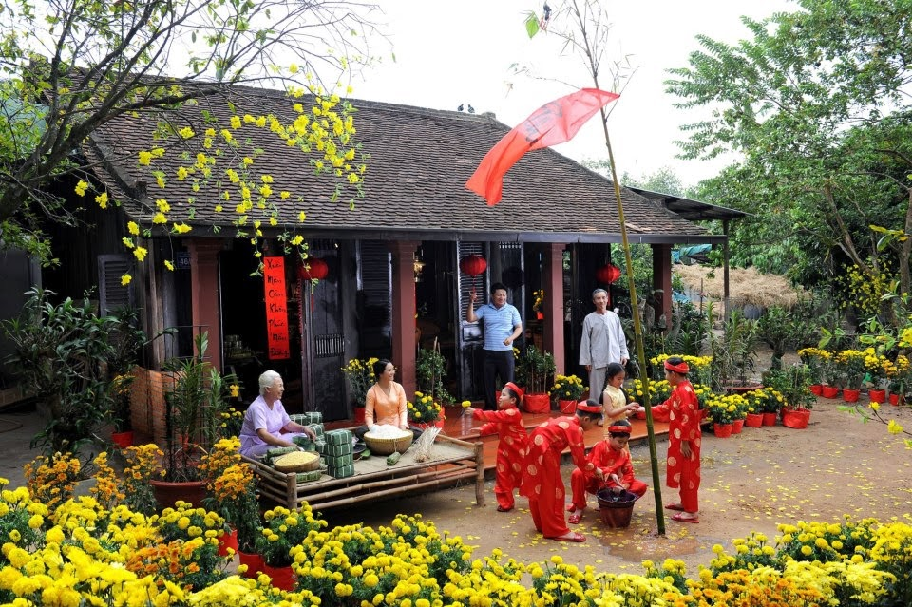
WARMLY WELCOME TO
OUR ENGLISH CLASS!

Slide 2
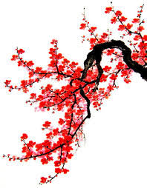
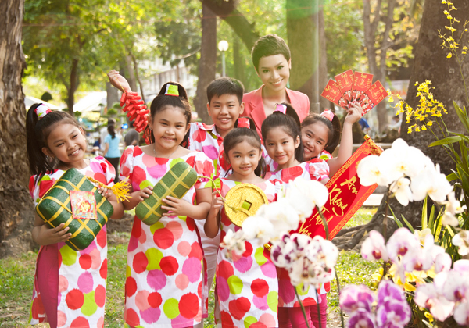
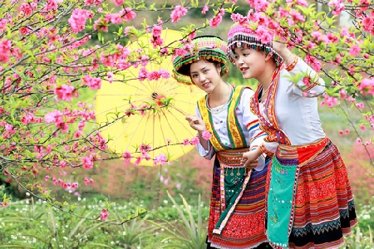
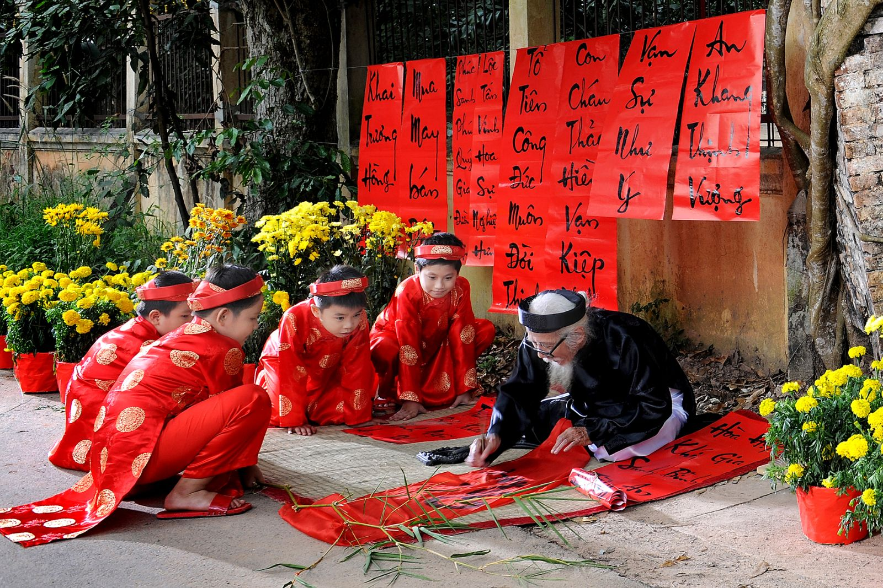
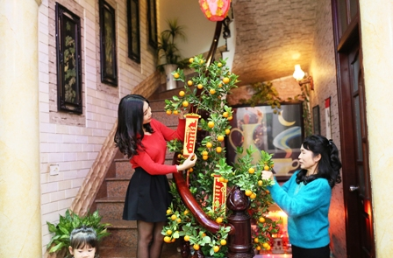
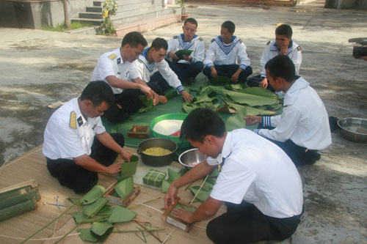
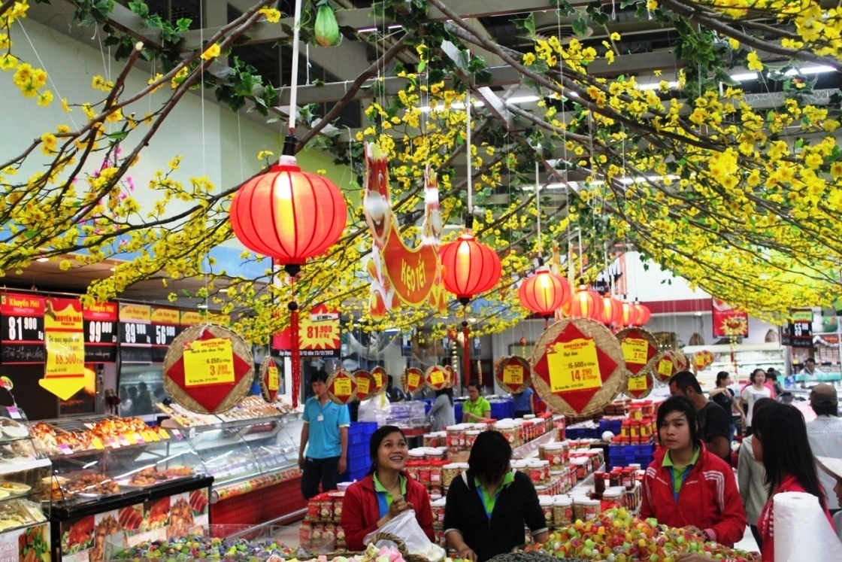
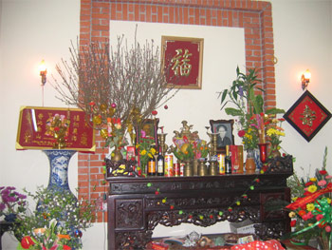
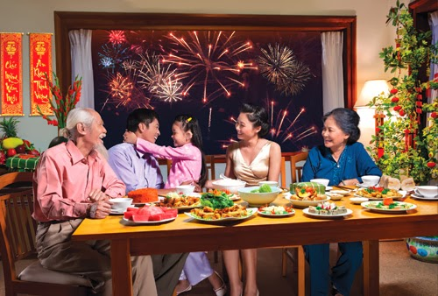
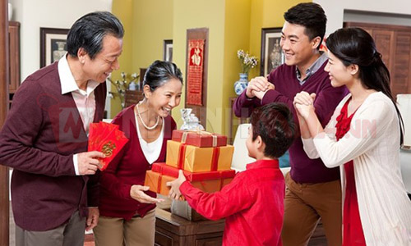
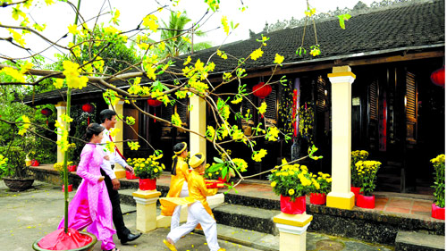
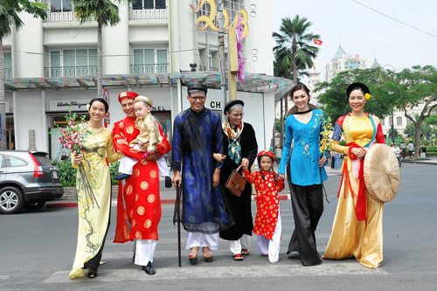
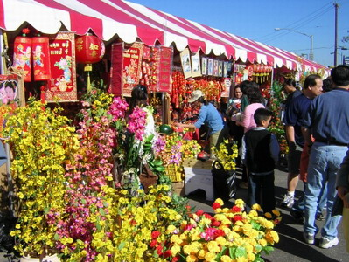
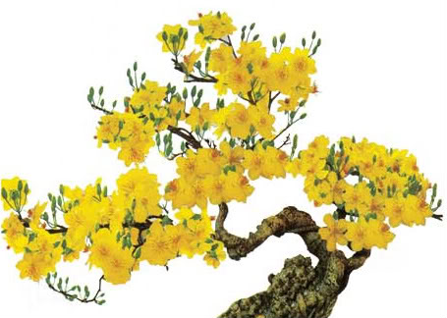

Slide 3

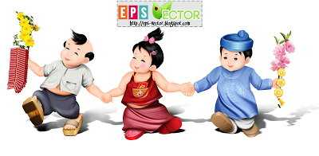
UNIT 6: OUR TET HOLIDAY
LESSON 41: GETTING STARTED

Slide 4

Phong

Slide 5


UNIT 6: OUR TET HOILDAY- LESSON 41: GETTING STARTED
I. New words
- decorate (v):
trang trí
decoration (n):
sự trang trí
-peach blossom (n):
hoa đào
-apricot blossom (n):
hoa mai

Slide 6
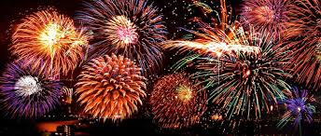
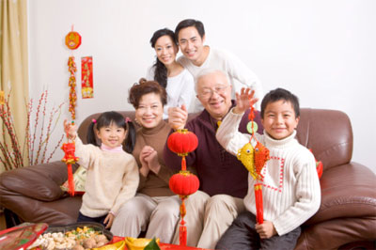
UNIT 6: OUR TET HOILDAY- LESSON 1: GETTING STARTED
I. New words
-decorate (v):
trang trí
decoration (n):
sự trang trí
-peach blossom (n):
hoa đào
-apricot blossom (n):
hoa mai
- fireworks (n):
pháo hoa
- family gathering (n):
sum họp gia đình
- celebrate (v):
kỉ niệm, tổ chức kỉ niệm
celebration (n):
lễ kỉ niệm
E.g: We celebrate Tet at the end of January.

Slide 7
UNIT 6: OUT TET HOILDAY- LESSON 41: GETTING STARTED
* Checking new words: WHAT AND WHERE
decorate
peach blossom
1
2
fireworks
celebrate
3
4
family gathering
5

Slide 8
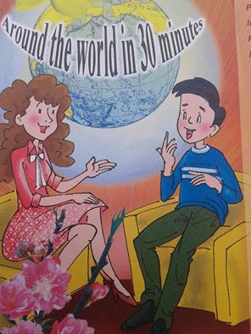
UNIT 6: OUR TET HOILDAY- LESSON 41: GETTING STARTED
Phong
the interviewer

Slide 9
UNIT 6: OU TET HOILDAY- LESSON 44: GETTING STARTED
II. Listen and read
1. True/ False prediction
(1). Phong is the first person on the show.
(2). This year, Tet is in February.
(3). People have a lot of fireworks at Tet.
(4). Phong loves eating good food during Tet.
(5). Next, the interviewer will talk to a person
from Japan.

Slide 10


UNIT 6: OU TET HOILDAY- LESSON 41: GETTING STARTED
II. Listen and read

Slide 11
UNIT 6: OU TET HOILDAY- LESSON 41: GETTING STARTED
II. Listen and read
2. Listen and do True/ False exercise
(1). Phong is the first person on the show.
(2). This year, Tet is in February.
(3). People have a lot of fireworks at Tet.
(4). Phong loves eating good food during Tet.
(5). Next, the interviewer will talk to a person
from Japan.
(1).Phong is not the first person on the show.
F
(2).This year, Tet is at the end of January.
F
(3). People don’t have a lot of fireworks at Tet.
F
T
T

Slide 12
UNIT 6: OUR TET HOILDAY- LESSON 41: GETTING STARTED
II. Listen and read
3. Read the conversation again and fill in the blanks.
1.This year we will have Tet at the end of January.
1. This year we will have Tet at …….
2. We decorate
our house.
2. We decorate
our ..…
4. We shouldn’t
burn …
OUR TET
HOLIDAY
3. We buy
and
3. We buy ……
and …..
5. We eat … and
get …during Tet.
6. Tet is a time
for ………..

Slide 13
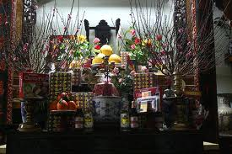
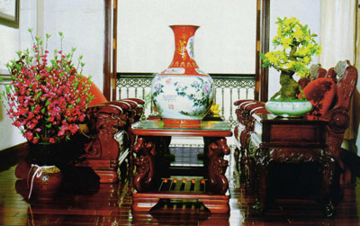


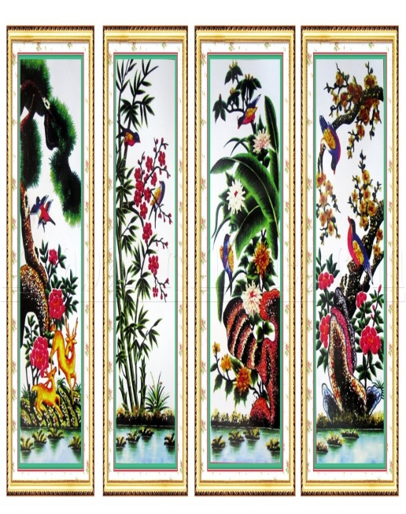
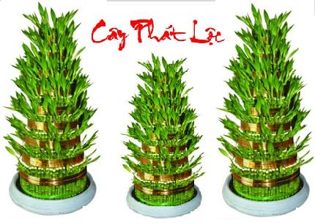

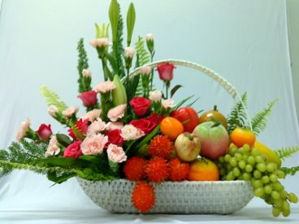

Slide 14
UNIT 6: OUR TET HOILDAY- LESSON 41: GETTING STARTED
II. Listen and read
3. Read the conversation again and fill in the blanks.
1.This year we will
have Tet at the end
of January.
4. We shouldn’t
burn fireworks.
4. We shouldn’t
burn….
2. We decorate our
house.
OUR TET HOLIDAY
5. We eat …. and
get …. during Tet.
3. We buy flowers
and plants.
6. Tet is a time for
………...

Slide 15
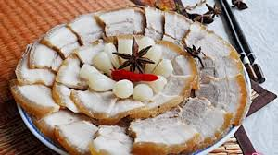
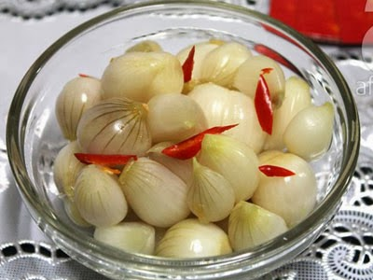
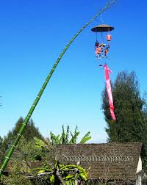
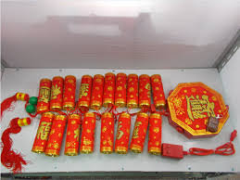
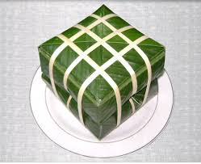

Slide 16
UNIT 6: OUR TET HOILDAY- LESSON 41: GETTING STARTED
II. Listen and read
3. Read the conversation again and fill in the blanks.
1.This year we will
have Tet at the end
of January.
2. We decorate our
house.
4. We shouldn’t
burn fireworks.
OUR TET HOLIDAY
5. We eat … and
get …during Tet.
5. We eat great food
and get lucky money
during Tet.
3. We buy flowers
and plants.
6. Tet is a time for
family gatherings.
6. Tet is a time for
………..

Slide 17

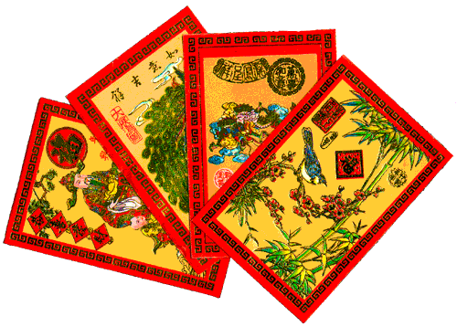
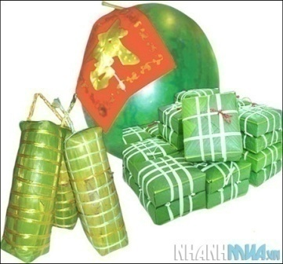
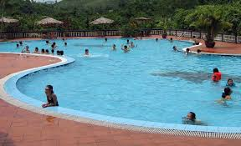
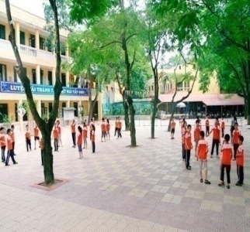
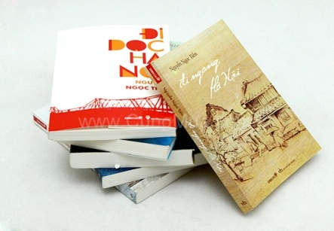
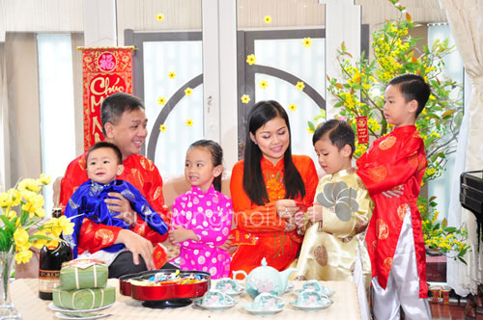

UNIT 6: OUR TET HOILDAY- LESSON 44: GETTING STARTED
II. Listen and read
4. Write the words / phrases under the appropriate pictures.
1
2
3
4
b. peach blossom and
apricot blossom
a. lucky money
c. banh chung
and banh tet
e. swimming pool
5
6
7
8
h. school ground
g. books
f. house decorations
d. family gathering
a. lucky money
c. banh chung and banh tet
f. house decorations
b. peach blossom and
apricot blossom
d. family gathering
g. books
e. swimming pool
h. school ground

Slide 18

UNIT 6: OUR TET HOILDAY- LESSON 41: GETTING STARTED
II. Listen and read
5. Look at the pictures again. Which pictures do you think are related to Tet?
1
2
3
4
5
6
7
8

Slide 19
UNIT 6: OUR TET HOILDAY- LESSON 44: GETTING STARTED
2
1
3
Pictures are related to Tet.
4
7
(in South Viet Nam)
8

Slide 20
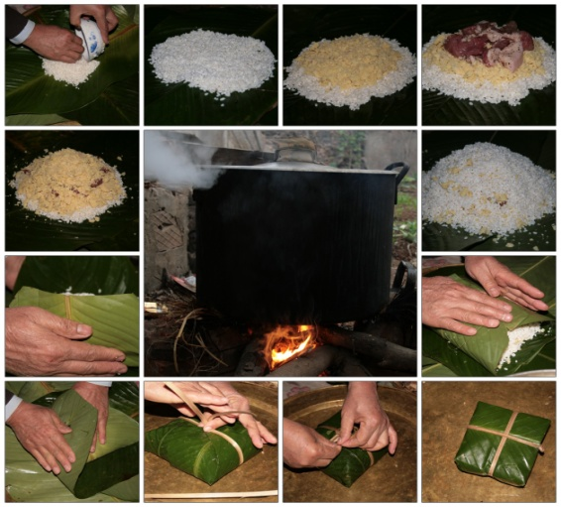
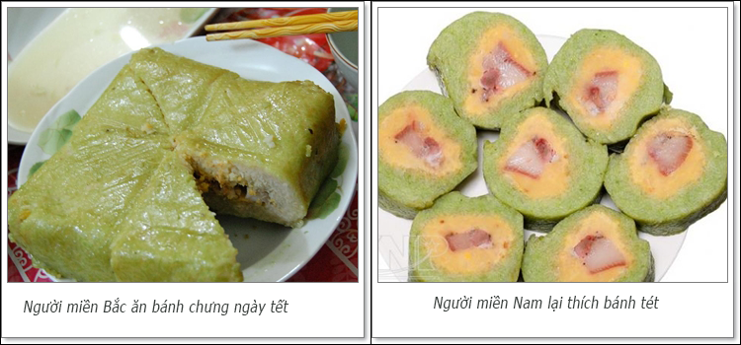
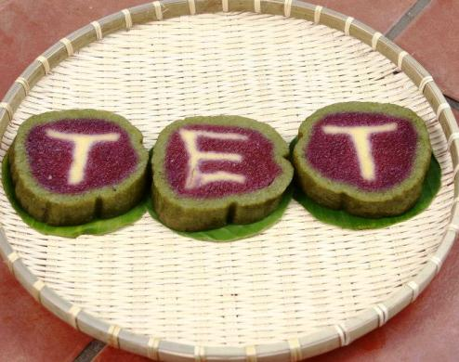

UNIT 6: OUR TET HOILDAY- LESSON 41: GETTING STARTED

Slide 21
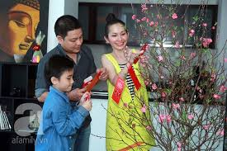
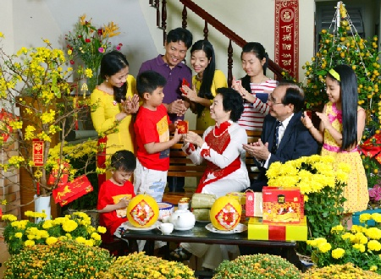

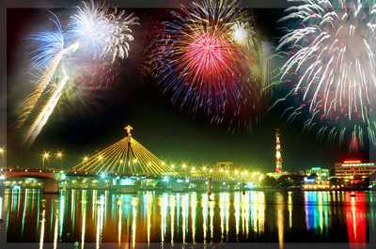
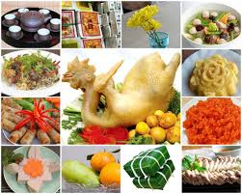
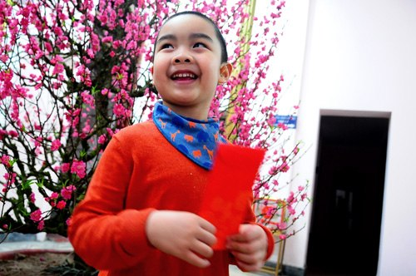
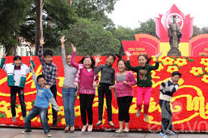
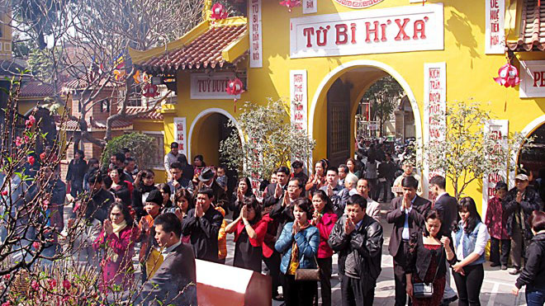

UNIT 6: OUR TET HOILDAY- LESSON 44: GETTING STARTED
* Name the activities in the pictures below
decorating house
visiting relatives
going shopping
watching
fireworks
eating special food
getting lucky money
going out with friends
going to a pagoda

Slide 22
UNIT 6: OUR TET HOILDAY- LESSON 44: GETTING STARTED
6.Write three things or activities you like best about Tet.
Example:
I like watching fireworks.

Slide 23
UNIT 6: OUR TET HOILDAY- LESSON 41: GETTING STARTED

Slide 24

UNIT 6: OUR TET HOILDAY- LESSON 44: GETTING STARTED

Slide 25
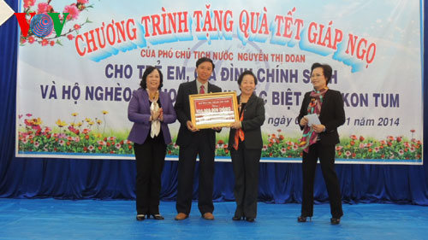
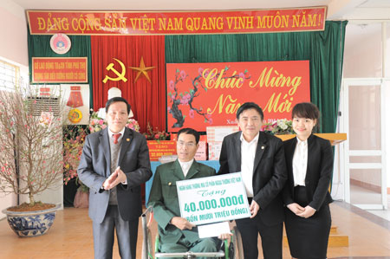
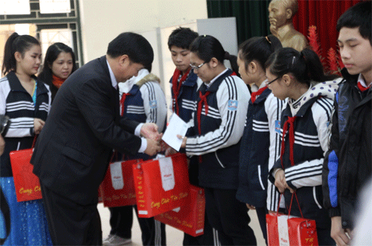
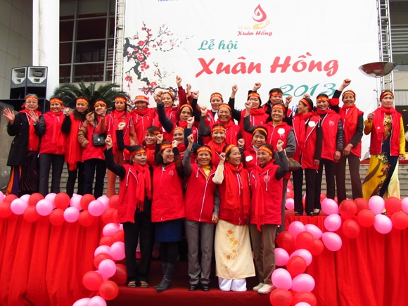
UNIT 6: OUR TET HOILDAY- LESSON 44: GETTING STARTED
Activities at Tet

Slide 26
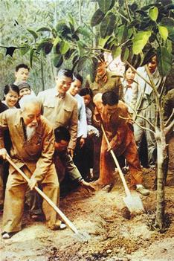




UNIT 6: OUR TET HOILDAY- LESSON 41: GETTING STARTED

Slide 27




UNIT 6: OUR TET HOILDAY- LESSON 41: GETTING STARTED

Slide 28




Tranh của : Khánh Ngọc- 6E
Tranh của : Mai Hương- 6B
Tranh của : Sơn Lâm- 6E
Tranh của : Lê Thắng- 6B

Slide 29

MEETING FAMOUS PEOPLE
- PROGRAMME
- Is New Year called Tet in Vietnam?
- When will Tet be this year?
- Should you buy fireworks?

Slide 30
UNIT 6: OUR TET HOILDAY- LESSON 41: GETTING STARTED
Homework
Learn by heart all new words.
Read the dialogue again.
Make postcards and write wishes in English to your friends and relatives+ draw pictures about
Tet and spring festivals.
Prepare A closer look 1.

Slide 31

Thank you for your attendance!

