Slide 1
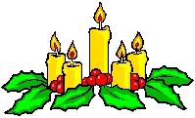
WELCOME TO MY CLASS
Good afternoon Everybody

Slide 2
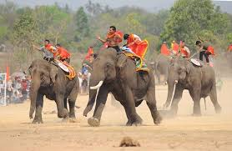
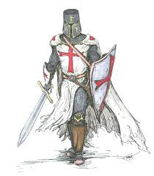
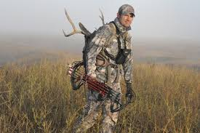
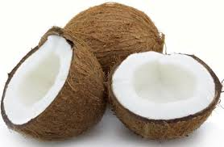
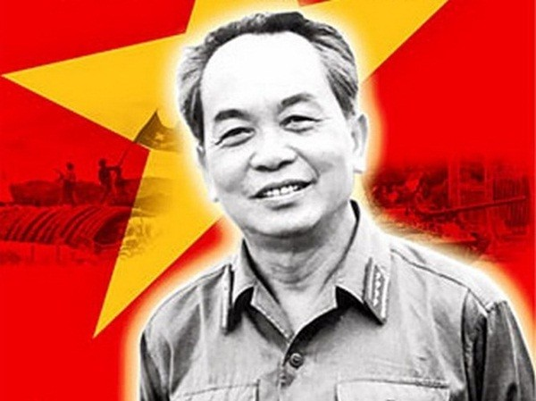
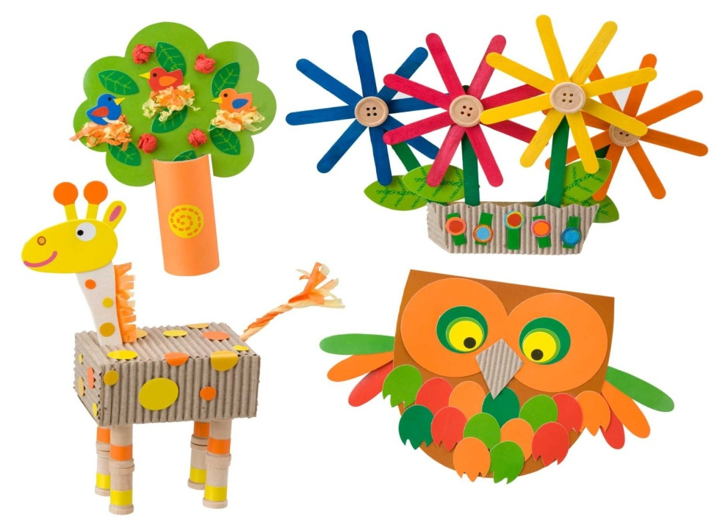
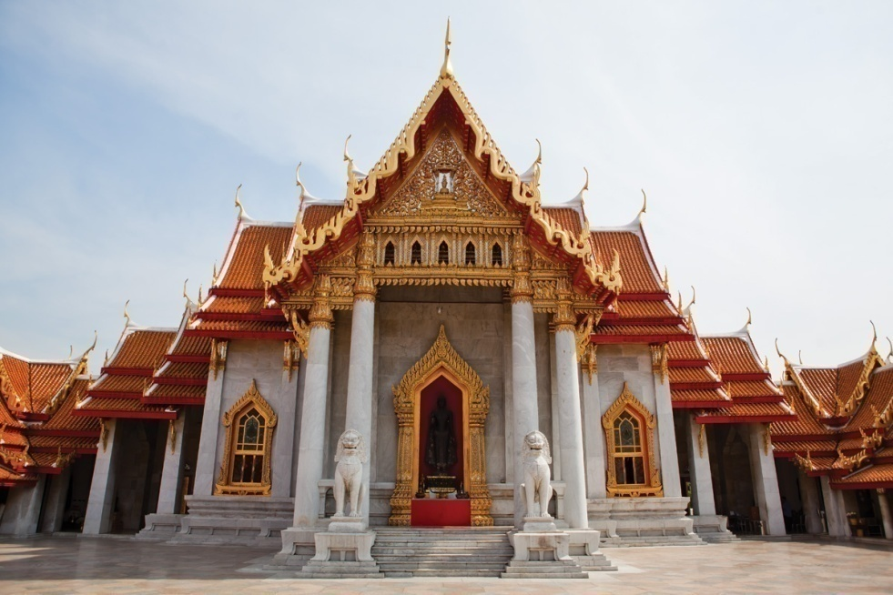
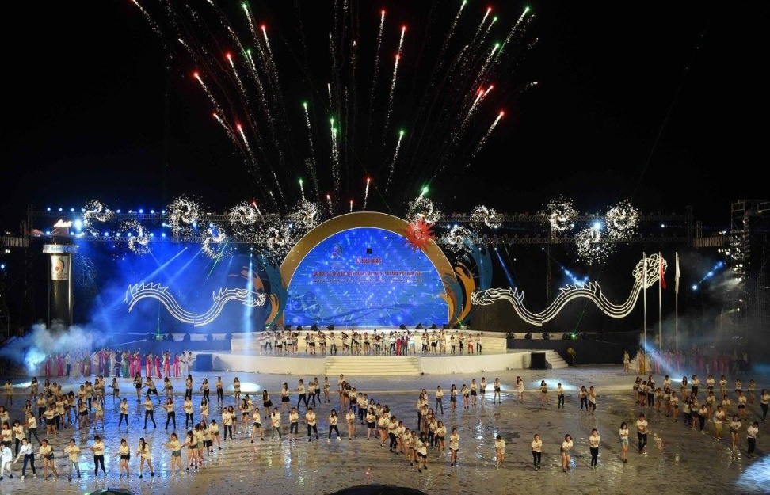
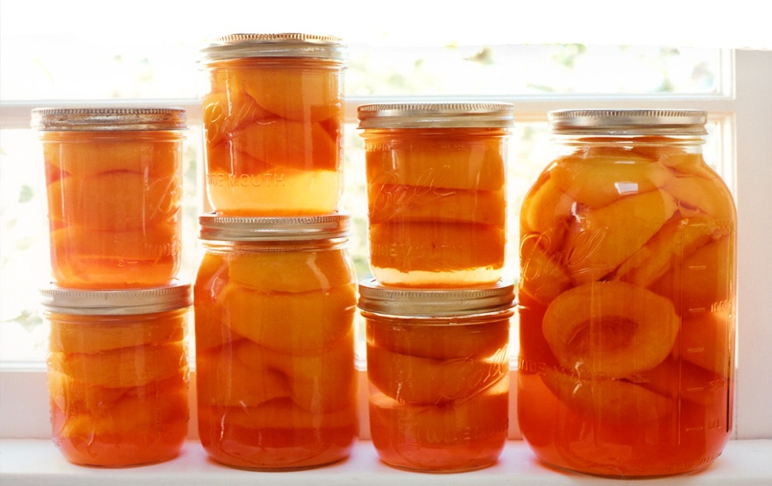
* WARM UP: CROSSWORD PUZZLE
PROCESSION
What is this?
The thai _________their ancestors.
1
T | E | M | P | L | E
2
C | E | R | E | M | O | N | Y
3
H | E | R | O
ELEPHANT RACE ________.
4
C | R | A | F | T
5
P
R
E
S
E
R
V
E
6
F | E | S | T | I | V | A | L
7
W
O
R
S
H
I
P
8
K
N
I
G
H
T
9
C
O
C
O
N
U
T
10
H | U | N | T

Slide 3
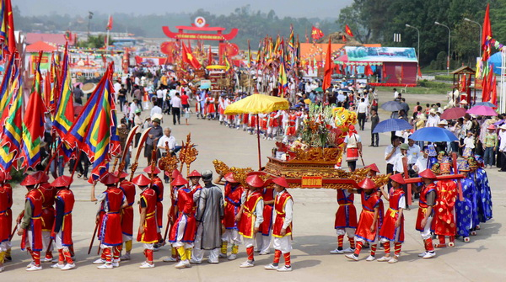
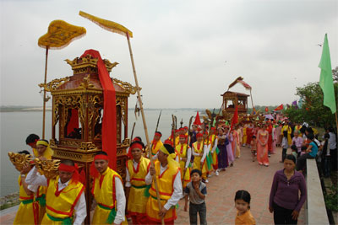


Slide 4
Date
UNIT FIVE
FESTIVALS IN VIET NAM
Period 41
SKILLS 1

Slide 5
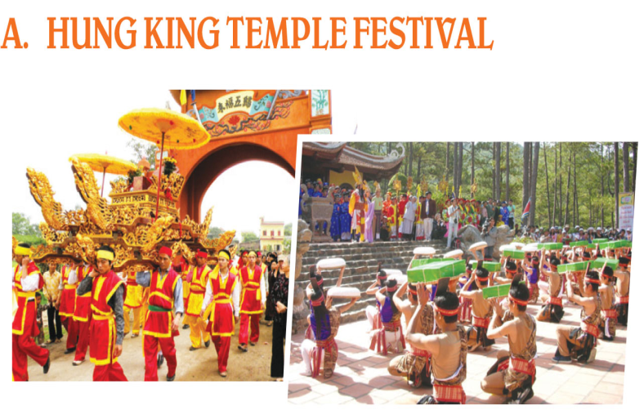
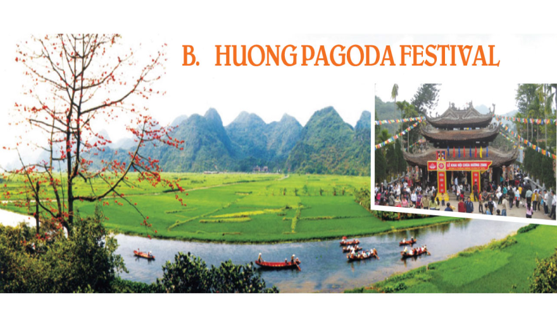
I. READING
1. Below are pictures from websites about festivals in Viet Nam. Work in groups to answer the following questions. (Ex. 1 /p. 54)
1. What are the people doing in each picture?
2. Who do people worship at the Hung King Temple Festival?
3. Who do people worship at the Huong Pagoda Festival?
They are doing worshipping ceremony.
Hung King.
Budda.

Slide 6

2. Now read the information about these festivals to check your ideas. (Ex. 2/p. 54)
A. The Hung King Temple Festival takes place from the 8th to the 11th day of the third lunar month in Phu Tho. This festival is held to worship the Hung Kings who are the founders and also the first emperors of the nation. The festival features a procession from the foot of the Nghia Linh mountain to the High Temple on top of the mountain. Here, there is a ceremony of offering incense and specialities such as chung cakes, daycakes and five-fruit trays to the Kings. Moreover, there are also many joyful activities including bamboo swings, lion dances, wrestling and xoan singing performances.

Slide 7
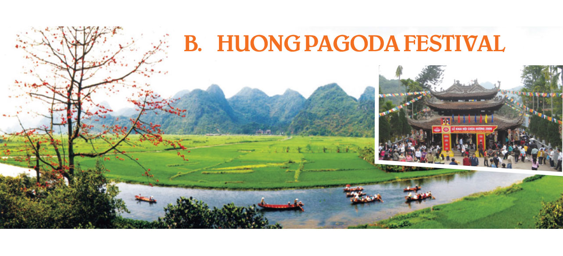
B. This Buddhist Festival is held annually and lasts for three months from the first to the third lunar month. During the festival, visitors come from all over the country and from overseas to join the procession and make offerings of incense, flowers, fruit and candles to worship Buddha at the pagoda. In addition to the ceremonies, people enjoy activities at this festival such as hiking in the mountains, exploring caves and taking photos of the beautiful scenery.

Slide 8
3. Find words/ phrases in the passages that have similar meaning to these words or phrases. (Ex. 3 / p. 54)
1. kings
2. includes as an important part of something
3. interesting, full of fun
4. from abroad
5. going for a long walk
6. natural surroundings
emperors
features
joyful
from overseas
hiking
scenery

Slide 9
4. Read the information again and answer the following questions. (Ex. 4 /p. 54)
When does the Hung King Temple Festival take place?
→
What is included in the offerings to the Hung Kings?
→
Why is it joyful to go to the Hung King Temple Festival?
→
What do people do to worship Buddha at the Huong Pagoda Festival?
→
Which of the activities at the Huong Pagoda Festival do you like most?
→
Lucky numbers

Slide 10
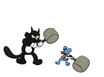
Lucky numbers
1
2
3
4
5
x
6
o
x
7
o
x
8
x
x
o

Slide 11

1. When does the Hung King Temple Festival take place?
From the 8th to the 11th day of the third lunar month.

Slide 12
2. What is included in the offerings to the Hung Kings?
Incense, specialities such as chung cakes, day cakes and five-fruit trays.

Slide 13
3. Why is it joyful to go to the Hung King Temple Festival?
Because there are many joyful activities including bamboo swings, lion dances, wrestling and xoan singing performances.

Slide 14
4. What do people do to worship Buddha at the Huong Pagoda Festival?
People join the procession and make offerings of incense, flowers, fruit and candles.

Slide 15
5. Which of the activities at the Huong Pagoda Festival do you like most?

Slide 16
LUCKY
NUMBER

Slide 17
LUCKY
NUMBER

Slide 18


SORRY !
SORRY !
SORRY!
YOU LOSE 5 MARKS

Slide 19
II. SPEAKING
1. Work in pairs. Your teacher is organising a trip. You have two options: going to Huong Pagoda or going to Hung King Temple. You have to decide the following. (Ex. 5a/p. 54)
1. Which place do you prefer to go to? Explain your choice.
Hung King Temple | Huong pagoda

Slide 20
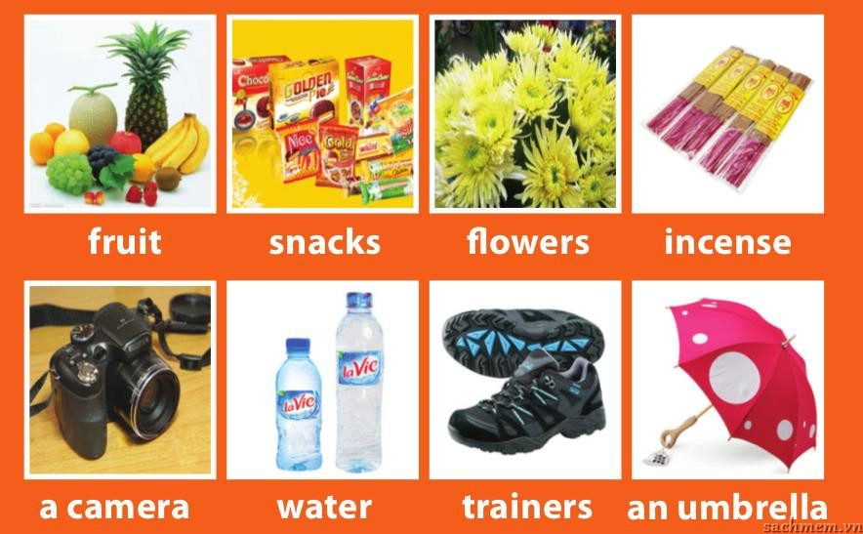
2. What things should you take with you? Why?

Slide 21
2. Now report your decisions to the class. Which location is more popular and Why? (Ex. 5b/p. 54)

Slide 22
III. AT HOME
Learn by heart new words.
Practise speaking with your partner.
Do Ex. D1, D2 / p. 41, 42 in workbook.
Prepare SKILLS 2.

Slide 23

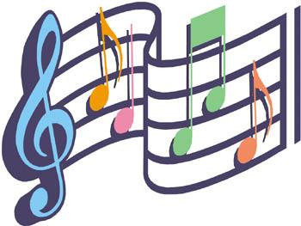


The bye bye song
Bye, bye.
See you tomorrow.
Bye, bye.
See you tomorrow.
Bye, bye.
See you tomorrow.
Bye, bye. Bye, bye.
The bye bye
song
Notes:
23

