Slide 1
Welcome to our class!
Period 77: Review 3
Lesson 2: Skills

Slide 2

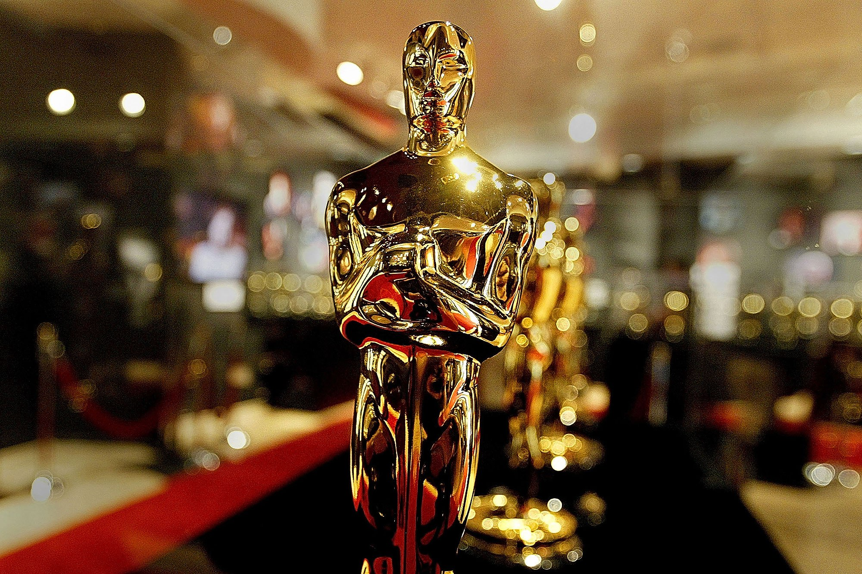
What is this?
This is a cup of Oscars award

Slide 3
Reading Task 1: Read the passage. Match the headings in the box with the paragraphs.
Tips:
Step 1: Read the headings first
Step 2: Read the paragraph quickly
Step 3: Find the main point of each paragraph by finding topic sentence

Slide 4

1. Different awards in The Oscars
2. What are The Oscars?
3. The Oscar statuette
A._______________
The Academy Awards, commonly known as The Oscars, are the most famous film awards in the world. They have been held since 1929. They are called The Oscars after the golden statuette awarded to the winners.
B.________________
The Oscar statuette is officially called the Academy Award of Merit. It is 13½ inches high and weighs 8½ pounds. The Oscar statuette was designed by Cedric Gibbons and sculpted by George Stanley. It is a knight holding a crusader's sword, standing on a reel of film. The first Oscar was given to Emil Jannings on May 16, 1929.
C.________________
The most important Oscar is the “Best Picture” prize which is given to the best film. Two other important awards are “Best Actor” and “Best Actress” in a leading role. There are lots of other prizes too, such as “Best Director”, “Best Supporting Actor” and “Best Supporting Actress”,”Best Costume Design”,”Best Film Editing”.etc.

Slide 5

Task 2: Read the passage again and answer the questions.
1. When were The Oscars first organised?
=> They were first organised in 1929.
2. What are the awards named after?
=> They are named after the Oscar statuette.
3. Who is Cedric Gibbons?
=> He is the person who designed/ He designed the Oscar statuette.
4. Who received the first Oscar statuette?
=> Emil Jannings received the first Oscar statuette.
5. What is the Best Picture prize?
=> It is the prize for/ given to the best film.

Slide 6
A. What are The Oscars?
The Academy Awards, commonly known as The Oscars, are the most famous film awards in the world. They have been held since 1929. They are called The Oscars after the golden statuette awarded to the winners.
B.The Oscar statuette
The Oscar statuette is officially called the Academy Award of Merit. It is 13½ inches high and weighs 8½ pounds. The Oscar statuette was designed by Cedric Gibbons and sculpted by George Stanley. It is a knight holding a crusader's sword, standing on a reel of film. The first Oscar was given to Emil Jannings on May 16, 1929.
C.Different awards in The Oscars
The most important Oscar is the “Best Picture” prize which is given to the best film. Two other important awards are “Best Actor” and “Best Actress” in a leading role. There are lots of other prizes too, such as “Best Director”, “Best Supporting Actor” and “Best Supporting Actress”,”Best Costume Design”,”Best Film Editing”.etc.

Slide 7

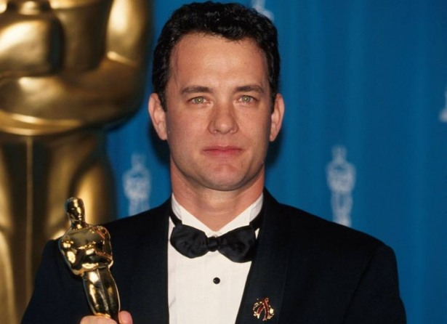
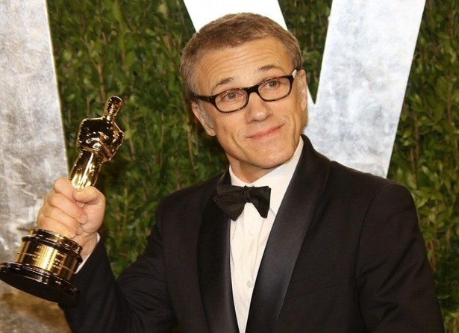
Speaking Task 3: Work in groups. Discuss the following questions.
1. Which actors and actresses you know have been awarded an Oscar?
Tom Hanks
Christoph Waltz

Slide 8

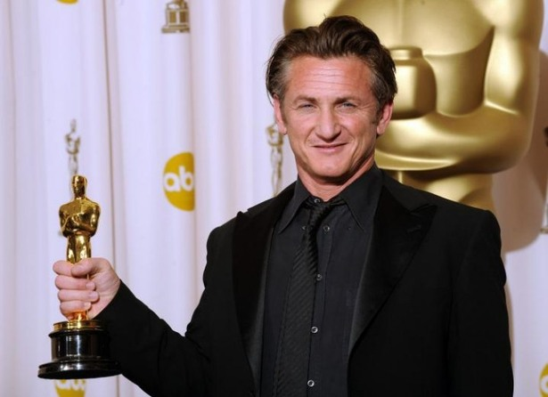
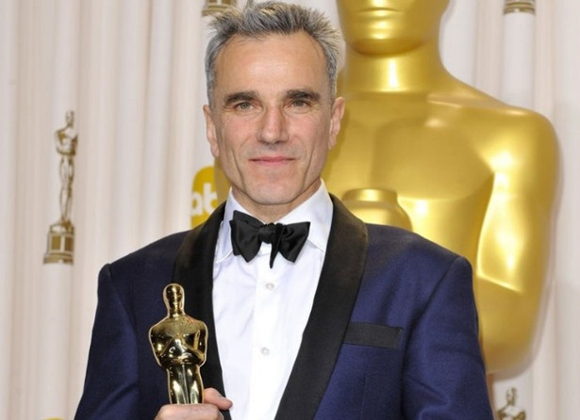
Sean Penn
Daniel Day Lewis

Slide 9
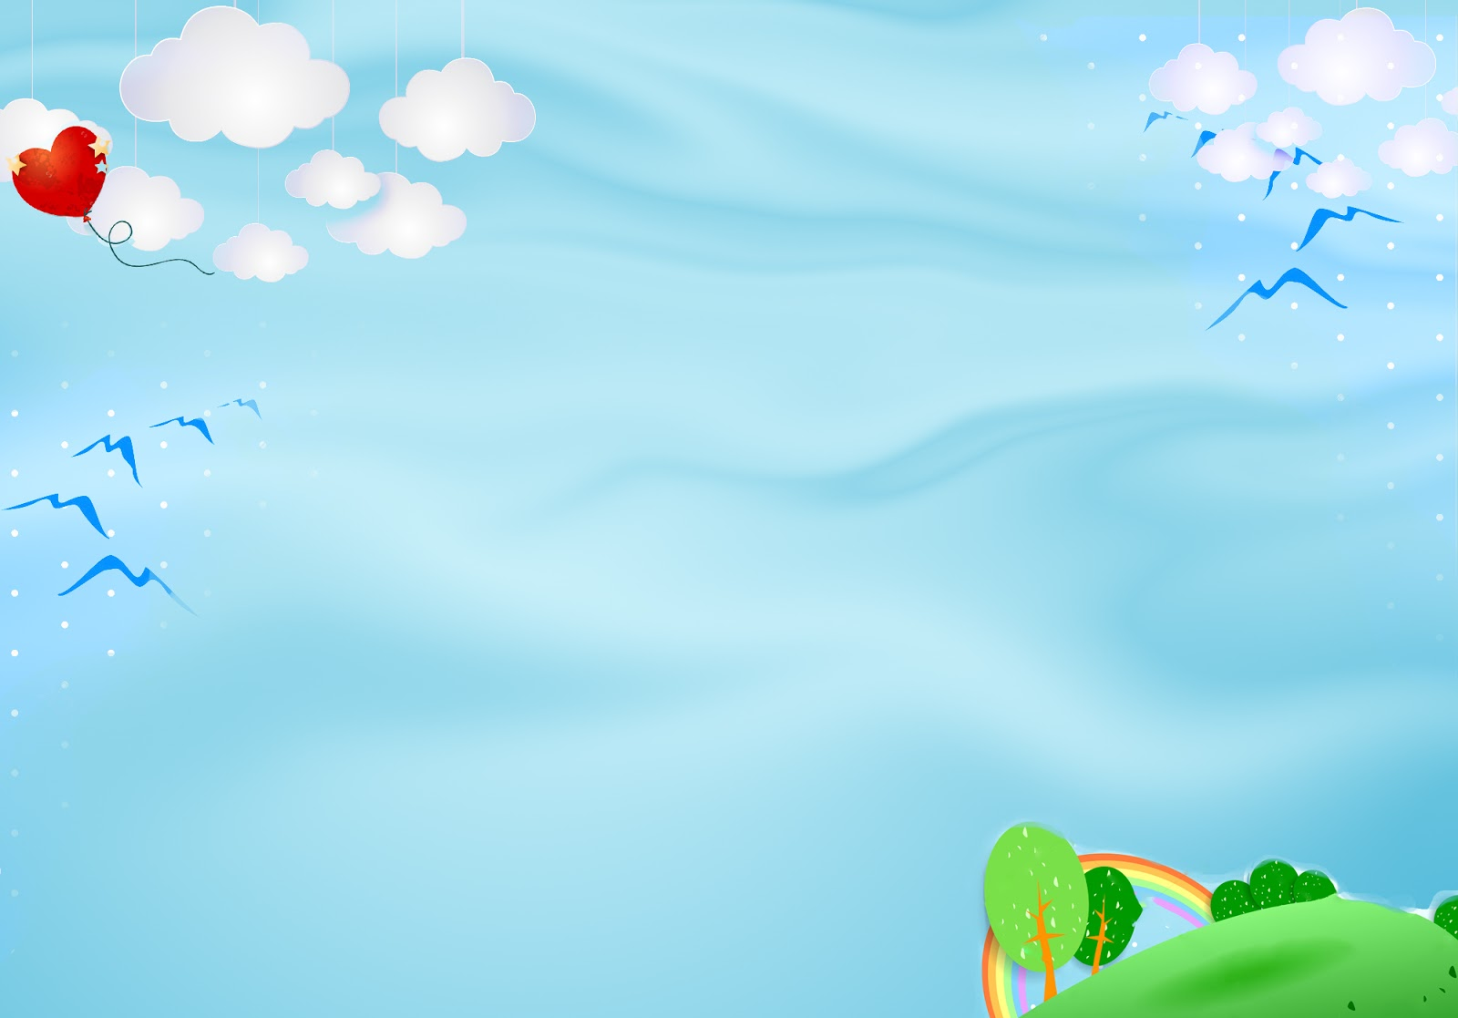
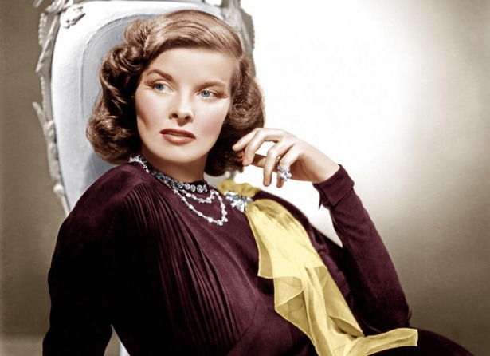
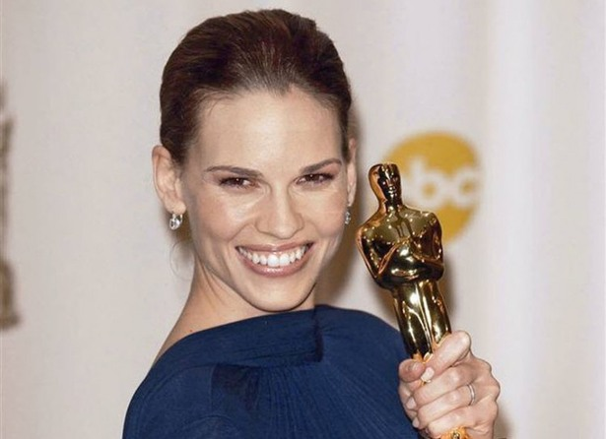
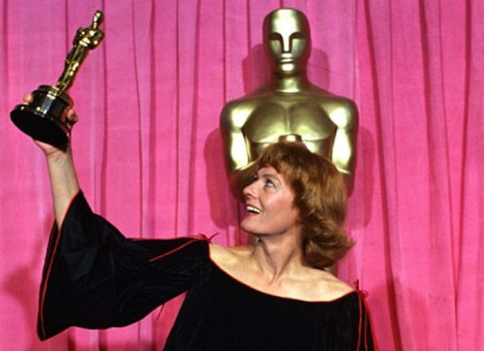
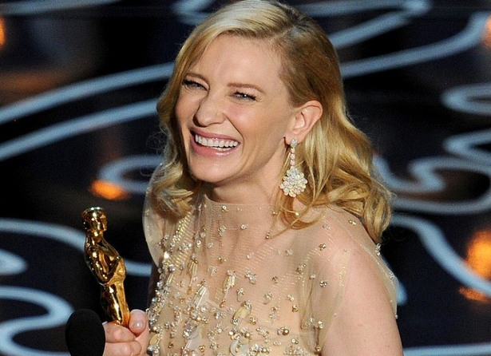
Katharine Hepburn
Hilary Swank
Ingrid Bergman
Cate Blanchett

Slide 10
2. Why do you think The Oscars are important to actors and actresses?
- It can really help a film's success or an actor's career if they win an Oscar.
- Because this award can bring them fame and earn a lot of money.
- This prize prove their talent of acting.

Slide 11

Task 4: Mi and Nick visit Ms Hoa at home. Listen to their conversation. Write T (true) or F (false).
1. Mi and Nick have been to Ms Hoa’s house before.
They saw some pictures in an album.
3. Nick has been to the Tulip Festival in Holland.
Ms Hoa went to the Tulip Festival last September.
Ms Hoa’s son is in Melbourne.

Slide 12


1. Mi and Nick have been to Ms Hoa’s house before.
=> Because Mrs Hoa said: It’s the first time you’ve come to my house, isn’t it?
They saw some pictures in an album.
=> Because the photos are on the wall.
3. Nick has been to the Tulip Festival in Holland.
Ms Hoa went to the Tulip Festival last September.
Ms Hoa’s son is in Melbourne.
(F)
(T)
(T)

Slide 13

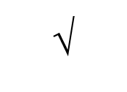
Task 5: Listen to the conversation again. Who did the following things? Tick (√) the appropriate column. Sometimes you may need to tick both.
 | Ms Hoa | Nick
1. tried Dutch foods and drinks
2. watched traditional Dutch dancing
3. watched parades
4. listened to folk music
5. was interested in the festival
√

Slide 14

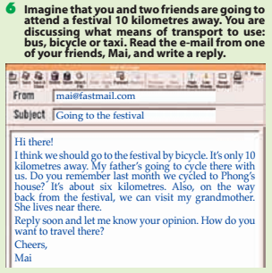
Writing

Slide 15
Tips:
In your reply email, you should answer these questions:
What kinds of transport to use: bus, bicycle or taxi?
Do you agree with Mai’s idea that you and she will go there by bicycle?
Do you want to visit Mai’s grandmother with her?

Slide 16

Hi Mai,
Bicycle is a good idea. Cycling is good for our health and it’s a good occasion for us to do exercise. We should check our bicycles carefully before the trip. We also wear coats, hats, gloves, sunglasses and prepare some snacks and bottles of water. I will ride to Hoa’s house firstly and then both of us will get to your house. We and your father will start from your house. I think it will take less than 1 hour from your house to festival.
How about Hoa?
Cheers,
Nam

Slide 17

Homework:
Do exercises on workbook.
Review unit 7, 8, 9.
Prepare for the 45 test.
Complete the email in task 6 and submit in next lesson.

Slide 18
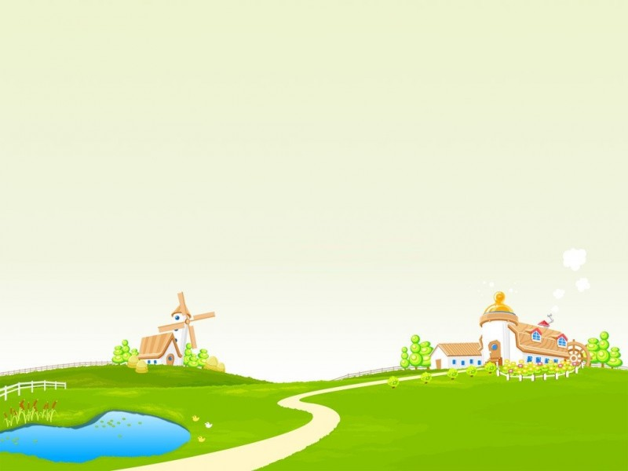
See you again!

Slide 19
Practice
I. Choose the best answer .
1. A film in which fun and romantic is called a/an .................
A. thriller B. comedy C. romantic comedy D. animation
2. The movie on TV last night made me ................. .
A. bore B. boring C. bored D. boredom
3. They are really ................. in going to the cinema tonight.
A. excited B. interested C. amused D. pleased
4. ................. beginning with a terrible disaster, the film has a happy ending.
A. In spite of B. Despite of C. Although D. However
5. Christmas songs are ................. for people in town and villages.
A. enjoyed B. described C. performed D. appeared
6. Public .................. in my town is good and cheap.
A. transport B. tour C. journey D. travel
7. .................. is not very far from here to the city Centre.
A. That B. This C. It D. There
8. You should.................. right and left when you go across the roads.
A. see B. look C. be D. take
9. Mai's dad usually drives her to school ................ her school is very far from her house.
A. but B. though C. because D. or
10.. Yesterday Hoa and Lan...................... round West Lake. It took them an hour.
A. cycle B. cycles C. cycling D. cycled
11. Oanh: "Hey, Mai. How about going cycling round the lake on Saturday?" – Mai: " ................."
A. Great idea B. That's sound terrible C. you're welcome D. No, thanks
12. Duong: "How about seeing a film?" – Mai: " …………………….! What shall we see? "
A. Good idea B. Great idea C. That sounds great D. All are correct
II. Find out and circle the mistake by choosing A, B, C or D.
13. Traffic accidents can be preventing if people obey the rules strictly.
A B C D
14. It’s about 3 kilometers between my house to my school.
A B C D
15. Despite my dad was a film director 20 years ago, nobody knows him now.
A B C D

