Slide 1
Welcome to our class
UNIT 3: TEEN STRESS AND PRESSURE
Lesson 1: Getting started

Slide 2
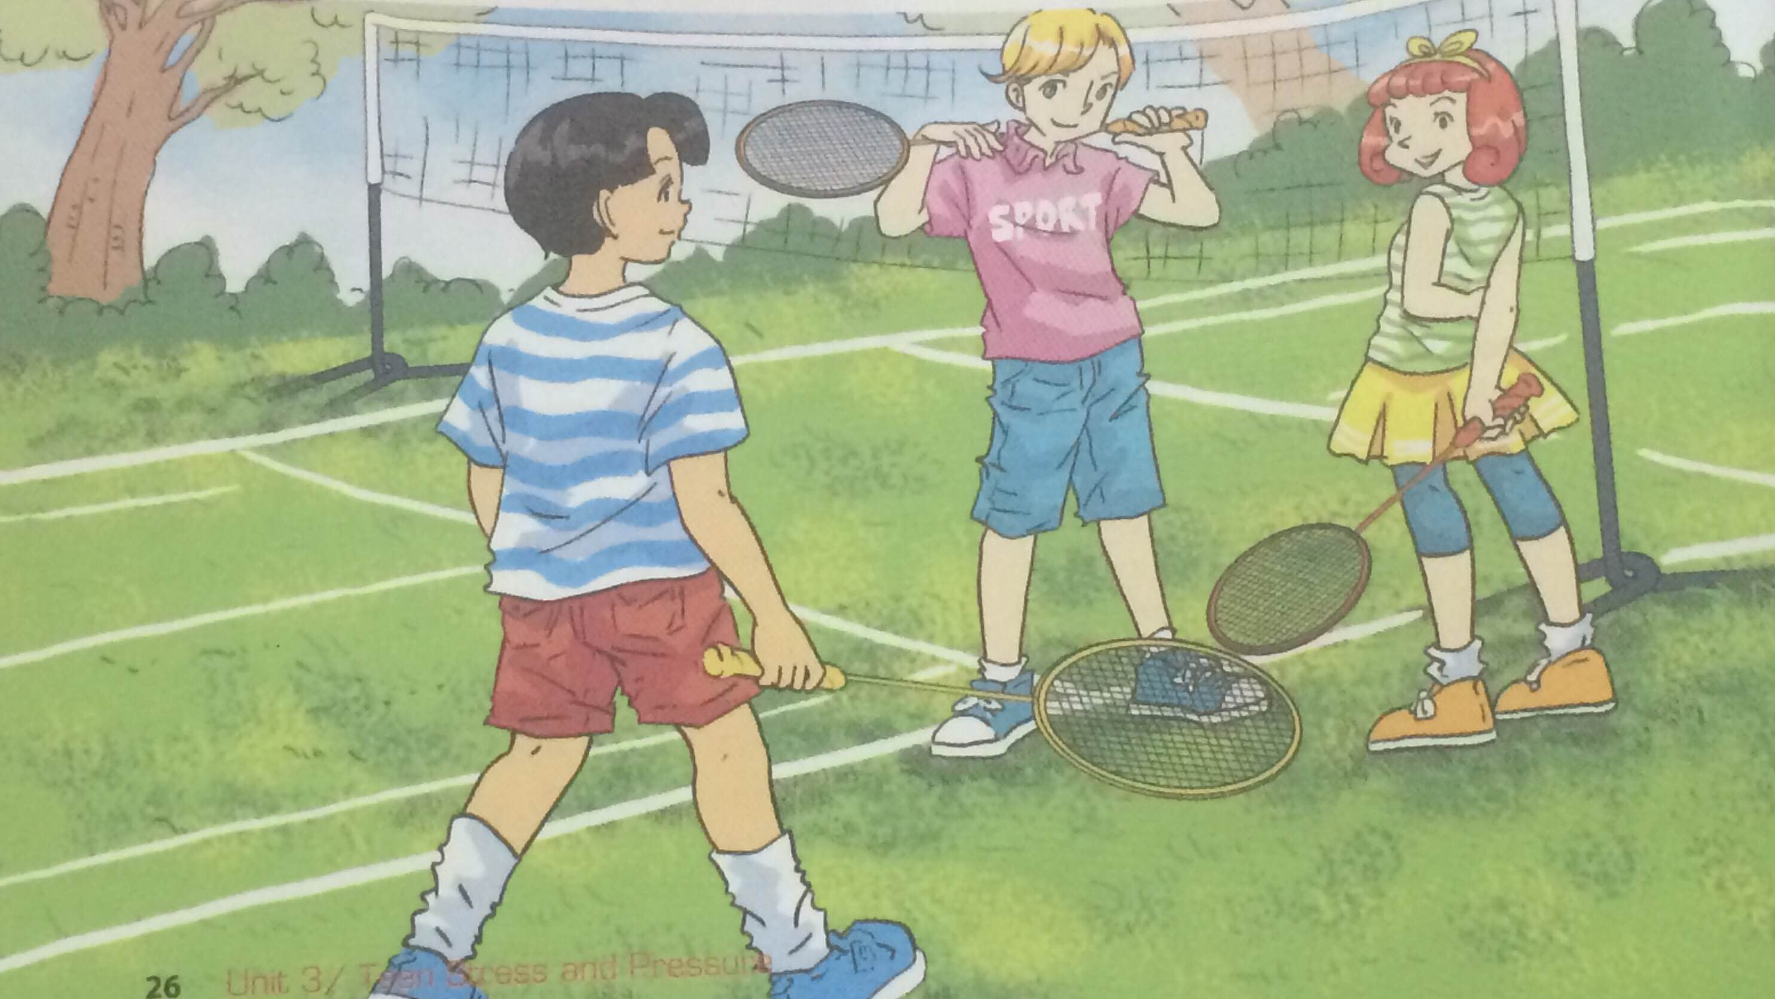
Look at the picture and answer
What are they going to do?
Who are they?
Where are they?

Slide 3
Listen and read
Amelie: Hi Phuc! Where’s Mai? Isn’t she coming? Phuc: She said she was too tired and didn’t want to go out. She’s been staying up late studying for the exam. Nick: Does she need to be that stressed out? Phuc: Maybe not. But my parents always expect her to get good grades and she doesn’t want to disappoint them. They want her to go to a top college and study medicine. Veronica: Really? She told me she wanted to be a designer… Phuc: Yes, that’s why she’s been a bit tense lately. She doesn’t know what to do. My parents said design graduates wouldn’t find jobs easily and they wanted her to get a medical degree. Amelie: Oh, I understand. Sometimes I wish my parents could put themselves in my shoes...
Nick: Anyway, Mai needs to take a break. I'll call and ask her if she wants to go and see a film with us tomorrow. Phuc: Oh, I doubt it... She's already fully booked for the weekend with her maths class, English class, judo class, and music lesson!

Slide 4
01
Reading comprehession

Slide 5
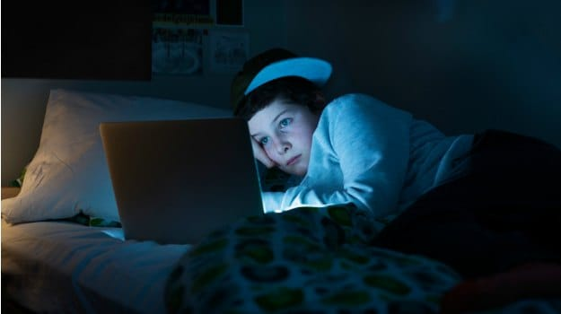
- To go to bed early ><
Find the OPPOSITE of the following words in the conservation
To stay up late
(v) Thức khuya

Slide 6

- To be relaxed ><
Find the OPPOSITE of the following words in the conservation
To be stressed (out)
(a) Lo lắng
= anxious, nervous

Slide 7

- Bad exam result ><
Find the OPPOSITE of the following words in the conservation
Good grades
(n) Điểm cao
= high score/band

Slide 8

- To make someone happy><
Find the OPPOSITE of the following words in the conservation
To disappoint someone
(v) Làm ai thất vọng
= let someone down
= discourage someone

Slide 9

- To work continuosly><
Find the OPPOSITE of the following words in the conservation
To take a break
(v) Nghỉ ngơi

Slide 10
- To have no plan ><
Find the OPPOSITE of the following words in the conservation
To be fully booked
(v) được đặt kín

Slide 11
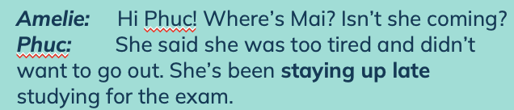
Choose the best answer
1. Why is Mai not playing badminton with Phuc, Nick, and Amelie A. She doesn't like playing badminton. B. She is late. C. She wants to stay at home.
→ C. She wants to stay at home

Slide 12
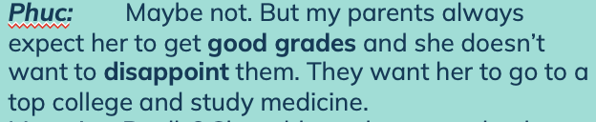
Choose the best answer
2. Why is Mai working very hard for the exam? A. She failed the last exam. B. She wants her parents to be proud of her. C. She wants to compete with her classmates.
→ B. She wants her parents to be proud of her

Slide 13
Choose the best answer
3. How is Mai feeling now? A. Confident and tired B. Tense and disappointed C. Tired and stressed
→ C. Tired and stressed

Slide 14
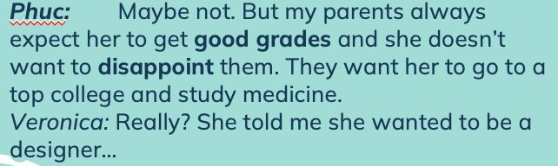
Choose the best answer
4. What do Mai's parents want her to be? A. A medical doctor B. A designer C, A musician
→ A. A medical doctor

Slide 15
Choose the best answer
5. What does Mai want to be ? A. A medical doctor B. A designer C. A musician
→ B. A designer

Slide 16
Choose the best answer
6. What are Phuc, Nick, and Veronica trying to do ? A. Understand Mai's situation and help her feel better. B. Make Mai feel left out. C. Find somebody else to replace Mai for the badminton
→ A. Understand Mai's situation and help her feel better.

Slide 17
c. What do you think Veronica means when she says, “ Sometimes I wish my parents could put themselves in my shoes”?
- Veronica wishes her parents could put themselves in her situation to better understand her.

Slide 18
2. Fill the gaps with the words in the box. In some cases more than one word may be suitable.
1. Thu had been studying very hard for the exam, but she still felt _______________________. Now that she has done well in the exam she is feeling much more ______________ .
2. My mother is a strong person. She stays __________ even in the worst situations.
3. Linh is feeling a bit ____________________ about her study. She's failed the exam once again!
Tense/worried/stressed
relaxed/ confident
calm
Depressed/frustrated
Tense
Confident
Depressed
Frustrated
Relaxed
Calm
Delighted
Worried
Stressed

Slide 19
2. Fill the gaps with the words in the box. In some cases more than one word may be suitable.
4. I think taking a speech class is a good idea if you want to be more _______________________.
5. Emma is feeling so ____________________ with her fashionable new hairstyle.
6. Phuc, Nick, and Veronica feel ___________________.They want to help Mai but don't know what they can do for her.
relaxed/calm/ confident
delighted/ confident
frustrated/worried
Tense
Confident
Depressed
Frustrated
Relaxed
Calm
Delighted
Worried
Stressed

Slide 20
Remember!
Many adjectives of emotions and feelings are formed from the -ed form of verbs: excited, relaxed, frustrated, etc. Can you find more examples?

Slide 21
What do ‘give advice’, ‘encourage’, ‘empathize’, and ‘assure’ mean? Match the word with the correct definitions.
1. __________: to be able to understand how someone else feels 2. __________: to give someone support and confidence to do something 3. __________: to give suggestions and ideas to help somebody make a decision
4. __________: to tell someone that something is going to be all right, so that they do not worry
give advice
encourage
empathize
assure

Slide 22
3. Match the statements with the functions.
give advice to someone encourage someone
empathise with someone. assure someone
1. Go on! I know you can do it! 2. If I were you, I would (get some sleep). 3. You must have been really disappointed. 4. Stay calm. Everything will be alright. 5. I understand how you feel.
6. Well done! You did a really great job!
Encourage someone
Give advice to someone
Empathise with someone
Assure someone
Empathise with someone
Encourage someone

Slide 23

4. How do you feel today?
Work in pairs. Tell your friend how you feel today and what happened that made you feel that way. Your friend responds to you, using one option from the box 3.

Slide 24
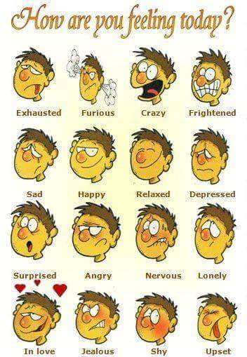
Example
A:
Today, I feel happy and motivated. My English teacher gave me an A+ for my English presentation in class.
B:
Well done !
You did a really great job

Slide 25
Good bye class!
- Prepare ”A CLOSER LOOK 1”
Learn by heart all the new words
Do exercises A1, B1 in WB

