Slide 1

WELCOME TO OUR CLASS
Unit 1
Lesson 3: A closer look 2

Slide 2
Grammar
Complex sentences: review
1. DEPENDENT CLAUSES OF CONCESSION (MỆNH ĐỀ TRẠNG NGỮ CHỈ SỰ TƯƠNG PHẢN)
*** Mệnh đề trạng ngữ chỉ sự tương phản là mệnh đề phụ chỉ sự tương phản của hai hành động trong câu.
*** Mệnh đề này thường được bất đầu bằng các từ: though, although, even though (dù, mặc dù, cho dù), in spite of, despite (dù, mặc dù, cho dù).
2. DEPENDENT CLAUSES OF RESULT (MỆNH ĐỀ TRẠNG NGỮ CHỈ KẾT QUẢ)
*** Mệnh đề trạng ngữ chỉ kết quả là mệnh đề diễn đạt kết quà của một sự việc hoặc một hành động. Mệnh đề bắt đầu bằng so that/in order that
3. DEPENDENT CLAUSE OF PLACE (Mệnh đề trạng ngữ chỉ nơi chốn)
*** Mệnh đề trạng ngữ chỉ nơi chốn được bắt đầu bằng where (nơi mà) và wherever (bất cứ nơi nào).
4. DEPENDENT CLAUSE OF REASON (Mệnh đề chỉ trạng ngữ chỉ lý do)
*** Mệnh đề trạng ngữ chỉ lý do thường bắt đầu bằng: Because/Since/As

Slide 3
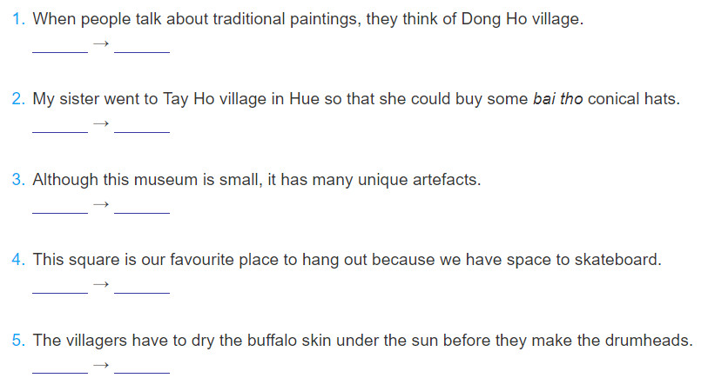
Ex 1. Underline the dependent clause in each sentence below. Say whether it is a dependent clause of concession (DC), of purpose (DP), of reason (DR), or of time (DT).
DT
→DP
DC
→DR
→DT

Slide 4
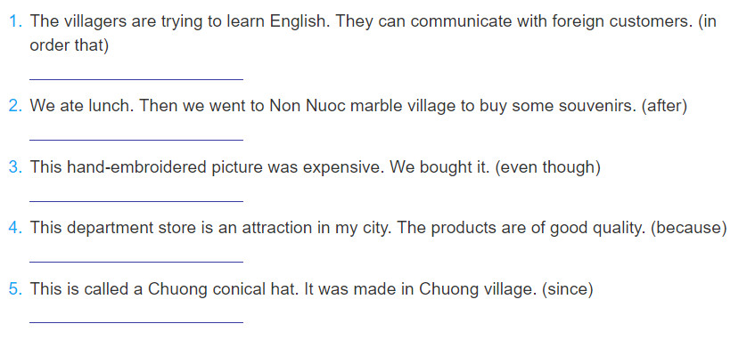
Ex2. Make a complex sentence from each pair of sentences. Use the subordinator provided and make any necessary changes.
1. The villagers are trying to learn English in order that they can communicate with foreign customers.
2. After we had eaten lunch, we went to Non Nuoc marble village to buy some souvenirs.
3. Even though this hand-embroidered picture was expensive, we bought it.
4. This department store is an attraction in my city because the products are of good quality.
5. This is called a Chuong conical hat since it was made in Chuong village.

Slide 5

PHRASAL VERBS

Slide 6

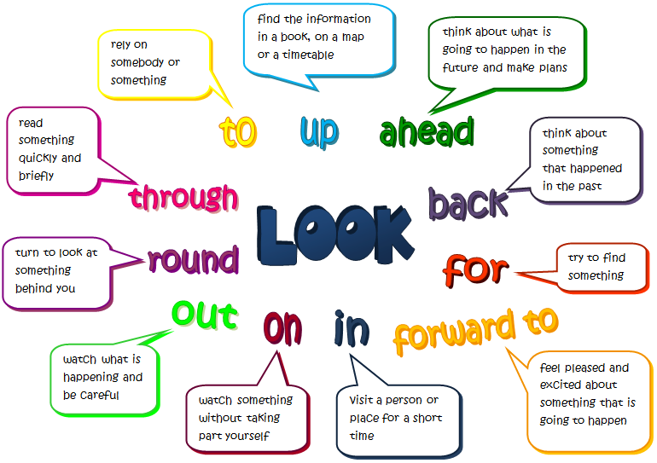

Slide 7
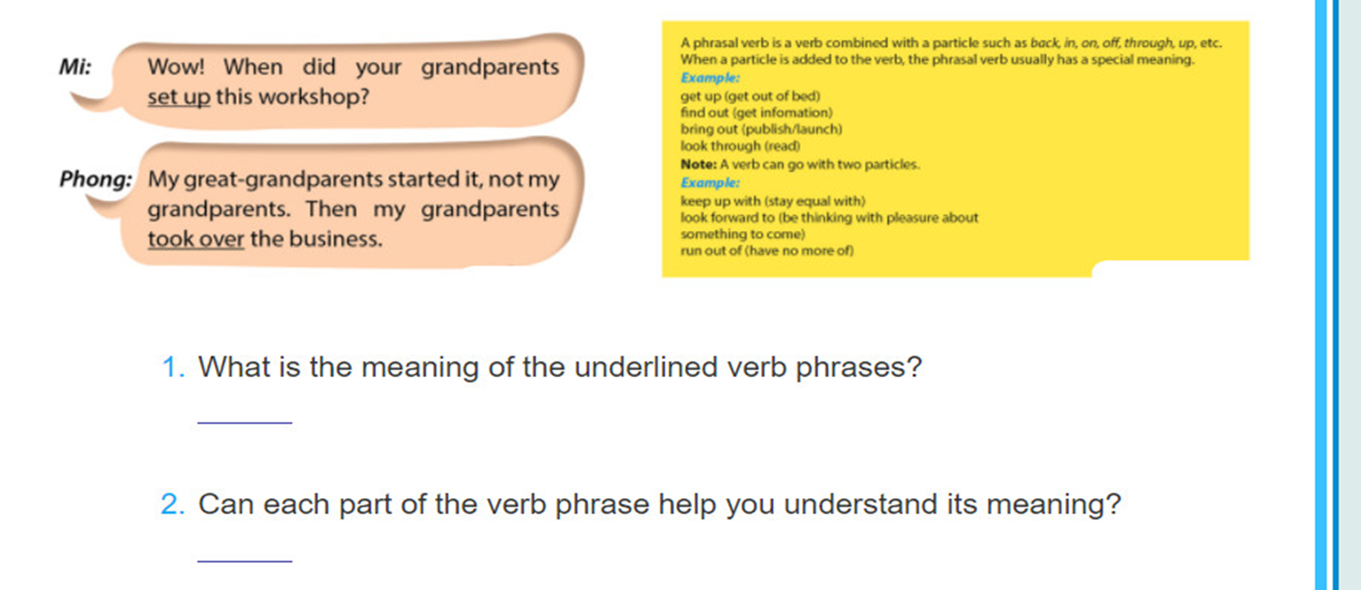
Ex 3. Read this part of the conversation from GETTING STARTED. Pay attention to the underlined part and answer the questions.
1. set up: start something (a business, an organisation, etc.)
take over: take control of something (a business, an organisation, etc.)
2. No, the individual words in the verb phrase do not help with comprehension. This is why they are sometimes considered difficult.

Slide 8
I- DEFINITION:
1- Form:
:
Verb + Particle (s) = Phrasal verb
Preposition:
on, in, at, after, off, with, about...
Adverb: over, up, down, into, away...
Go:
Go away, go on, go over, go off, go down with, go in for ...

Slide 9


2- Meaning:
Meaning of MAIN VERB
Meaning of PARTICLE
Meaning of PHRASAL VERB

Slide 10

Eat to live not live to eat.
She was wet because she was out in the rain.
➔ Let’s eat out today.
eat + out = eat out
look + down + on = look down on
Look! The bus is coming.
She is going down town.
There is a cat on the fence.
➔ She's so conceited. She always looks down on everybody.

Slide 11

II. CLASSIFICATION:
INTRANSITIVE:
Examples:
The patient passed away.
What time do you often get up?
The supermarket closed down because they didn't have many customers
2. TRANSITIVE :
Examples:
She took after her mother.
Jack made up the ghost story to prevent me.
Please take off your shoes when entering this room.

Slide 12

3. SEPARABLE:
Turn on the light = Turn the light on
I will pick up you at 7 p.m. = I will pick you up at 7 p.m.
She turned down my invitation = She turned my invitation down.
4. NON-SEPARABLE:
She was looking for the passport which she had lost.
( ≠ looking the passport for)
I can’t live on my teaching salary.(≠ live my salary on)
He ran away quickly. (≠ ran quickly away)
Note: - intransitive: non-separable
- transitive: separable and non-separable.

Slide 13
Some common phrasal verbs:
Get up (get out of bed) : thức dậy
Find out (get information): tìm kiếm
Bring out (publish/ launch): xuất bản/ giới thiệu
Look through (read) : đọc
Pick up : đón
Look up (get information, check): tra cứu
Break up : đột nhập
Bring up (rear/ educate a child): nuôi dưỡng, giáo dục
Call back (return a phone call): gọi điện lại cho ai
Carry on (continue) : tiếp tục
Run out of : hết,cạn kiệt
Take off (begin flight/ plane): cất cánh
Turn down (refuse/ reject): từ chối
Turn up (make an appearance): xuất hiện, đến
Come across (find/ meet by chance: tình cờ bắt gặp
Come back (return) : quay trở lại
Come up with (produce an idea): nghĩ ra
Fall off (drop from): ngã, rơi xuống
Get along with (be in good terms with s.b): hòa hợp, hòa thuận với ai
Get off ˃˂ get on: lên ˃˂ xuống
Look after (take care of) : chăm sóc
Look for (seek) : tìm kiếm
Look forward to (expect to) : trông mong, mong chờ
Put off (postpone): trì hoãn
Put up with (accept): chịu đựng
Run away (escape): chạy trốn
Wash up : rửa (chén, bát)

Slide 14


III. STUDY TIPS:
Try to guess the meaning- base on:
particle
context
Ex: The bomb went off when there were thousands
of people at the stadium.
2. Look up in a dictionary.
3. Make notes or put in sentences.

Slide 15

Up
1. An upward movement: phong trào đi lên
2. An increase, an improvement: sự gia tang, cải tiến
3. Completing, ending: hoàn thành, kết thúc
4. Approaching: đến gần, tiếp cận
Examples:
We left early, just as the Sun was coming up.
Sales have gone up recently.
We used up all the eggs for this cake.
I waited for him but he never showed up

Slide 16

IV. PRACTICE:

Slide 17
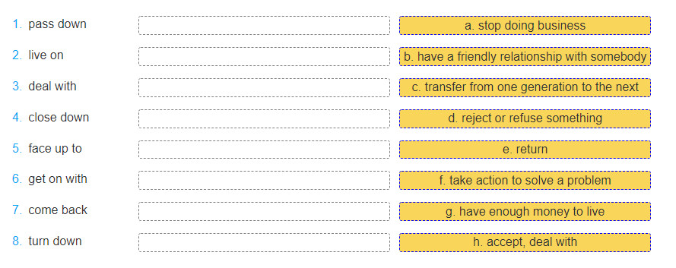
Ex 4. Match the phrasal verbs in A with their meaning in B.
1.c
2. g
3. f
4. a
5. h
6. b
7. e
8. d

Slide 18
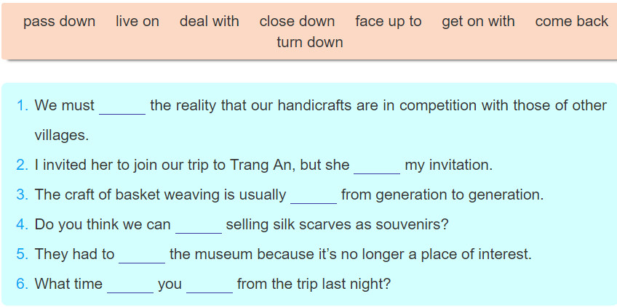
Ex 5. Complete each sentence using the correct form of a phrasal verb in 4. You don't need to use all the verbs.
face up to
turned down
passed down
live on
close down
did
come back

Slide 19
6. Complete the second sentence so that it has a similar meaning to the first sentence, using the word given.
1. Where did you get the information about Disneyland Resort? (find)
Where_______________________________________?
2. What time did you get out of bed this morning? (up)
When________________________________________?
3. rll read this leaflet to see what activities are organised at this attraction. (look)
I'll________________________________________.
4. They're going to publish a guidebook to different beauty spots in Viet Nam. (out)
They're________________________________________.
5. I'm thinking with pleasure about the weekend! (forward)
I'm_______________________________________!
did you find out about Disneyland Resort
did you get up this morning
look through this leaflet to see what activities are organised at this attraction.
going to bring out a guidebook to different beauty spots in Viet Nam.
looking forward to the weekend

Slide 20
HOMEWORK

Slide 21

2. Use the correct form of phrasal verbs to fill in the blanks:
1. After months of discussions, they finally ……………a decision.
2. You should …………….your research paper before you hand it in.
3. I woke up when my alarm clock…………….
4. He invited many friends to the party but few of them………….
5. She will go back to work if her mother …………….the children.
turn up - arrive at - look after - go off - go over
arrived at
go over
went off
turned up
looks after

Slide 22
3. Choose the best answers:
1. When the bus stops, passengers……………….
A. get on B. get off C. get in D. get on with
2. Sue was offered a job as a translator but she …
A. gave it away B. turned it down C. made it up D. filled it in
3.If we ______wasting water , there will be a shortage of fresh water
A. go out B. go up C. go in D. go on
4. It’s dark in here. Please ….all the lights,.
A. Turn off B. cut off C. Turn on D. Go on

