Slide 1
UNIT 2.
Period 10. Lesson 2. A closer look 1

Slide 2
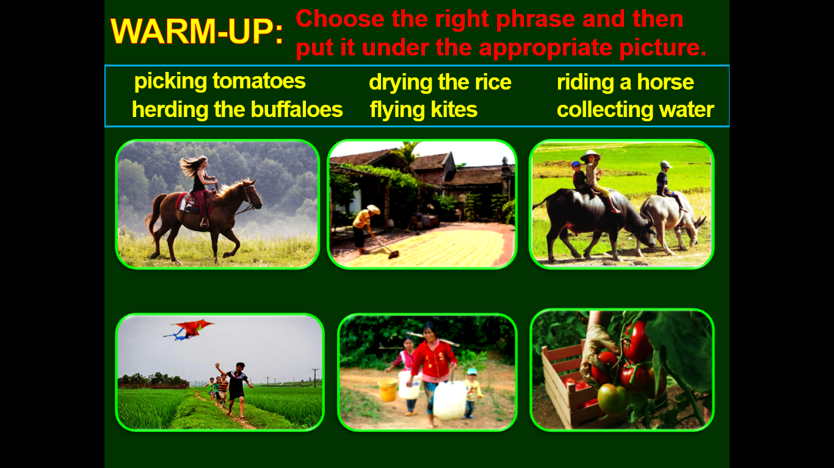
Riding a horse
Drying the rice
Herding the buffaloes
Flying kites
Collecting water
Picking tomatoes

Slide 3
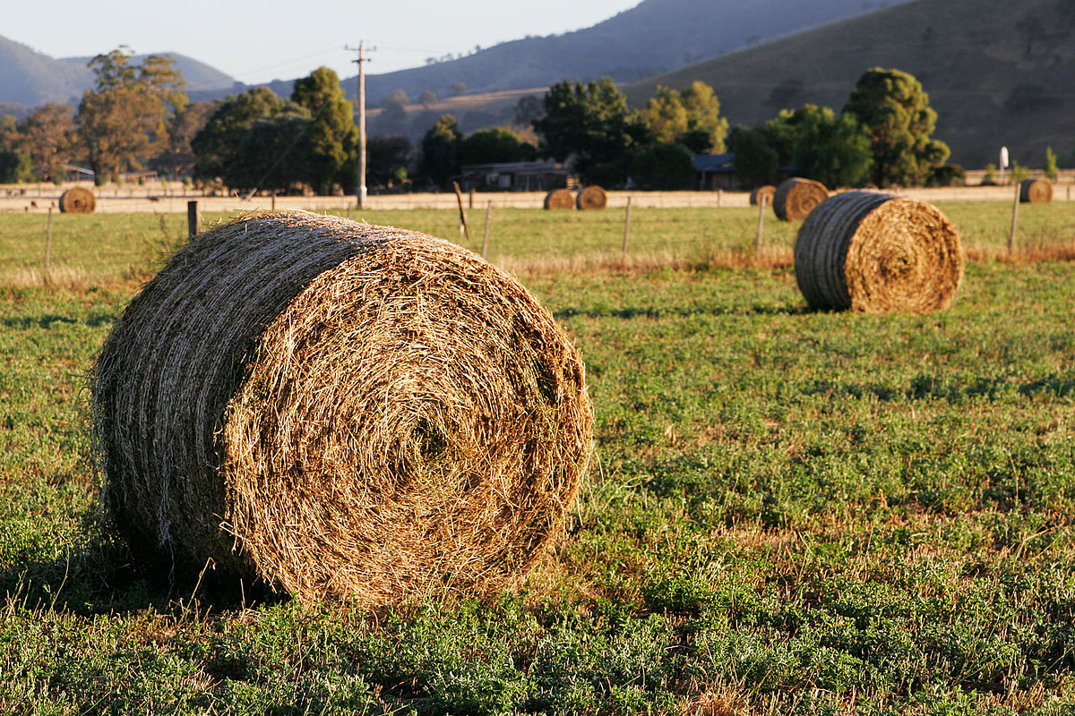
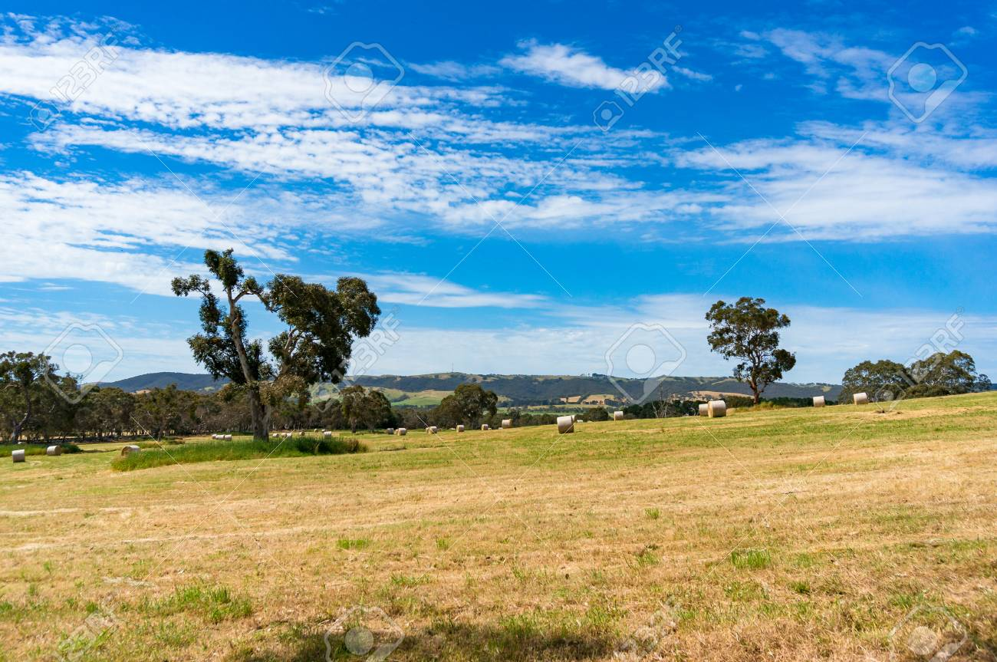
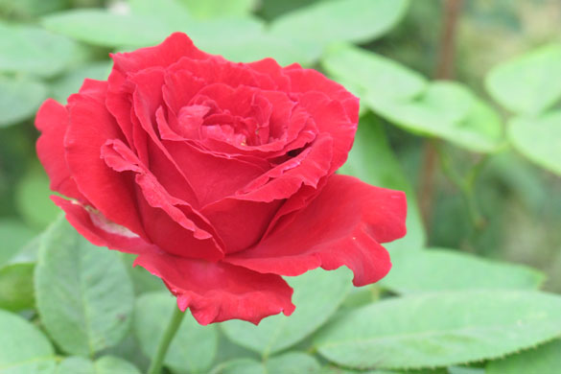
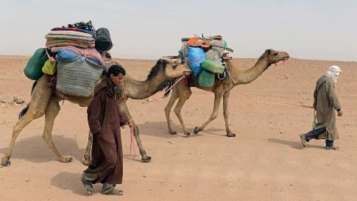
1. Vocabulary
Vast (a):
Brave (a): can đảm, dũng cảm
Nomadic (a):
Put up (v): dựng (lều…) lên
Pole (n): cái cột
Bloom (n)
Hay (n):
Cattle (n):
Rộng lớn, bao la
Du mục
= flower
Cỏ khô
Gia súc

Slide 4
2. Pronunciation
/bl/ | /cl/
blackberries | click
bloom | cloud

Slide 5
3. Homework
Learn by heart the new words.
Find some more words with /bl/ and /cl/ sounds and practise pronouncing them.
Do exercise B1, B2 on Workbook.

