Slide 1

Tuesday, April 7, 2020
ENGLISH 8

Slide 2
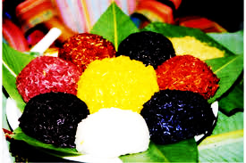
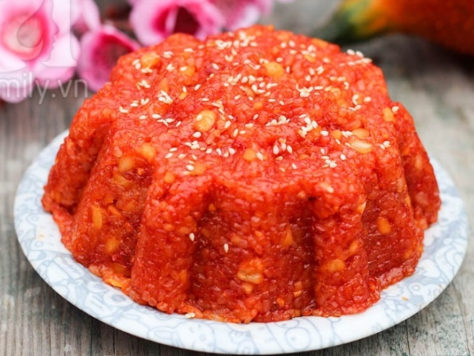
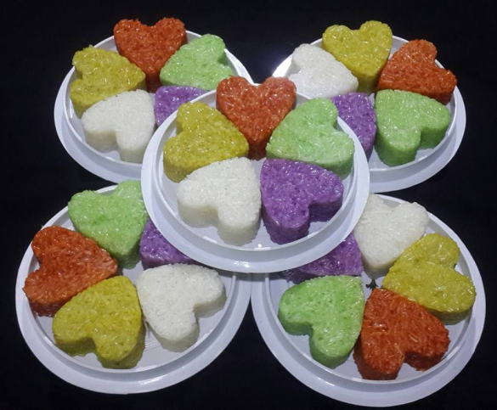
WARM UP
Answer the questions.
1. Do you like sticky rice?
- Yes, I do. / - No, I don’t.
2. When do we traditionally have sticky rice?
- Traditionally, we have sticky rice on special occasions, such as at Tet, in festivals and ceremonies, and whenever the family has guests.

Slide 3
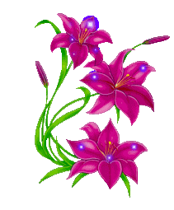


New lesson
UNIT 3: PEOPLES
OF VIETNAM
LESSON 6: SKILLS 2

Slide 4
1. Vocabulary:
chemical /ˈkemɪkl / (n)
root / ruːt / (n)
leaf /liːf / (n) → leaves /liːvz/ (pl)
harmony /ˈhɑːməni / (n)
represent /ˌreprɪˈzent / (v)
element / ˈelɪmənt / (n)
create / kriˈeɪt / (v)
heaven / ˈhevn/ (n)
: hóa chất
: gốc, rễ
: lá (cây)
: sự hài hòa
: đại diện cho
: thành phần, yếu tố
: tạo ra
: trời, thiên đường

Slide 5
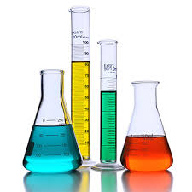

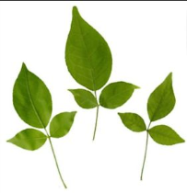
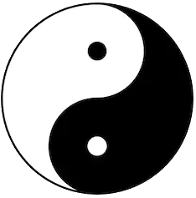
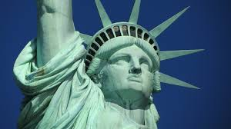
Checking vocabulary: Complete the sentences by replacing a picture or a phrase with suitable word(s).
The colours from the five-coloured sticky rice
are not but natural and .
People should be in with nature.
The statue of liberty the independence and freedom.
God this would within seven days.
Good people are commonly believed to be in
chemicals
roots
leaves
harmony
represents
created
made
heaven
after they die.
the home of God

Slide 6

LISTENING:
2. Listen to the passage and tick (✓) true (T) or false (F).
Statements | T | F
1. Five-coloured sticky rice is a traditional dish.
2. Five-coloured sticky rice is made with chemicals.
3. The colours represent the elements of life.
4. These elements create harmony between people.
5. This rice is only made when there are guests.
✓
✓
natural roots and leaves.
✓
✓
heaven and earth.
✓
, at Tet, in festivals and ceremonies.

Slide 7
3. Listen again and complete the sentences.
1. Five-coloured sticky rice is made by ethnic minorities in the northern ____________ regions.
2. The dish has five colours: red, yellow, green, ___________ and white.
3. It is made using ________ roots and leaves.
4. The green colour symbolises ________.
5. Five-coloured sticky rice is made on special occasions, for festivals and __________.
mountainous
purple/black
natural
plants
ceremonies

Slide 8
Audio script: Five-coloured sticky rice is an important traditional dish of many ethnic minorities in the northern mountainous regions. People call the dish five-coloured sticky rice because it has five colours: red, yellow, green, purple and white. The things that create the colours are not chemicals but natural roots and leaves. The five colours of the dish represent five elements of life according to Vietnamese beliefs: yellow is earth, red is fire, green is plants, white is metal, and purple or black is water. People believe that these five elements create harmony between heaven and earth. Five-coloured sticky rice is usually made and enjoyed at Tet, in festivals and ceremonies, on special occasions, and whenever the family has guests.

Slide 9
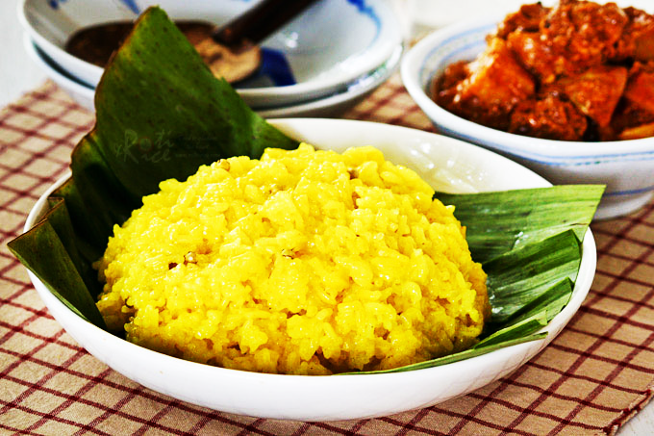
Writing:
How to make yellow sticky rice
4. Read the notes on how to make yellow sticky rice.
1 tablespoon = 15ml
Sticky rice: 500g
Turmeric: three tbsp extract
Shredded coconut: one cup
Salt: 1/4 tsp
1 teaspoon = 5ml
Notes:
1. Soak sticky rice – water – five hours +
2. Rinse rice – drain
3. Mix well w/ turmeric extract, wait – 10 mins.
4. Add coconut + salt – mix well
5. Steam – 30 mins – check cooked
6. Serve

Slide 10
5. Change the notes into cooking steps to show a foreign visitor how to make yellow sticky rice.
Organising your ideas
Introducing your dish
This is a very easy dish to make
Try this delicious recipe
Signposting the cooking steps
First, Then, Next, After that, Finally
Once the (rice is rinsed), (add) the (salt)
Giving advice
Remember to… = Don’t forget to…
Try to…
Concluding
Serve this dish with…
This dish is delicious with

Slide 11
5. Change the notes into cooking steps to show a foreign visitor how to make yellow sticky rice.
Example 1:
This delicious dish is very easy to make. First, you need to soak the sticky rice for at least five hours. Secondly, you need to rinse rice. Once the rice is rinsed, remember to mix well with turmeric extract and wait for about ten minutes. Don't forget to add coconut and salt, then mix well the mixture. Finally steam for 30 minutes and remember to check and see if it's cooked. Serve this with salted shredded meat. It's better to serve hot.

Slide 12
5. Change the notes into cooking steps to show a foreign visitor how to make yellow sticky rice.
Example 2:
This delicious dish is really easy to make. First, you need to soak the sticky rice in water for at least five hours. Then rinse the rice and drain it well. Next, add the turmeric extract and mix it well. Then wait for 10 minutes. After that, add the coconut and salt. Remember to mix it well. Finally, steam the rice for about 30 minutes. Check that it is fully cooked. You can serve this dish with chicken.

Slide 13
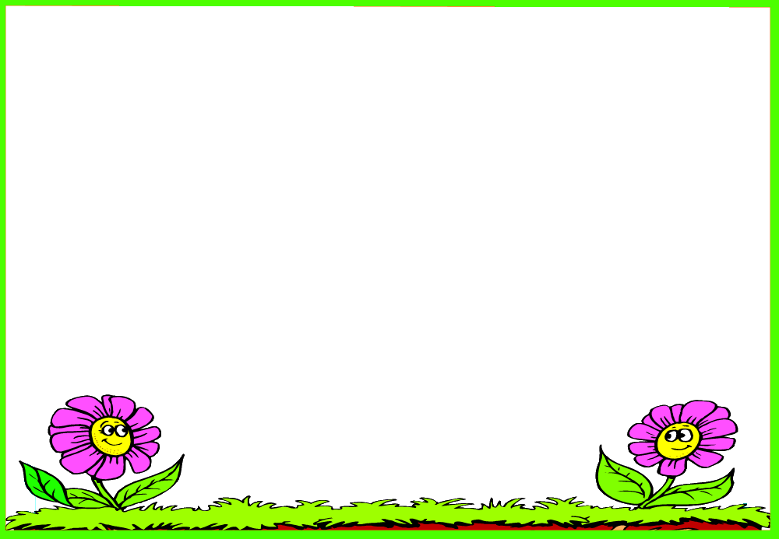
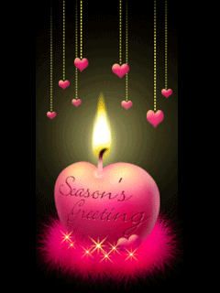
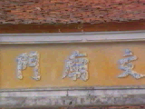
HOMEWORK
- Learn the new words by heart.
- Practice listening to the recording about five-coloured sticky rice on page 33 again.
- Write a passage on: How to make five- coloured sticky rice?
- Do exercises E1,2,3 in workbook (page 22, 23)
- Prepare for Unit 3: Looking back
+

Slide 14
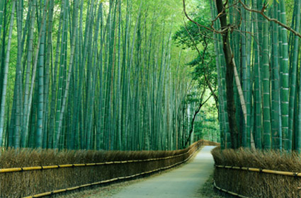
THANKS FOR YOUR ATTENTION!
Goodbye!
See you again!

Slide 15
Checking vocabulary:
chemical /ˈkemɪkl / (n)
root / ruːt / (n)
leaf /liːf /(n) → leaves /liːvz/ (pl)
harmony /ˈhɑːməni / (n)
represent /ˌreprɪˈzent / (v)
element / ˈelɪmənt / (n)
create / kriˈeɪt / (v)
heaven / ˈhevn/ (n)
: hóa chất
: gốc, rễ
: lá (cây)
: sự hài hòa
: đại diện cho
: thành phần, yếu tố
: tạo ra
: trời, thiên đường

Slide 16
